Slide 1
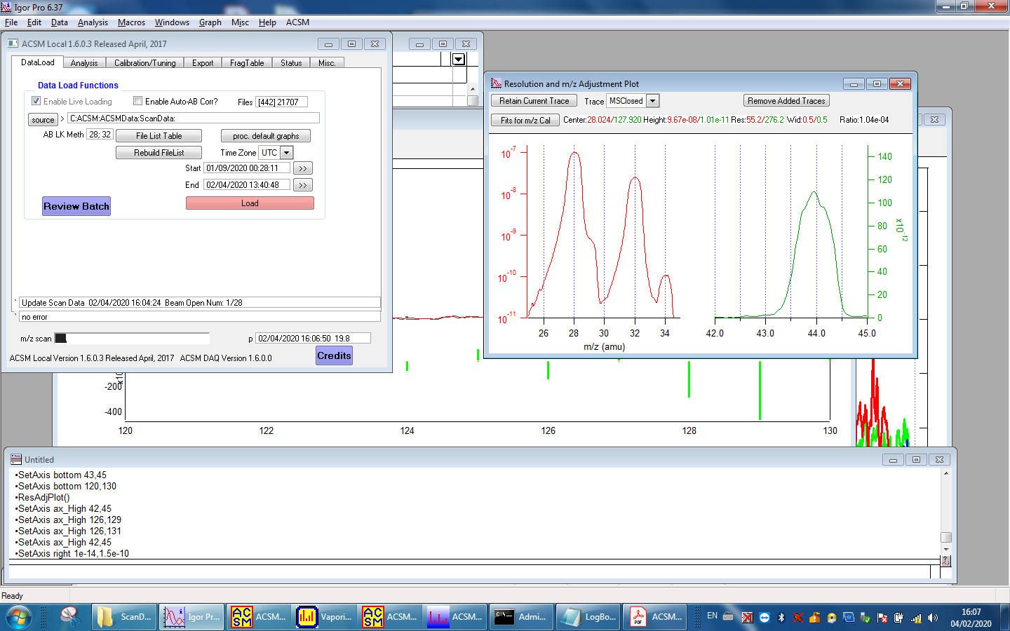
m/z cal 04022020 at CHC Samara e Lorrany

Slide 2
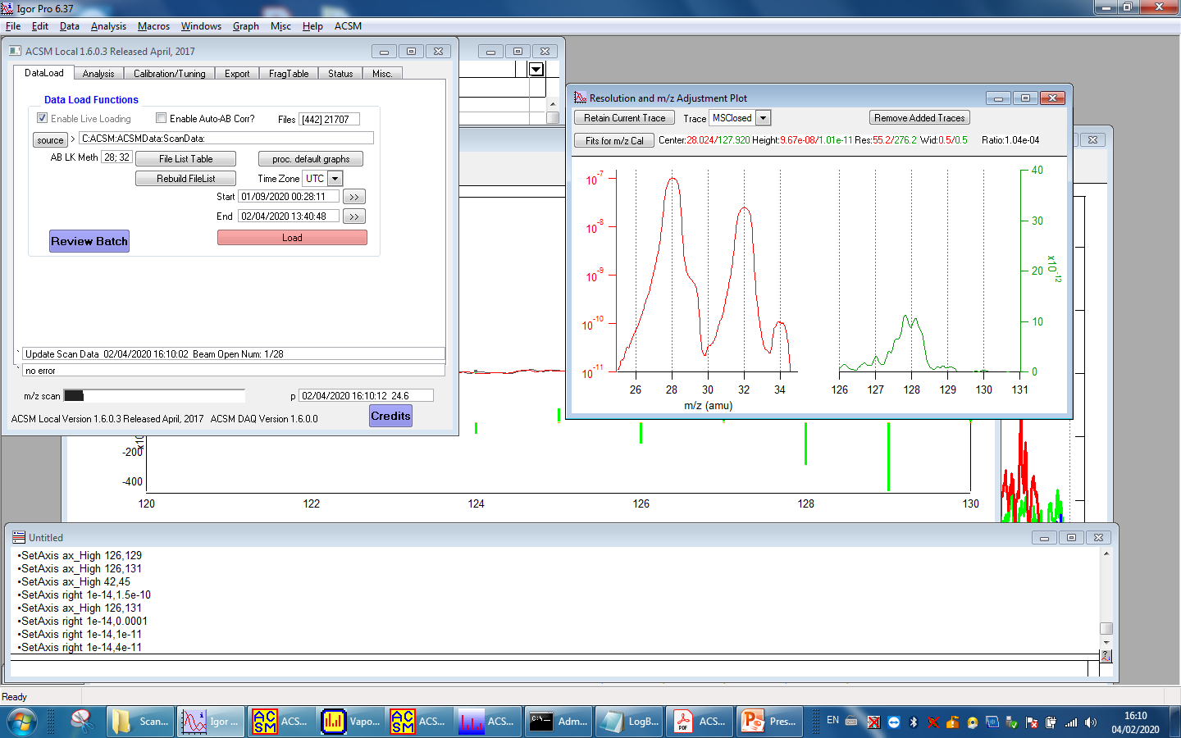

Slide 3
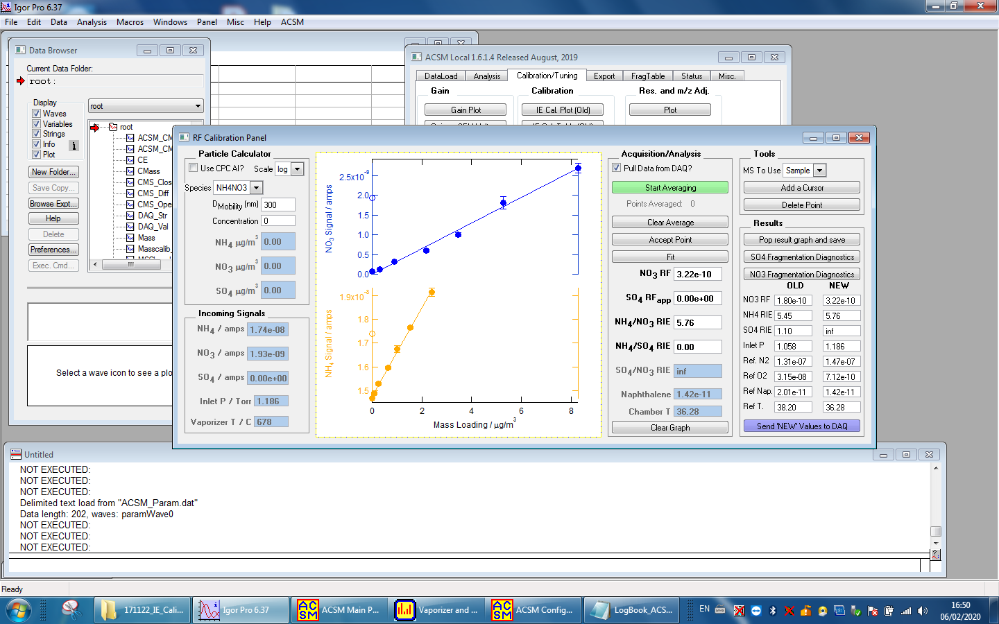

Slide 4
