Slide 1
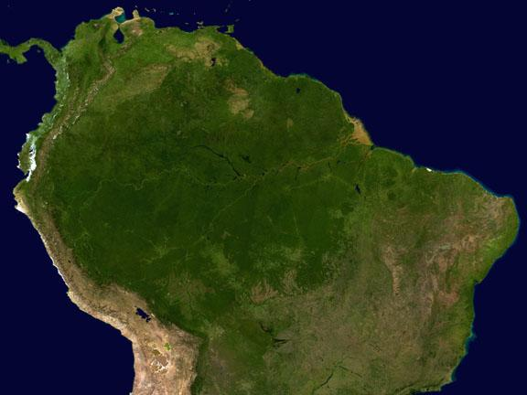

FAPESP Advanced School on Atmospheric Aerosols IFUSP – August 1, 2019
Secondary Organic Aerosols formation in Amazonia and urban areas
Paulo Artaxo
University of Sao Paulo, Brazil

Slide 2
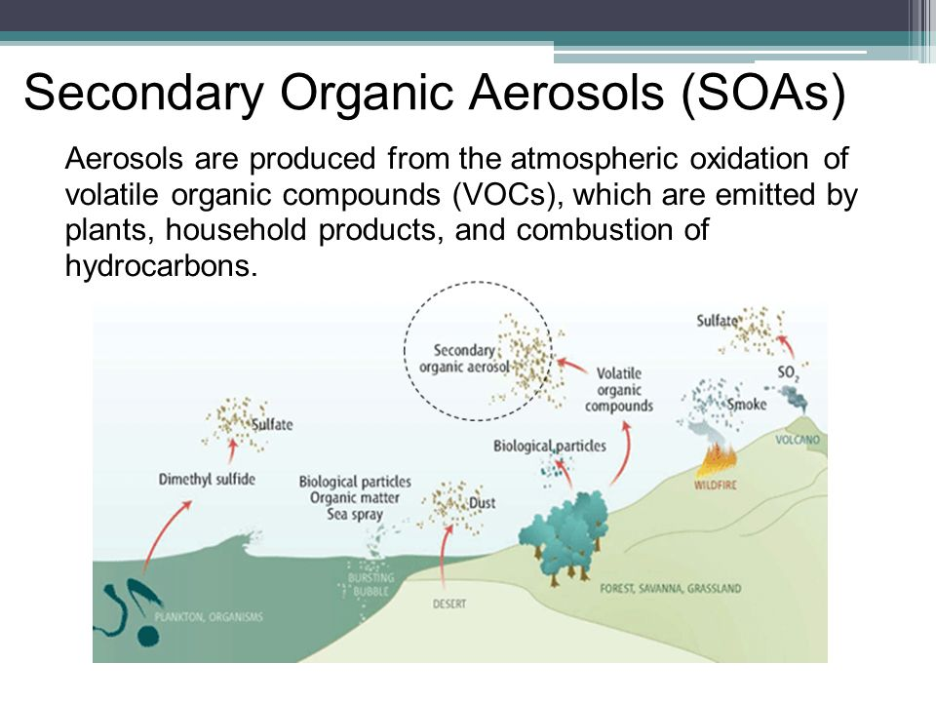

Slide 3
Swarup et al., Nature Comm, Dec 2018

Slide 4
SOA aerosols and Clouds life cycles with ecosystem impacts

Slide 6
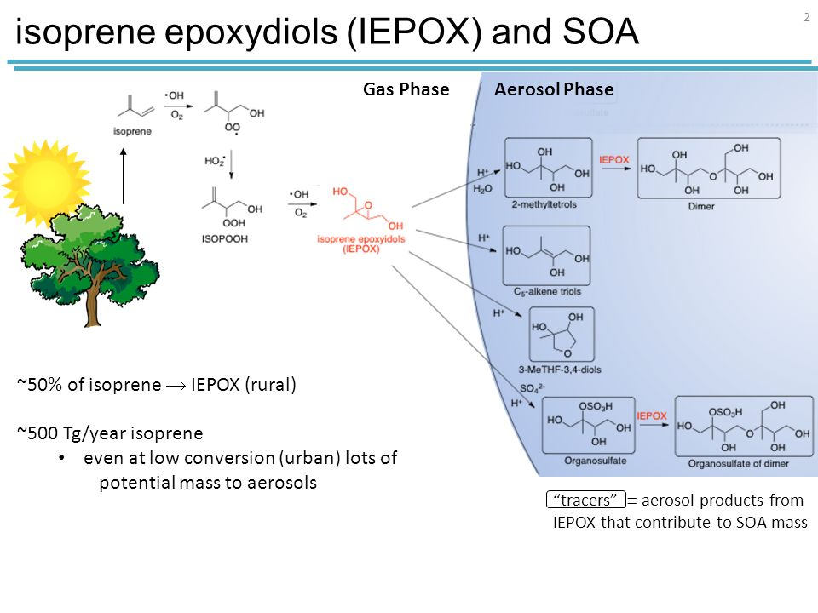

Slide 7

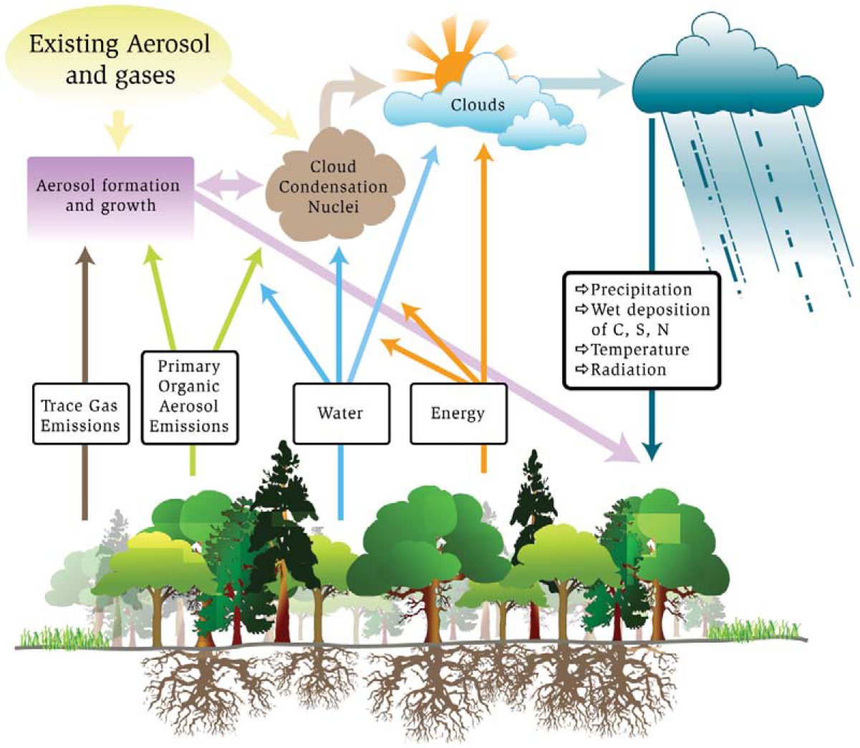
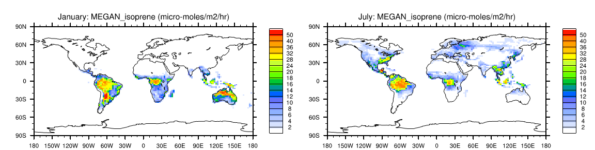
Atmospheric importance of isoprene
hν
Condensation
Absorption
Reactive uptake
OH, O₃
VOC
(isoprene, terpenes, etc.)
Biogenic SOA
Gas-phase oxidation products
January
July
Isoprene Emission
(μmol m⁻² hr⁻¹)
(Adapted from Guenther et al., 2012)
Notes:
Isoprene (2-methyl-1,3-butadiene, C₅H₈) is on the global scale the non-methane volatile organic carbon (VOC) mostly emitted to the atmosphere, accounting for almost half of the world’s biogenic emissions (Guenther et al., 2012). It is the compound most abundantly emitted by vegetation in the Amazonian forest (Kuhn et al., 2010).

Slide 8
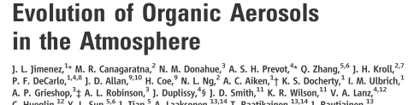
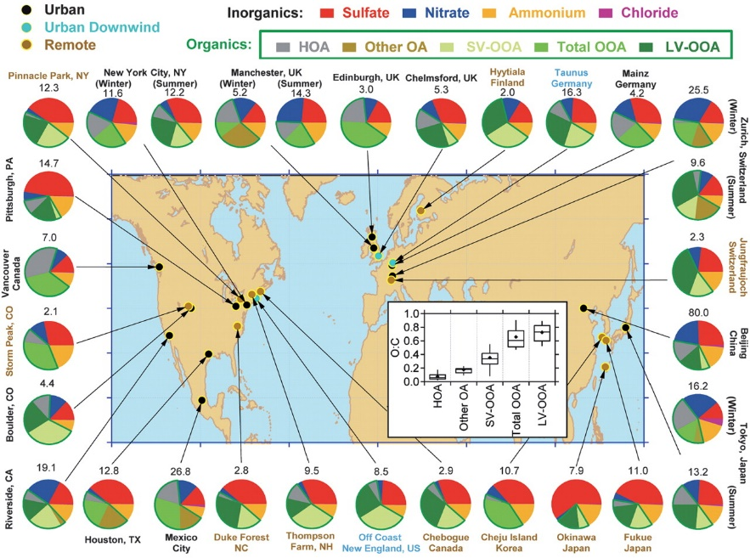
Aerosols:
1) Primary (Dust, sea salt, primary industry)
2) Secondary (SO4, NO3
3) Secondary Organic Aerosols (SOA)
World without Southern Hemisphere?
Jimenez et al – Science 2010
Notes:
Existem diversas questões em aberto com relação à produção de aerossóis orgânicos secundários

Slide 9
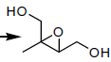
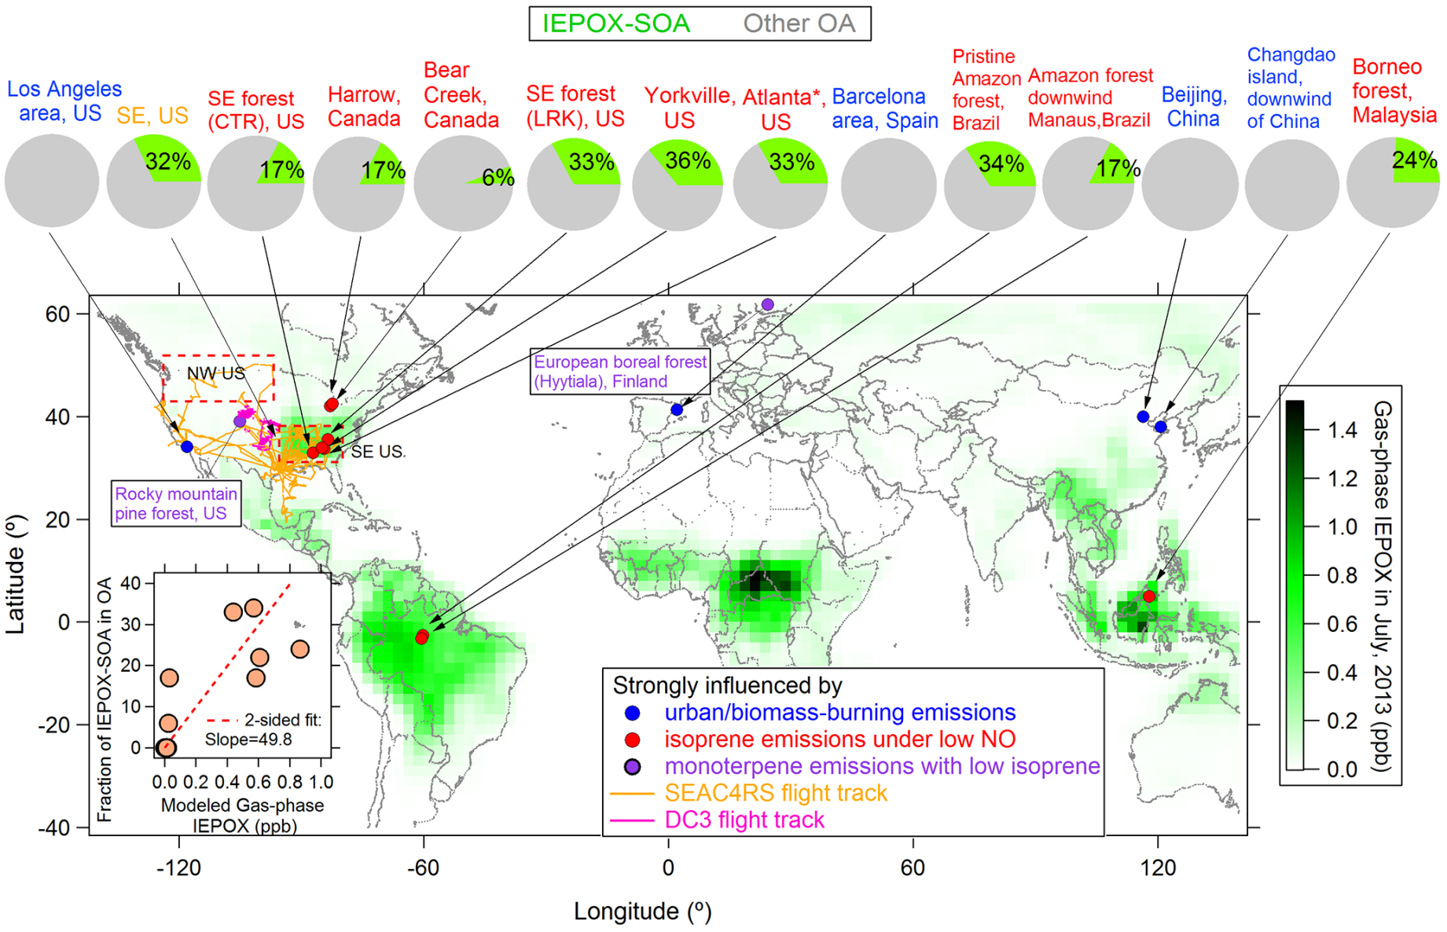
Atmospheric importance of IEPOX-SOA
IEPOX-SOA = SOA derived from isoprene epoxydiols (IEPOX):
IEPOX
IEPOX-SOA factor: estimated from positive matrix factorization (PMF) of AMS organic mass spectra
[Hu et al., 2015]
Notes:
So, first, what is IEPOX-SOA, and why is it important:
IEPOX-SOA is is Sec Org Aerosol derived from isoprene epoxydiols, which are known high yield products of isoprene oxidation through the HO2 pathway.
IEPOX-SOA is therefore a class of compounds, many of which are still unknown, but their contribution to organic particle mass as a whole can be estimated from AMS data, by applying the positive matrix factorization (or PMF) technique.
This estimated mass contribution is what is shown on the pie charts on this map, which show a significant percentage of this factor in regions* of high isoprene emissions and relatively low NO conditions – one of which is the Amazon forest, where isoprene is the compound most abundantly emitted by vegetation.
*in regions of the globe where the modeled gas phase IEPOX concentrations are higher, as shown by the green scale. And these regions are, accordingly,

Slide 10
Total Global SOA Emissions Range
Hodzic et al. (2016)
Total emission range of global SOA: 10 to 500 Tg/year;
Degree of ABSURD uncertainty;
Generally, from 60% to 80% of the total aerosol mass is SOA
Notes:
The SOA production budget is extremely important to global studies and in regional and global models this information is very important. In this Figure we can see that the emission range goes from ten to five hundred Teragrams per year.
So, how can the climate models predict correctly, for example, AOD, with a degree of uncertainty in a component that is generally thirty to eighty percent of the total aerosol mass.

Slide 11
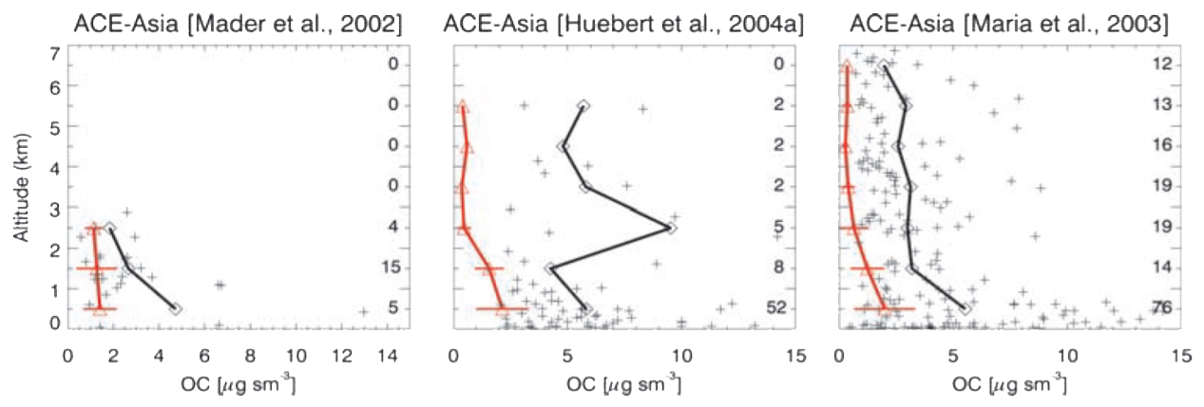
SOA Modeling / Simulation of Profile Evolution
Heald et al. (2005)
15 years ago, SOA was basically unknown information; At that time there was no necessary instrumentation.
Today in 2018, It is not explicitly included in all climate model;
Even models like WRF-Chem do not include all SOA production mechanisms (urban or remote).
Notes:
Besides that, Fifteen years ago, SOA was basically unknown information and today, urban or remote SOA production mechanisms are not explicitly included in all climate models.
Perfil medido é o vermelho e o simulado é o preto. Com uma diferença de mais ou menos 80% que não se conseguia prever da massa do aerossol atmosférico.
Um exemplo disso, é que alguns anos atras quando se comparava modelo com medida errada. Naquela época não havia instrumentação necessária.
O WRF- chem gera mais SOA anthro do que biogênico, isso é fato. E ambos continuam com concentrações baixas.
em geral o SOA contribui mais do que 50% da massa. Angel encontrou q é de 17% para SP

Slide 12
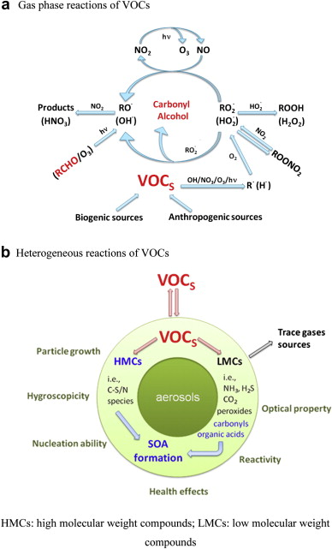
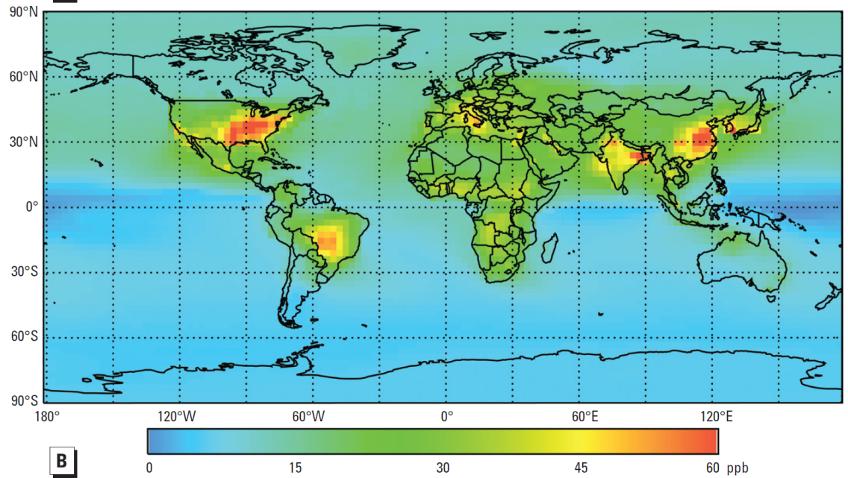
Química Atmosférica e Mudanças Climáticas
VOCs em fase gasosa: Ozônio
VOCs e produção de aerossóis secundários
Meia vida de metano controlada
pelo radical OH⁻
Monóxido de carbono (CO): importante no balanço de carbono
Aumento de ozônio (2010-1850) Máximo diário

Slide 13
Production of IEPOX-derived PM from the photooxidation of isoprene
Suzane de Sá 2016

Slide 14
From VOCs, SOA, CCN to the canopy processes in Amazonia
Fuentes et al., BAMS 2016
Notes:
Figure 1. An illustra0on Of the processes Associated with biogenicvola0le Organic compound (BVOC) emissions, secondary organic Aerosol (SOA) And cloud condensa0on Nuclei (CCN) forma0on, and the setup of
Instruments used To study Photo--‐oxida0on, chemical processing, and
Transport of atmospheric cons0tuents in a remote
Amazonian rainforest.
The
ver0cal
doIed
line
represents
a
characteris0c
day0me
profile
of
virtual
poten0al
temperature
(θV(z))
and
the
horizontal
dashed
line
represents
the
top
of
the
ABL.

Slide 15
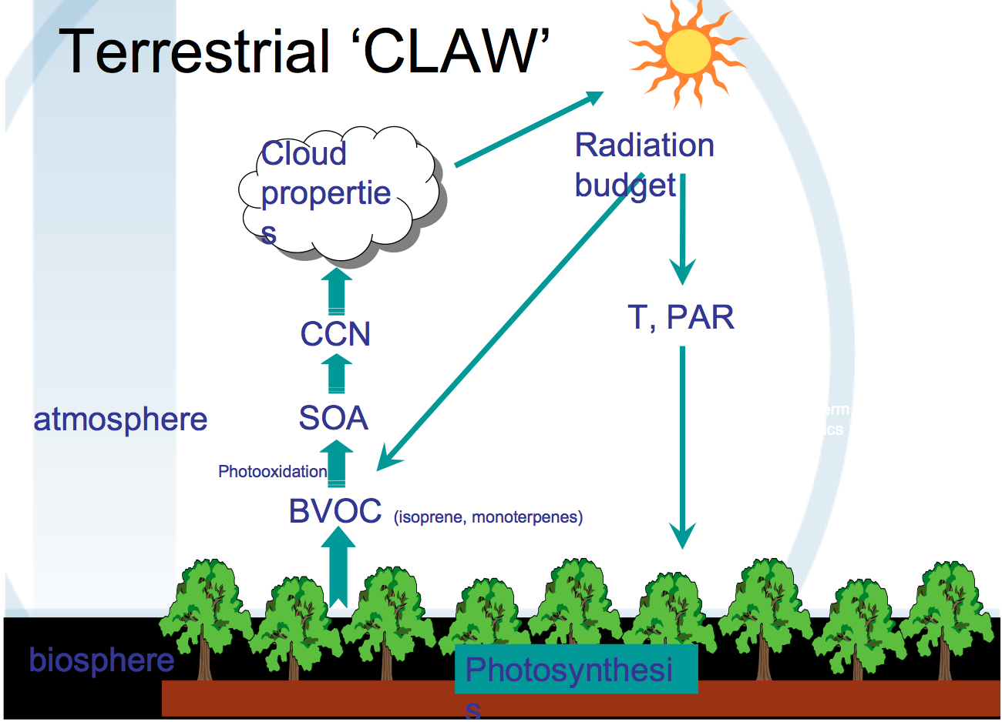
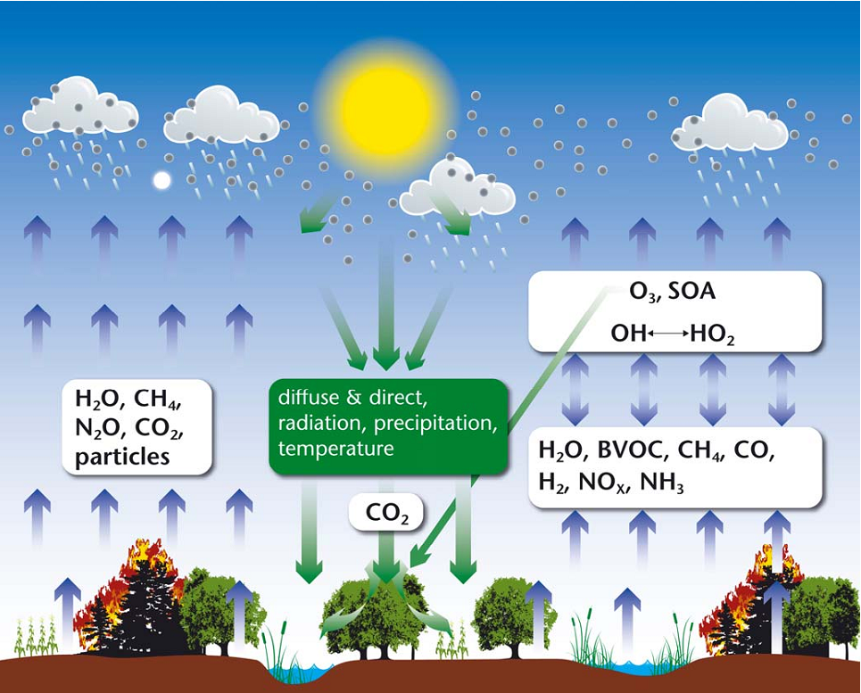
Conceptual overview of
terrestrial carbon cycle –
chemistry – climate interactions
Arneth et al., 2011
Kulmala et al, 2013
Notes:
The land surface aﬀects atmospheric chemistry and climate directly via surface energy partitioning into latent and sensible heat ﬂux (not shown), and emissions of greenhouse gases (H2O, CH4, N2O, CO) and aerosol particles from forests, grasslands, wetlands, agricultural systems, and vegetation biomass burning. Atmospheric chemistry and climate is also aﬀected by atmospheric reactions of reactive trace gases emitted from vegetation, soils and ﬁres (H2O, VOC, CH4, CO, NOx, NH3, H22). These contribute to complex oxidation patter ns along variable pathways that depend on the overall chemical and physical environment. Reaction kinetics vary greatly, and the lifetime of substances or their reaction products may vary from seconds (e.g., some BVOC) to years (e.g., CH) which in turn deter mines whether associated chemistry-climate eﬀects are regional or continental to global. The chief oxidizing agent is the hydroxyl radical OH, while some BVOC react directly with O3. Tropospheric humidity and hence latent heat ﬂux is an important constraint for OH formation. The main climate relevance of the atmospheric reactions is to consume or generate O, formation of secondary organic aerosol (SOA), and eﬀects on the lifetime of CH43. Climate feedbacks in the system occur directly (e.g., via the temperature and/or light response of emissions) or indirectly, for example, O
eﬀects on vegetation composition, productivity and carbon cycle.

Slide 16
Wet Season Dry season
Air mass trajectories and footprint

Slide 17
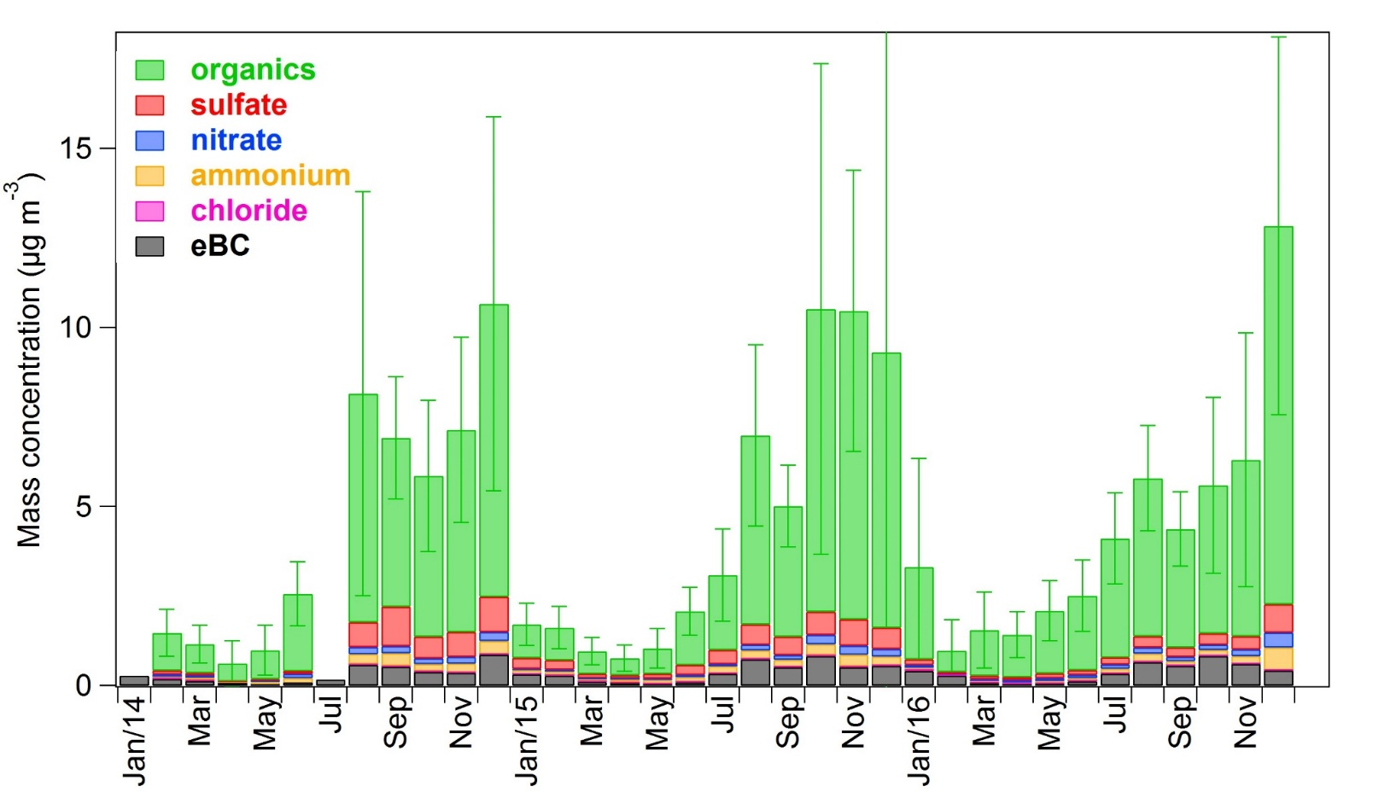
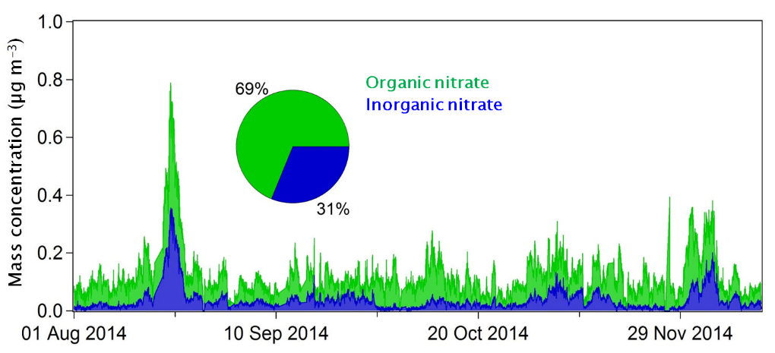
ATTO ACSM Monthly averages 2014-2016
Most of the nitrates are organics

Slide 18
Organic aerosols from ATTO to Tiwa and Manacapuru (with BC)
Wet
Dry
T0a
T2
T3

Slide 19
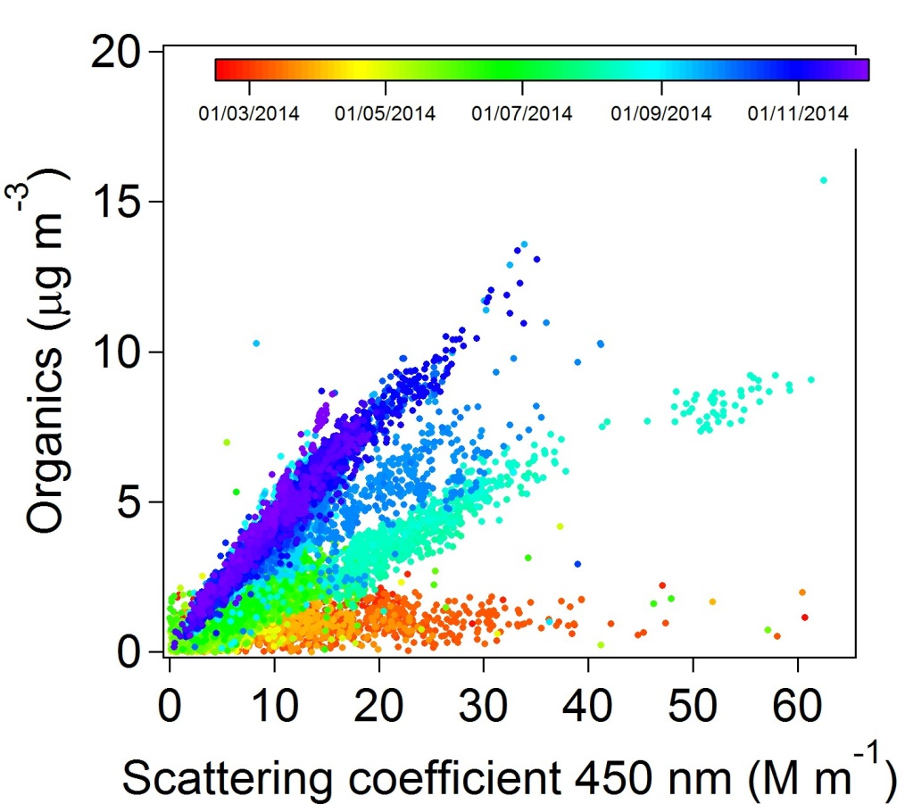
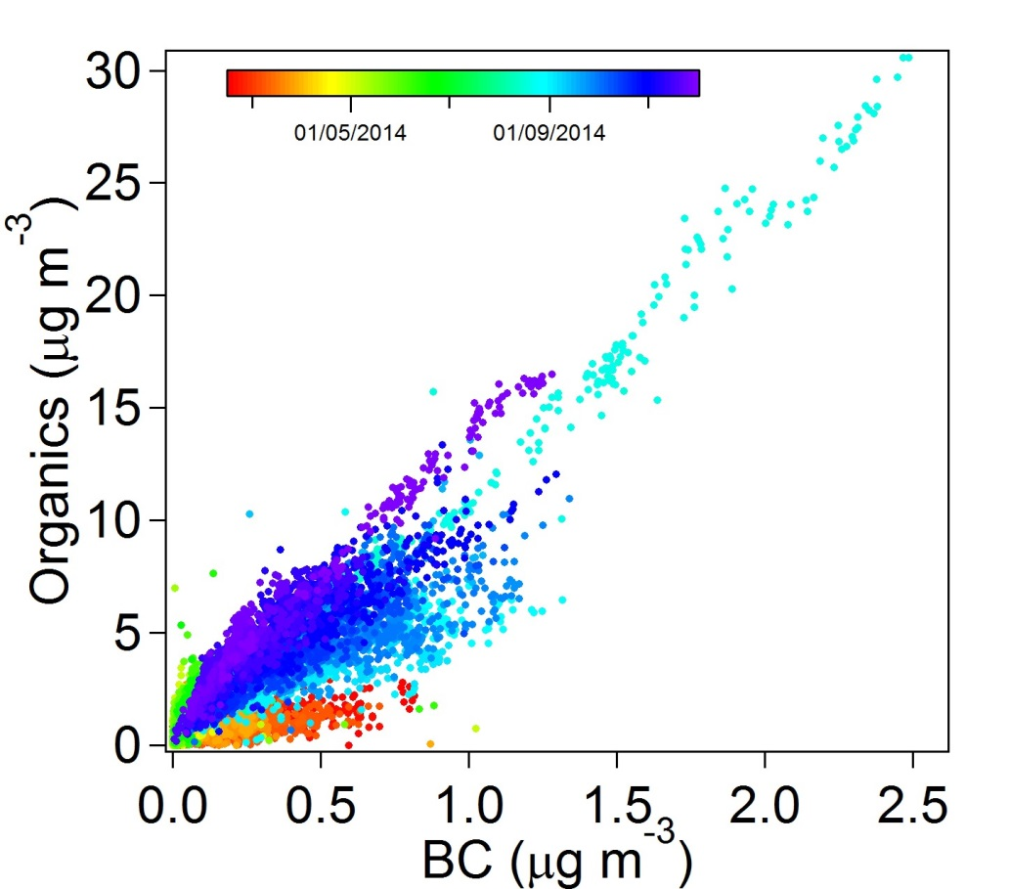
What drives light scattering and absorption for PM1?
T0a ATTO - Organics versus light scattering and absorption
The organics made up to 76% of the fine particles and when investigated as a function of the scattering coefficient (σ₄₅₀) different patterns (with different slopes) were observed over time. BC also shows different patterns but less pronounced

Slide 20
The hygroscopicity parameter γ versus the organic mass fraction
The hygroscopicity parameter γ the organic mass fraction for boreal aerosol measured in Hyytiälä, Finland (green points).
The grey show more inorganic dominated aerosol in Melpitz, Germany, during winter time.
γ describes the magnitude of the scattering of enhancement factor f(RH), where f(RH)=α(1-RH)- γ.
Zieger et al. (2015).

Slide 21
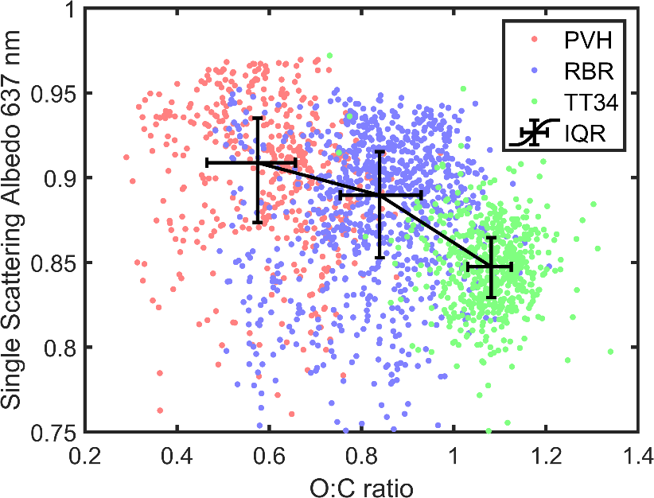
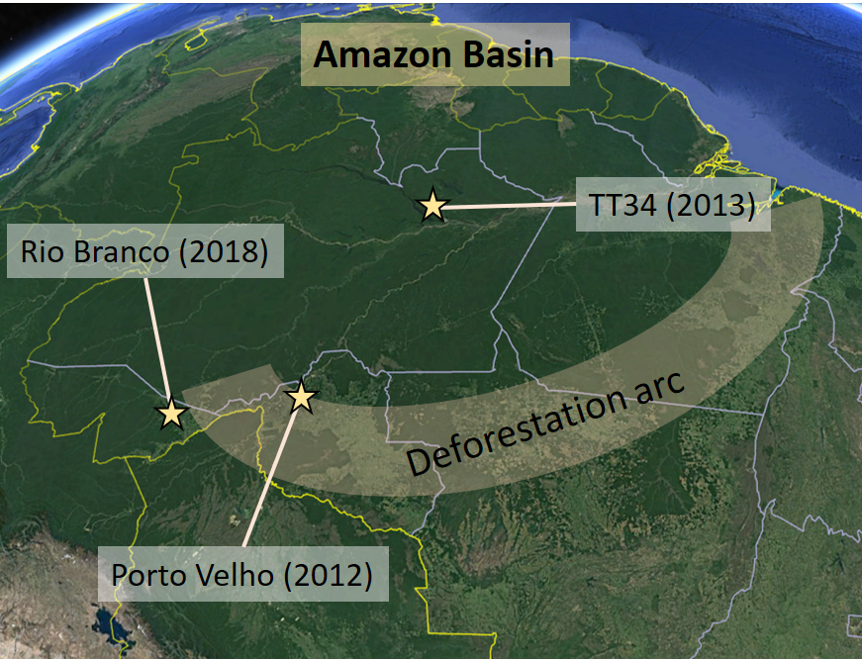
Optical properties versus aerosol aging – PVH, RBR, TT34
  SSA decreases with aerosol ageing
    SSA decreasing trend – A clear trend of SSA decrease (stronger relative absorption) has been observed between sites, and correlating with O:C ratio. This could be result of enhanced absorption with atmospheric ageing (e.g. formation of Brown Carbon (BrC). (Joel Brito, 2019)

Slide 22
Fate of isoprene RO2 radicals (ISOPO2) depicting different chemical pathways that depend on the NOx, HOx, and RO2 regimes. Several pathways lead to SOA formation, but the particle loading/composition differs greatly between different regimes, and also depends on acidic/non-acidic seeds.

Slide 23

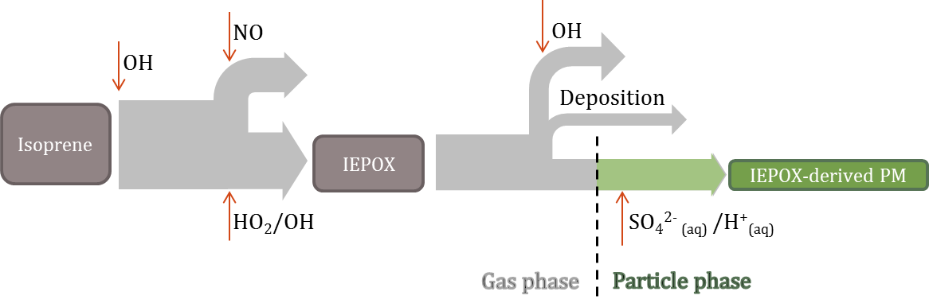
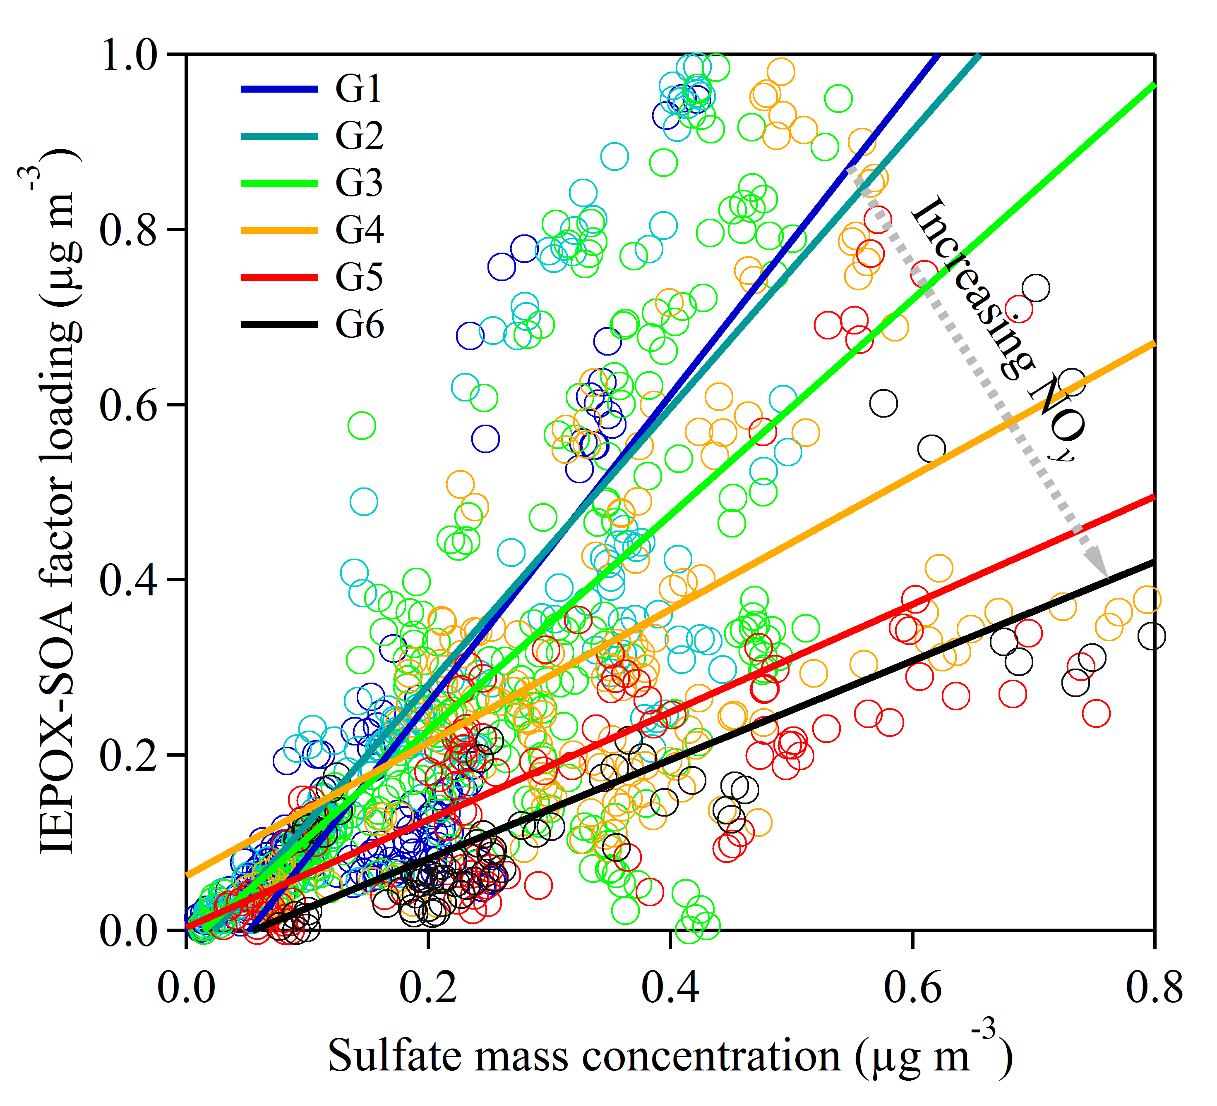
Influence of anthropogenic emissions on isoprene-derived particulate matter in central Amazonia
Observational constraints of sulfate as a first order predictor and NO as a modulator of IEPOX-derived PM.
  NO_{y} serves as indicator of integrated exposure of airmass to NO chemistry.
  IEPOX-SOA factor obtained from PMF analysis of AMS data is a proxy for IEPOX-derived PM.
Lower loadings of IEPOX-SOA factor observed for polluted compared to background conditions
S. de Sá, et al., 2017

Slide 24
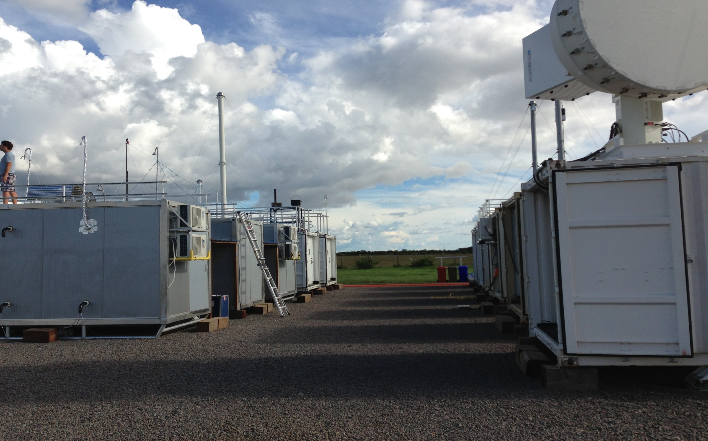
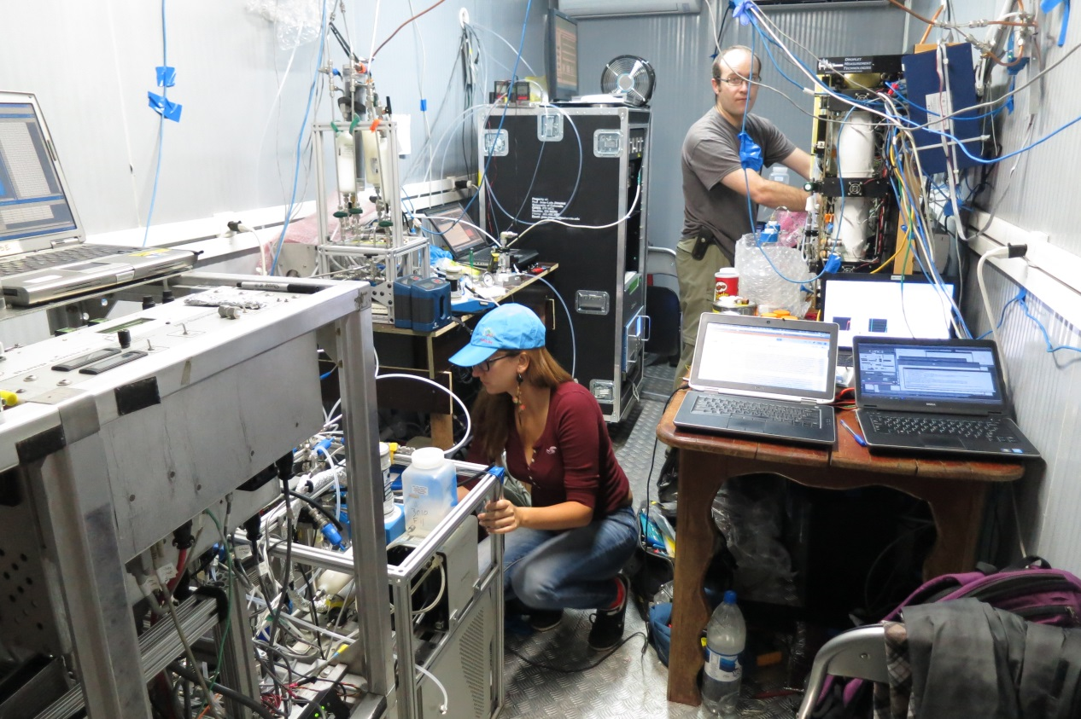
The T3 research site
6/23
Intensive Operation Periods (IOPs) - 2014
IOP1: wet season IOP2: dry season
Feb 1 – Mar 31 Aug 15 – Oct 15
Notes:
Site maintanined by DOE in a farm site, close to Manacapuru
A wide range of different measurements are being carried at this location, not only of aerosol particles composition and properties, but also of trace gases, meteorology, radiation, etc
I was in this trailer, which had mainly measurements for physical and chemical characterization of aerosol particles and and CCN

Slide 25
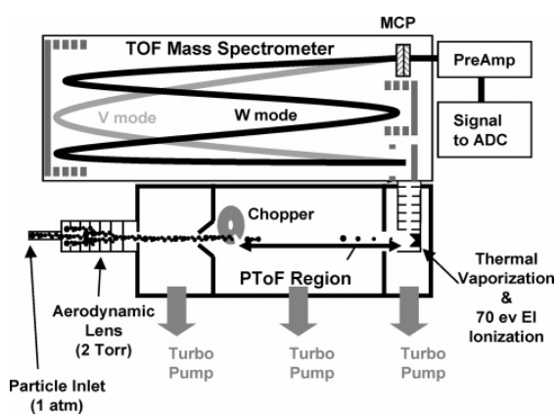
Aerosol Mass Spectrometry
7/23
HR-ToF-AMS
Aerodyne
High-resolution Time-of-Flight
Aerosol Mass Spectrometer (AMS)
NR material
Universal
Reproducible
Fragmentation
[DeCarlo et al., 2006]
Non-refractory PM1
Mass concentrations: Organic, Sulfate, Ammonium, Nitrate, Chloride
Chemically resolved mass-size distribution
Mass spectra, EI → “fingerprint”
Notes:
→ for extras: know physical laws and equations for the ToF (m/z and path, etc)
Make sure to tell your routine in the field – calibrations, troubleshooting, daily checks, preliminary data analysis for first approx. QC
what is the:
S/N ratio?
uncertainty/error in the measurements? How calculated?
DL?

Slide 26
SV-TAG - semi-volatile thermal desorption aerosol gas chromatograph with in situ derivatization, which provides hourly resolved concentrations and gas-particle partitioning of most common BVOC oxidation tracers
SOAS+GoAmazon: The results of the present study show that the gas-particle partitioning of approximately 100 known and newly observed oxidation products is not well explained by environmental factors (e.g., temperature). Compounds having high vapor pressures have higher particle fractions than expected from absorptive equilibrium partitioning models. Many commonly measured biogenic oxidation products may be bound in low-volatility mass that decomposes to individual compounds on analysis
Gabriel Isaacman-VanWertz, A. Godstein EST 2016

Slide 27
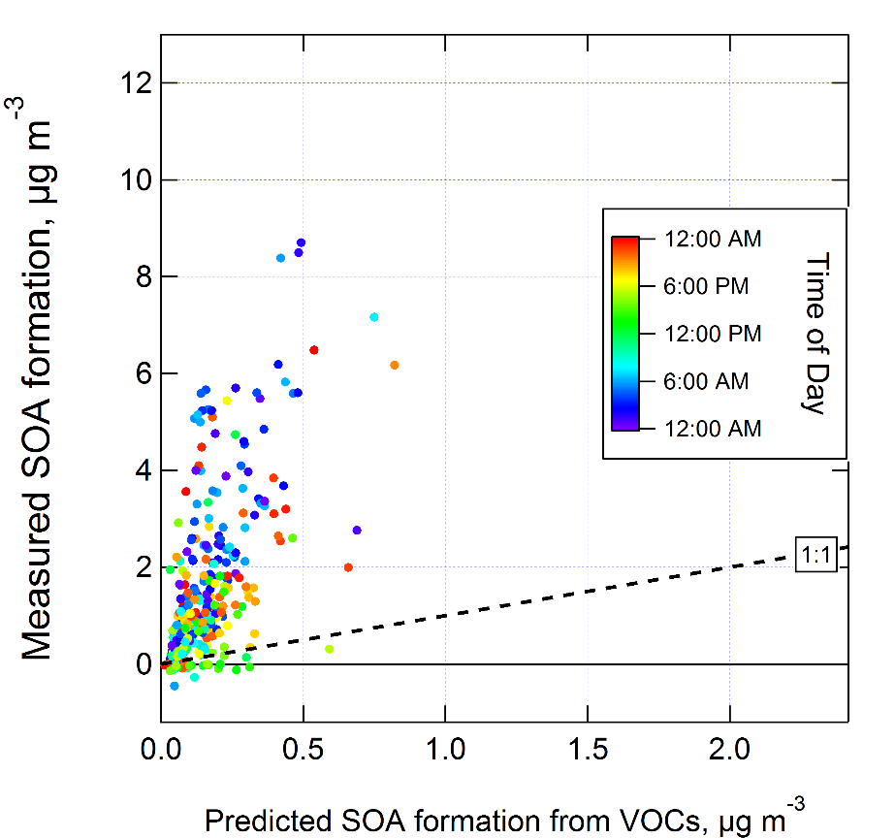
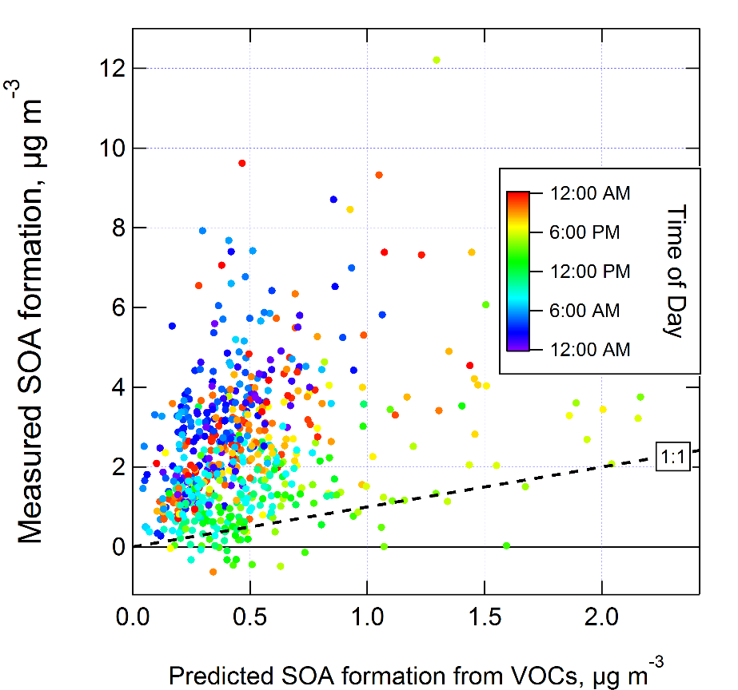

More Secondary Aerosol Potential than Expected
Objective:
Test through in situ data sets the potential for secondary aerosol production and compare to state of understanding with respect to known species and their reactive yields
IOP1 Wet Season
IOP2 Dry Season
Measured Formation, μg m⁻³
Measured Formation, μg m⁻³
UTC
UTC
Predicted Formation, μg m⁻³
Predicted Formation, μg m⁻³
Results:
Secondary aerosol produced from oxidation by OH of ambient air
Production much greater than predicted from modeled yields of measured ambient precursors
Suggests that production is dominated by unmeasured species
Palm, Jimenez, et al., GoAmazon2014/5 Special Issue

Slide 28
Particle composition at T3
3%
1%
IOP1
(Wet season)
4%
IEPOX-SOA
17%
13%
PMF
79%
Other factors
83%
IOP2
(Dry season)
3%
1%
11%
IEPOX-SOA
15%
PMF
Organic
Sulfate
Ammonium
Nitrate
Chloride
85%
Other factors
85%
Notes:
I am assuming that you will have already shown the location of T3 on a map before this slide.

Slide 29
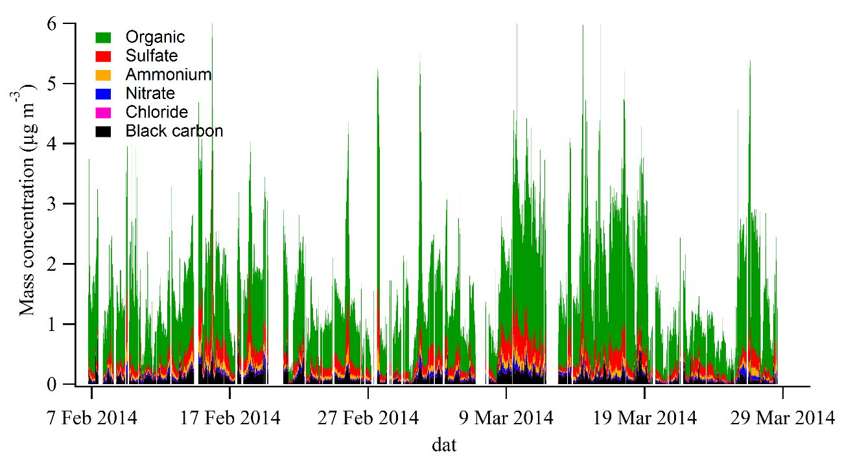
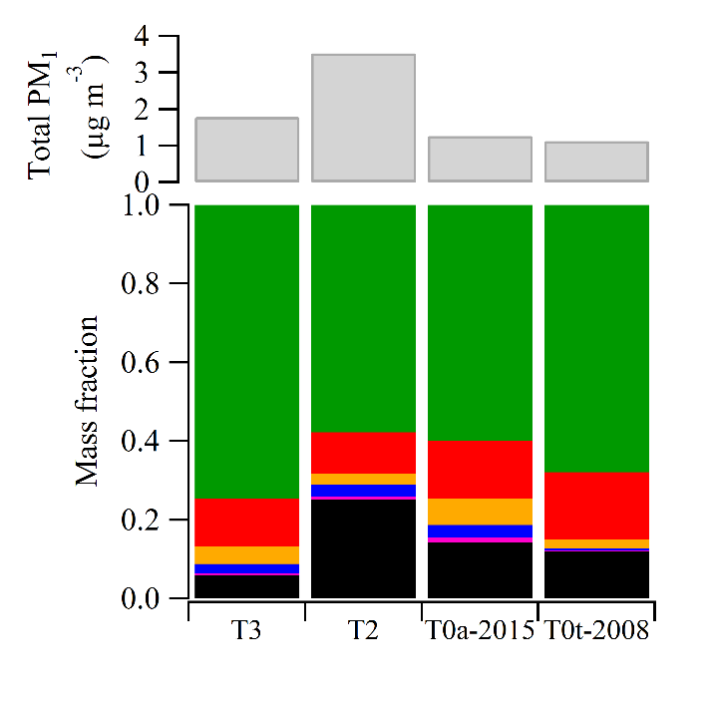
Wet season aerosol composition in central Amazonia
Manaus
T3
Clear - T0
Suzane Sá, 2018
Notes:
Comparison to previous results: Chen et al., Martin et al.
- Mention org & inorg nitrate: analysis shown in supplement. Use their time series to corroborate other interpretation, but the amount of nitrate itself is small

Slide 30
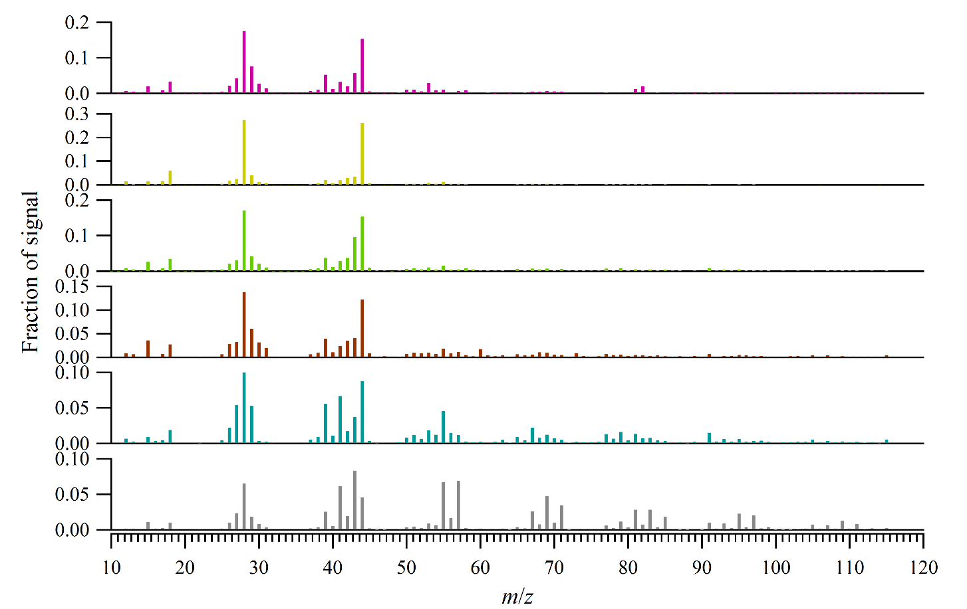
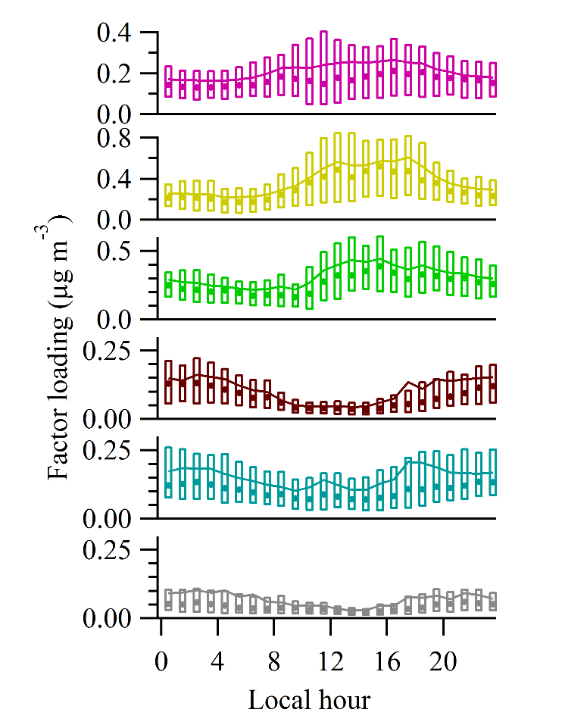
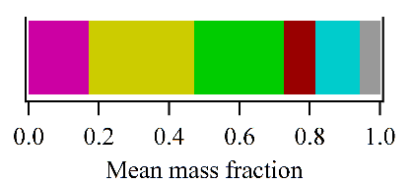
  3.2. Source apportionment of organic PM
(a)
(b)
IEPOX-SOA
53
82
44
MO-OOA
LO-OOA
43
BBOA
60
Fac91
41
55
91
HOA
55
57
Figure 3

Slide 31
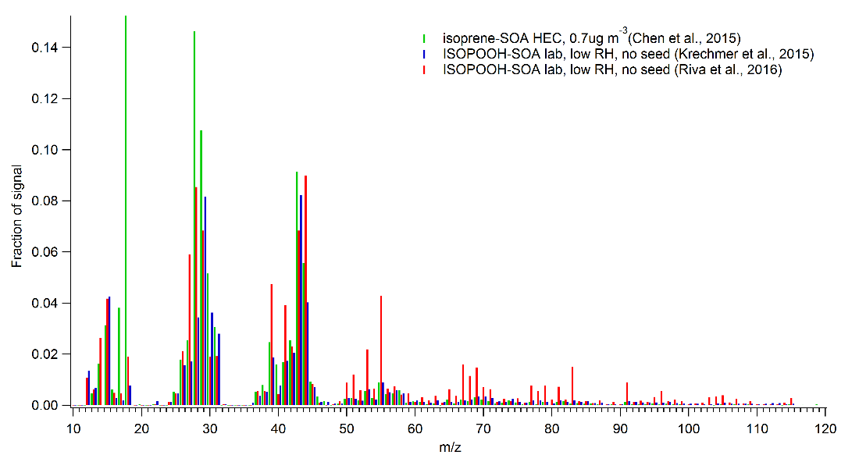
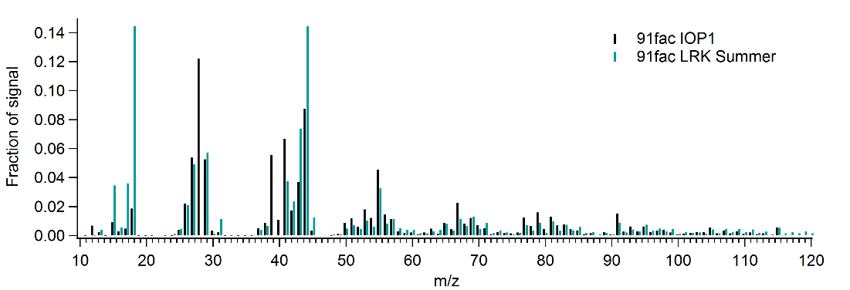
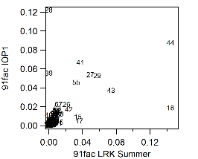
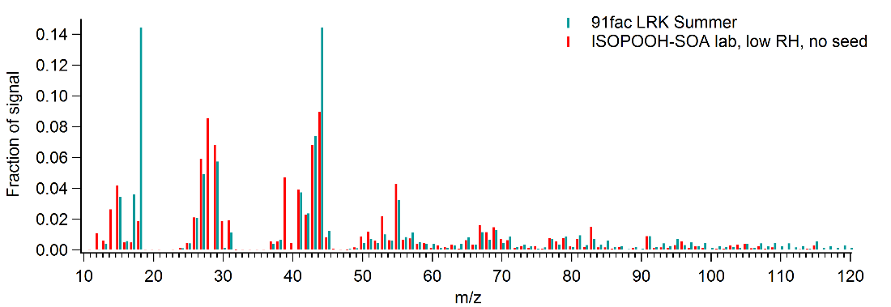
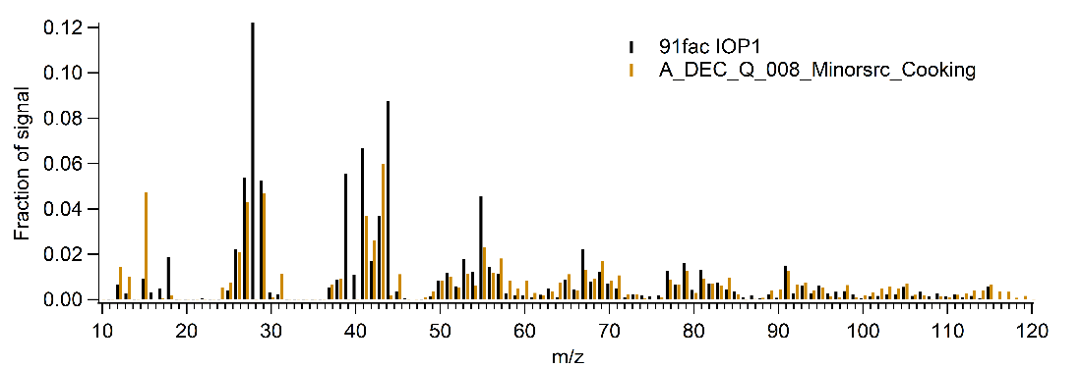
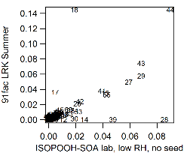
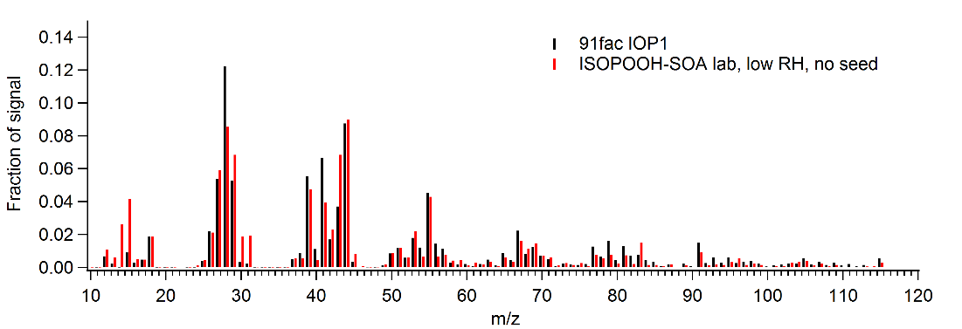
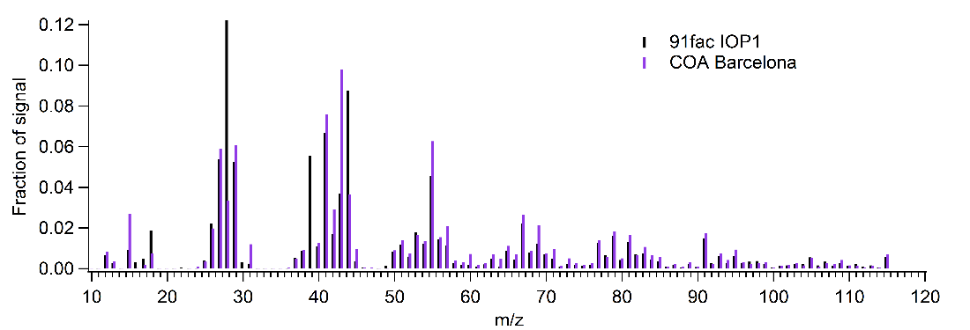
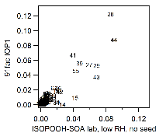
Fac 91 (parenthesis)
Bio-anthrop. SOA?
Cooking OA!

Slide 32
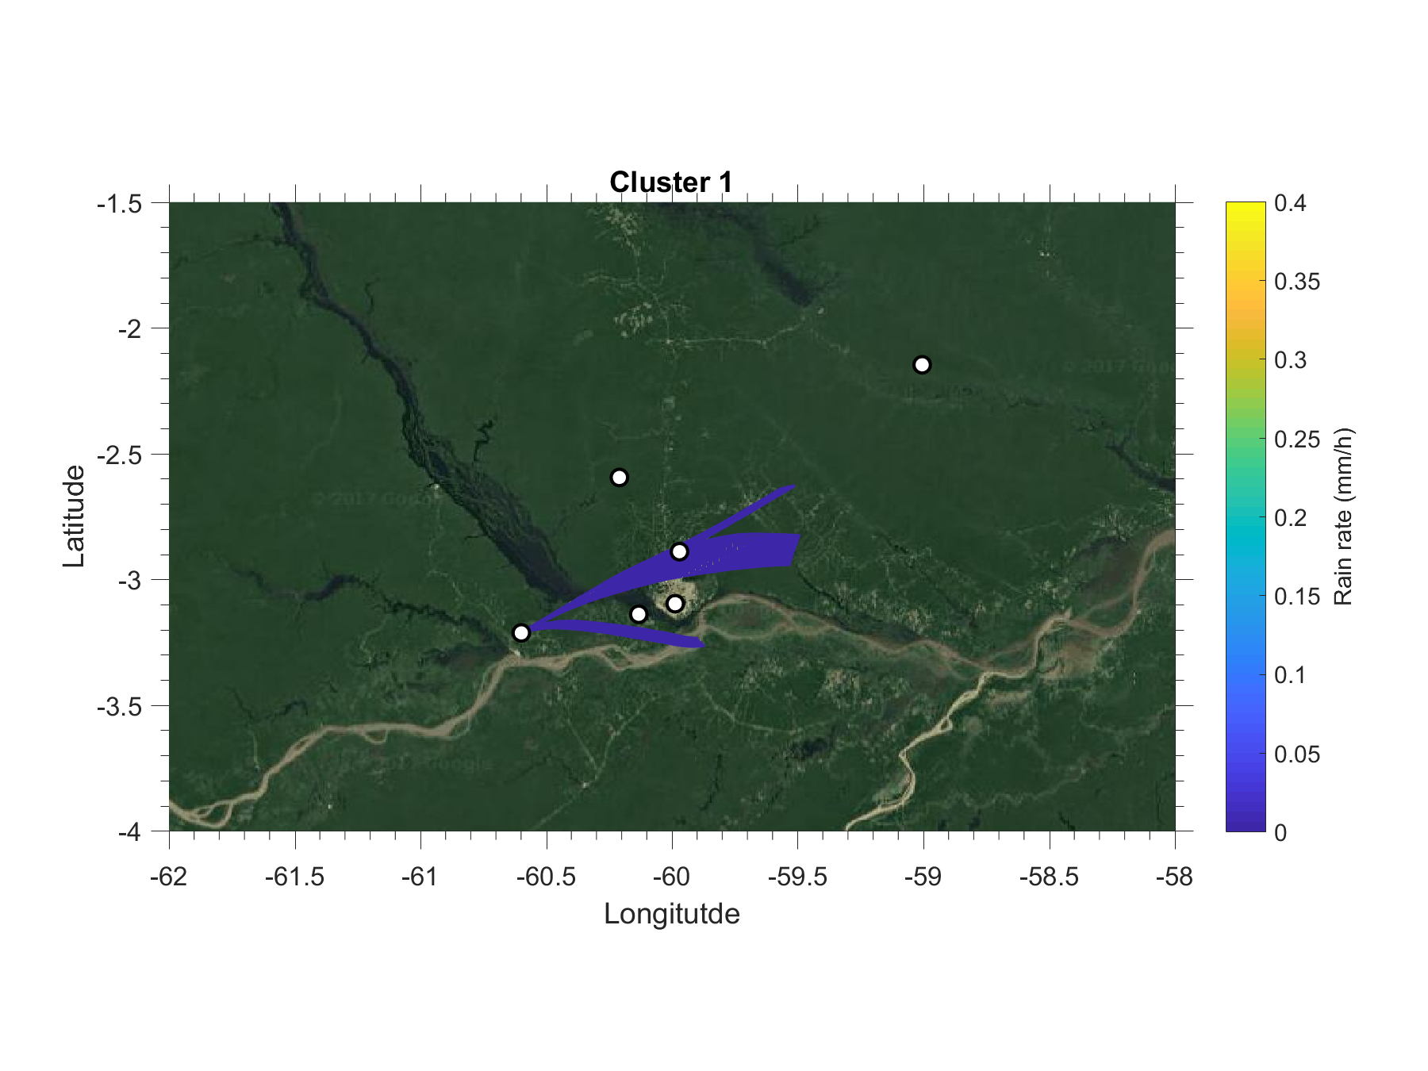
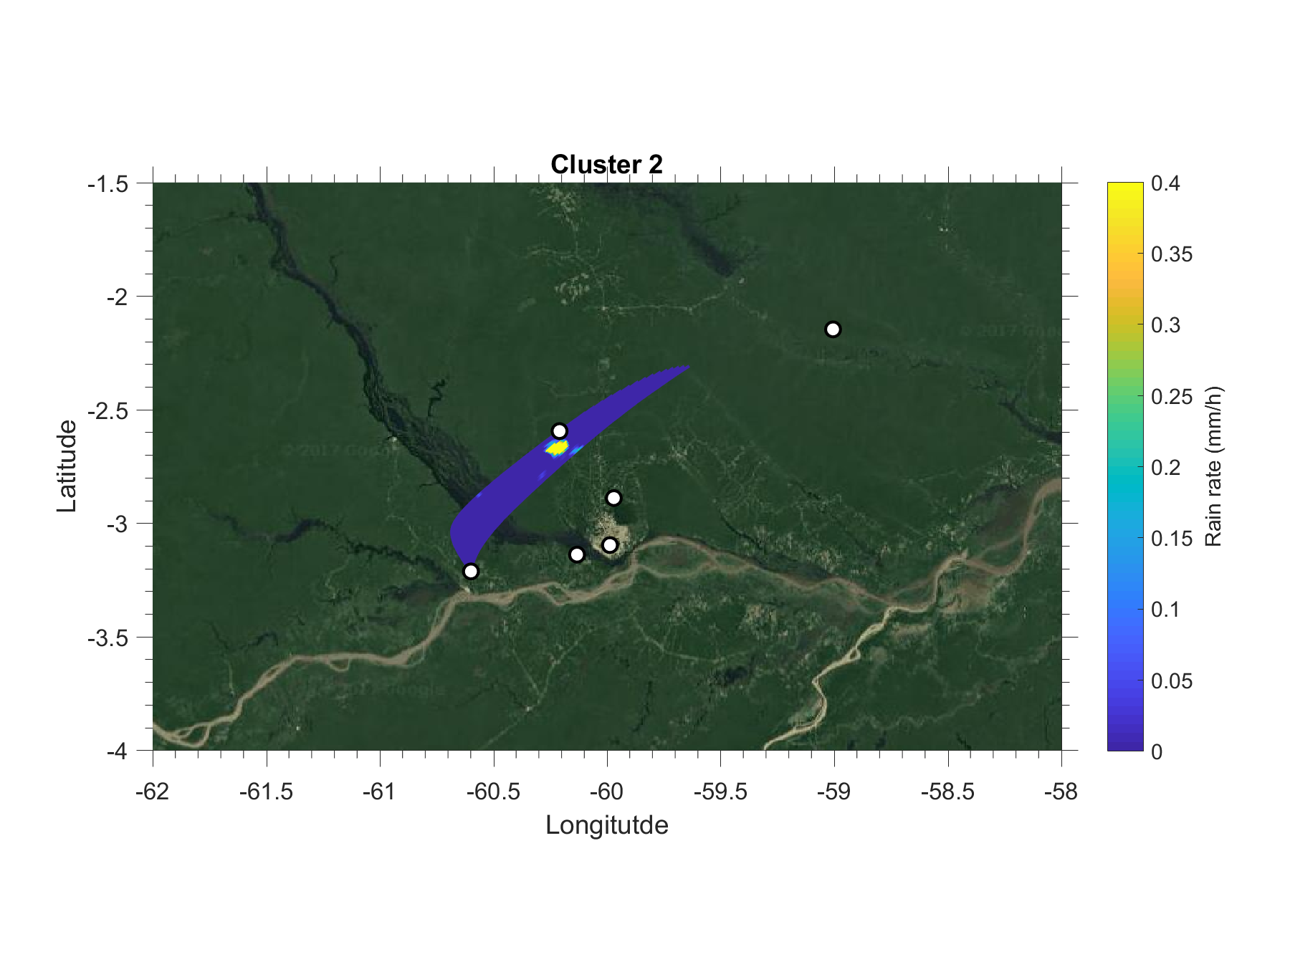
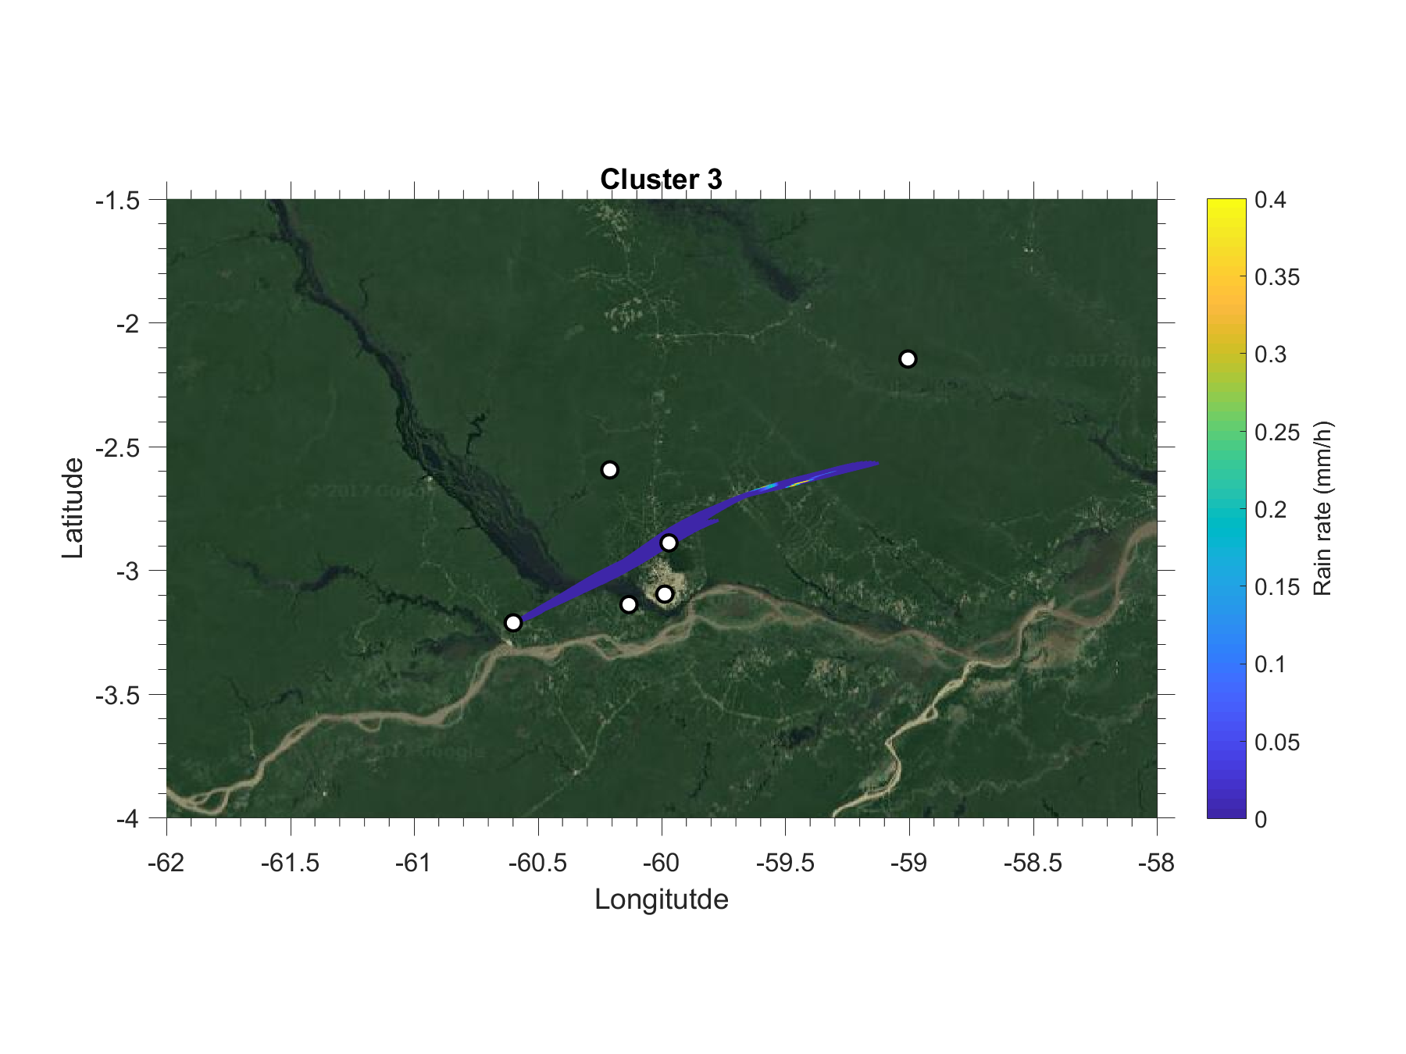

  Shifts in aerosols with anthrop. influences
Notes:
ADD BC!!

Slide 33
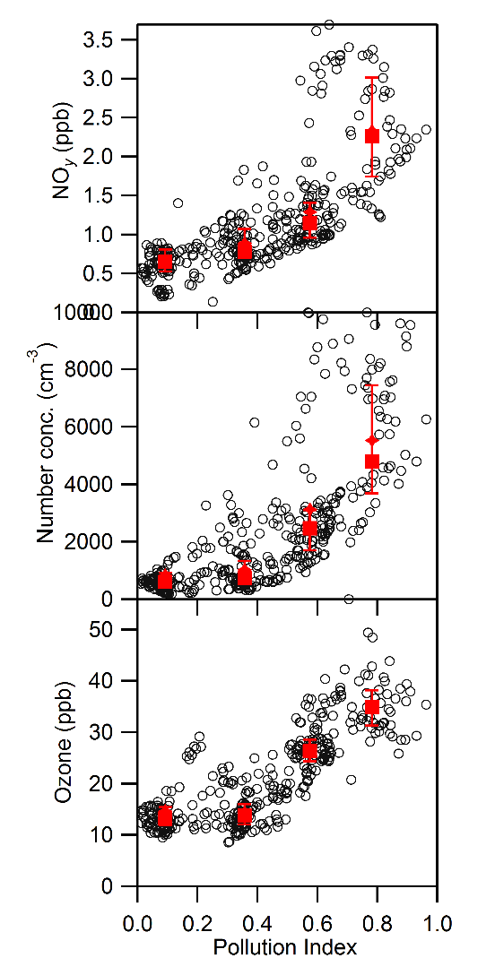
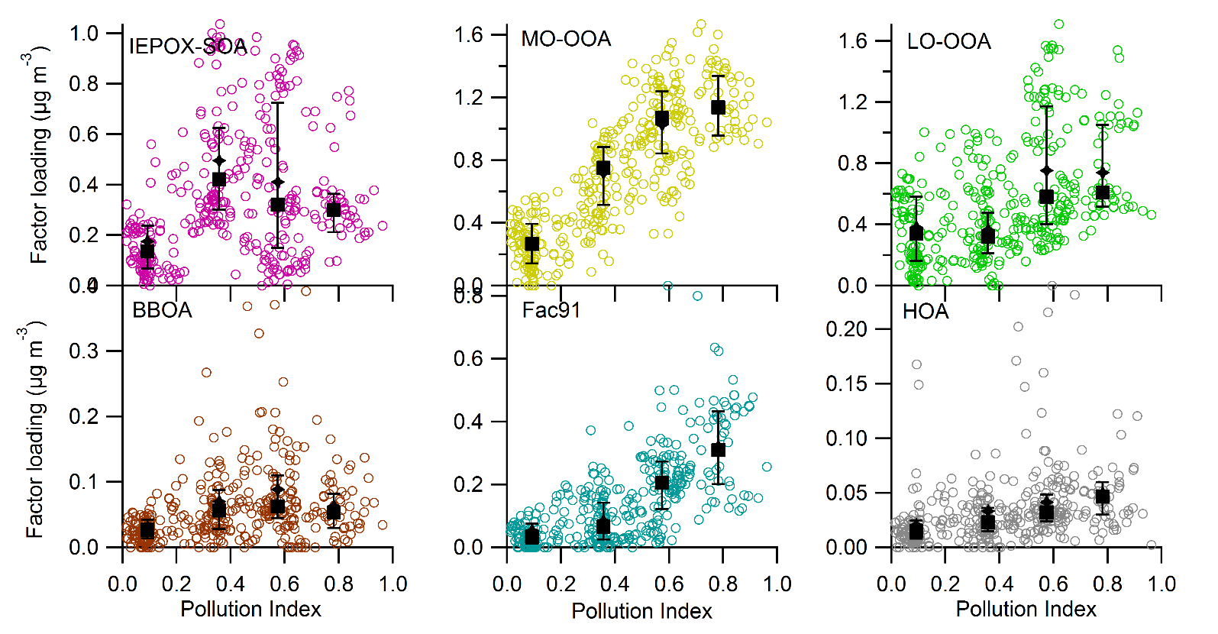
Deriving a pollution index with Cluster analysis
Conditions: afternoon (12-16 LT), no rain (10h in traj), Sol rad (4h) > 200 W m⁻²
Input variables: NO_{y}, O₃, logCPC, SO₄²⁻, NO₃⁻, NH₄⁺, Cl⁻, BC

Slide 34
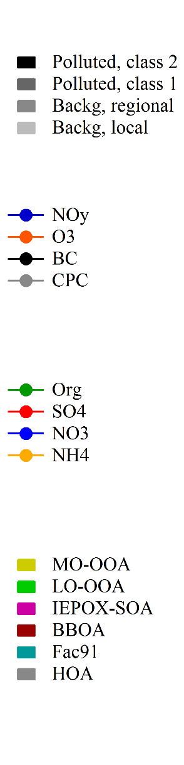
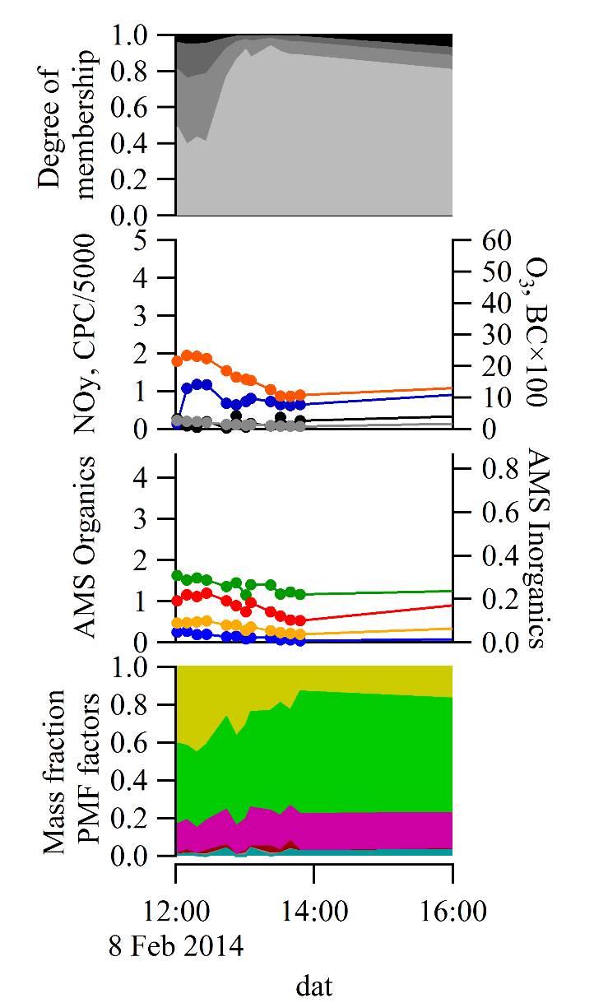
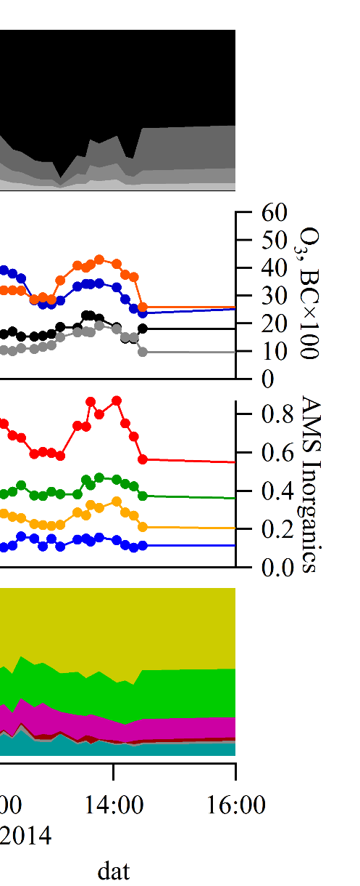
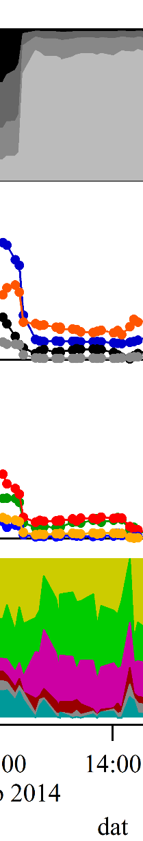






  Shifts in PM with anthrop. influences
Time scale
1 h
8 Feb 2014
9 Feb 2014
10 Feb 2014
13 Feb 2014
16 Feb 2014
9 Mar 2014
14 Mar 2014
Suzane Sá, 2017
Notes:
ADD BC!!

Slide 35

  Shifts in aerosols with anthrop. influences
Time scale
1 h
8 Feb 2014
9 Feb 2014
10 Feb 2014
13 Feb 2014
16 Feb 2014
9 Mar 2014
14 Mar 2014
Figure 5
Notes:
ADD BC!!

Slide 36

  Shifts in aerosols with anthrop. influences
Time scale
1 h
8 Feb 2014
9 Feb 2014
10 Feb 2014
13 Feb 2014
16 Feb 2014
9 Mar 2014
14 Mar 2014
Figure 5
Notes:
ADD BC!!

Slide 37

  Source apportionment of organic PM
(c)
Suzane Sá, 2018

Slide 38

  Source apportionment of organic PM – AMS + SV-TAG + PTR+ Others
IEPOX-SOA
MO-OOA
LO-OOA
BBOA
Fac91
HOA
AMS
SV-TAG
PTR-MS
Other
Suzane Sá, 2018
Notes:
ADD BC!!

Slide 39

  Shifts in aerosols with anthrop. influences
Clean Regional Small pollution Heavy pollution
  Increase in organic aerosols from 0.7 to 4 ug/m³
Notes:
ADD BC!!

Slide 40
SOA production in Amazonia DRY season

Slide 41

  3.3. Shifts in PM with anthrop. influences
Notes:
ADD BC!!

Slide 42
A very dynamic system with the interaction of the Manaus plume with the background air
Large temporal and spatial variability: a challenge for the models
Rahul Zaveri et al., 2018

Slide 43


Transverse Transects of Urban Plume
500 m, 11 AM local, 13 March 2014
Data Sources: Mei Fan, Stephen Springston, IARA Experiment, DOE AAF G1 Platform

Slide 44
Box and whisker representations of the G-1 AMS data for both the wet and dry seasons (top panel), average particle chemical composition for each flight (middle panel), and average aerosol chemical composition for all flights (bottom).

Slide 45
Time traces of relevant quantities on March 13th, 2014 flight. AMS data uses the HR-analysis routine described in the literature to minimize interferences (Aiken et al., 2007). Note the mass of inorganic species (SO4, NO3, NH4) has been multiplied by a factor of five to improve the figure clarity. PTR-MS signal at m/z 69 corresponds to isoprene, m/z 71 corresponds to the sum of methylvinyl ketone (MVK), methacrolein (MACR), and isoprene hydroxyhydroperoxide (ISOPOOH), all oxidation products of isoprene, and m/z 79 corresponds to benzene.

Slide 46
PMF analysis of the organic aerosol on the March 13th 2014 flight. The PMF analysis utilized the high resolution dataset. All data from the wet season were included in the analysis.

Slide 47
Shrivastava et al., Nature Comm 2019

Slide 48
Fig.1. (a) OA measured along aircraft flight transects at 500-m altitude on March 13 (orange) and model-predicted OA, as described in the text. (b) Measured and model predicted average percent enhancement in plume compared to background organic aerosol on 4 different flight transects, as marked in (a). Bars represent measurements while symbols represent a model-predicted increase of OA within Manaus plume compared to background conditions
WRF-Chem simulations showing (a) Biogenic SOA when all emissions are on (b) Biogenic SOA when biogenic VOC emissions are on but Manaus emissions are turned off (c) Biogenic SOA enhancement factor calculated as the ratio of two simulations with Manaus emissions turned on/off i.e. (a)/(b). WRF-Chem predictions are at ~500 m altitude, averaged during the afternoon (16-20 UTC = 12-16 local time) of March 13, 2014.

Slide 49
Fig. 3. WRF-Chem simulated concentrations of NOx (ppbv), O3 (ppbv) and OH (106 molecule cm- 3) for an altitude of ~500 m, averaged during the afternoon (16-20 UTC) of March 13, 2014. Top panels show simulations with all emissions on, while bottom panels show simulations with biogenic emissions on but Manaus emissions off. A comparison of top and bottom panels demonstrates how NOx and oxidants are greatly enhanced by the Manaus plume within the otherwise pristine Amazon
Aircraft-measured and WRF-Chem simulated median values of absolute OA concentrations in-plume and at background locations. Calculations are shown for individual flight transects on 13 March 2014, since the aircraft clearly identified the plume evolution on this day, as described in the text. An Average across all flight transects is shown for March 14 and 16, and the modeled plume was determined by scanning all radial locations downwind T1 site

Slide 50
How particles are produced in Amazonia?
Feb. 1- Mar. 31, 2014
T0 site (ATTO)
(All data)
N: ~320 cm⁻³
Day time
UTC
T0 site (ATTO)
(dry season)
N: ~3100 cm⁻³
Day time
UTC
It rains a lot. Removal very high. How the particles are formed?

Slide 51

Central Questions
What controls the lifecycle – especially the sources – of aerosols in the pristine atmosphere?
How do secondary aerosol particles originate?
What is the role of nucleation “banana” events?
(Kerminen et al., 2012)

Slide 52

AMS Aerosol composition: Organics
and nitrates. No sulfates
Andi Andreae, Schneider, in prep 2016
Andi Andreae, 2016

Slide 53


Aging of organic aerosol – AC 13 Altitude & f82 dependence
Fresher organics at high altitudes
with high f82

Slide 54
IEPOX tracer f82 against R44/43 for the lower troposphere (dark green, LT) and upper troposphere (light green, UT).
High altitude aerosols are fresh and mostly IEPOX derived…

Slide 55

Biogenic organic aerosol formation at low H₂SO₄ happens in UT!
Was this the dominant mechanism in the pristine atmosphere before the advent of air pollution?

Slide 56

Clouds as active aerosol processors in the atmosphere

Slide 57

Convective precipitation brings these particles down to the surface
Wang et al. (2016, in press)

Slide 58



Thanks for the attention!!!!

Slide 59


Thanks for the attention!!
Free data police: All GoAmazon data is freely available at the DoE ARM site and in our Brazilian database

Slide 60









Aerosol Hygroscopicity
Results: Dominated by organics, with very low hygroscopicity; Manaus plume affects the Aitken mode, oxidized T2->T3
T3
T2
T0
Pöhlker et al., Thalman et al., Barbosa et al., in prep
Notes:
DATA:
T0= average of the whole year
T2= Polluted is just Feb/2015 (hence only manaus, no biomass burning); T2/BB is Sep/15 until Oct/15 2014 (that month of high BB regional)
T3= Ryan’s criteria to separate, all year, into the three classifications.
What I see here:
Background => T0/ATTO and T3-Clean agree with preivous campaign (Gunthe)
Pollution => T2 is lower than T3-polluted only for small particles (<=100nm). They should grow
Biomass Burning=> I don’t understand why T2 is lower than T3 for small sizes. If the Manaus plume (higher values) is mixed with the BB, the results should be more higroscopicity, right??

Slide 61




Isoprene Chemistry over the Amazon Rain Forest
CTM prediction
Liu, Artaxo, Martin et al., PNAS
Isoprene
[ISOPOOH]
[MVK] + [MACR]
OH
Observations
NO
HO₂
MVK
Methyl vinyl ketone
MACR
Methacrolein
…
ISOPOOH
Isoprene-derived
hydroperoxides
…
ppb NO_{y}
Bkgd
Anthropogenic Pollution
Observational constraints of anthropogenic influence.
Underestimate of the NO pathway for background conditions.

Slide 62

Aerossóis Carbonáceos
Responsáveis por >70% da massa de aerossol na Amazônia;
Diferentes tipos de aerossóis carbonáceos:
  Carbono orgânico (OC):
    refere-se ao carbono presente em compostos majoritariamente orgânicos;
    pode ser primário ou secundário (SOA);
  Carbono elementar (EC):
    Fração de carbono com composição similar à fuligem;
    Altamente absorvedor de radiação;
  Black Carbon (BCe):
    Carbono altamente absorvedor de luz com propriedades ópticas semelhantes às da fuligem.
US EPA
Notes:
Não falar em medição
Black carbon (BC), produced during incomplete fossil-fuel and biomass combustion processes, is one of the major absorbing particulate species in the atmosphere
The variability in MAE has been interpreted in terms of source regions, analytical measurement protocols, chemical and optical properties of aerosols at a sampling site

Slide 63

Isoprene Photochemistry in Transition?
OH
Isoprene
ISOPOO
NO
HO₂
Isomerization
RO₂
Products
Products
methyl vinyl ketone
(MVK, C₄H₆O)
methacrolein
(MACR, C₄H₆O)
…
ISOPOOHs
(C₅H₁₀O₃)
…
(Tuazon et al., 1990; Paulot et al., 2009; Surratt et al., 2010; Crounse et al., 2011,
Peeters et al., 2009; 2010; 2014; Fuchs et al., 2013…)
Harvard University Environmental Chemistry Group
Notes:
In this study we tried to approach this question of anthropogenic influence by directly measuring the concentrations of their respective major products over Amazonia under both clean and polluted conditions. MVK, MACR are major products of NO pathway and ISOPOOH is the major products of HO2 pathway.

Slide 64


Amazonia: Liquid Organic Particulate Matter
Aerosols are part of the liquid atmosphere (not the solid one)…
Solid
Liquid
Adam Bateman (2016)

Slide 65


How external (Biomass Burning, Sahara dust, pollution) and internal emissions (primary organic aerosol particles and SOA) interact chemically and physically altering aerosol and cloud properties.
2 years continuous measurements at seven ground based stations and two aircraft flying dry and wet seasons
Pöschl, et al., Science, 2010
Image Source: Jerome Fast

Slide 66



T0z: Scattering versus organics

