Slide 1
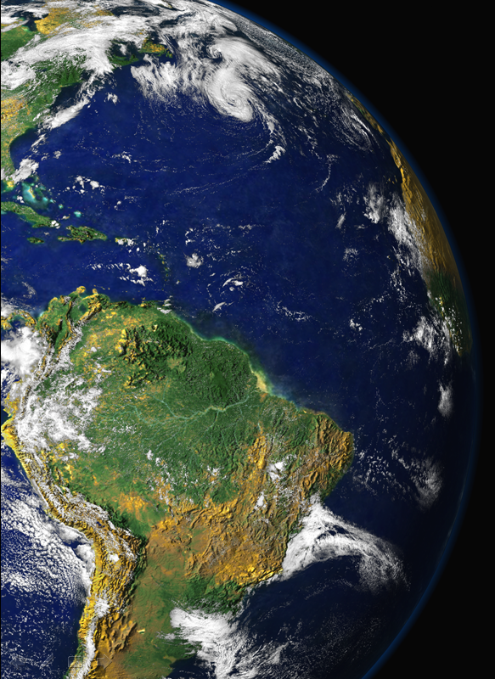

iLEAPS Early Science Career Workshop Nanjing, May 2014
Aerosols from Amazonia: Where biology meets atmospheric chemistry, dynamics and social sciences
Paulo Artaxo, Henrique Barbosa,
Joel F. de Brito, Luciana Rizzo and others.
University of São Paulo, Brazil

Slide 2
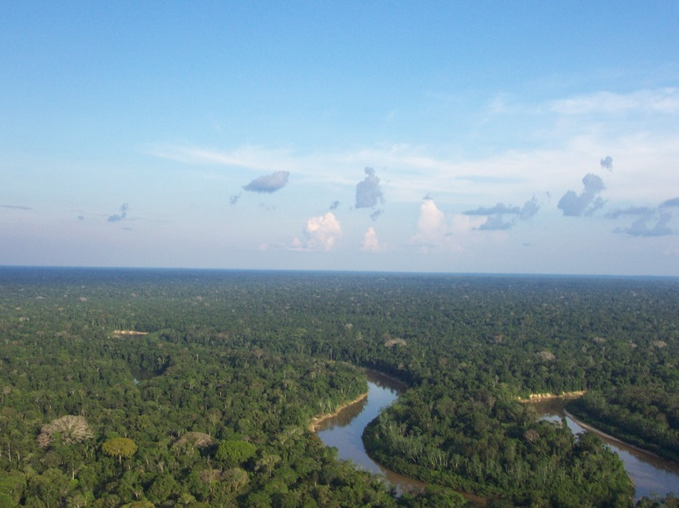
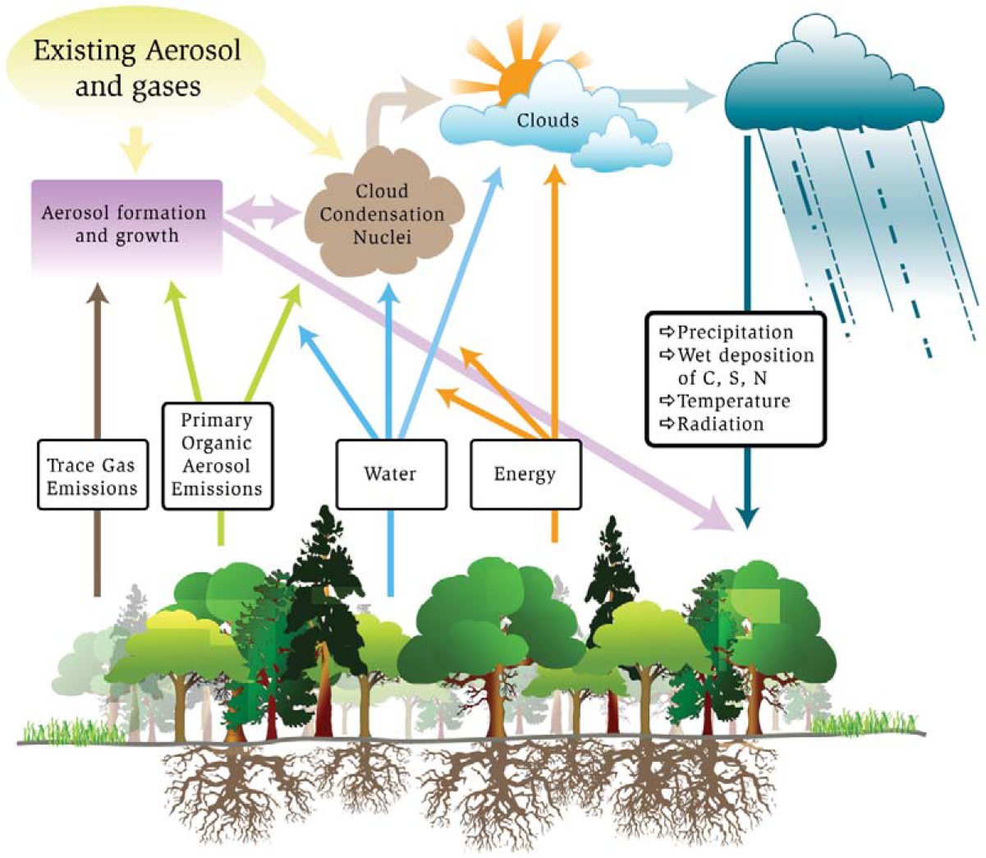
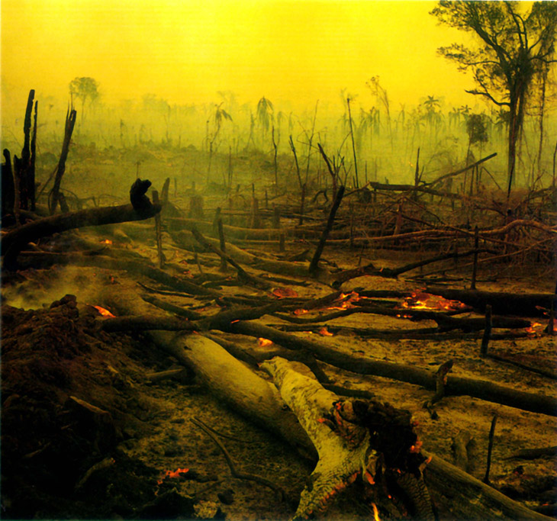
Naturally, the Amazon forest interacts strongly with the atmosphere and climate. There are strong and complex links between the forest biology, and the physics and chemistry of the atmosphere
Natural System

Slide 3
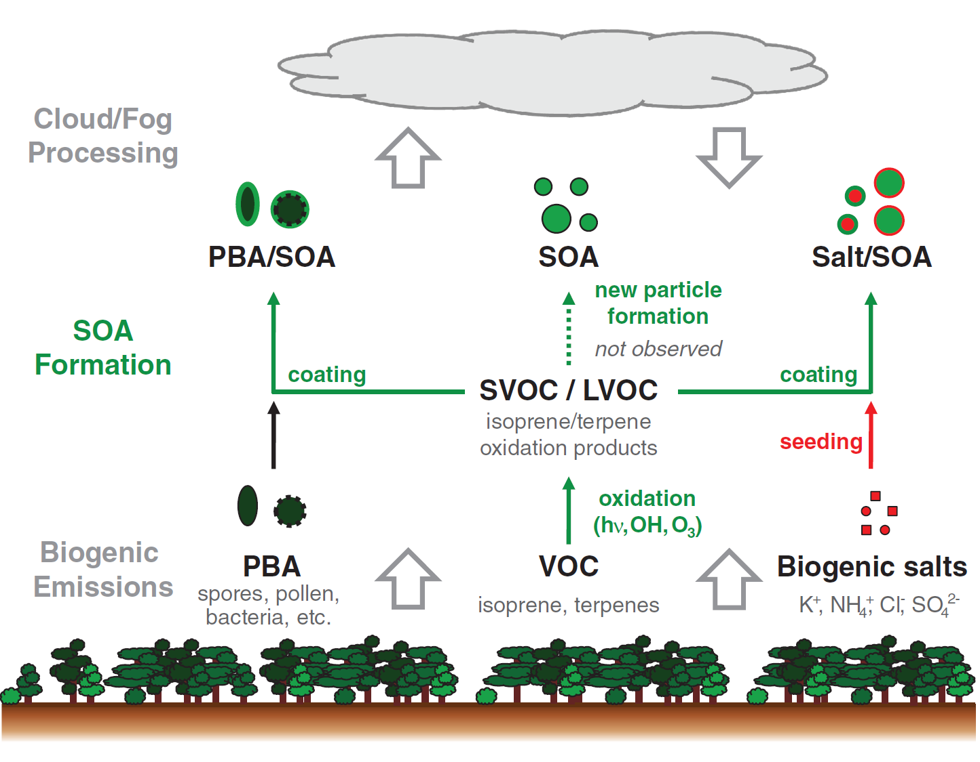
Sources and processing of organic aerosol in pristine Amazonian boundary layer air
C. Pöhlker et al.,
Science 2012

Slide 4
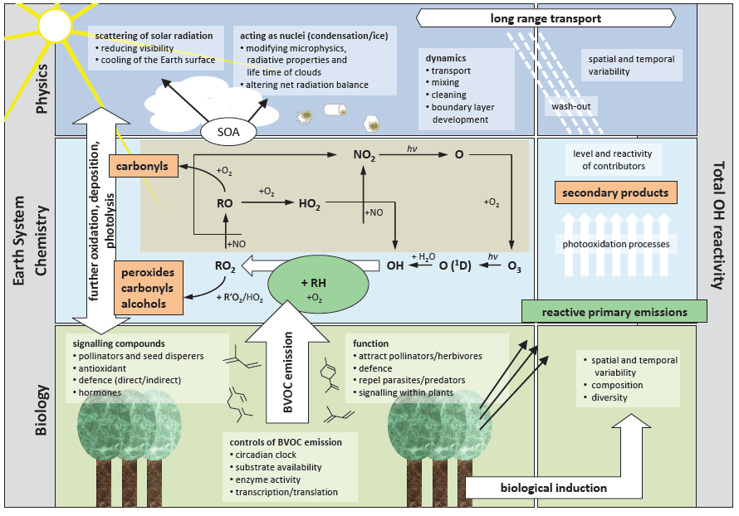
Amazonia as a Complex Nonlinear Interactive System
Ilustration from Anke H

Slide 5
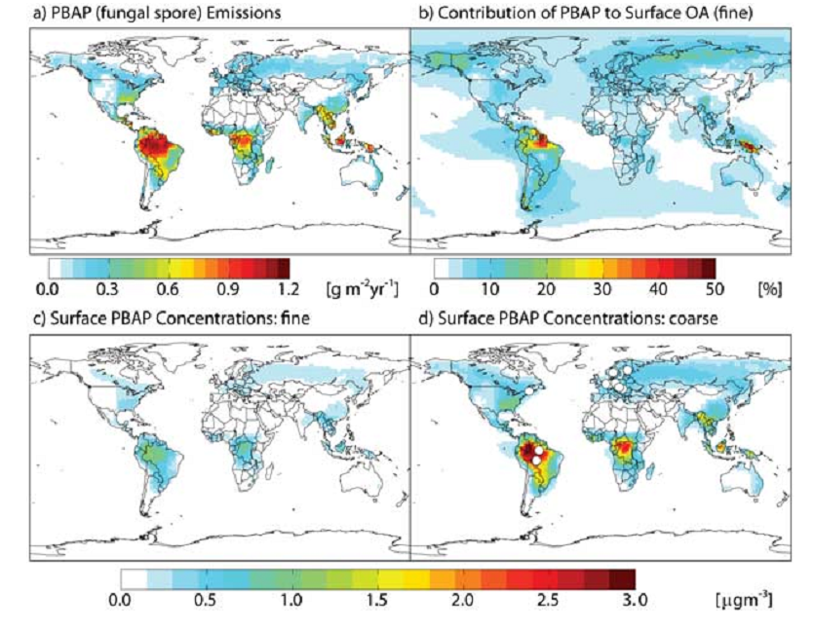
Biology matters on airborne aerosol particles
Atmospheric budget of primary biological aerosol particles from fungal spores
Annual mean of optimized GEOS-Chem simulation of fungal PBAP: (a) PBAP emissions, (b) percentage contribution of fungal PBAP to fin e organic aerosol (OA) surface concentrations, (c) fine-mode fungal PBAP surface concentrations, and (d) coarse-mode fungal PBAP surface concentrations.
Notes:
[ 1 ] The contribution of primary biological aerosol particles (PBAP) to the global budget of organic aerosol is poorly understood. Concentrations of mannitol, a biotracer for fungal spores, are used here t o constrain the first global model (GEOS-Chem) simulation of PBAP from fungi. Emissions are driven by leaf area index and atmospheric water vapor concentrations and are empirically optimized based on the geographical and seasonal variability of observed mannitol concentrations. Optimized global emissions total 28 Tg yr1 with 25% of that total emitted as fine mode (PM ) aerosol. Fungal spores contribute 23% of total primary emissions of organic aerosol, or 7% of t he fine -mode source. Annual mean simulated surface concentrations of PBA P over vegetated regions range from 0.1 – 0.7 m gm
2.5 3 (PM 2.5 ) and 0.4 – 3.0 m gm 3 (PM ), with the highest concentrations in the tropics, where PBAP may be the dominant source of organic aerosol. Further validation is required t o r educe the substantial uncertainties on this budget.

Slide 6
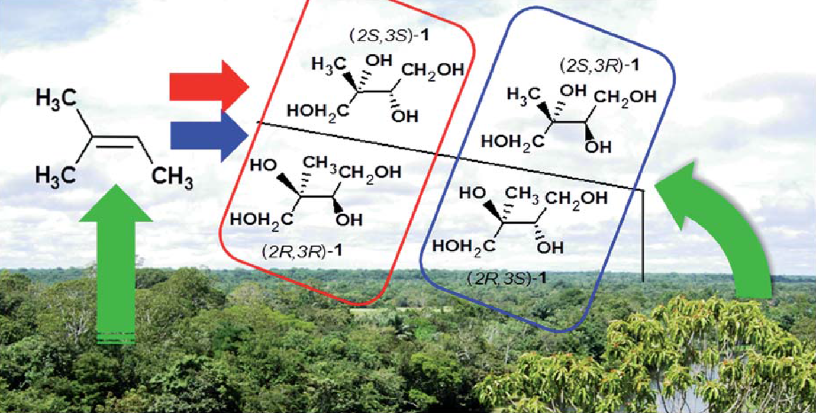
Chiral analysis of 2- methyltetraols
Gonzales et al., 2014
Chiral and isomeric analysis can be used to distinguish between atmospheric chemistry process or primary biological origin

Slide 7
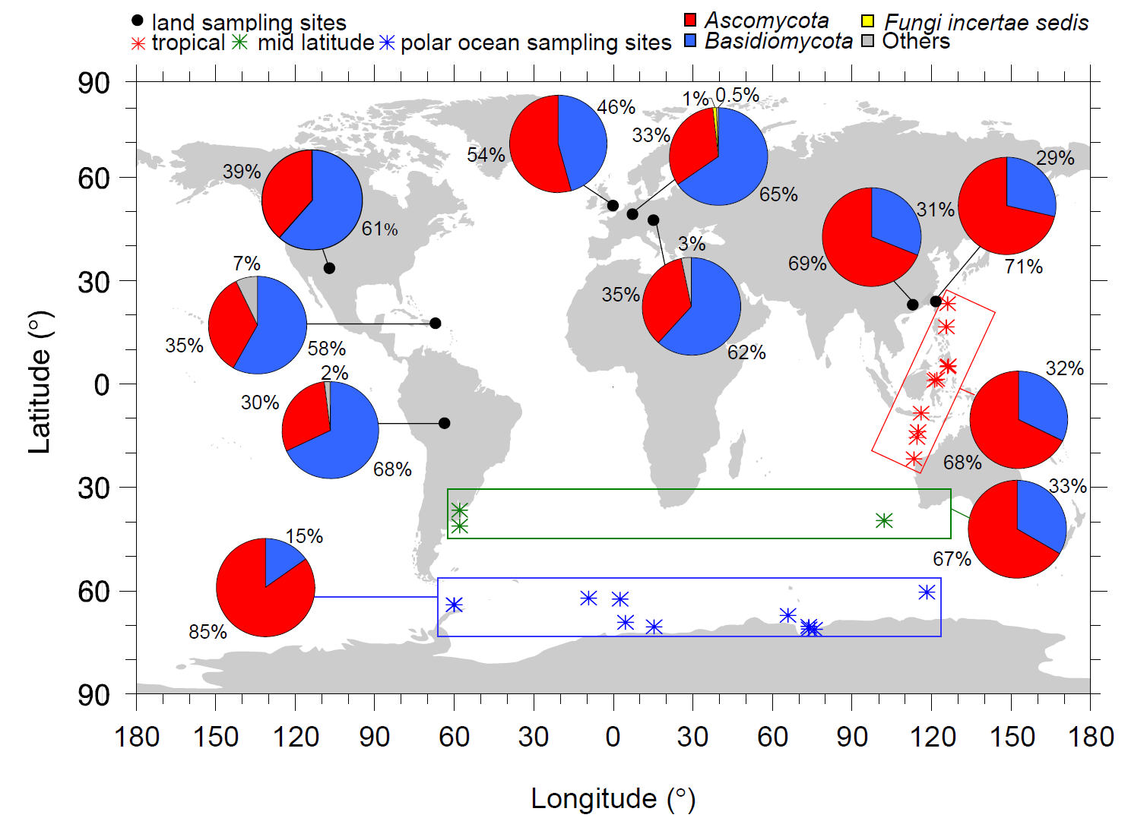
Biogenic aerosols: Diversity and biogeography of airborne microorganisms (fungi)
These airborne microorganisms are in aerosol particles, cloud droplets, etc.
Frohlich-Nowoisky, BGD 2011

Slide 8
Aerosol and cloud lifecycles

Slide 9
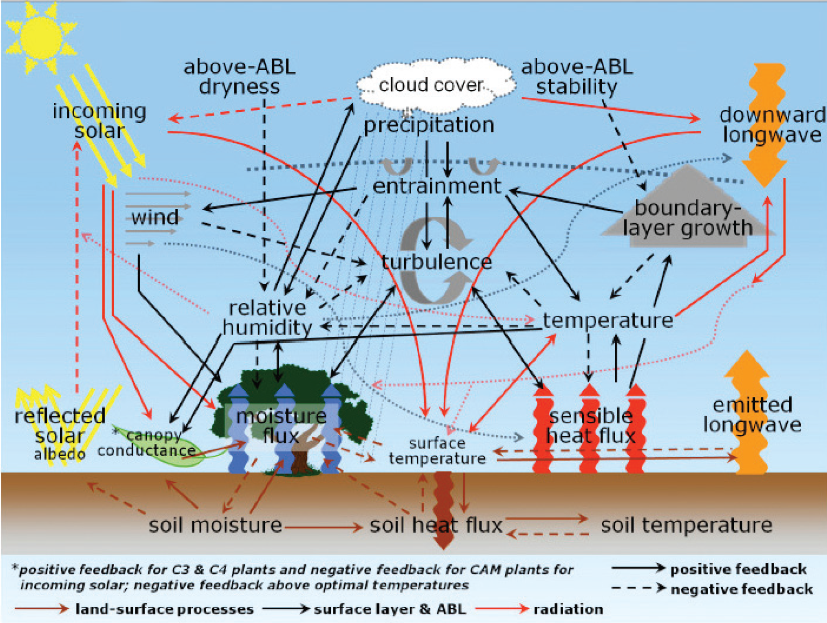
Interactions and feedbacks between soil, surface and atmosphere
(GEWEX 2013)

Slide 10
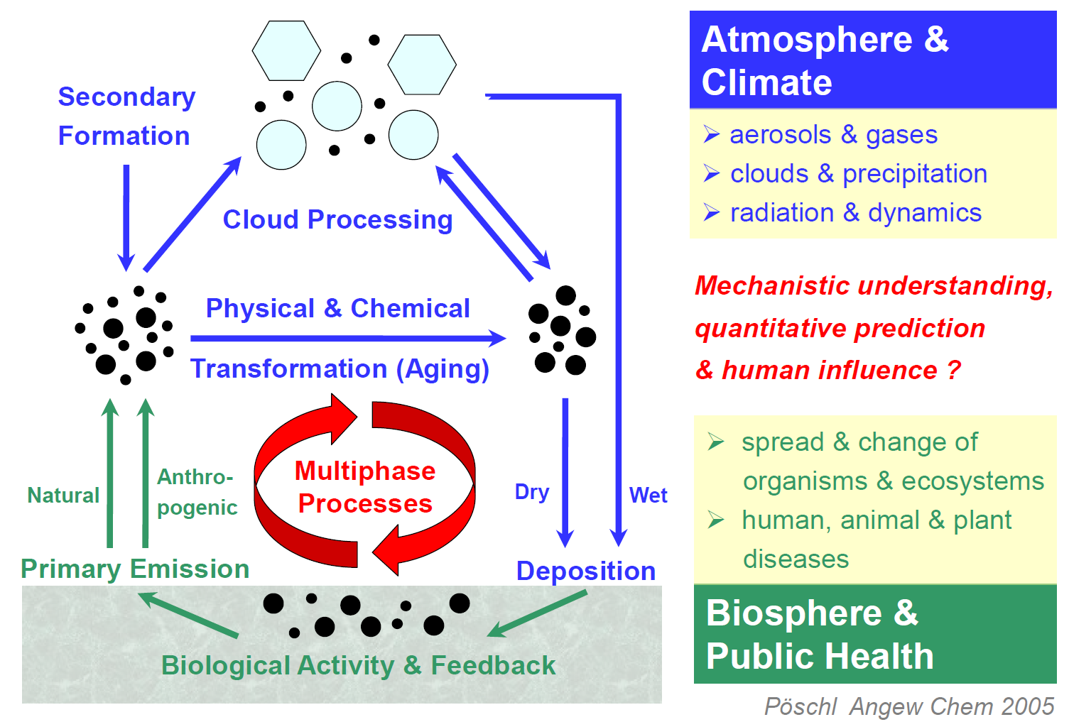
Aerosol cycling in Amazonia
Uli Pueschl, 2012

Slide 11
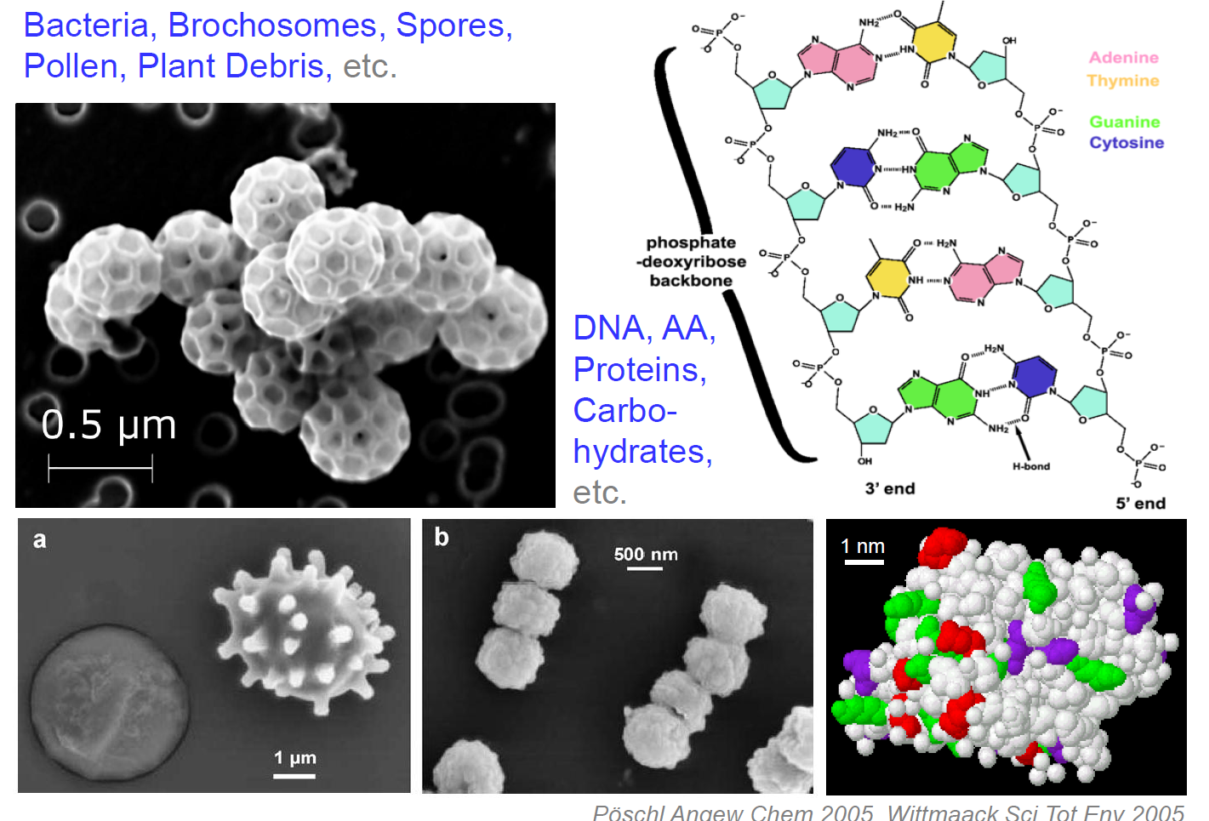
The biology of aerosol particles
Uli Pueschl, 2012

Slide 12
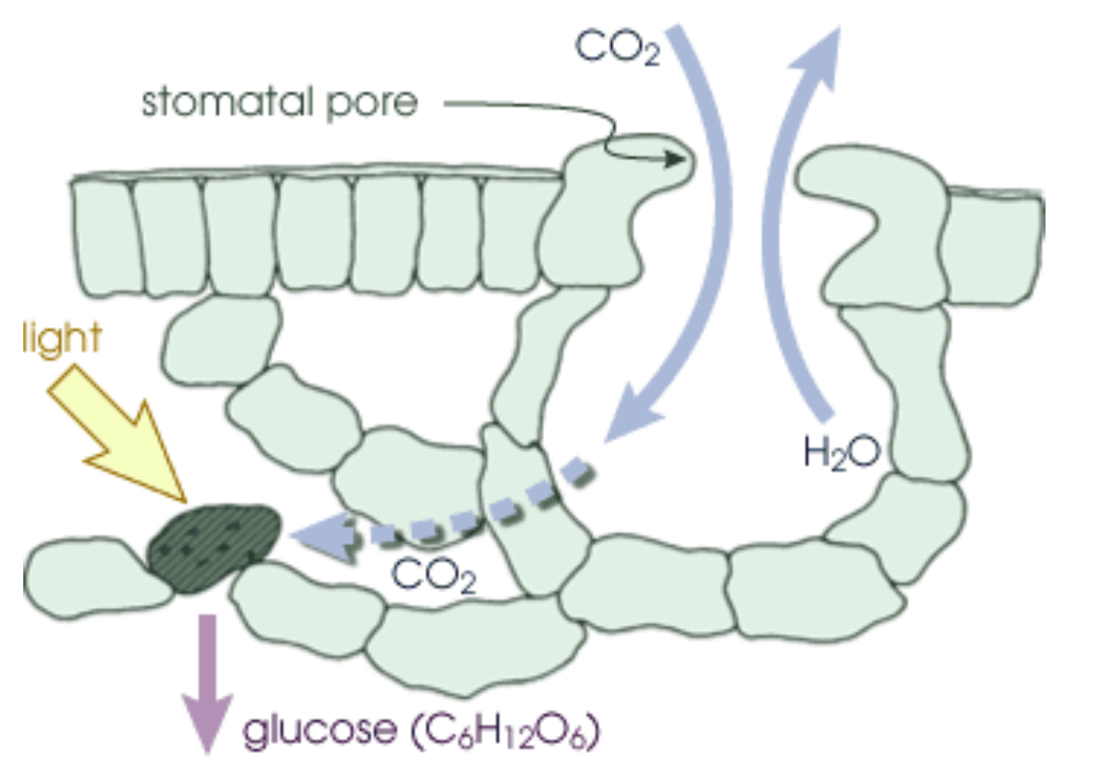
Photosynthesis: where radiation meets life
During photosynthesis, plants absorb carbon dioxide and sunlight to create fuel, glucose and other sugars for building plant structures. This process forms the foundation of the biological carbon cycle.

Slide 13

The climate system – HadGEM2
CLIMATE
Direct and
Indirect Effects
Greenhouse Effect
Human
Emissions
AEROSOLS
GHG’s
Fe deposition
CH₄, O₃,
Oxidants:
OH, H₂O₂
HO₂,O₃
DMS,
Mineral dust
CO₂
Human
Emissions
Human
Emissions
CHEMISTRY
Biogenic Emissions:CH₄
Dry deposition: stomatal conductance
ECOSYSTEMS
Land-use
Change
Where is the biological functioning of our world?

Slide 14
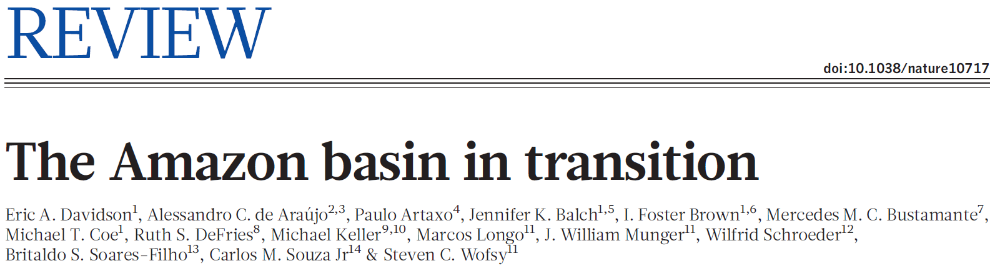
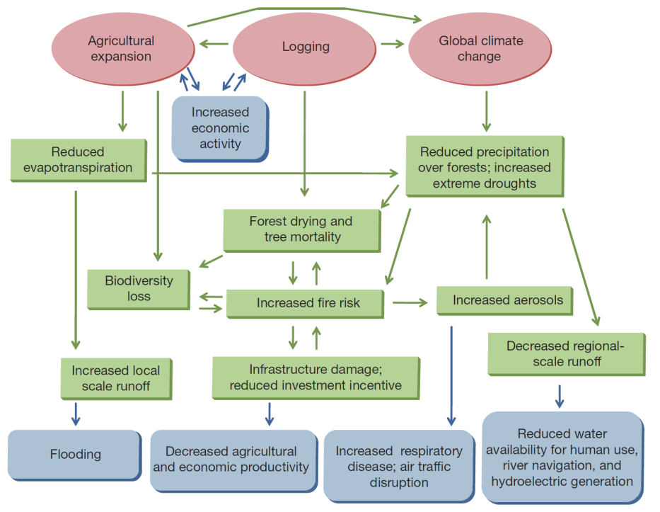
A expansão da agricultura e a variabilidade climática são agentes importantes nas alterações que estão ocorrendo no ecossistema amazônico. Em partes da região é possível observar sinais de transição para um regime dominado pelas alterações ambientais. Estes sinais incluem mudanças no balanço de energia e hidrológico na porção sul e este da Bacia Amazônica.
Interações entre mudanças globais, mudanças de uso do solo, queimadas, hidrologia, ecologia e dimensões humanas na Amazônia
Forçantes são indicadas por ovais vermelhos. Processos são as caixas verdes e consequencias estão nas caixas azuis.

Slide 15
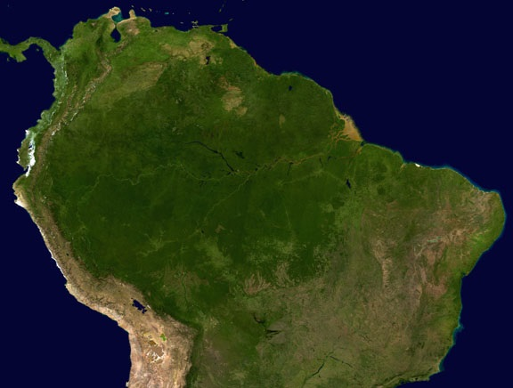
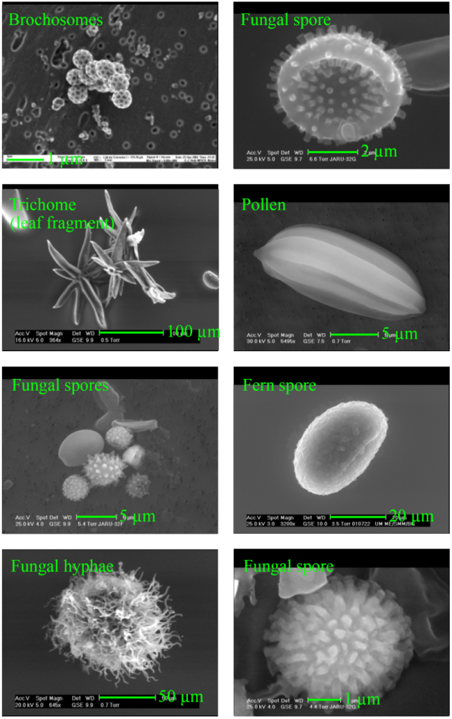
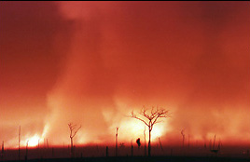
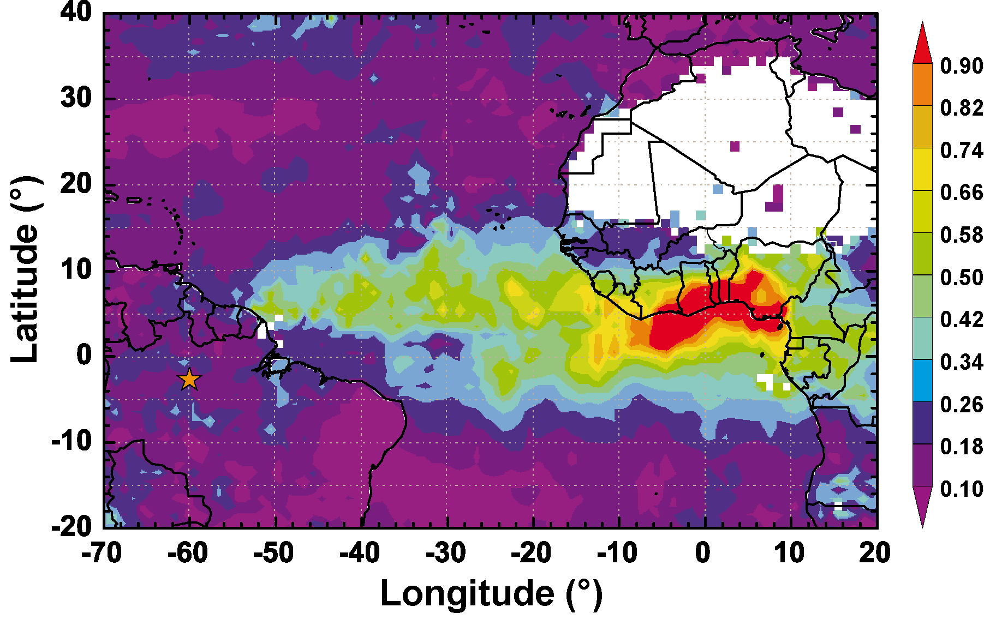

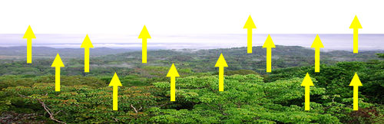
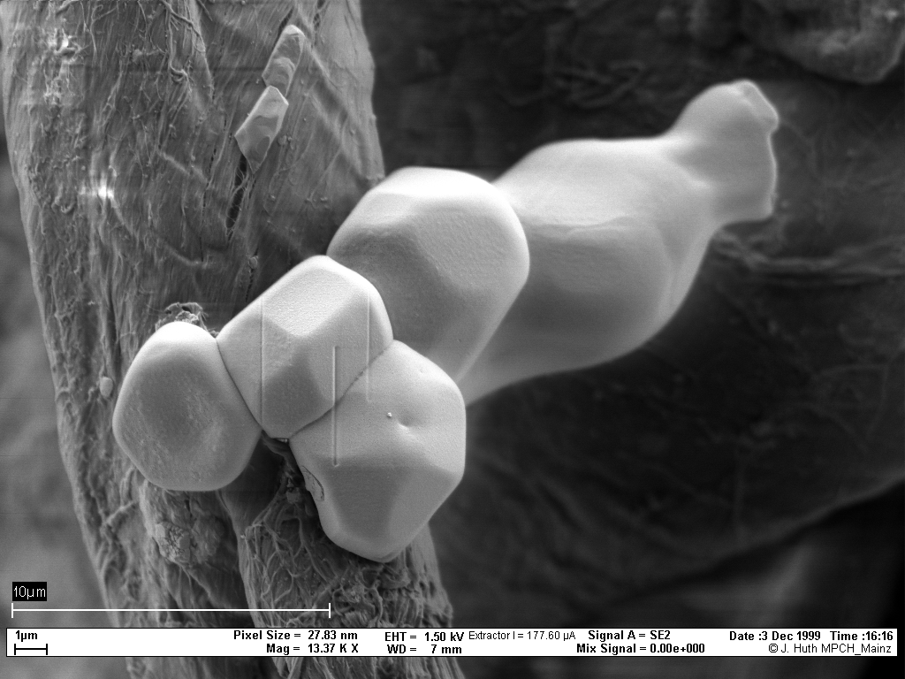
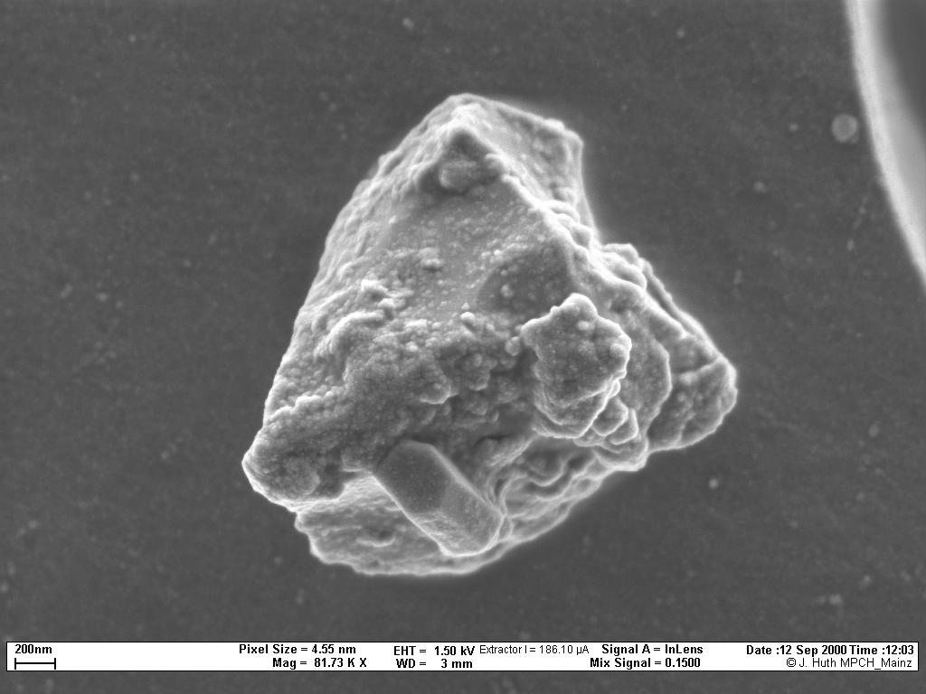
Amazonia: 3 types of aerosol particles
Biogenic (primary and SOA)
Biomass Burning
Dust from Sahara
Each with VERY different properties and impacts
Size: from 1 nanometer to 10 micrometers

Slide 16
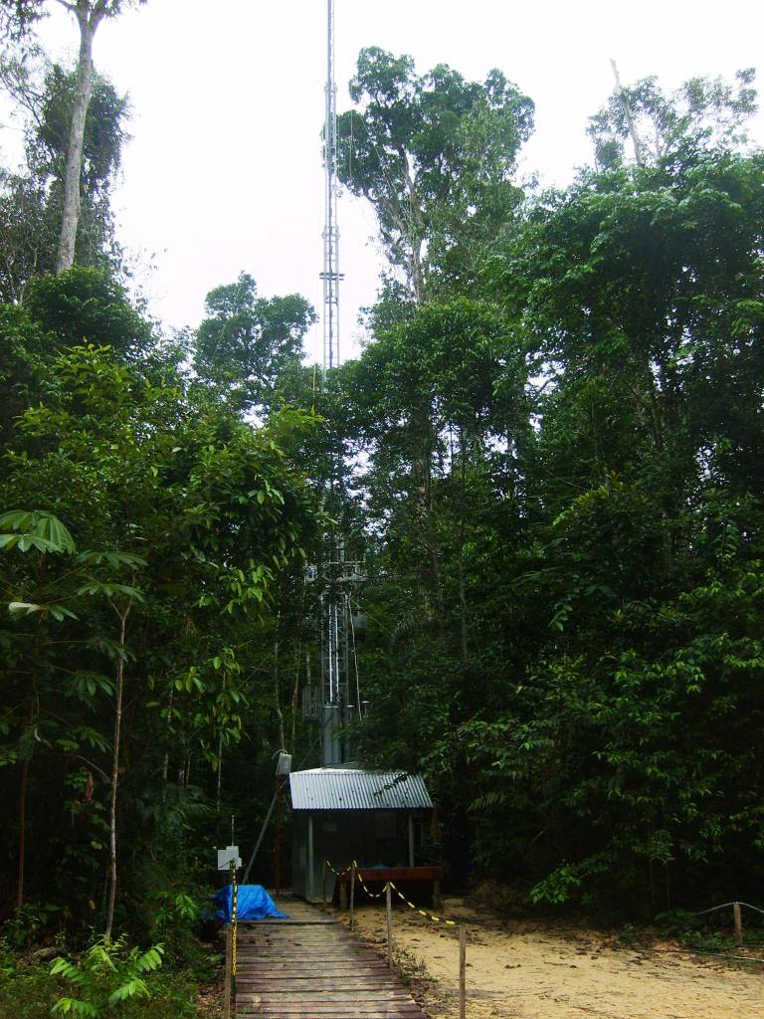
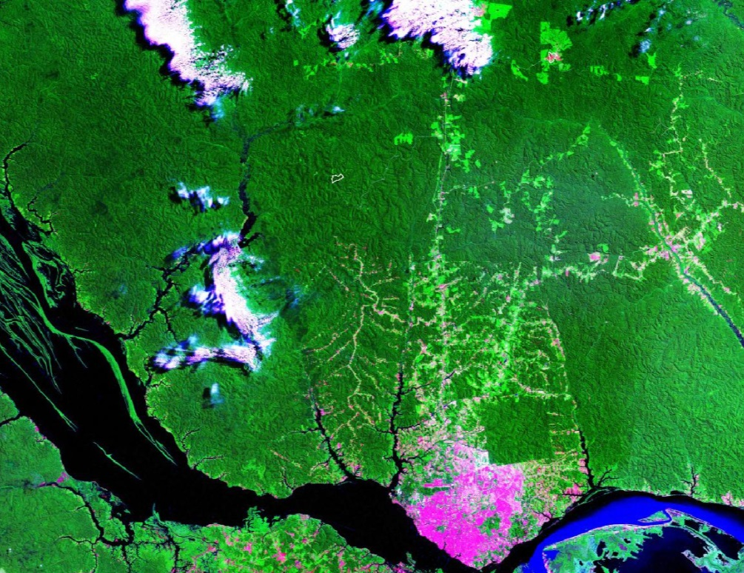
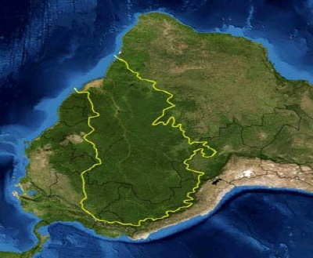
The measurement
site in Central Amazonia
Rbio Cuieiras
Manaus
Dry aerosol (RH<40%)
Site continuously operational since Feb 2008.

Slide 17
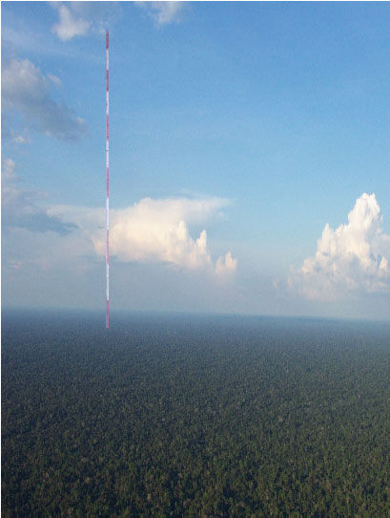
Amazon Tall Tower Observatory - ATTO: Picture of the 85 meters tower that is being used for aerosol and trace gas measurements and the proposed 320 tall tower under construction.

Slide 18
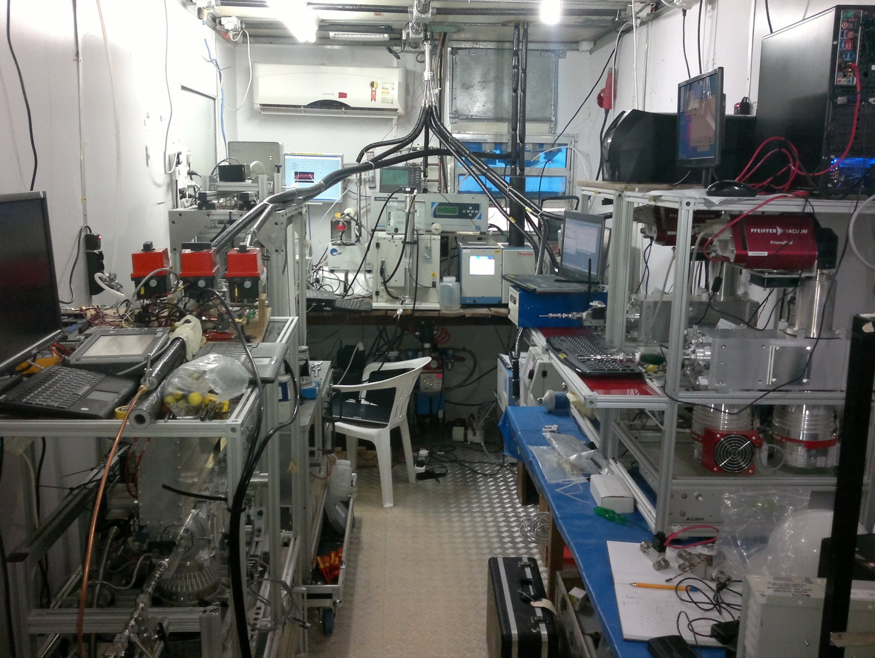
Manaus aerosol and trace gas measurements

Slide 19
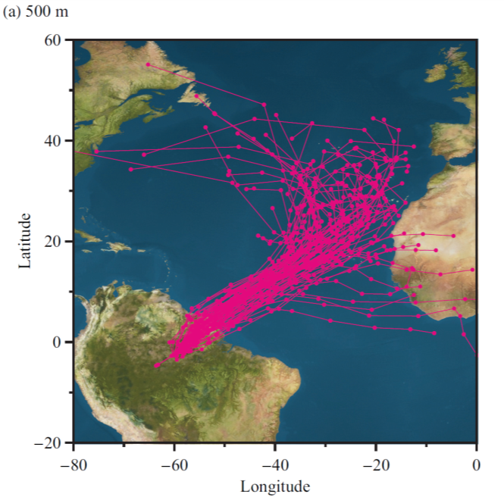
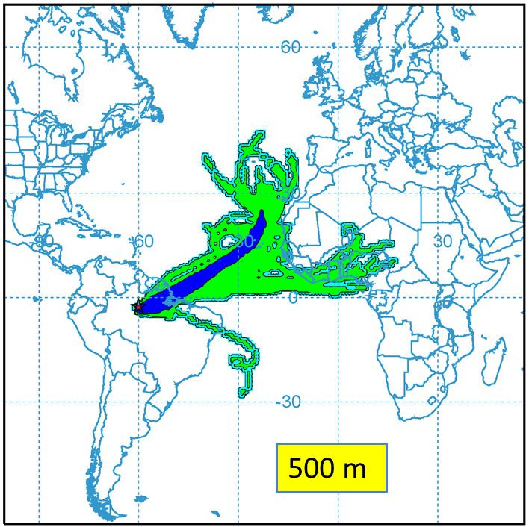
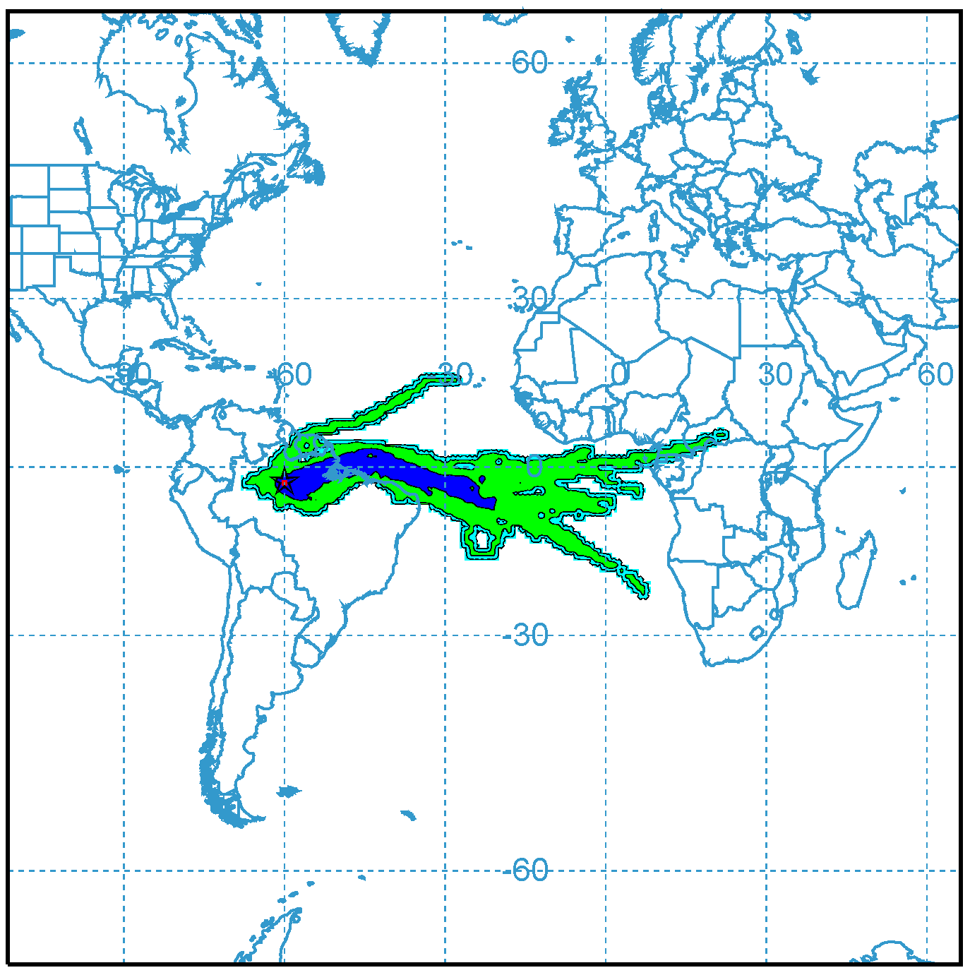
Air Mass Trajectories (10 days) and Footprint
Manaus Footprint
Manaus Footprint
500 m November
500 m - May

Slide 20
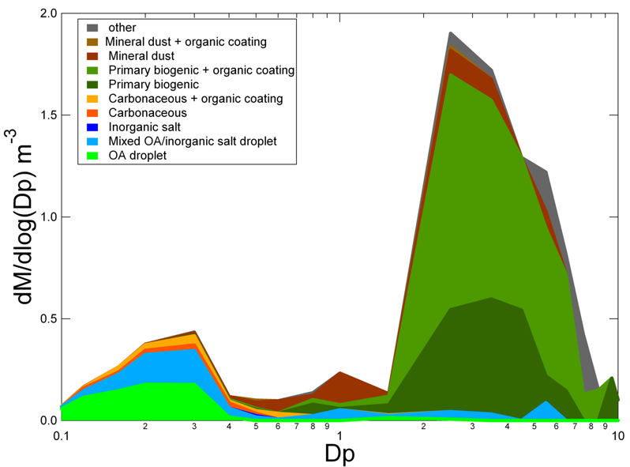
Particles in clean air over Amazon
Mass/size distribution
Biological, chemical, and physical processes over the Amazon form a closely coupled system
Martin et al., 2010, Pueschl et al., 2010

Slide 22
New particle formation? Bursts of particles 10<D_{p}<30 nm.
Aerosol size distributions measured in 2009 Apr 4th. There was a burst of ultrafine particles from 2:00 to 4:00 UTC time.
New particle formation and subsequent growth was seldom observed along two years of measurements. Nevertheless, in 70% of the days, bursts of particles with diameters in the range 10-40nm were detected. The events usually lasted from 20 to 120min, and the subsequent growth to larger sizes was not always clearly observed.

Slide 23
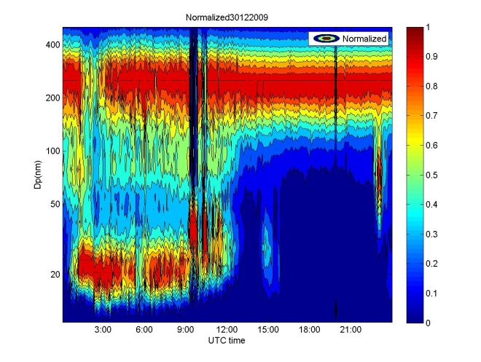
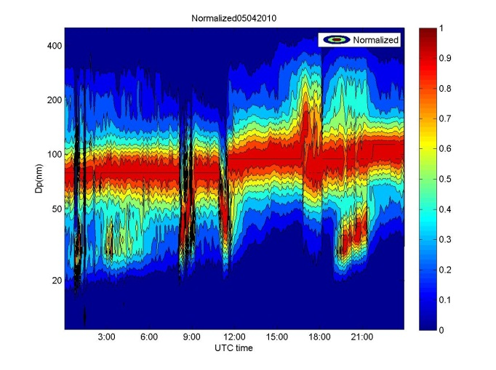
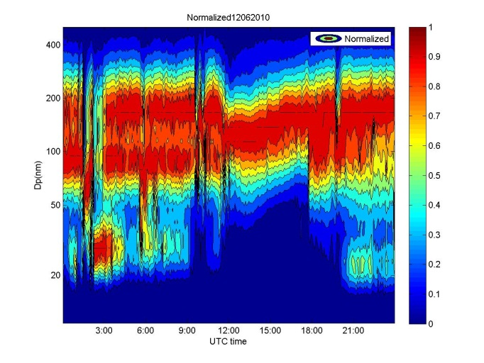
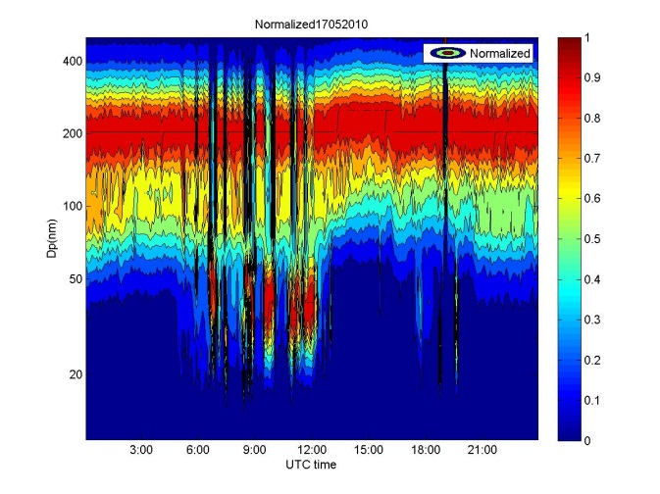
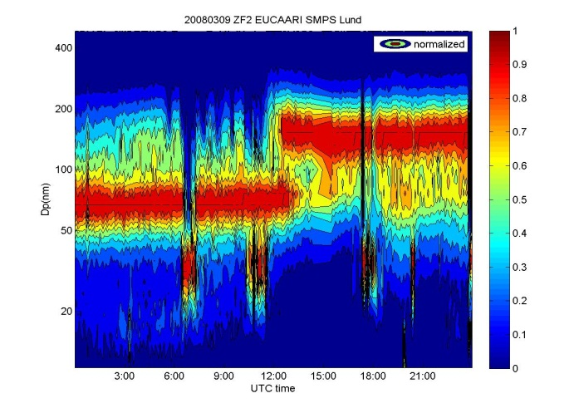
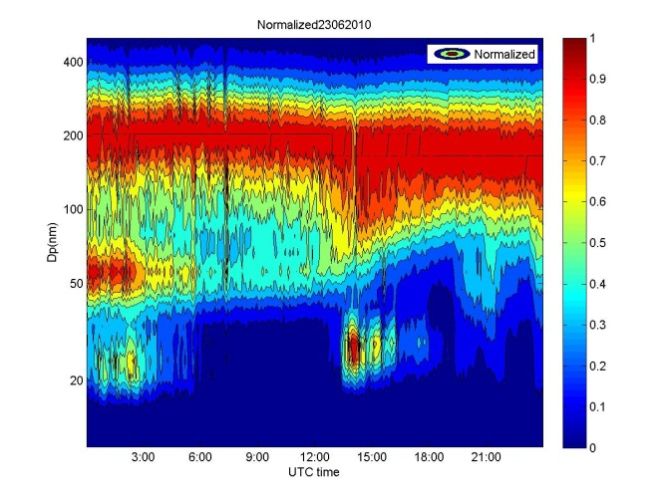
Particle bursts 20-30 nm at nighttime

Slide 24
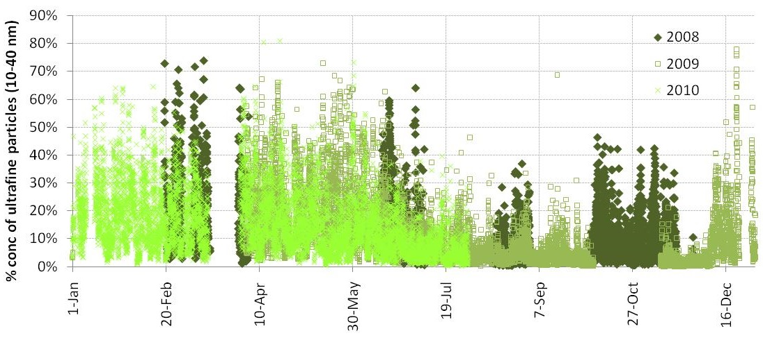
Percentage of particles with diameter from 10 to 40 nm
When this number is higher than 20%, an event of particles at 20 nm was observed.

Slide 25
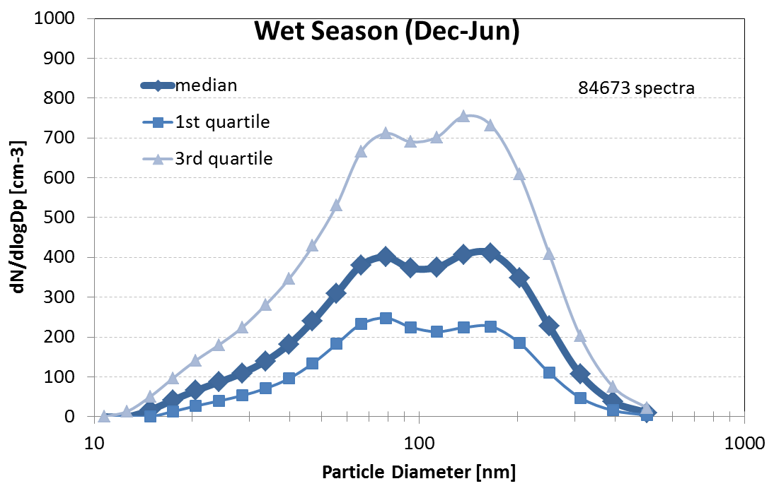
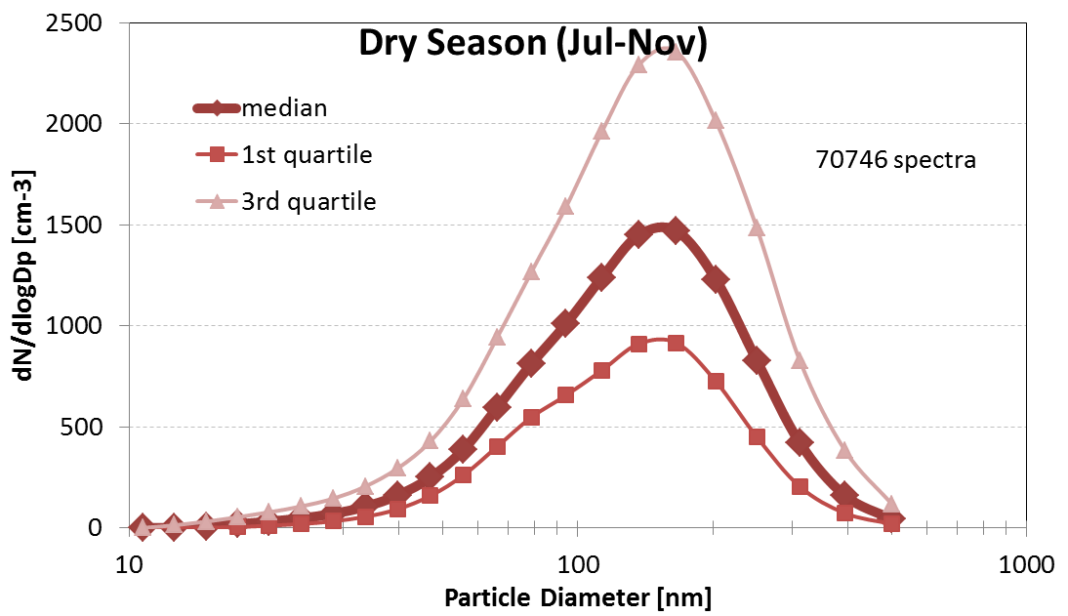
Manaus aerosol size distributions 2008-2011
Wet season
Dry season
Fit Parameters for median size distributions:
 | Ultrafine mode |  |  | Aitken mode |  |  | Accumulation mode
 | N1 [cm-3] | Dpg1 [nm] | sg1 | N2 [cm-3] | Dpg2 [nm] | sg2 | N3 [cm-3] | Dpg3 [nm] | sg3
Wet season (Dec-Jun) | 121 | 34.9 | 0.28 | 314 | 71.0 | 0.20 | 403 | 163.5 | 0.24
Dry season (Jul-Nov) |  |  |  | 926 | 117.3 | 0.36 | 699 | 175.9 | 0.22

Slide 26
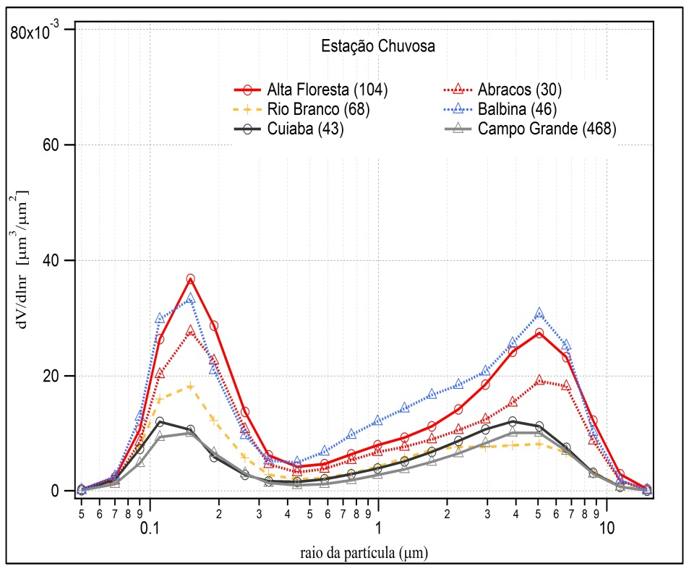
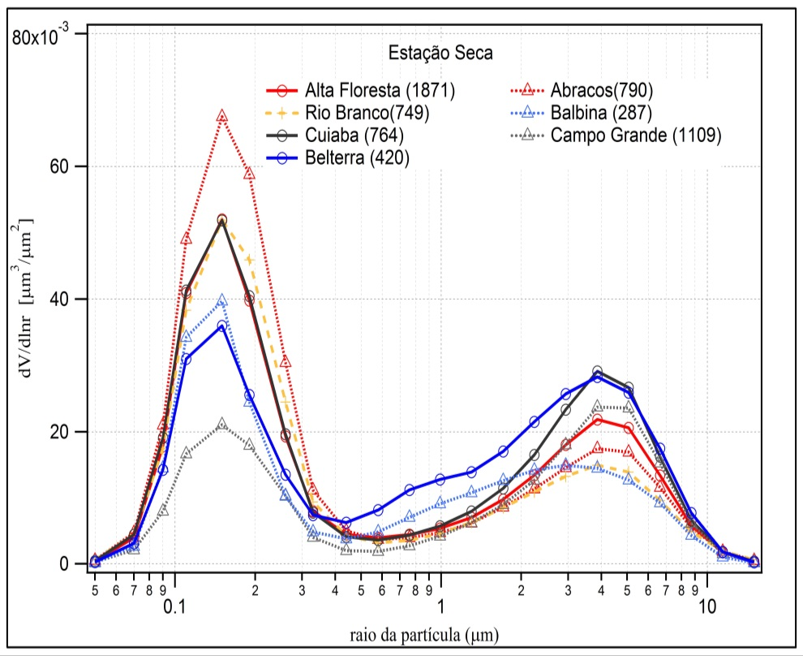
AERONET size distributions
BB/SOA
SOA
PBP
PBP
Size distribution Wet Season
Dry Season
AERONET size distribution similar with ground based SMPS

Slide 27
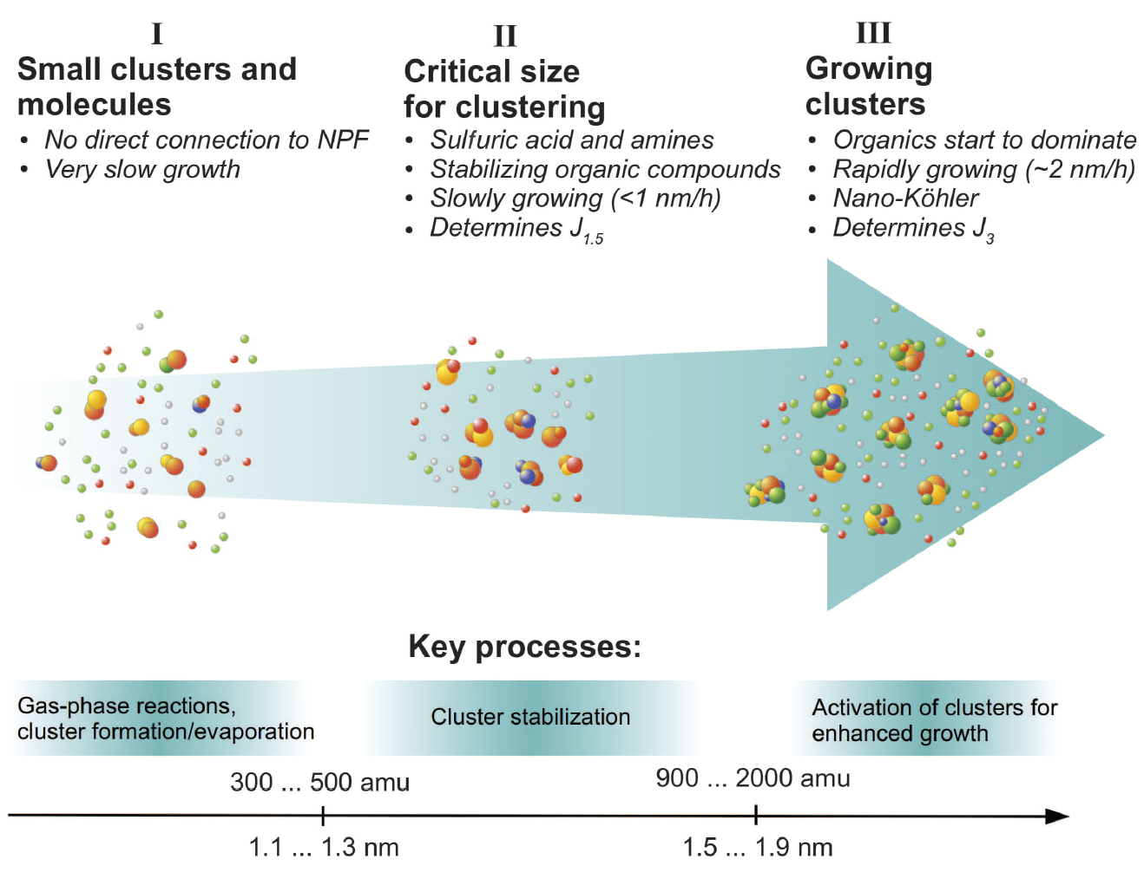
No new particle formation observed at surface under pristine conditions in Amazon
New particle formation: a two-step process:
1st step: sulfuric acid and amines, ammonia, or organic vapor form stable clusters
2nd step: organic vapor leads to enhance growth rate of the clusters to larger sizes.
Kulmala et al., 2013
Why no new particle formation?
Low SO₂ concentration (20-30ppt) suggests the concentration of H₂SO₄ is low
Organic concentration may be low for the growth of stable clusters.
What is the impact of Manaus plume on NPF?

Slide 28
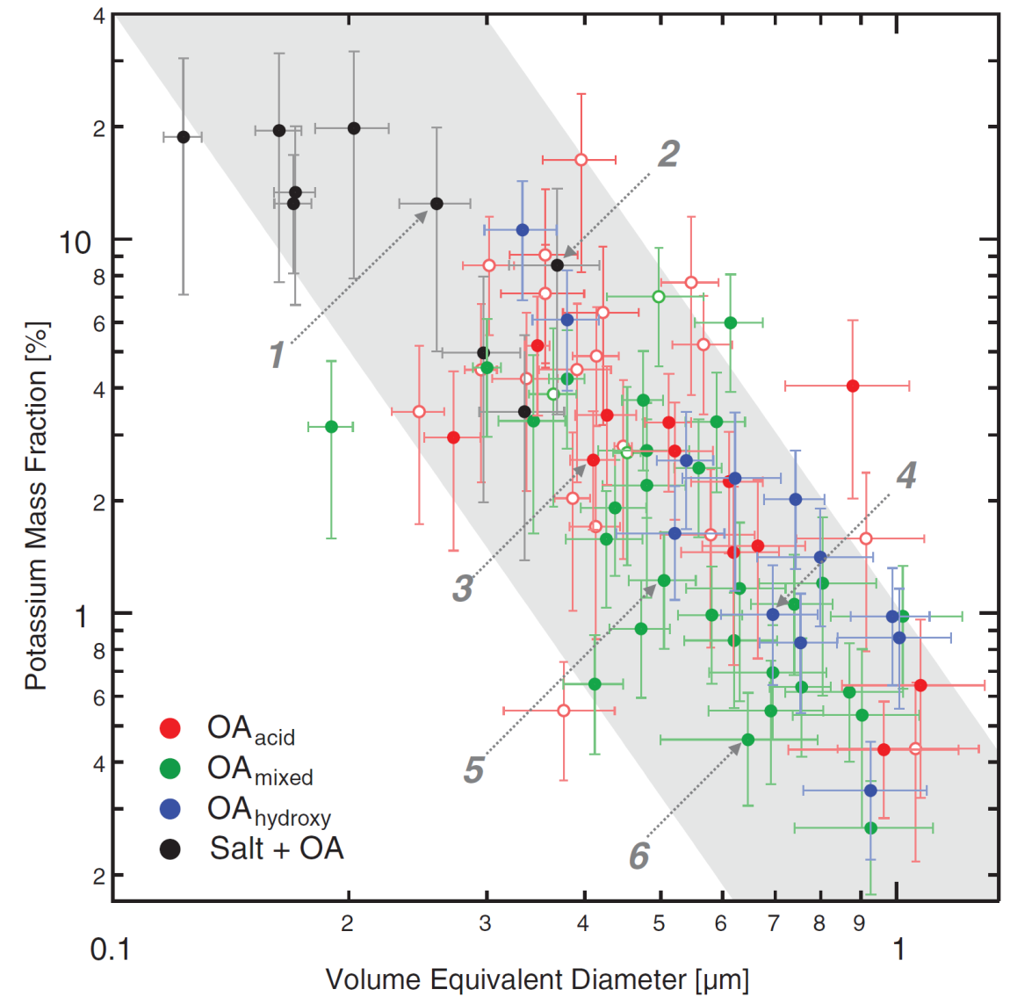
Size dependence of potassium mass fraction in Amazonian organic aerosol particles
Chris Pöhlker et al.,
Science 2012
STXM-NEXAFS shows that 95% of particles contains K, even SOA with dp 20-40 nm
The growth of organic aerosol particles can be initiated by potassium-salt–rich particles emitted by biota in the rainforest

Slide 29
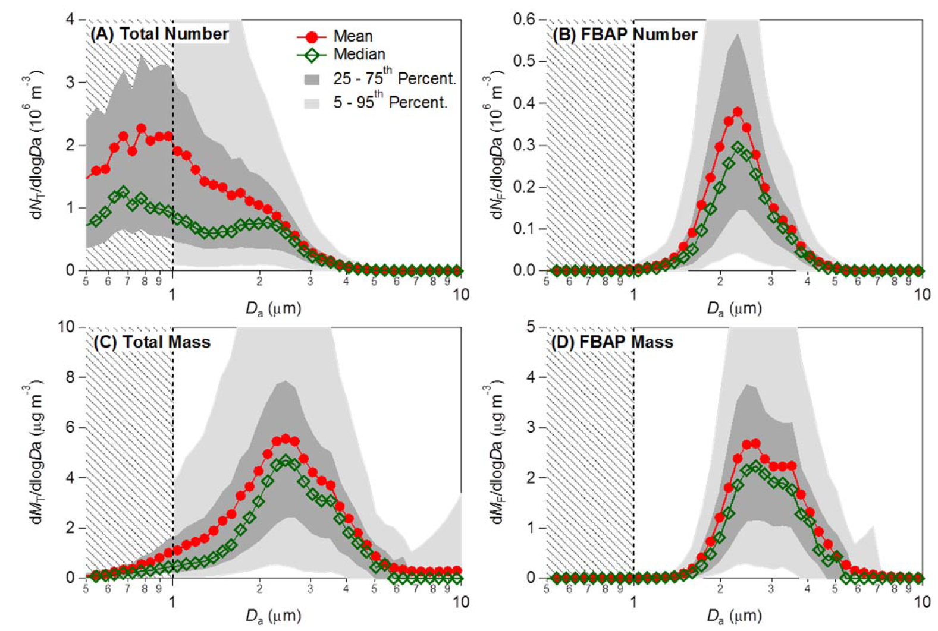
UV-APS Aerosol size distribution and UV fluorescence
Alex Huffman, ACPD 2012
(A) total number (dNT/dlogDa), (B) FBAP number (dNT/dlogDa),
(C) total mass (dMT/dlogDa), (D) FBAP mass (dMF/dlogDa).

Slide 30
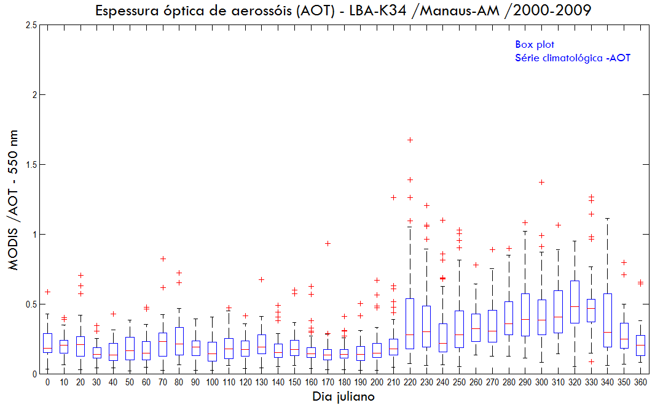
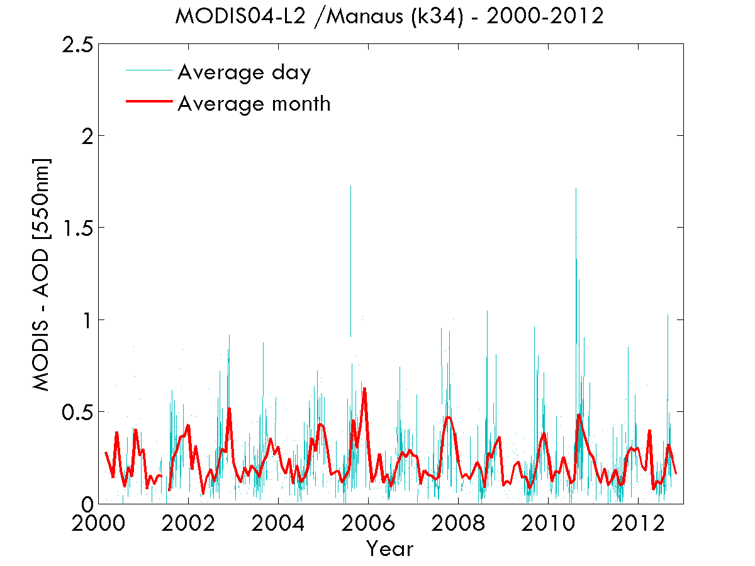
Aerosol Optical Thickness in Manaus – MODIS 550 nm
(b)
(a)

Slide 31

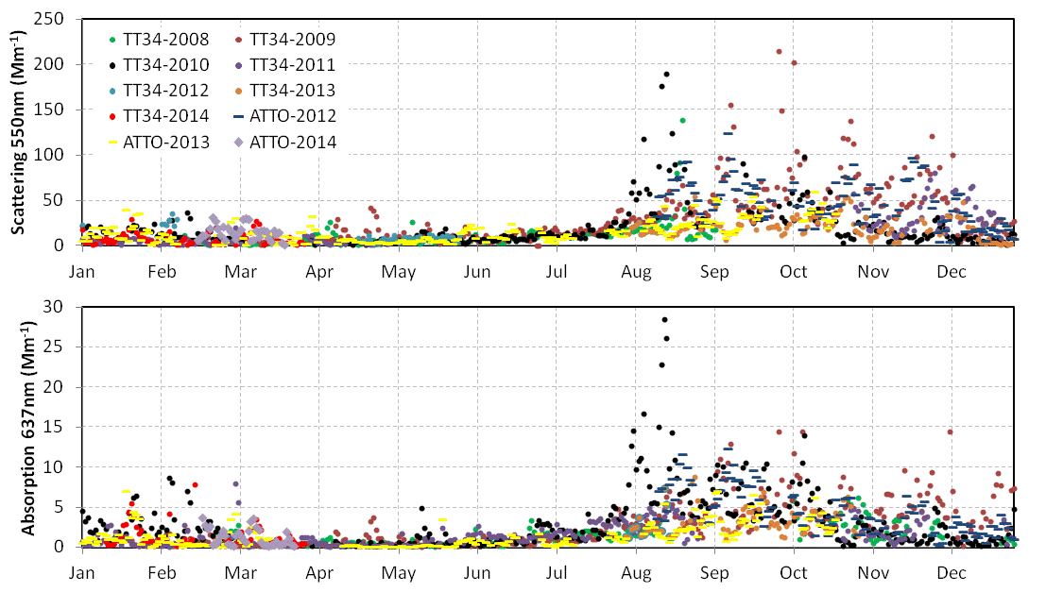
Scattering and absorption daily median comparison (2008-2014)
All data corrected for STP (1013 mbar, 0C).
Notes:
Dry season: ATTO and TT34 are very similar (regional biomass burning emissions dominate particle optical properties).
Wet season: occasional differences between ATTO and TT34. All data corrected for STP (1013.25 mbar, 0oC). Scattering corrected for truncation error.

Slide 32
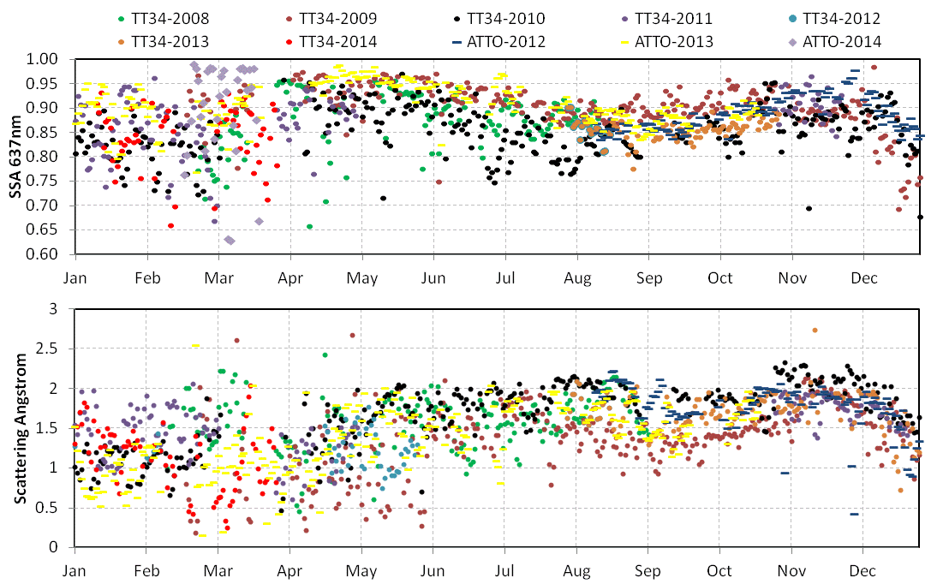
Single scattering albedo and scattering angstrom daily median comparison (2008-2014)
Notes:
Wet season: Single Scattering Albedo and Angstrom exponent are noisier at both sites, partly due to low aerosol loadings and prevailance of coarse mode particles. All data corrected for STP (1013.25 mbar, 0oC). Scattering corrected for truncation error.

Slide 33
Scattering, absorption and SSA in Manaus and Porto Velho
Monthly statistics (2009 – 2012) for light scattering coefficient σ_{s} at 637 nm and light absorption coefficient σ_{a} at 637 nm in Mm⁻¹ for Porto Velho (PVH, in black) and central Amazonia (TT34, in red).
Single Scattering Albedo Lower at the pristine site
Artaxo et al., 2013

Slide 34
Manaus organic aerosol wet season measurements
Brito et al., 2013

Slide 35
Organic aerosol measurements in Rondonia
Brito et al., 2013

Slide 36
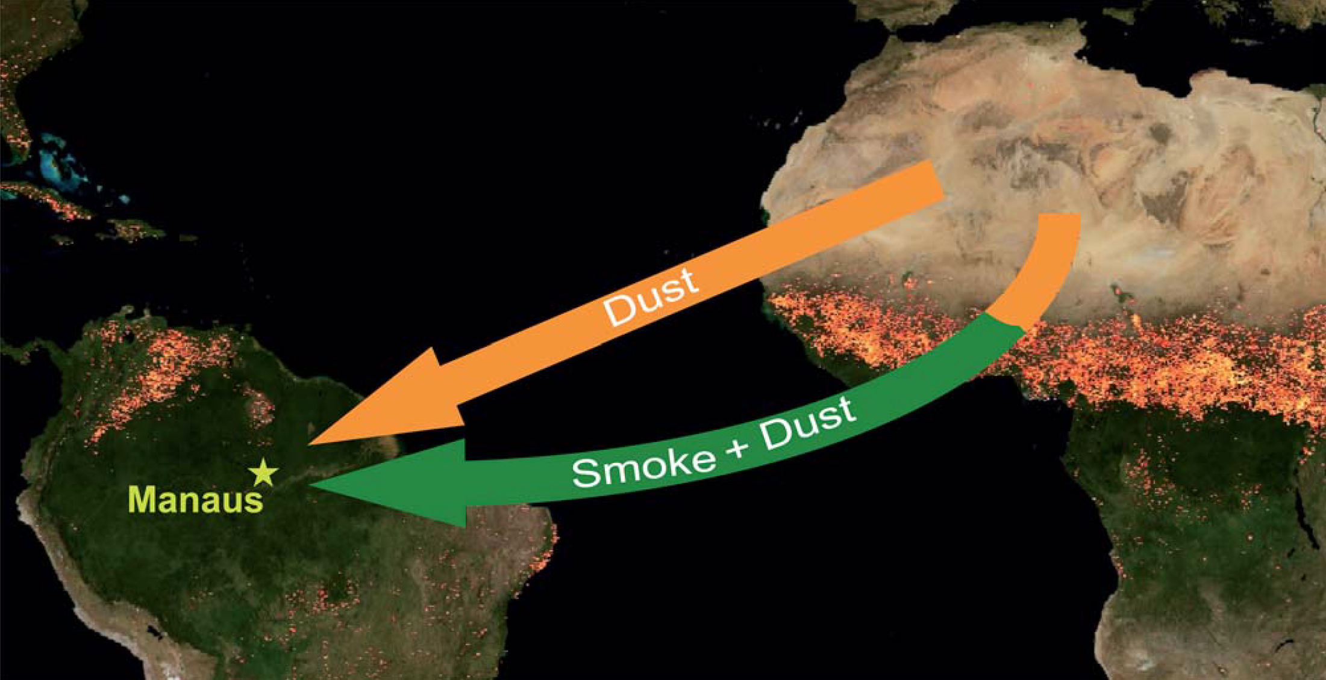
Long range transport of Sahara desert particles to Amazonia

Slide 37

African aerosol in central Amazonia
Smoke and dust AOD for the 17 observation cases in 2008 indicating the advection of African aerosol toward Amazonia (Baars, 2011).

Slide 38

Deforestation was reduced from 27,700 Km² in 2004 to 4,500 Km² in 2012.
A very dynamical system, and we need to know what effects on the ecosystem these changes have produced

Slide 39

Espessura ótica de aerossóis em 550 nm 1999-2012 em Porto Velho, Rondonia

Slide 40



Large scale aerosol distribution in Amazonia
Severe health effects on the Amazonian population (about 20 million people)
Climatic effects, with strong effects on cloud physics and radiation balance.
Changes in carbon uptake and ecosystem functioning

Slide 41




Pyrocumulus clouds
Hydrological cycle critical for Amazonia
Natural clouds

Slide 42

Aerosol particle acting as cloud condensation nuclei
Water vapor
Correct atmospheric thermodynamics conditions
All non linear processes

Slide 43
Amazonia is critically important for water vapor transport in South America

Slide 44

Water lux redistribution in South America
Which processes controls this transport?
José Marengo, INPE

Slide 45


Relationship between aerosols and precipitation in the La Plata Basin
AERONET (Aerossols) +
TRMM (Precipitation) + BRAMS (simulations)
Reduction in precipitation with increase in aerosols
BRAMS: Simulations with cloud microphysics confirm the measurements
Silva Dias et al., 2013

Slide 46


Cloud formation suppression due to biomass burning emissions
Terra and Aqua satellite images of the east Amazon basin, 11 August 2002. (A) The clouds (Terra, 10:00 local time) are beginning to form. (B) The clouds (Aqua, 13:00 local time) are fully developed and cover the whole Amazon forest except for the smoke area. The boundary between forest and Cerrado region is marked in white on both images, and the seashore is marked in green. (From Koren et al., 2004)

Slide 47

Low cloud suppression by aerosols in Amazonia
Cloud fraction as function of aerosol optical depth (OD). The cloud fraction decreases almost linearly with increasing OD. The red and blue curves denote the average of east and west areas, respectively. On average, the cloud fraction decreases to less than 1/8 of the cloud fraction in clean conditions when OD = 1. The shaded area represents the relative area covered by the respective OD, with the integral of this curve equal to one, representing the total Amazon basin. (from Ilan and Kaufman, 2003)

Slide 48

Cloud fraction and height as a function of aerosols in Amazonia
Microphysics
absorption effects
Cloud top pressure (P) vs. AOD
Cloud fraction vs. AOD.
Koren et al., Science 2008

Slide 49

Regional and global energy balance

Slide 50


Amazonia
Average aerosol forcing clear sky
INDOEX
average aerosol forcing clear sky
Top: - 10 w/m²
Top: - 7±1 w/m²
Atmosphere: + 28 w/m²
Atmosphere: + 16±2 w/m²
Surface: - 38 w/m²
Surface: - 23±2 w/m²
Conditions: surface: forest vegetation
AOT (τ=0.95 at 500nm); 24 hour average
7 years (93-95, 99-02 dry season Aug-Oct)
Conditions: surface: ocean
AOT (τ=0.3 at 630 nm); 24 hour average
Jan-Mar 99
Procópio et al. (2006), Artaxo et al., (2009)

Slide 51

Average spatial distribution of the direct radiative forcing (DRF) of biomass burning aerosols in Amazonia during the dry season of 2010
CERES and MODIS
Sena et al., 2013

Slide 52

Mean Diurnal Radiative Forcing due to change in surface albedo in Rondonia:
-7.3 + 0.9 W/m²
Mean Diurnal Aerosol Forcing Efficiency:
Forest: -22.5 + 1.4 W/m²
Cerrado: -16.6 + 1.7 W/m²
Water column difference by 6-10%
Forcing of water vapor column: -0.4 to -1.2 W m⁻²
Land-use change radiative forcing. Forested areas are selected in red and deforested areas are selected in yellow.
Sena et al., 2013

Slide 53

Aerosol Effects on
Net Plant Productivity
CO₂ Concentration
Aerosol Concentration
+
-
+
Temperature
+
+
+?
Photosynthesis
BVOC emissions
+
Kulmala et al., 2004

Slide 54

Experimento de exclusão de chuvas em Caxiuanã e Santarem
Florestas intactas são resistentes a secas sazonais, mas começam a morrer depois de alguns anos sucessivos de secas seguidas.
Nepstad et al (2007), Ecology, Fisher et al. (2007), Global Change Biology, Brando et al (2008), Philosophical Transactions of the Royal Society B, Sotta et al. (2008), Global Change Biology

Slide 55

Tendência de biomassa, 123 RAINFOR plots 1980-2004
Gain = 0.93+0.30 t ha⁻¹ a⁻¹
^{RAINFOR,} ^{unpublished data}

Slide 56



Sensibilidade da Floresta Amazônica à secas
Annual aboveground biomass change during the 2005 interval.
Effect of the 2005 drought in the carbon balance in Amazonia
Phillips et al. 2009 Science

Slide 57
Fortes efeitos dos aerossóis na fotossíntese
Increase in aerosol loading

Slide 58



Effects of aerosol particles on carbon uptake by the forest: Diffuse radiation plays a major role
Rondonia
(Glauber Cirino, 2014)
Manaus

Slide 59


Observations and Modeling of the Green Ocean Amazon
GoAmazon2014 (US-DoE)
GoAmazon2014
Green Ocean Amazon 2014
Carbon Cycle Cloud Life Cycle Aerosol Life Cycle
Climate
Ecosystems
Atmospheric Composition

Slide 60

GoAmazon Experiment 2014-2015
Interactions of the urban plume of Manaus with the forest producing secondary organic aerosols, ozone and others

Slide 61

Sites
T0-ATTO
T0-ZF2
T0-EMBRAPA
T3 - Manacapuru
T2 - Tiwa

Slide 62

GoAmazon T3 site: 15 containers and growing

Slide 63


Amazonia in 20 years from now?
Nepstad et al., PTRSB 2008

Slide 64

Effects of climate change in Amazonia
Complex Earth System Models are needed to study
all these interacting and simultaneous drivers
LUCC
Climate
Change
Fire
Climate
Extremes
Nobre et al., 2011

Slide 65

Earth System Modeling
We need a new way of making Science...

Slide 66


Biological, chemical, physical and social processes over the Amazon form a pretty complex coupled system
Still a lot to learn…
Thanks for the attention!!!

