Slide 1
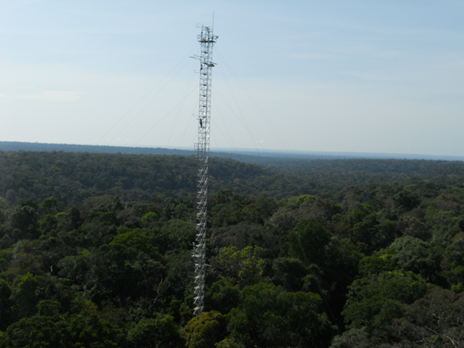




BVOC profiles at the Amazonian Tall Tower Observatory site.
AGU Fall Meeting 2013
A.M. Yañez-Serrano, A. C. Nölscher, J. Williams, K. Jardine, S. Wolff, G.A. Martins, P. Artaxo, J. Kesselmeier.

Slide 2
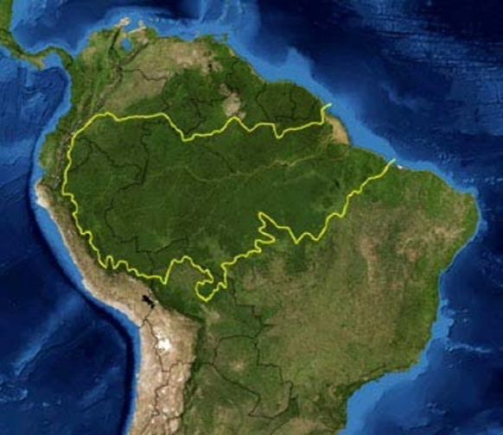
The Amazon Rainforest
Tropical photoreactor
  High temperatures
  High solar radiation
  High humidity
  High forest-atmosphere interactions
There is a strong coupling between the atmosphere and the biosphere via the hydrological cycle, radiation balance and nutrient cycles among others.
The Amazon is 50% of the world’s tropical rainforest – High density of biomass

Slide 3



Radiative Properties
Condensable vapours
Ozone
CO
CH₄
Secondary
Organic
aerosol
Organic
Aerosol
CCN
Oxidation
OH
O₃
NO₃
rain
Isoprene
Monoterpenes
Oxygenated VOC
Other BVOC
VOCs
+ NOx
BVOC from vegetation
BVOC from soil

Slide 4
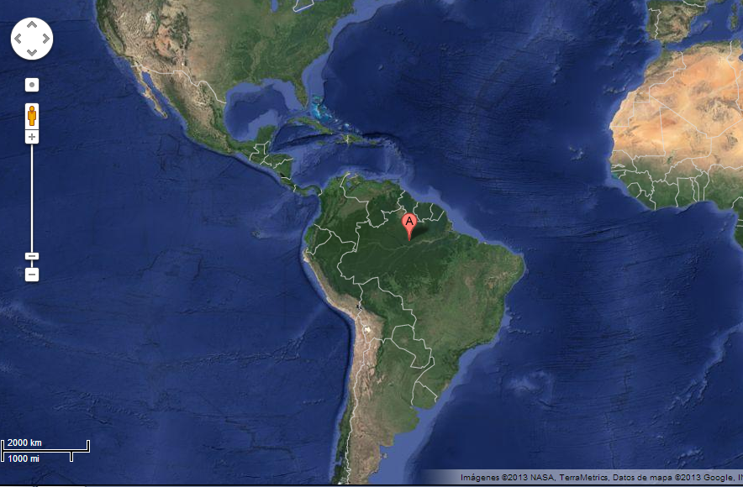
ATTO: Amazonian Tall Tower Observatory
Negligible influence from Manaus plume
Logistically viable
150 km NE of Manaus
Temperature 24-34ºC
Main wind direct. NE
Ozone 2-30 ppbV
NO 0,3-0,7 ppbV
S 02°08’38.8”
W 58°59’59.5”

Slide 5
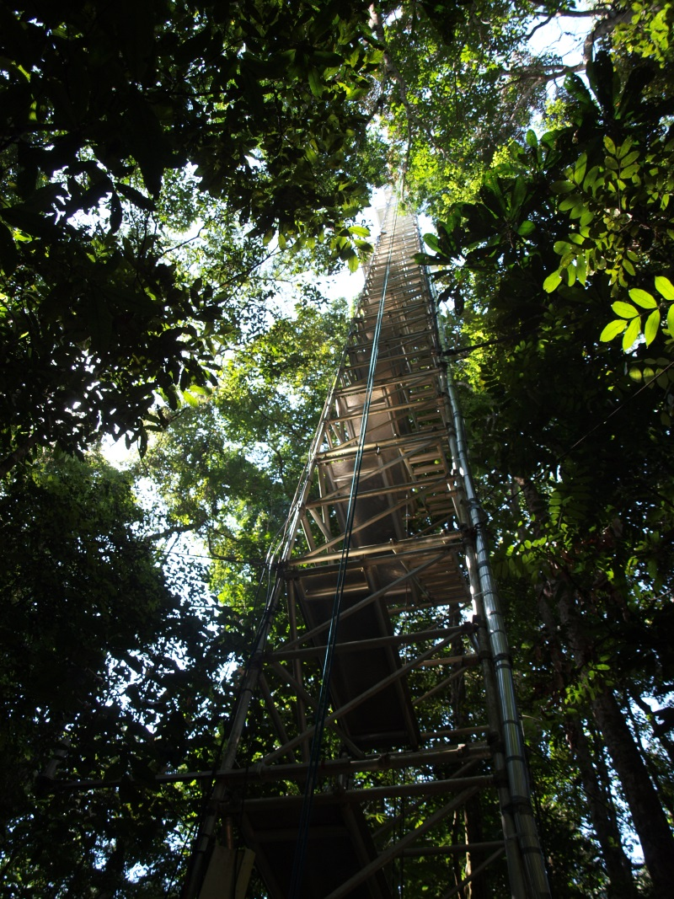
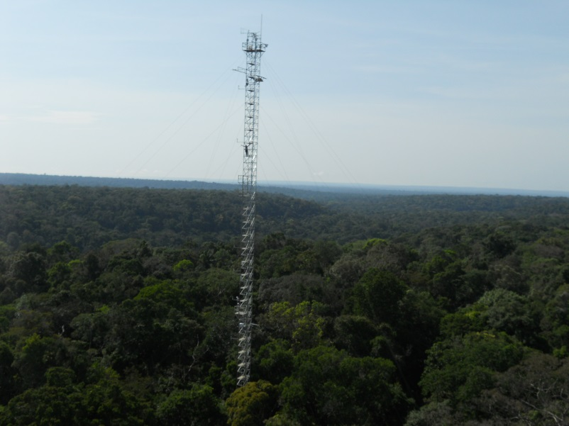
Sampling methodology
Insulated heated Teflon lines
Flushing at all times
79m
53m
The
38m
24m
12m
container
4m
0,5m
0,05m

Slide 6
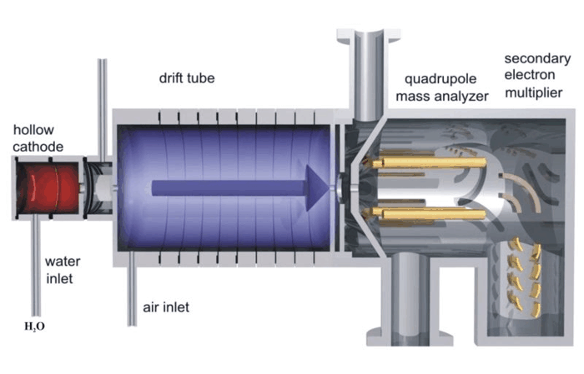
PTR-MS Proton Transfer Reaction Mass Spectrometer
Measures online VOCs at low concentrations.
Soft chemical ionization technique
Sample is protonized and mass spectrometer detects selected masses +1.

Slide 7
Time of measurements
Calibrated Compounds
m/z | Compound | m/z | Compound
45 | Acetaldehyde | 71 | Methyl vinyl ketone + Methacrolein
59 | Acetone | 73 | Methyl ethyl ketone
69 | Isoprene | 81+137 | Monoterpenes
February/March 2013 – WET SEASON
September 2013 - DRY SEASON

Slide 8
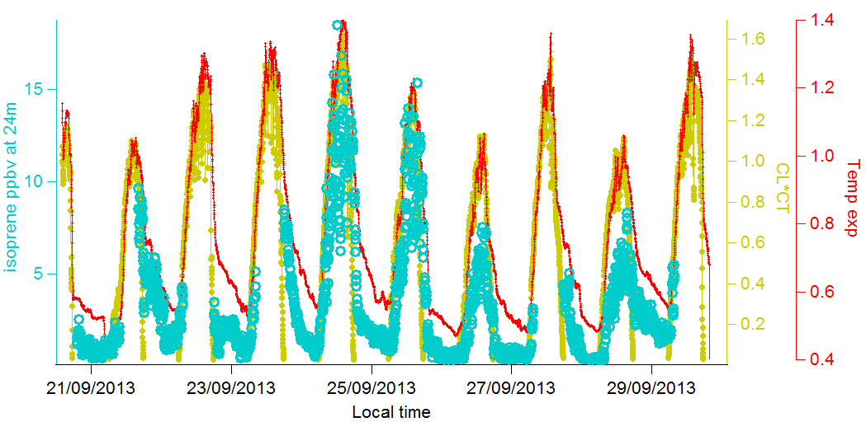
Isoprene light & temperature dependence

Slide 9
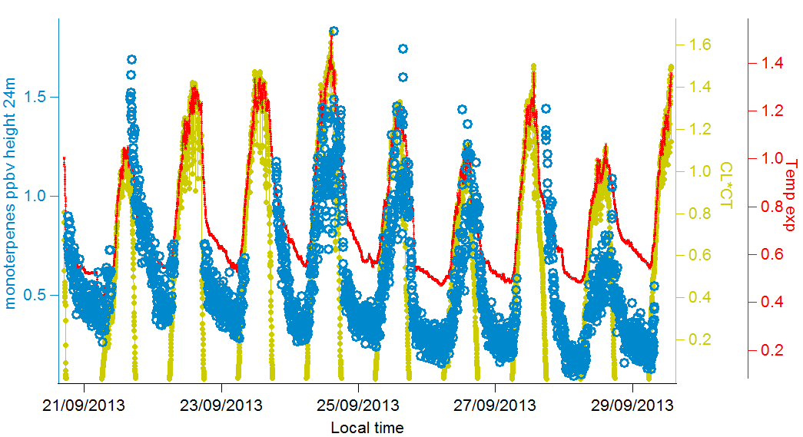
Monoterpenes light & temperature dependence

Slide 10
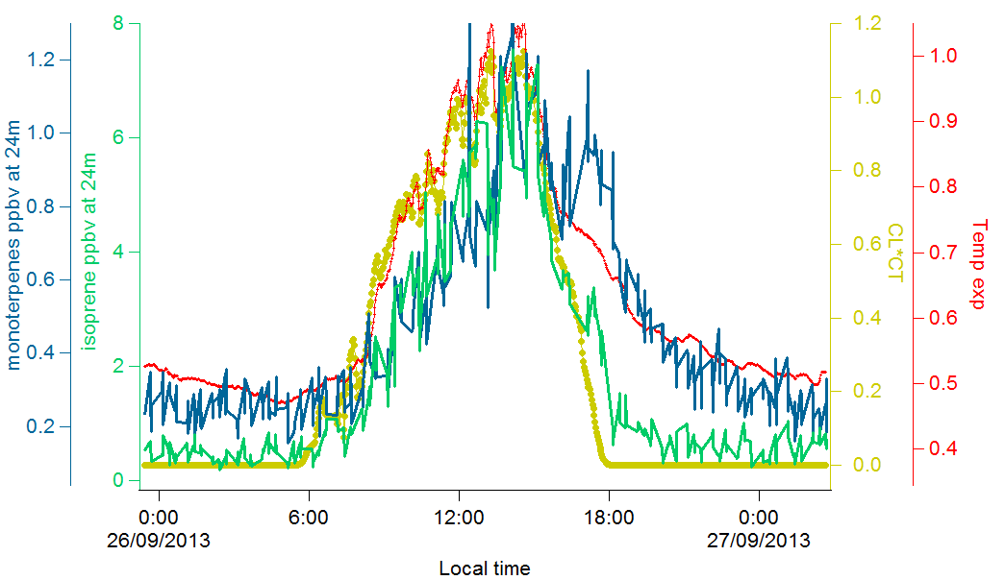
Isoprene – Monoterpene comparison to light and temperature driven emission algorithms

Slide 11
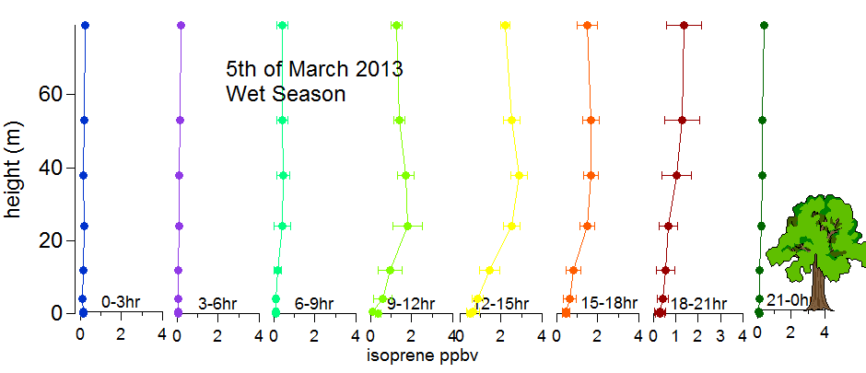
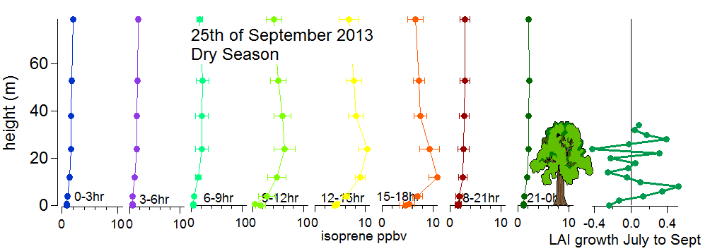
Isoprene typical day- height profile

Slide 12
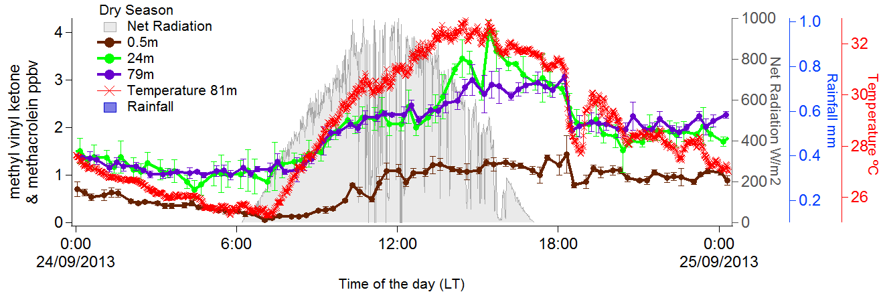
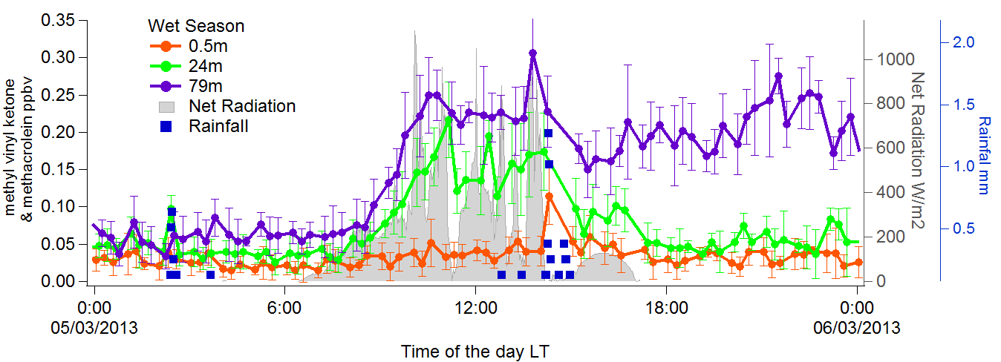
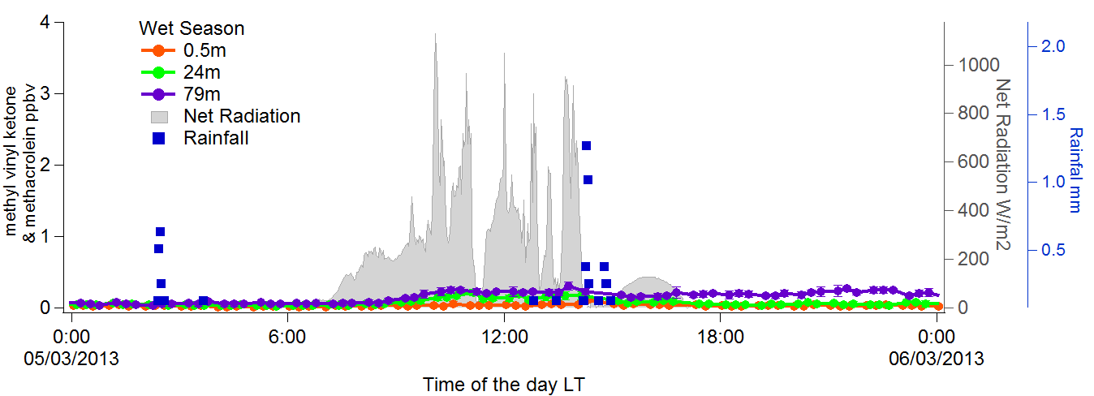
MVK+MACR: typical day

Slide 13
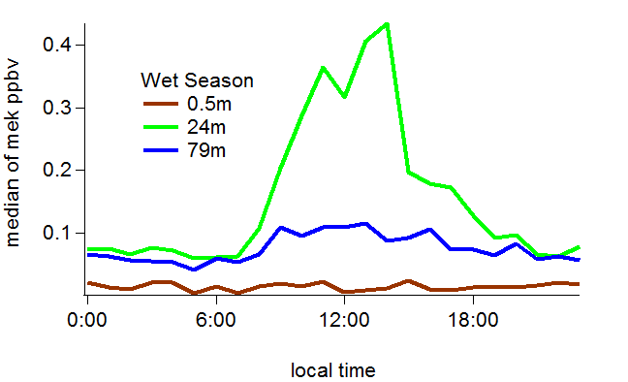
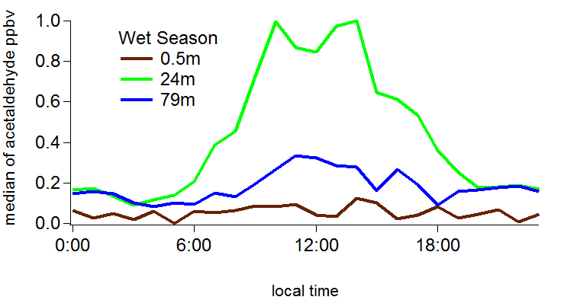
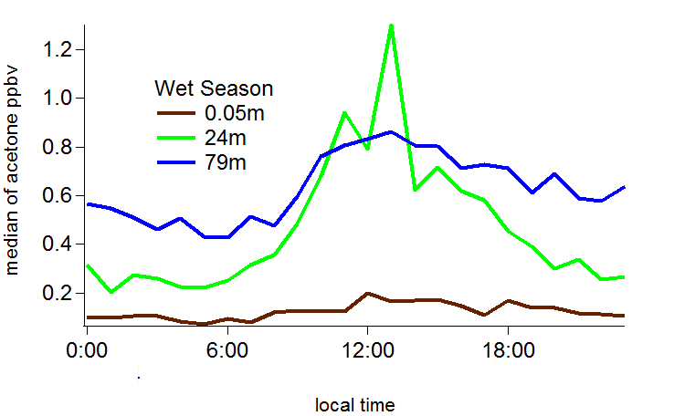
Oxygenated Compounds: houly medians WET SEASON

Slide 14
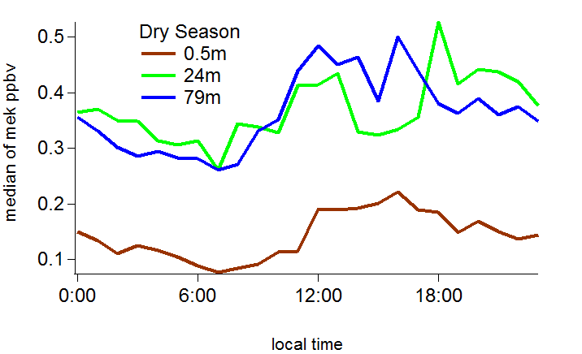
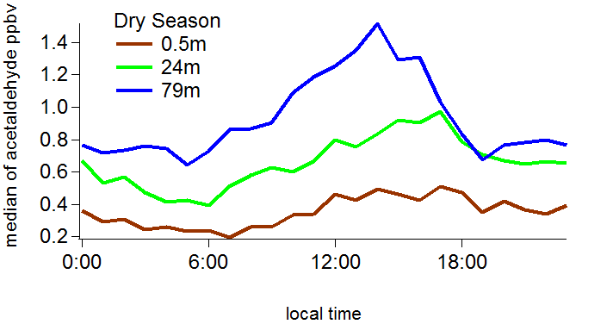
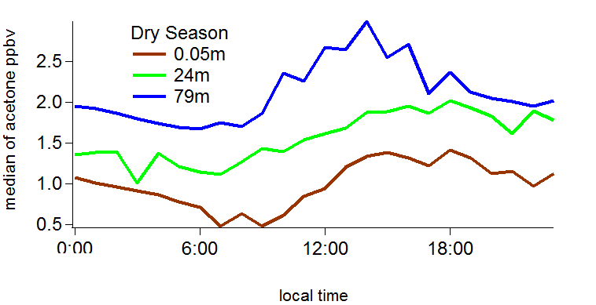
Oxygenated Compounds: houly medians DRY SEASON

Slide 15
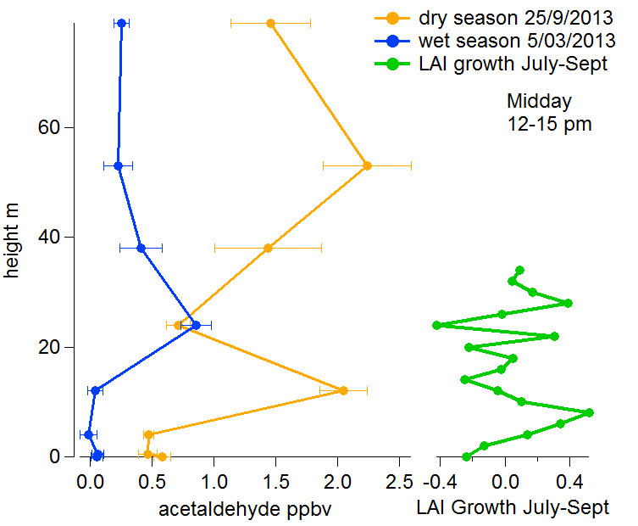
Acetaldehyde typical day height profiles at noon

Slide 16
Conclusions
Patterns of isoprene and monoterpene concentrations seem to differ in relation to their emission capacities as indicated by emission algorithms.
  May monoterpene concentrations partly be influenced by release from storage pools triggered by temperature only?
It seems that for late September 2013 the understory was more active than the top of the canopy for some compounds.
Isoprene oxidation products are directly related to the isoprene concentrations during the wet season.
  Possible direct plant emission during the dry season as well?
Oxygenated compounds seem to be related to sources of both photochemical and biological origin, differing among seasons.

Slide 17
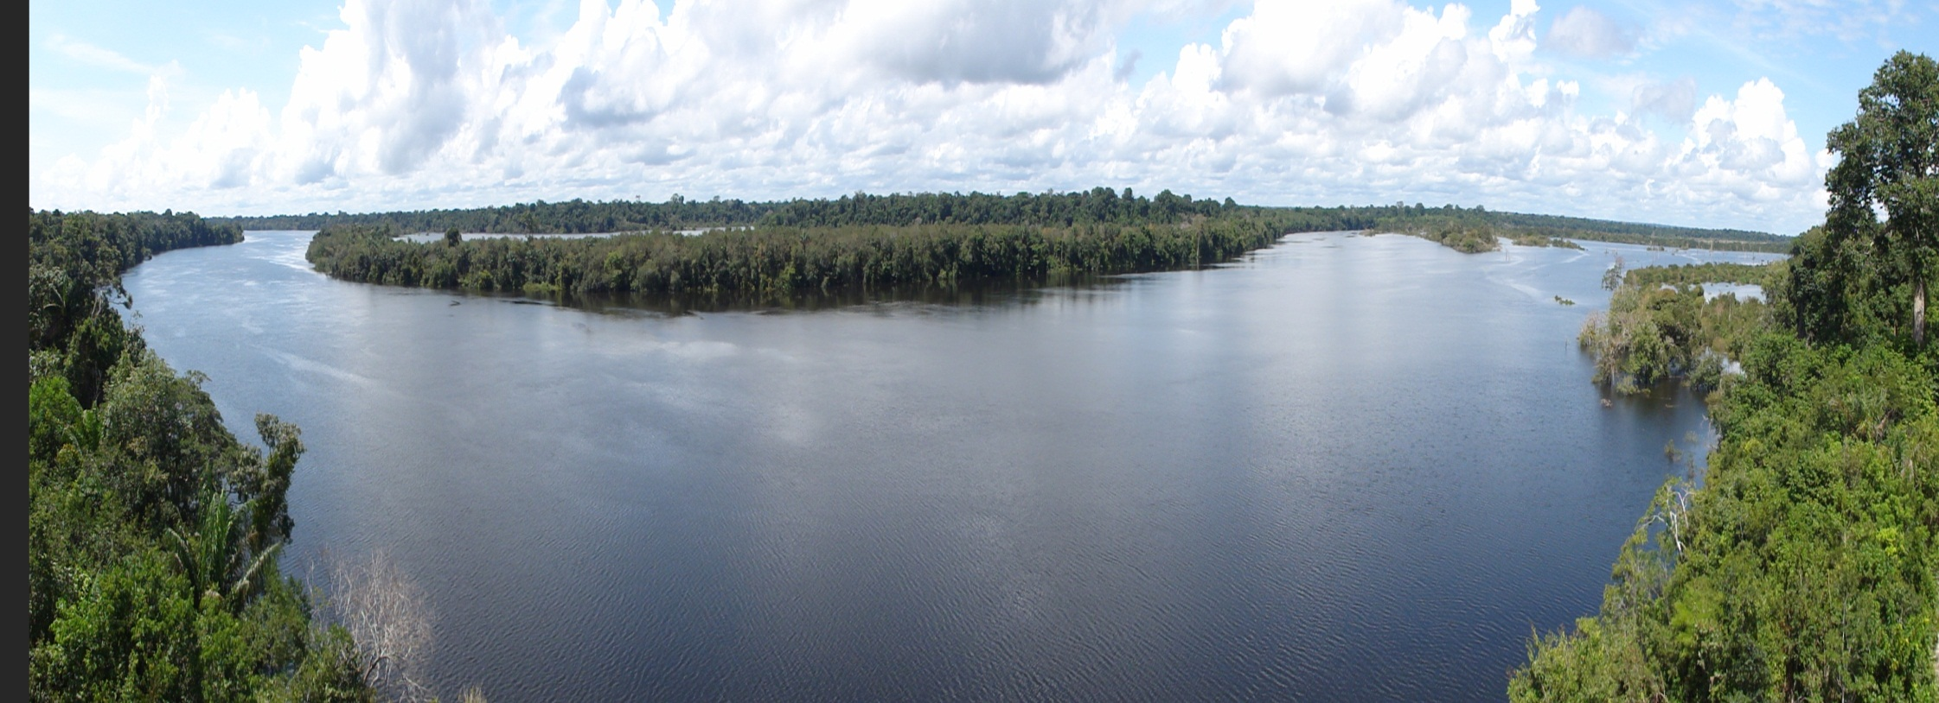
Thank you!

