Slide 1
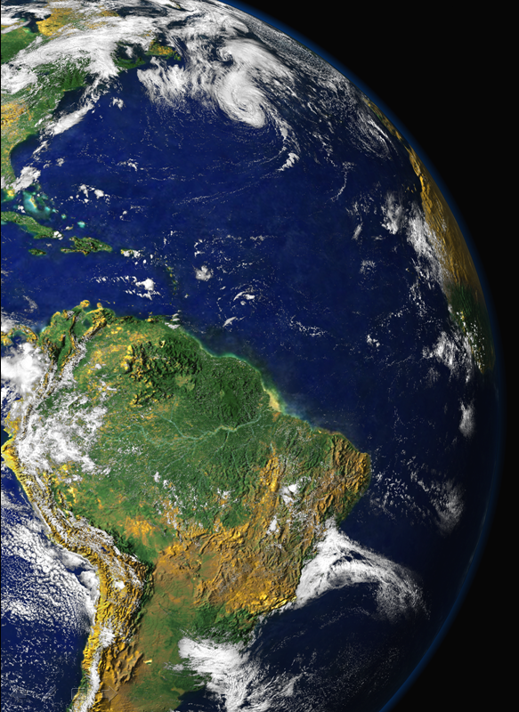
Faraday Discussions 165 – Tropospheric Aerosols Leeds, 23 July 2013
Atmospheric aerosols in
Amazonia and land use change: from natural biogenic to biomass burning conditions
Paulo Artaxo, Luciana Rizzo, Joel F. Brito, Henrique Barbosa , Andrea Arana, Elisa T. Sena, Glauber G. Cirino, Wanderlei Bastos, Scot Martin, Meinrat O. Andreae
Institute of Physics, University of São Paulo, Brazil, artaxo@if.usp,br,

Slide 2
Long term (4 years) study on land use change in Amazonia. Effects on:
Aerosol population, composition, size distribution
Aerosol optical properties
Trace gas concentrations
Radiative forcing
Carbon uptake by the forest
Interaction between forest biology and aerosols is very strong for PBAP as well as SOA

Slide 3
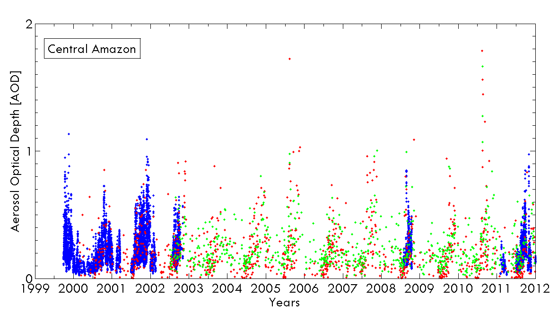
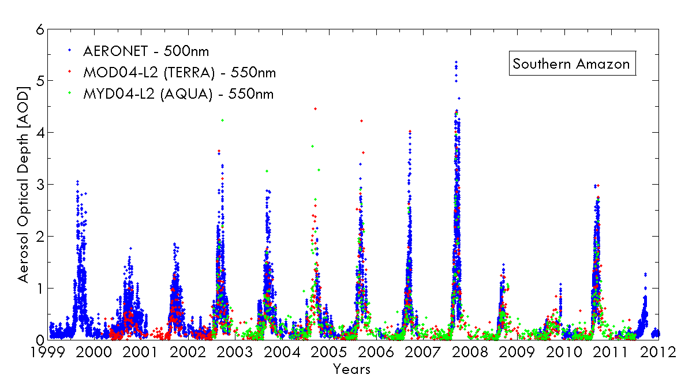
Time series of aerosol optical depth at the Central and Southern Amazonia with MODIS (550 nm) and AERONET (500 nm) retrievals from 1999 to 2012.

Slide 4
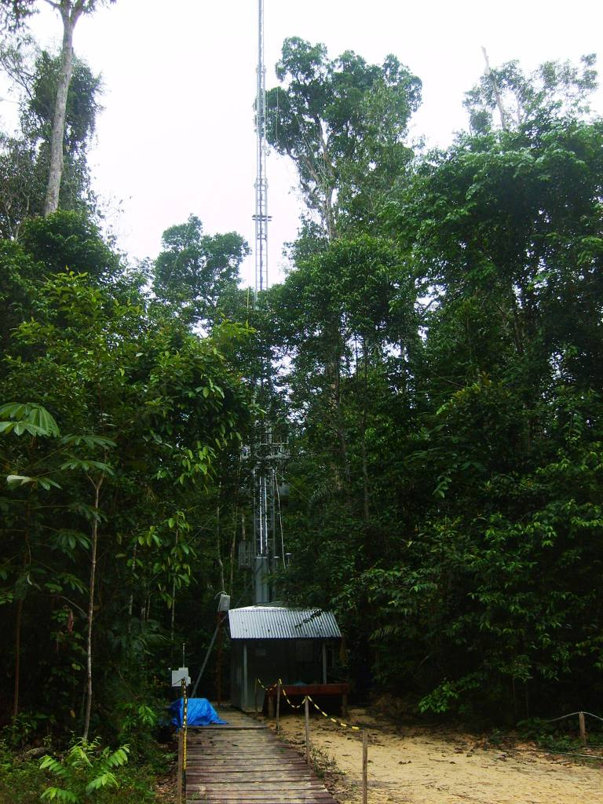
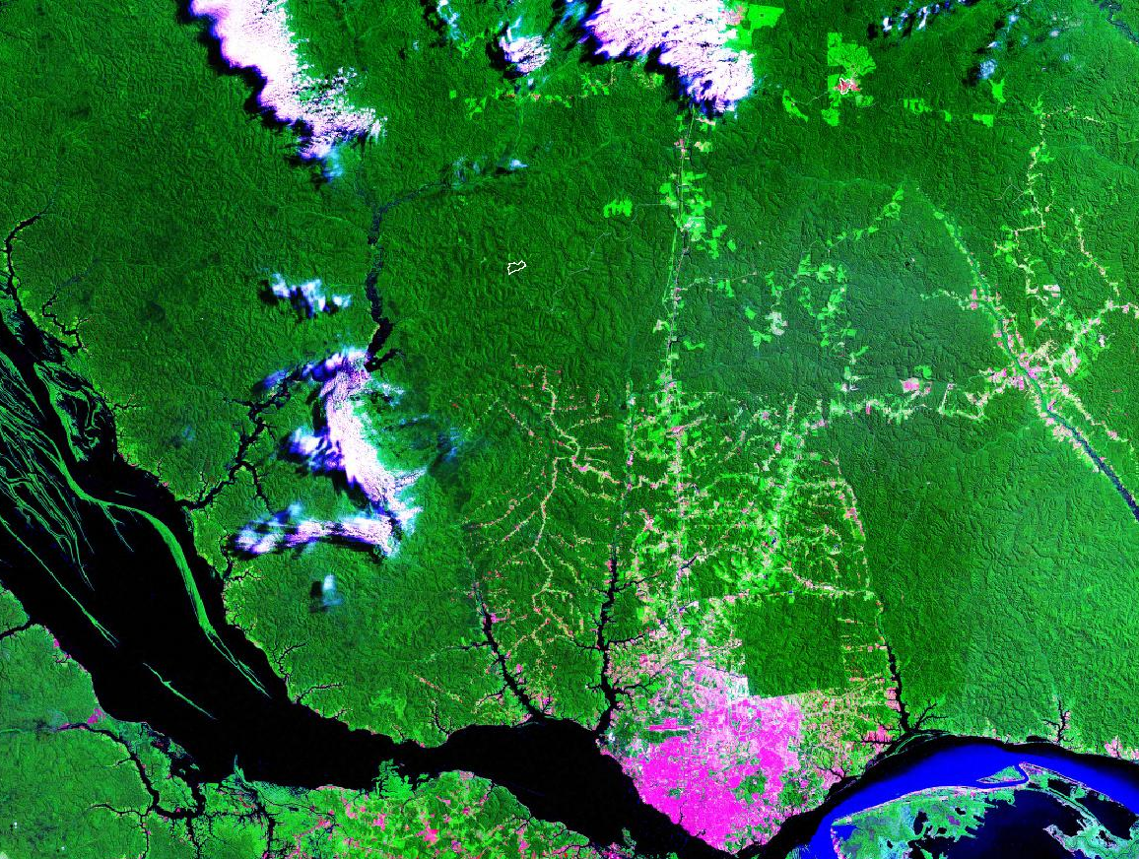
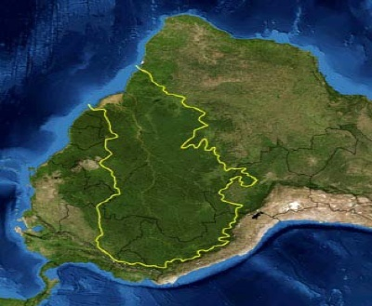
Two long term monitoring stations in Amazonia
Foto: Carina Prado
Fonte: Flávio Luizão.
Rbio Cuieiras
Rio Negro
Manaus
Rio Amazonas
Manaus and Porto Velho

Slide 5
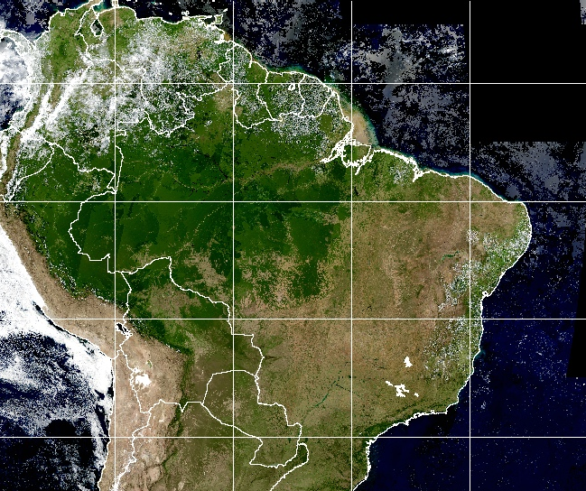
Porto Velho aerosol and trace gases sampling location
-80
-70
-60
-50
Porto Velho
-40
-30
5
-10
-11
-12
-5
-64
-63
-62
-61
-15
-15
-25
-25
-80
-70
-60
-50
-40
-30

Slide 7
Porto Velho aerosol mass concentration and black carbon from 1999 to 2012

Slide 8
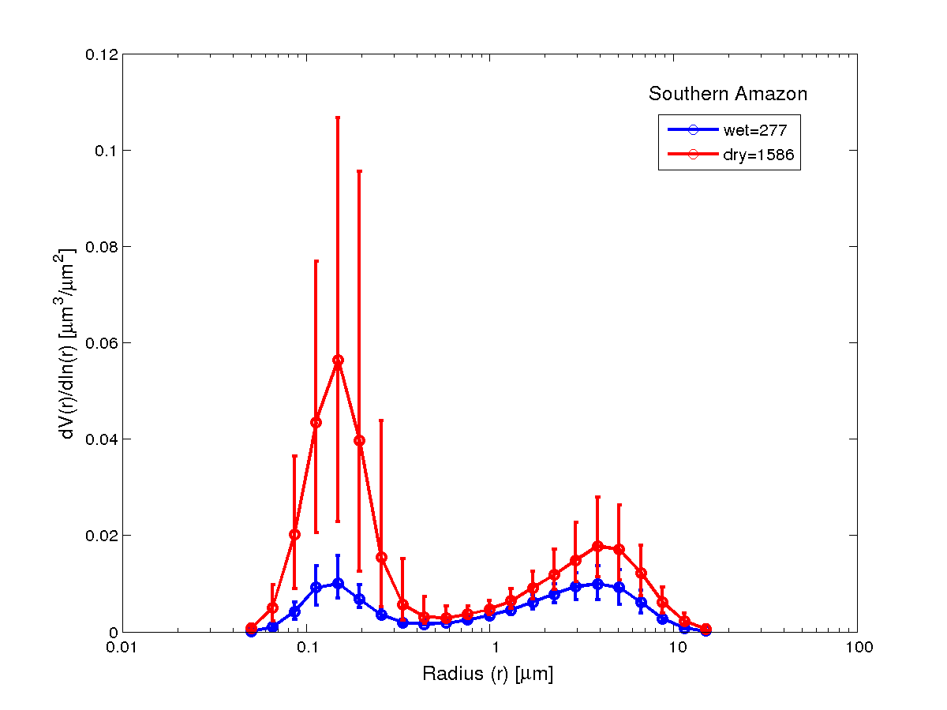
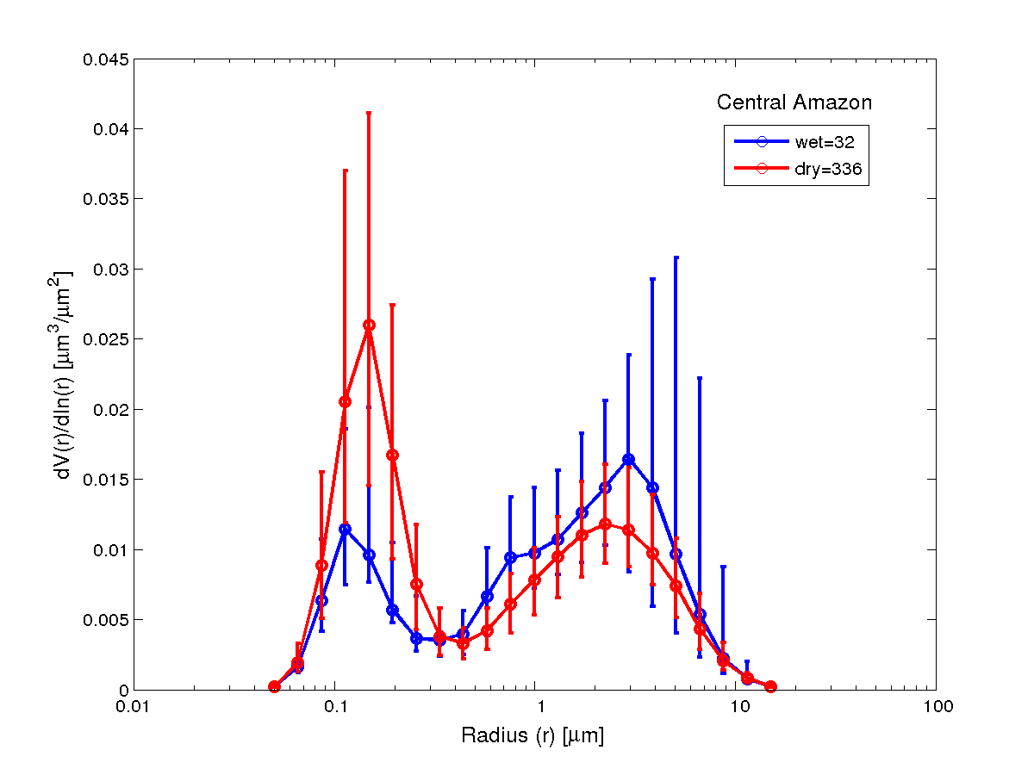
Aerosol size distributions: SMPS and AERONET

Slide 9
Manaus ACSM 2013 wet season measurements

Slide 10
ACSM measurements in Rondonia

Slide 11
Scattering, absorption and SSA in Manaus and Porto Velho
Monthly statistics (2009 – 2012) for light scattering coefficient σ_{s} at 637 nm and light absorption coefficient σ_{a} at 637 nm in Mm⁻¹ for Porto Velho (PVH, in black) and central Amazonia (TT34, in red).
Single Scattering Albedo Lower at the pristine site

Slide 12
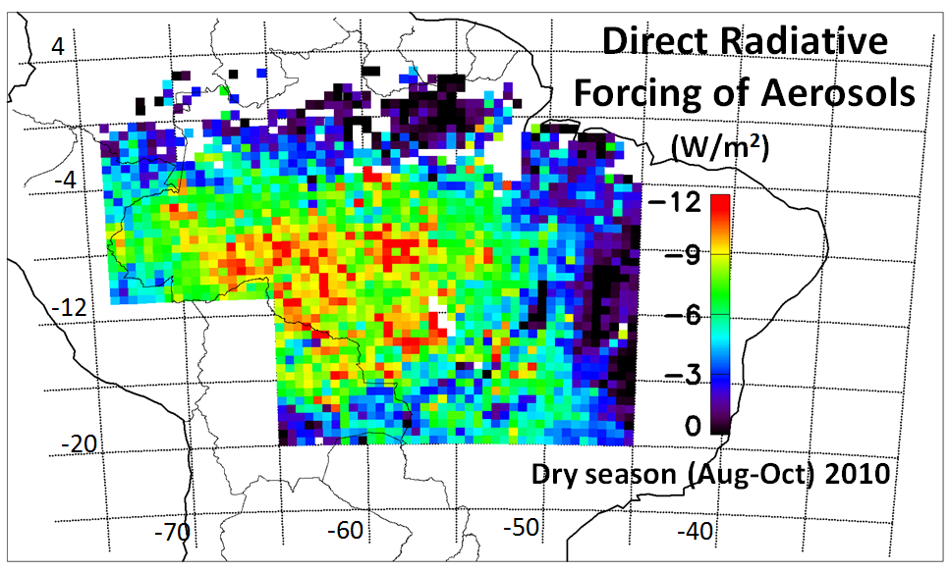
Average spatial distribution of the direct radiative forcing (DRF) of biomass burning aerosols in Amazonia during the dry season of 2010
CERES (Clouds and the Earth's Radiant Energy System) and MODIS

Slide 13
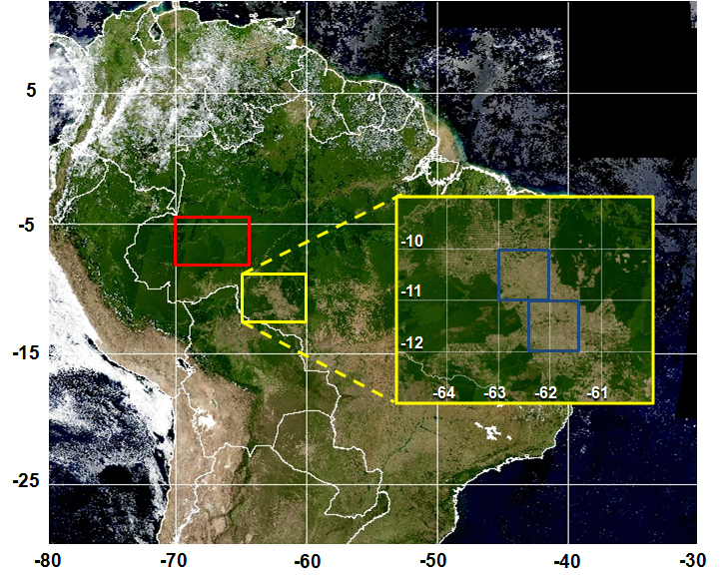
Mean Diurnal Radiative Forcing due to change in surface albedo in Rondonia:
-7.3 + 0.9 W/m²
Mean Diurnal Aerosol Forcing Efficiency:
Forest: -22.5 + 1.4 W/m²
Cerrado: -16.6 + 1.7 W/m²
Water column difference by 6-10%
Forcing of water vapor column: -0.4 to -1.2 W m⁻²
Land-use change radiative forcing. Forested areas are selected in red and deforested areas are selected in yellow.
Sena et al., 2013

Slide 14
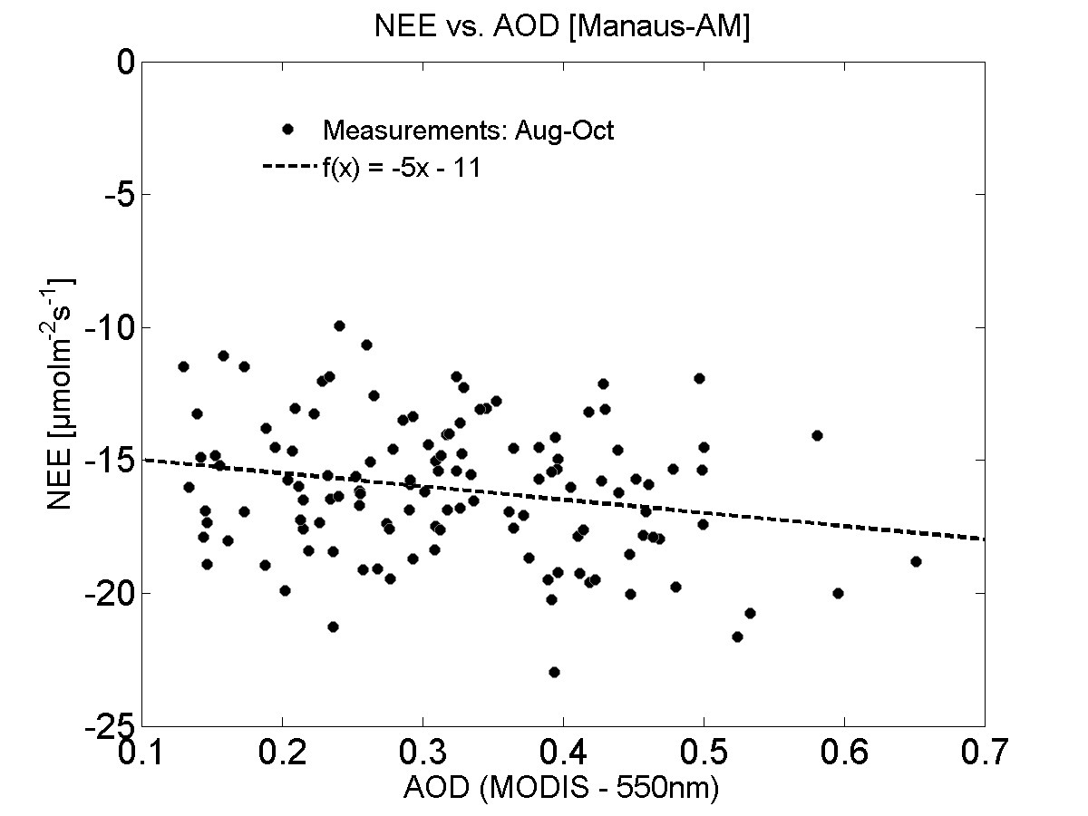
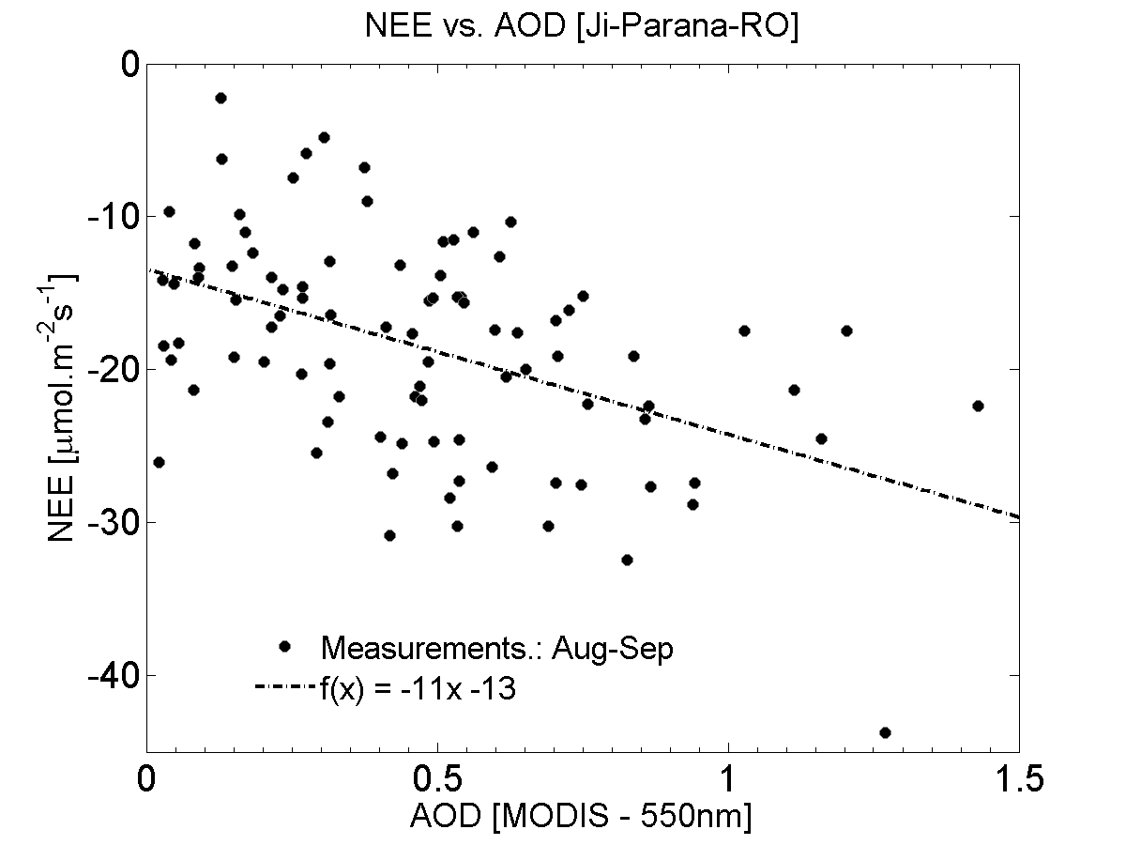
Effects of aerosols on carbon uptake expressed as Net Ecosystem Exchange (NEE) at central Amazonia (TT34 forest preserved site), and at southern Amazonia (PVH impacted site).

Slide 15
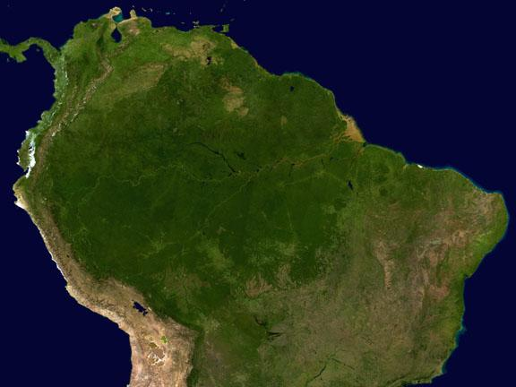
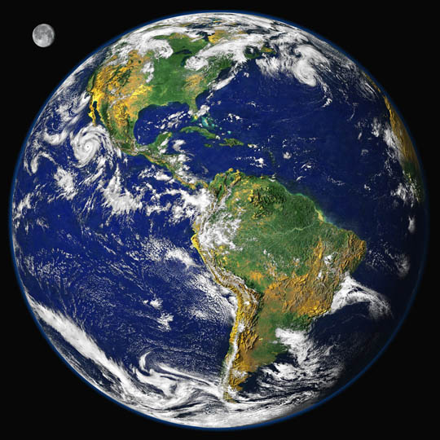
Thanks for the attention!!!

Slide 16
Annual deforestation rates in the Brazilian Amazonia from 1977 to 2012
Figure 1 – Annual deforestation rates in the Brazilian Amazonia from 1977 to 2012 measured by the PRODES (Projeto de Monitoramento do Desflorestamento na Amazônia Legal) program from INPE (The Brazilian National Institute for Space Research).

Slide 17
Seasonal variability (2009 – 2012) of ozone volume mixing ratios in Porto Velho (PVH) and central Amazonia (Manaus TT34 tower). Circles represent median values, and bars represent 10 and 90 percentiles.

Slide 18
Diurnal variability in scattering and absorption

