Slide 1
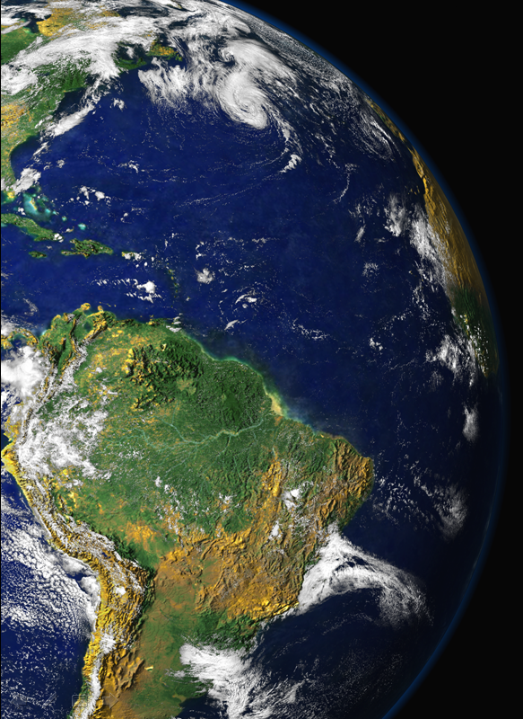
Curso de Verão 2014 IFUSP
10-14 de Fevereiro de 2014
Aspectos científicos recentes das mudanças climáticas globais
Paulo Artaxo, Henrique Barbosa
Departamento de Física Aplicada Instituto de Fisica da USP
artaxo@if.usp.br

Slide 2
Estrutura do Curso de Verão 2014
CURSO 5 - Física aplicada a meio ambiente: Aspectos observacionais e modelagem climática - Palestrantes: Profs. Paulo Eduardo Artaxo Netto e Henrique de Melo Jorge Barbosa
Muitas questões ambientais requerem um tratamento de processos físicos fundamentais. Questões como balanço radiativo atmosférico, formação e desenvolvimento de nuvens, espalhamento e absorção de radiação, estudos de fluxos de gases e partículas, processos de medidas de partículas nanométricas entre muitos outros requerem aplicações de processos físicos. A modelagem do sistema climático é um problema complexo, multidimensional e que precisa de abordagem que leve em conta processos na superfície e de transporte atmosférico, além de questões associadas a balanço de massa e energia. Este minicurso visa dar ao aluno uma visão de física aplicada a questões climáticas, com uma abordagem multidisciplinar.
Aula 1 – Introdução às mudanças climáticas Globais
Aula 2 – Balanço de radiação atmosférica e os efeitos de aerossóis e nuvens
Aula 3 – Introdução à modelagem climática
Aula 4 – Aspectos físicos da modelagem do sistema climático regional e global
Aula 5 – Aspectos observacionais de medidas de aerossóis atmosféricos e balanço de radiação terrestre.

Slide 3
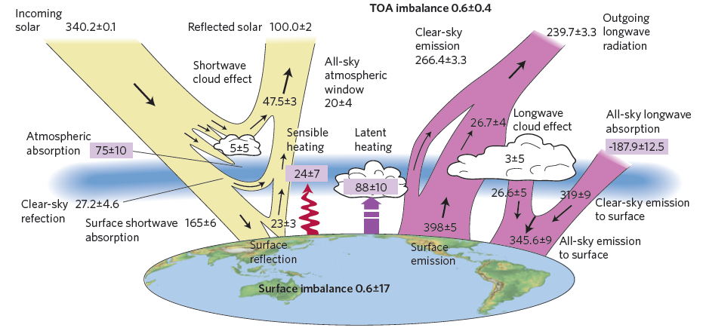
Balanço de Energia do sistema terrestre
The global annual mean energy budget of Earth for the approximate period 2000–2010. All fluxes are in Wm^{–2}. Solar fluxes are in yellow and infrared fluxes in pink. The four flux quantities in purple-shaded boxes represent the principal components of the atmospheric energy balance. (Stephens, Nature 2012)

Slide 4
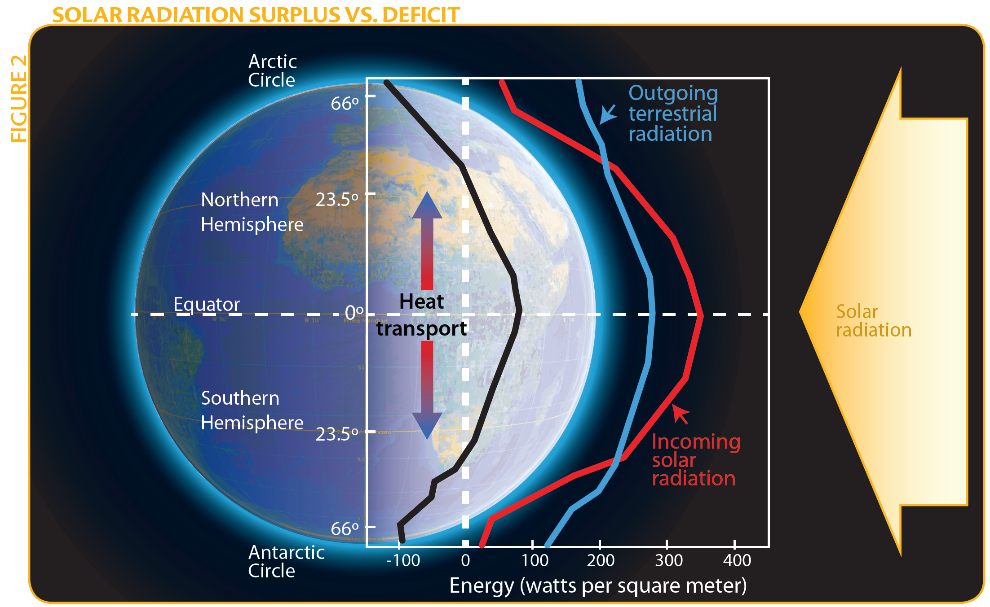
Balanço de radiação solar

Slide 5
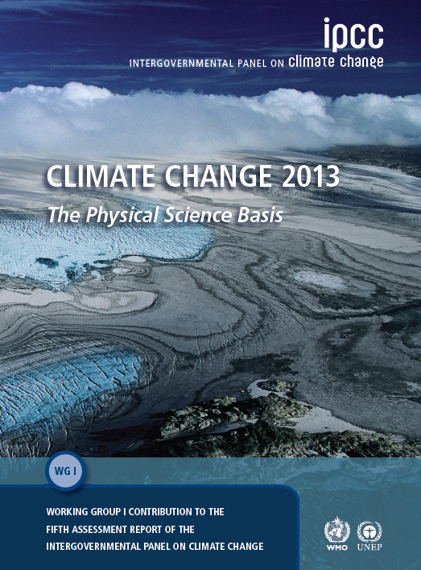
IPCC AR5 WG1
Climate Change 2013: The Physical Science Basis
4 anos de trabalhos
2.250 páginas em 14 capítulos
9.200 referencias
209 Lead Authors de 39 países
54.677 Comentários de revisores
Revisores: 1.089 de 55 países
195 países aprovaram o SPM
Nenhuma outra área de pesquisa
faz trabalhos de assessments
Com esta envergadura...

Slide 6
Nosso planeta em mudança, nos compartimentos:
Atmosfera
Criosfera
Biosfera
Geosfera
Hidrosfera

Slide 7
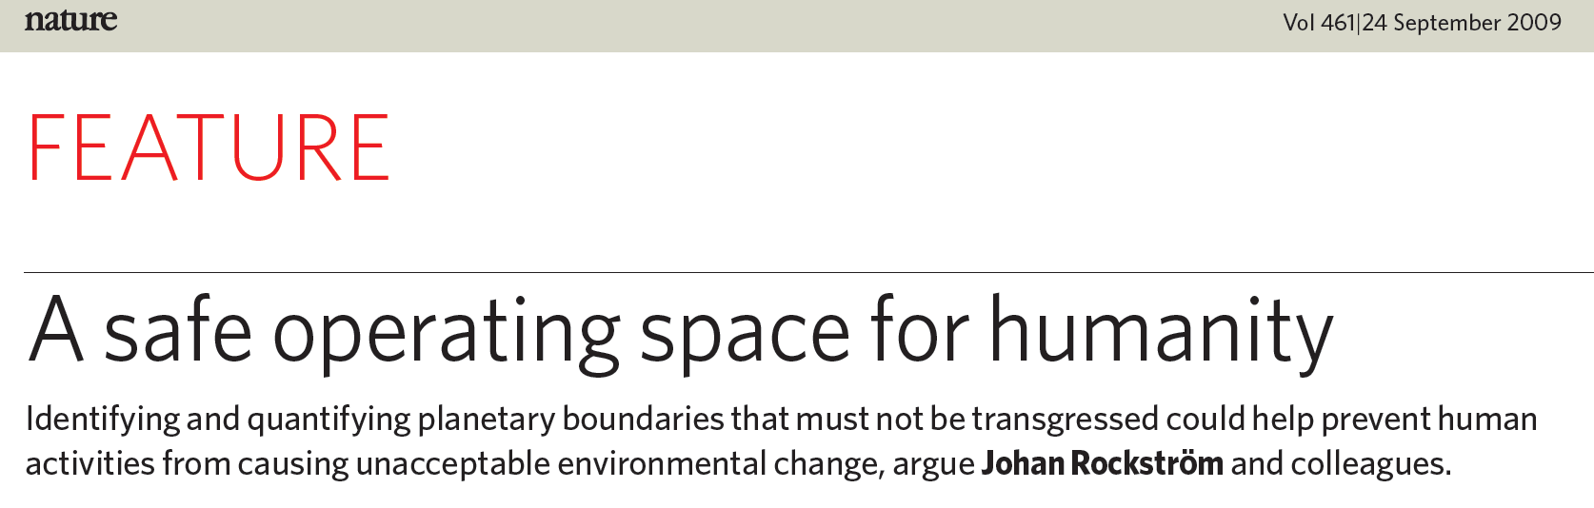
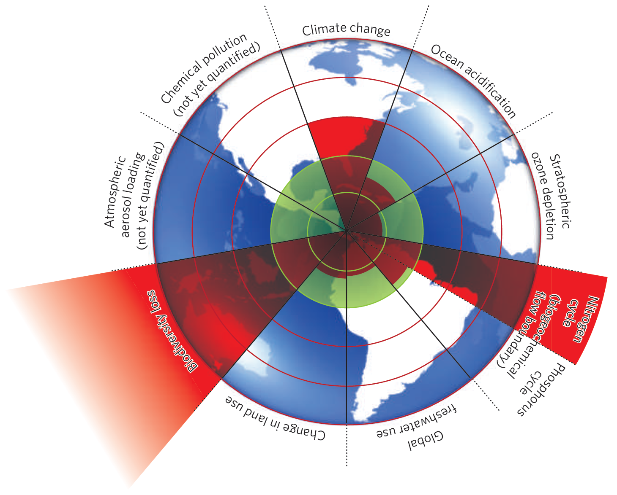
Estimativas da evolução quantitativa de variaveis de controle para sete limites planetários desde níveis preindustriais até o presente
Mudança Climática
Beyond the boundary. The inner green shading represents the proposed safe operating space for nine planetary systems. The red wedges represent an estimate of the current position for each variable. The boundaries in three systems (rate of biodiversity loss, climate change and human interference with the nitrogen cycle), have already been exceeded.
Perda de biodiversidade
Deposição de Nitrogênio
Nature, 2009

Slide 8
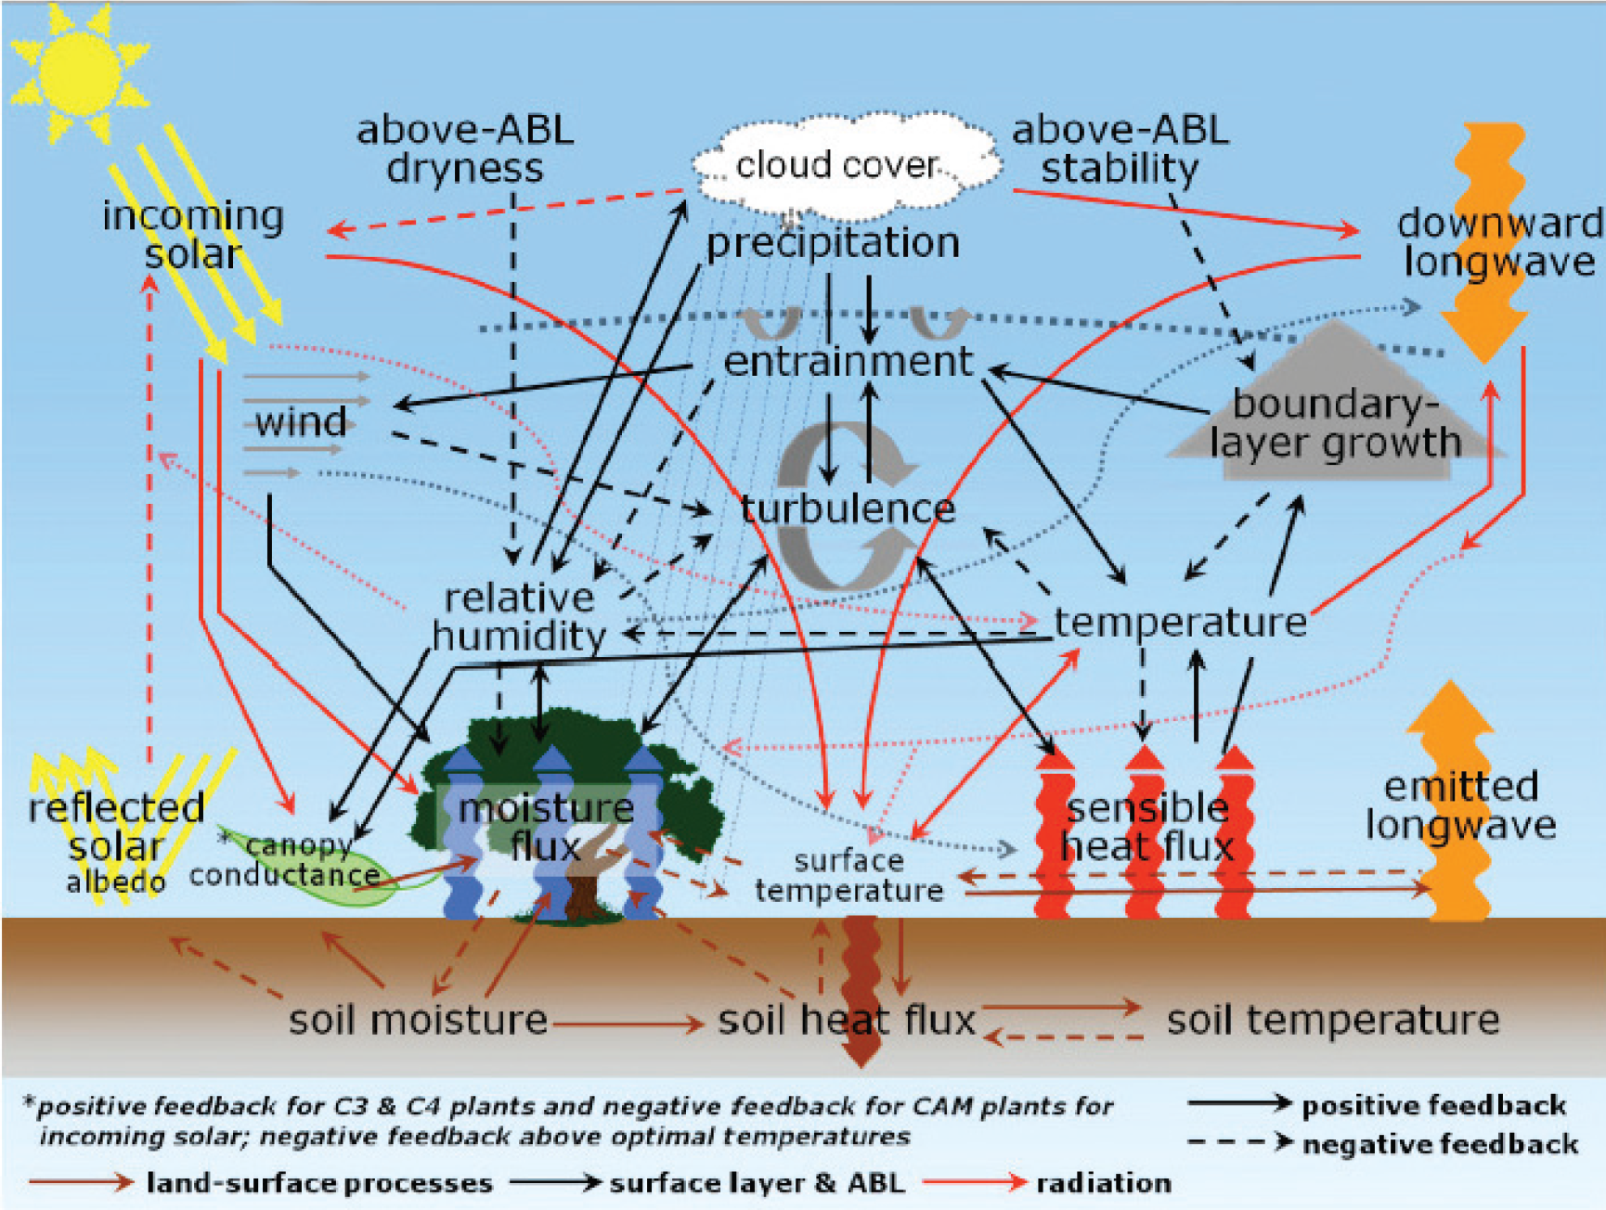
Interações e feedbacks entre solo, superfície e atmosfera
(GEWEX 2013)

Slide 9
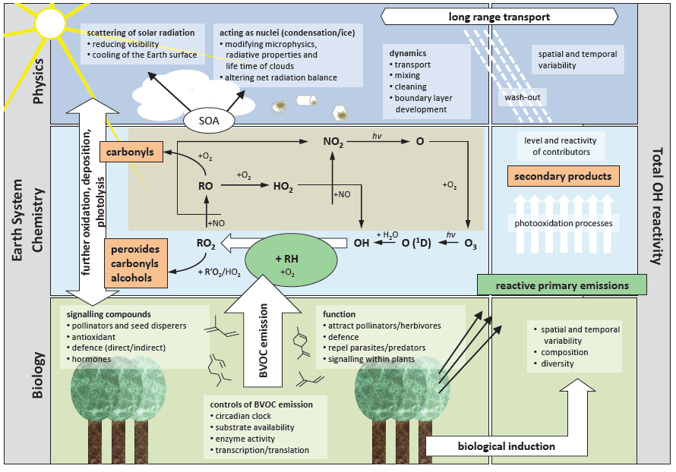
Processos químicos atmosféricos são fundamentais

Slide 10
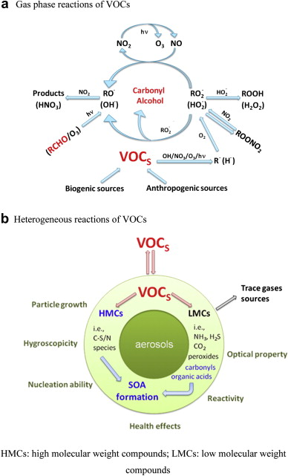
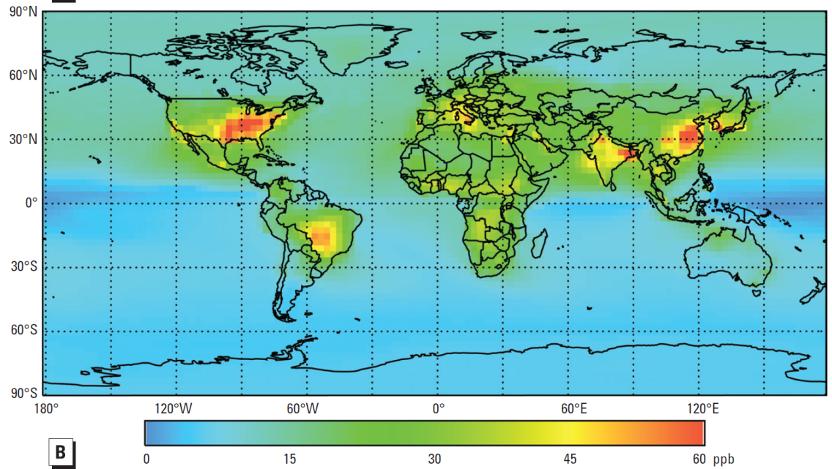
Química Atmosférica e Mudanças Climáticas
VOCs em fase gasosa: Ozônio
VOCs e produção de aerossóis secundários
Meia vida de metano controlada
pelo radical OH⁻
Monóxido de carbono (CO): importante no balanço de carbono
Aumento de ozônio (2010-1850) Máximo diário

Slide 11
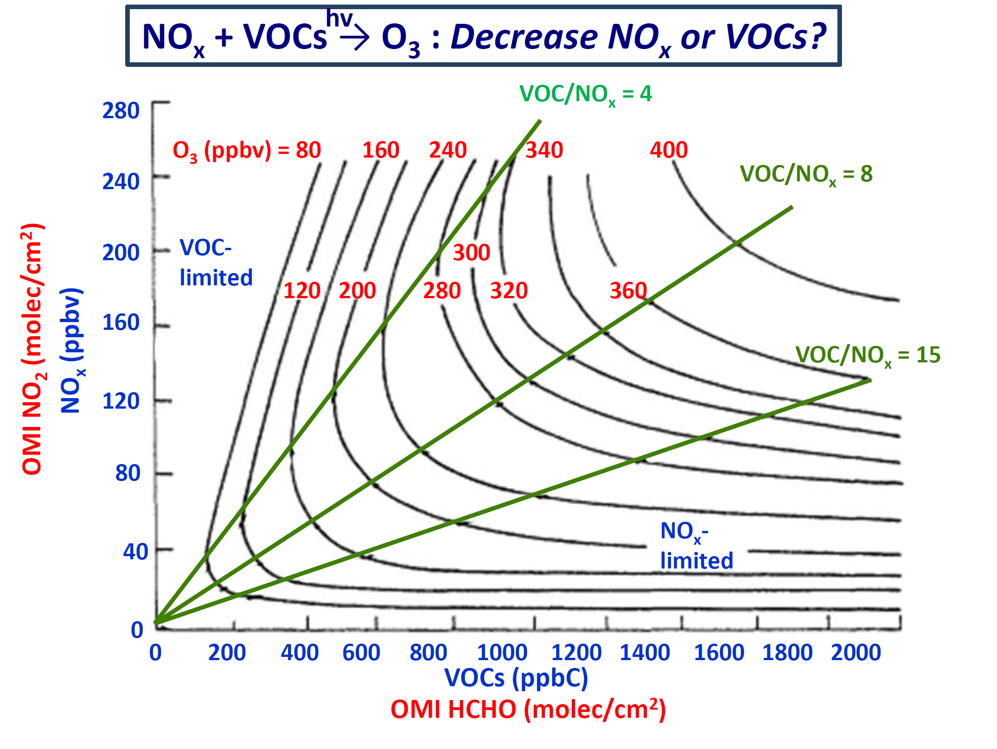
Ozônio é um forte gás de efeito estufa

Slide 12
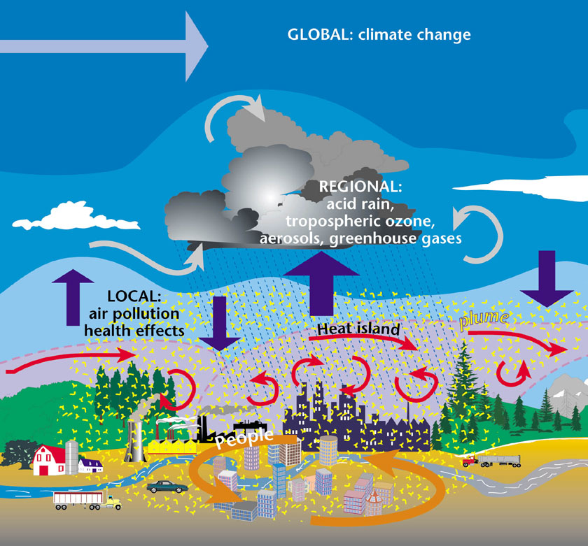
É fundamental considerar todas as escalas

Slide 13

Interações entre a biosfera e a atmosfera

Slide 14
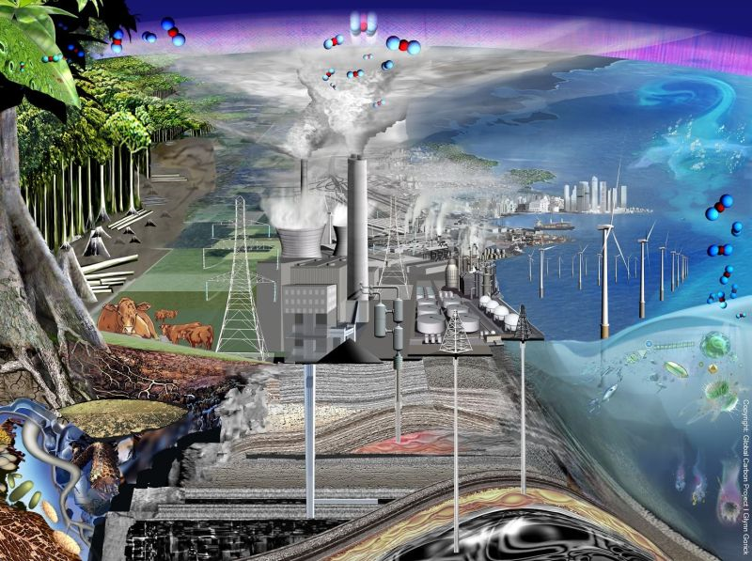
Perturbações humanas no ciclo do carbono global
© Global Carbon Project I Glynn Gorick

Slide 15
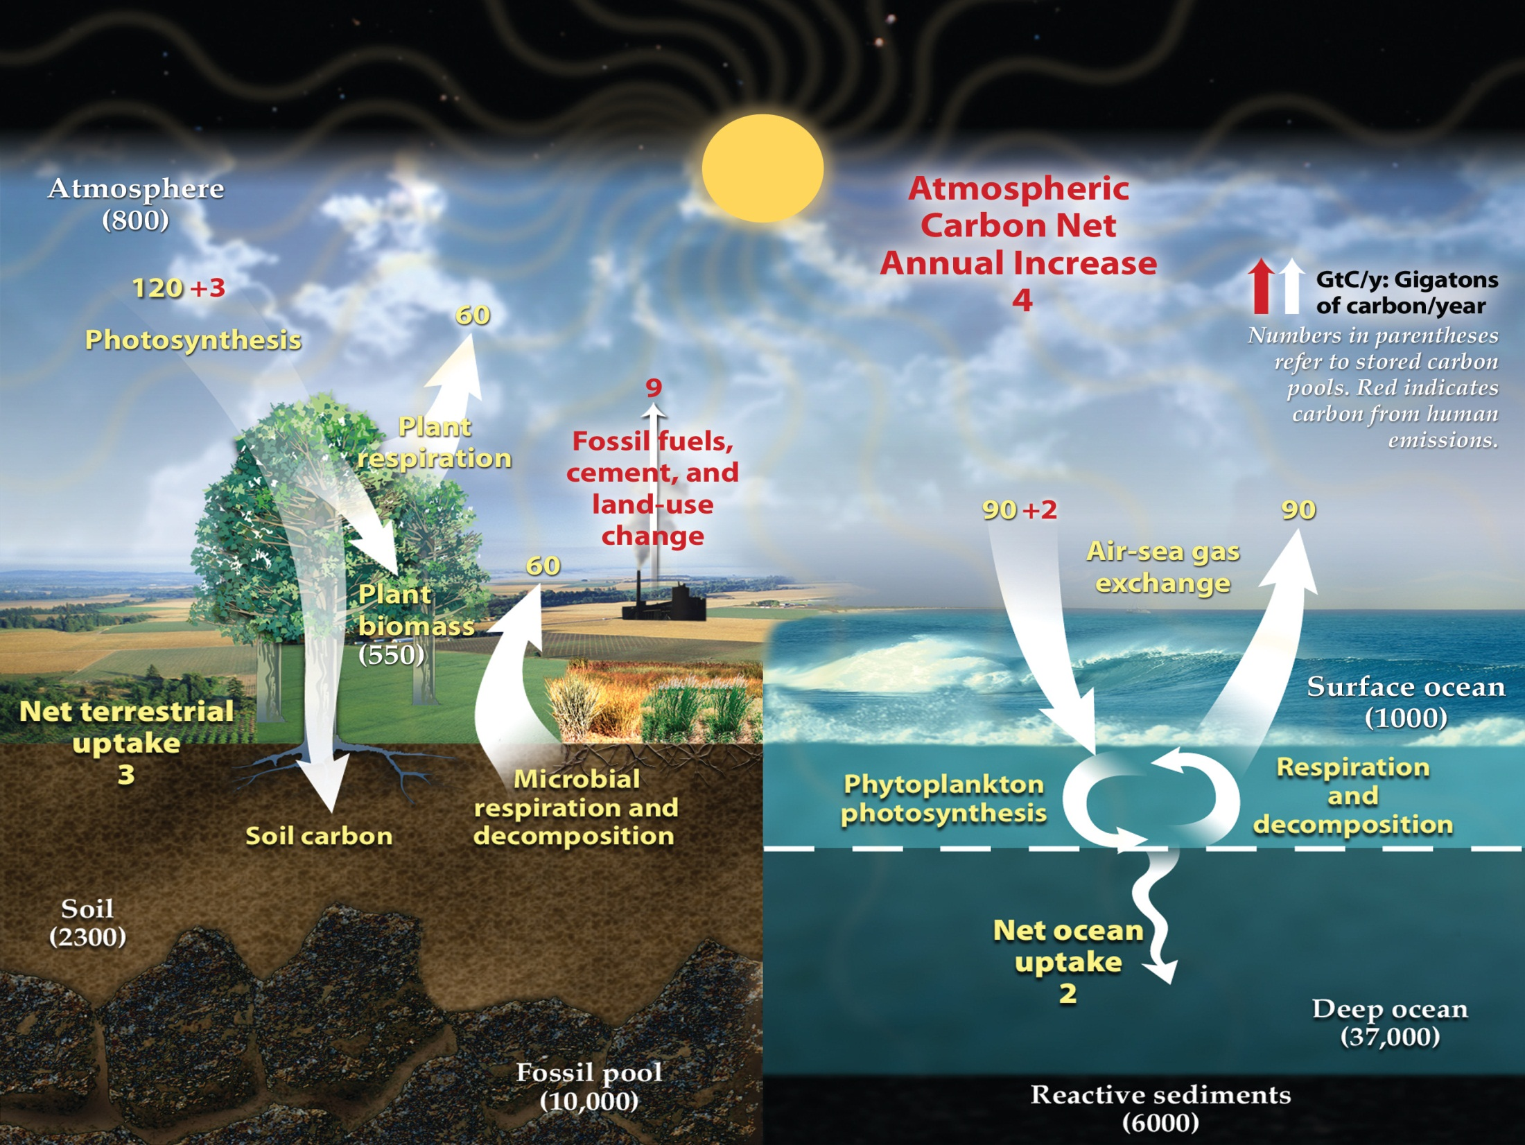
Human Perturbations of the Global Carbon Cycle
(Global Carbon Project 2010)

Slide 16
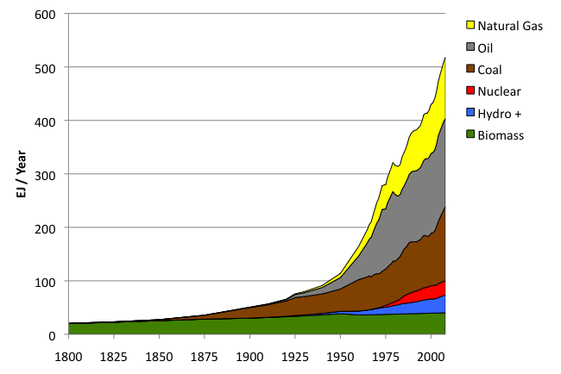
Suprimento de energia global: 1800 – 2008
Fossil
fuels
Hydro + :means hydropower plus other renewables
Sources: Grubler (2008) - Energy Transitions, BP (2009) – Statistical Review of World Energy, EIA (2009) – International Energy Annual

Slide 17
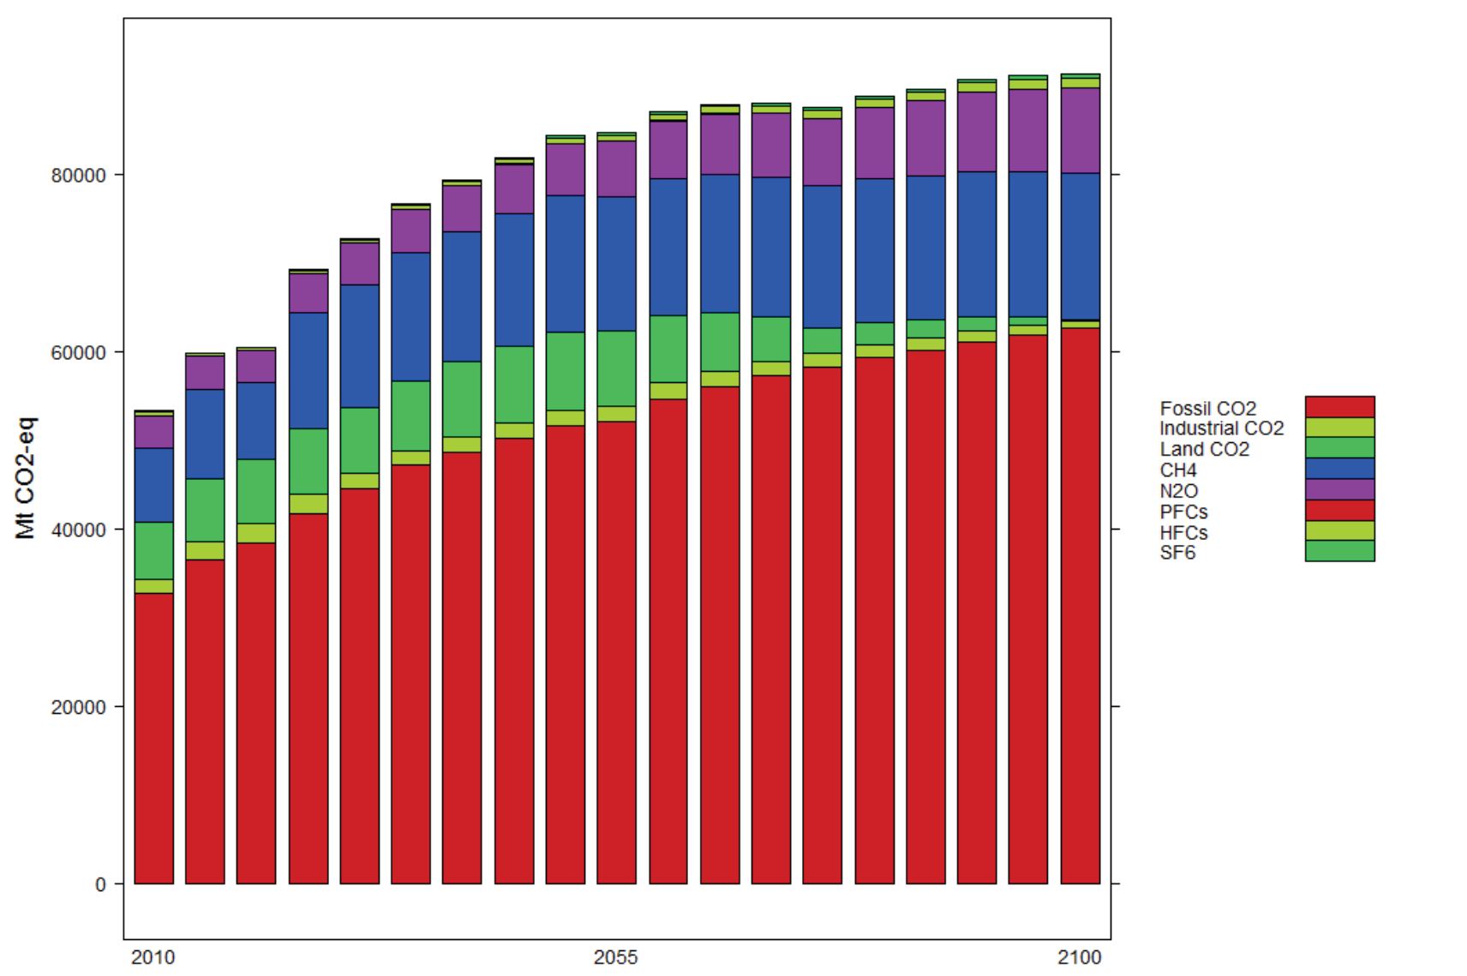
Emissões globais de gases de efeito estufa 2010-2100
MIT 2012

Slide 18
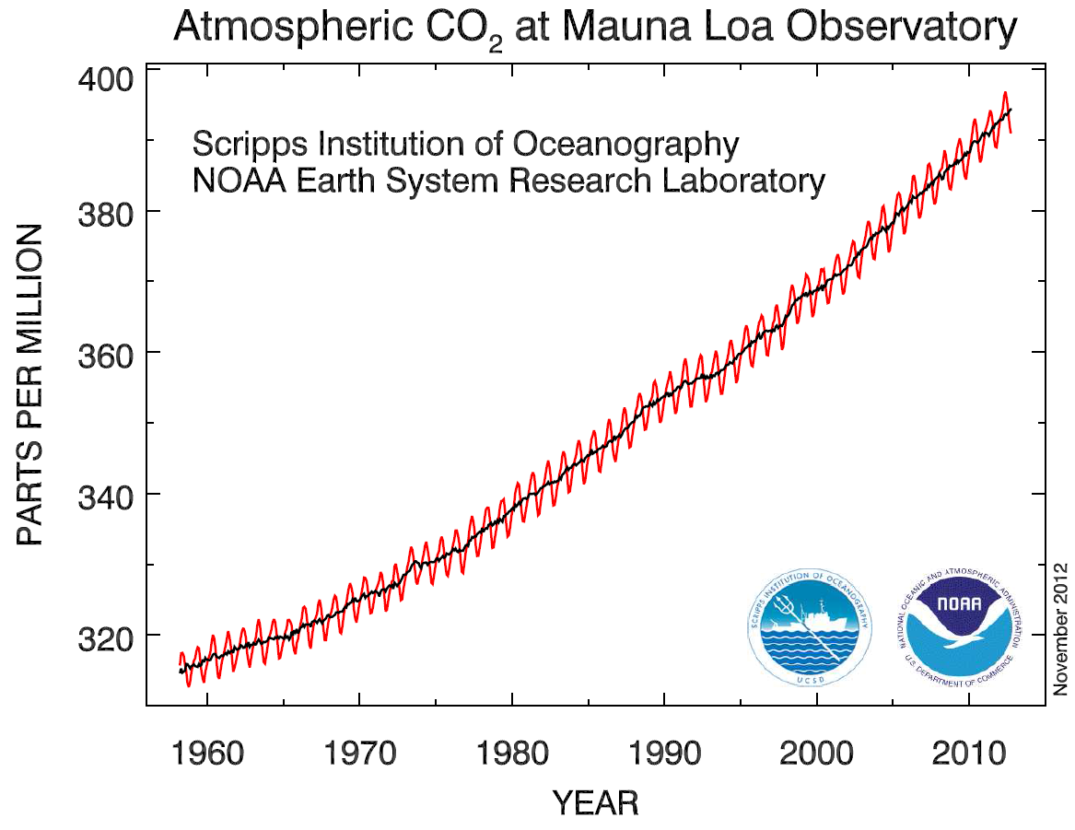

Slide 19
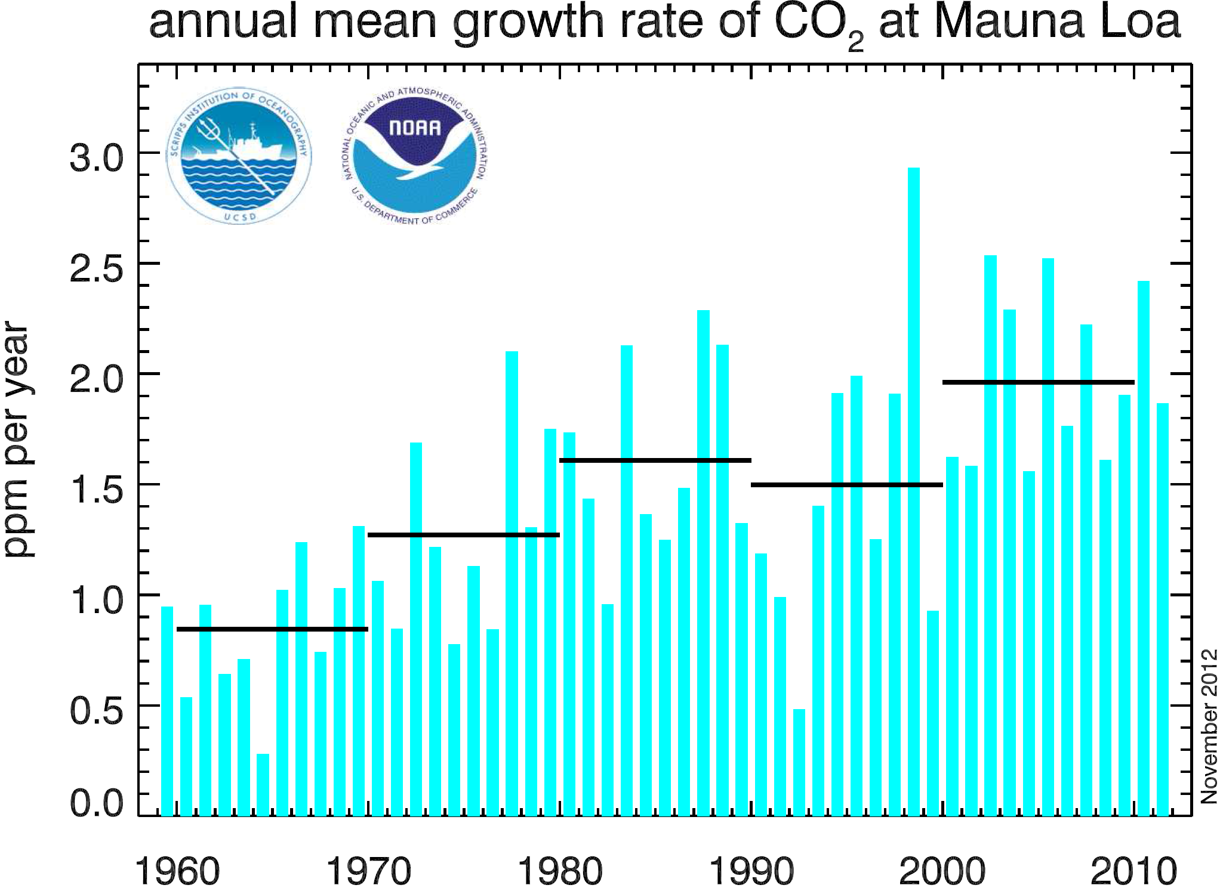

Slide 20
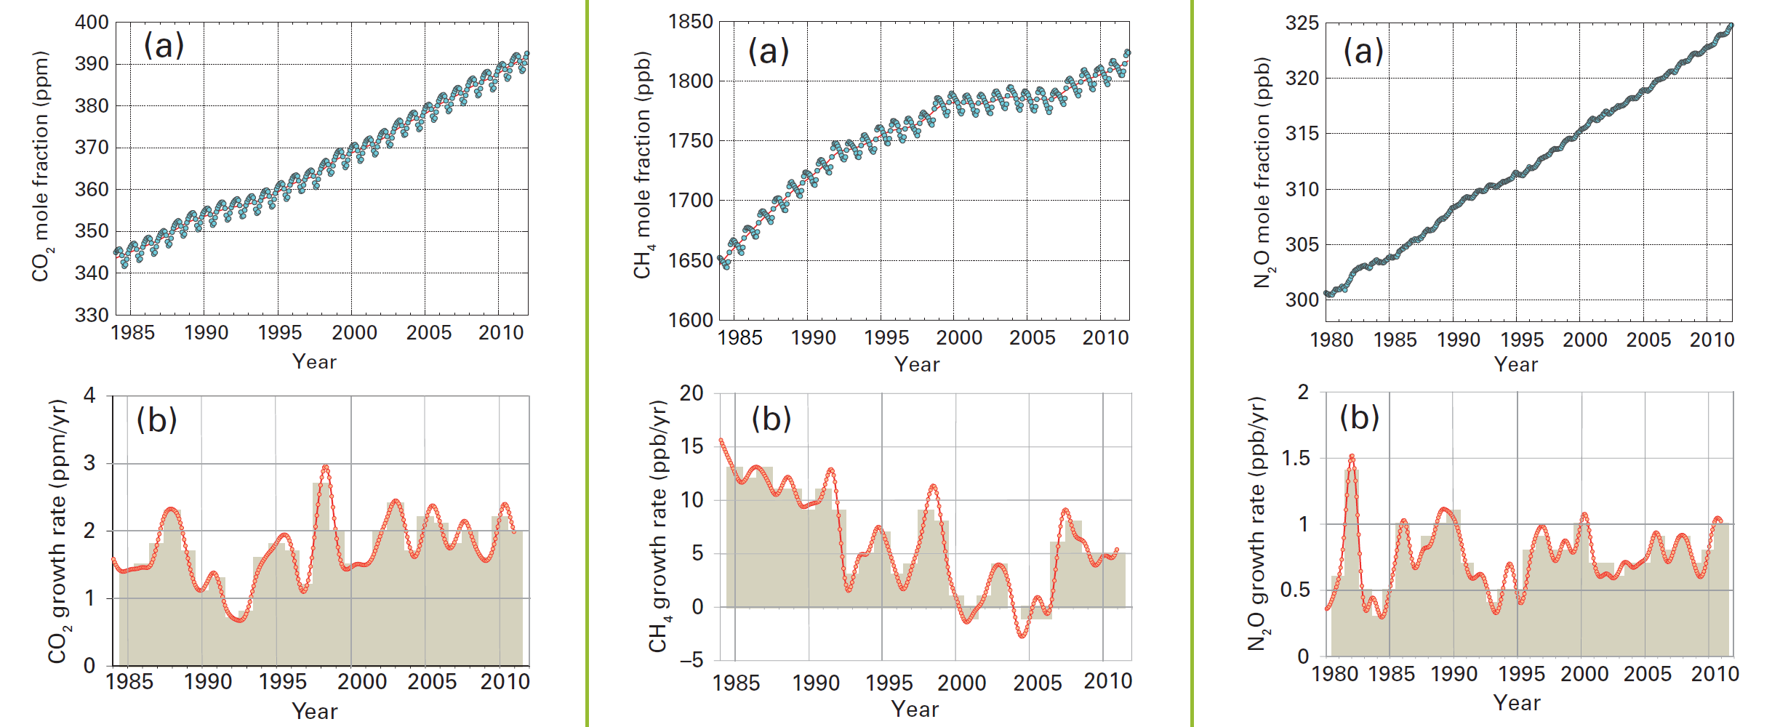
CO₂, CH₄ e N₂O de 1985 a 2011
39% aumento desde 1850
158% aumento desde 1850
20% aumento desde 1850
Globally averaged CO2 mole fraction (a) and its growth rate (b) from 1984 to 2011.
Globally averaged CH4 mole fraction (a) and its growth rate (b) from 1984 to 2011.
Globally averaged N2O mole fraction (a) and its growth rate (b) from 1980 to 2011.
WMO GREENHOUSE GAS BULLETIN Oct 2012

Slide 21
O aumento de CO₂ é devido às emissões antropogênicas
Isótopos de carbono e oxigênio mostram fontes antropogênicas
A concentração de oxigênio está diminuindo
Composição isotópica mostra aumento de carbono fóssil

Slide 22
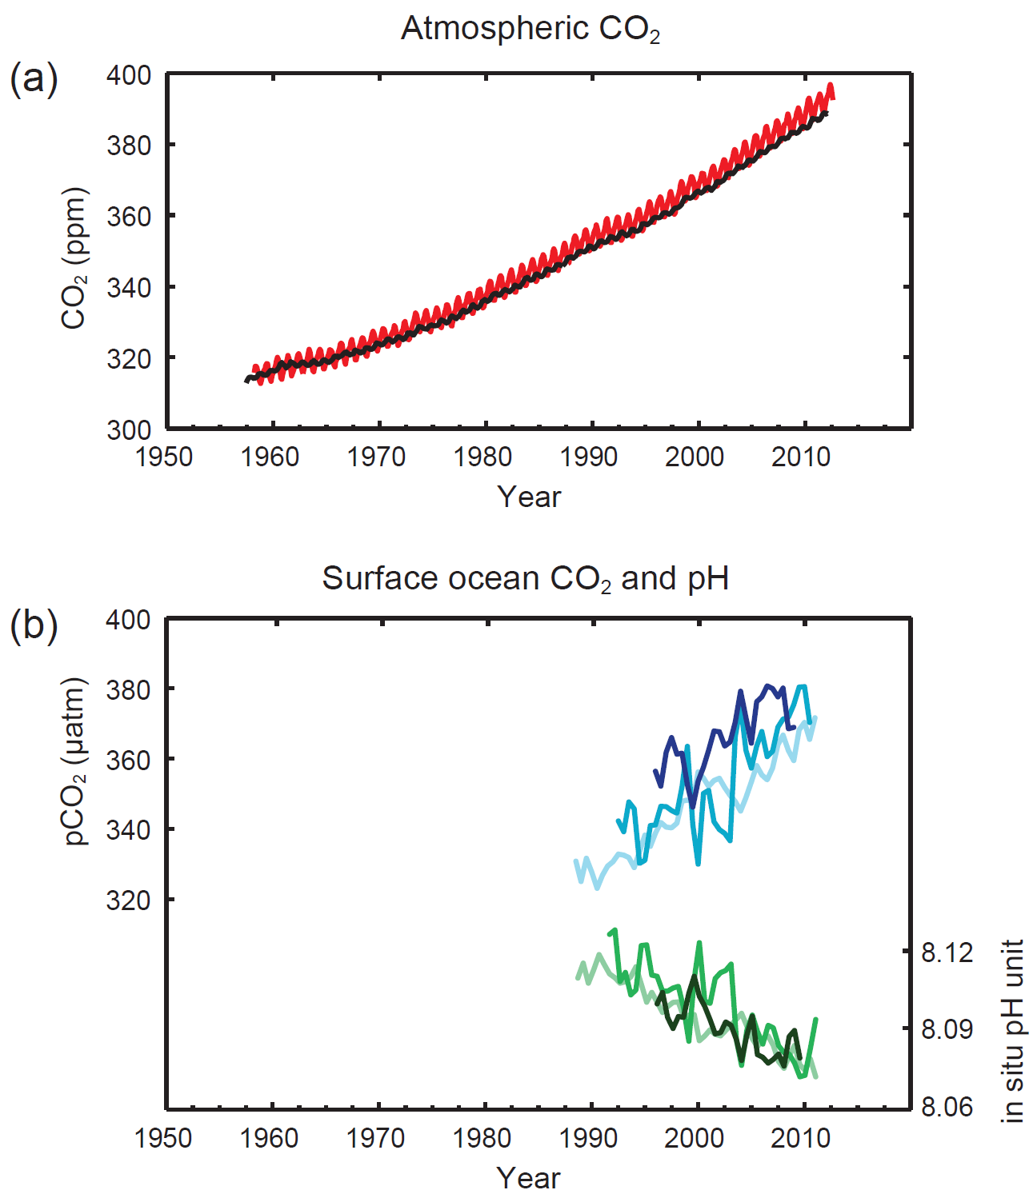
CO₂ atmosférico e nos oceanos

Slide 23
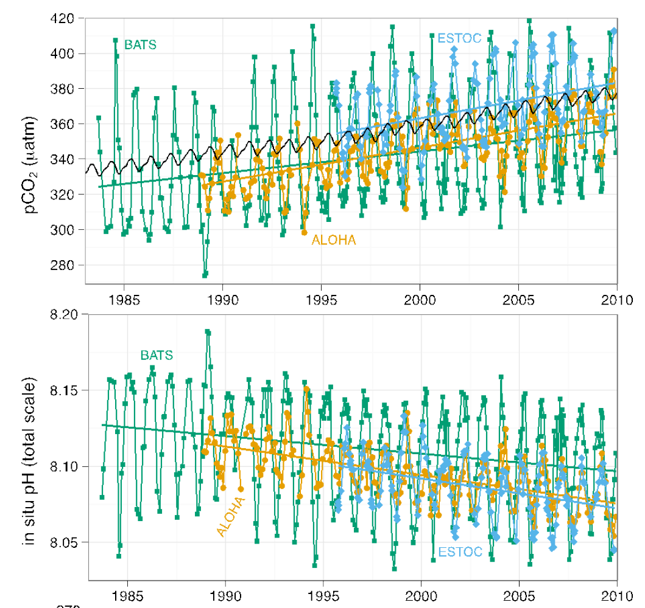
Concentração de CO2 na água do mar (pCO2) e pH
Acidez do mar aumentou 30%

Slide 24

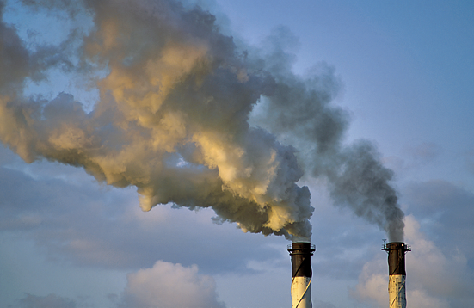
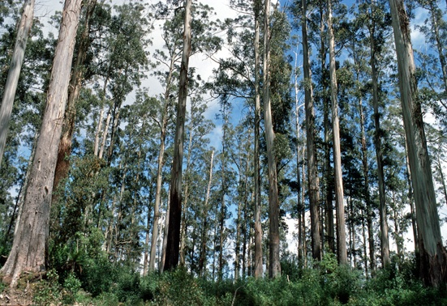
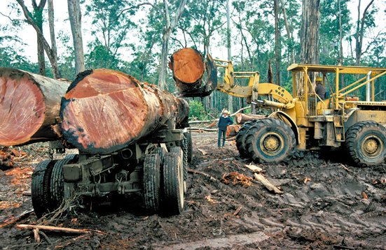
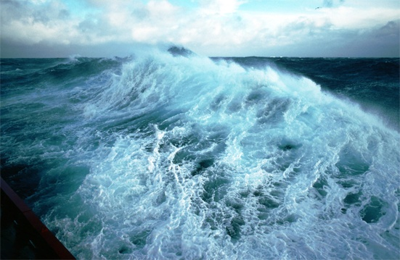
Fate of Anthropogenic CO₂ Emissions (2002-2011 average)
8.3±0.4 PgC/yr 90%
4.3±0.1 PgC/yr
46%
+
2.6±0.8 PgC/yr
28%
Calculated as the residual
of all other flux components
1.0±0.5 PgC/yr 10%
26%
2.5±0.5 PgC/yr
Source: Le Quéré et al. 2012; Global Carbon Project 2012

Slide 25
800.000 anos de história climática
(a) CO₂, CH₄ e nivel do mar nos últimos 800.000 anos
(b) Forçantes climáticas devido a mudanças nos gases de efeito estufa e áreas congeladas.
(c) Temperatura global calculada baseada nas forçantes acima e em uma sensibilidade climática de ¾°C por W/m².
Jim Hanssen, NASA GISS
Notes:
Now we can look at 800,00 years. The same sensitivity fits for the earlier times, even better.
Bottom line: The fast feedback climate sensitivity is nailed. It is 3 C for doubled CO2, plus or minus half a degree.

Slide 26
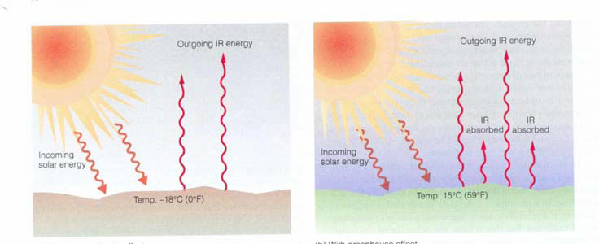
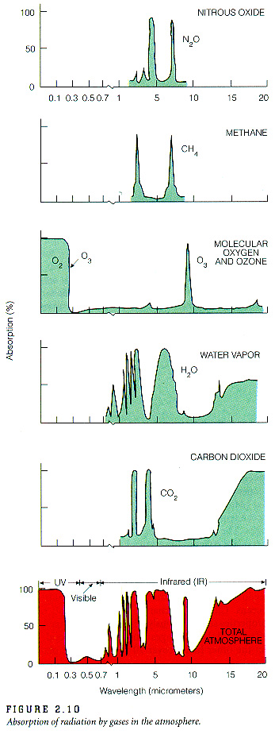
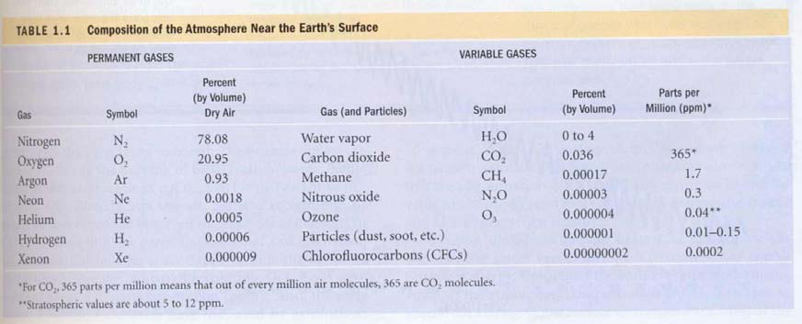
Absorção Infravermelha de radiação por gases de efeito estufa
N₂O
CH₄
O₃
H₂O
CO₂
Trace gases

Slide 27
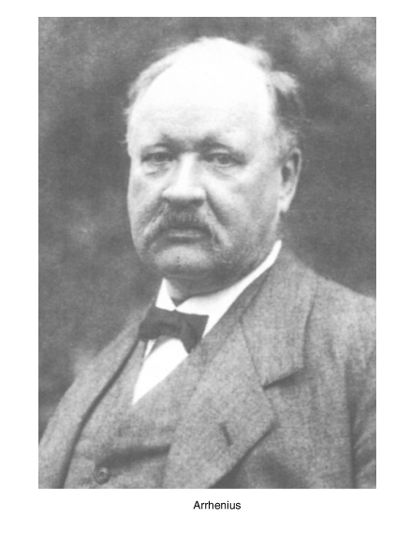
Em 1896, a primeira previsão climática de Svante Arrhenius
Arrhenius quantifies in 1896 the changes in surface temperature (approx. 5 C) to be expected from a doubling in CO₂, based on the concept of ”glass bowl” effect introduced in 1824 by Joseph Fourier

Slide 28
Dez indicadores de um mundo em aquecimento
TODOS os indicadores estão variando de acordo com o esperado

Slide 29
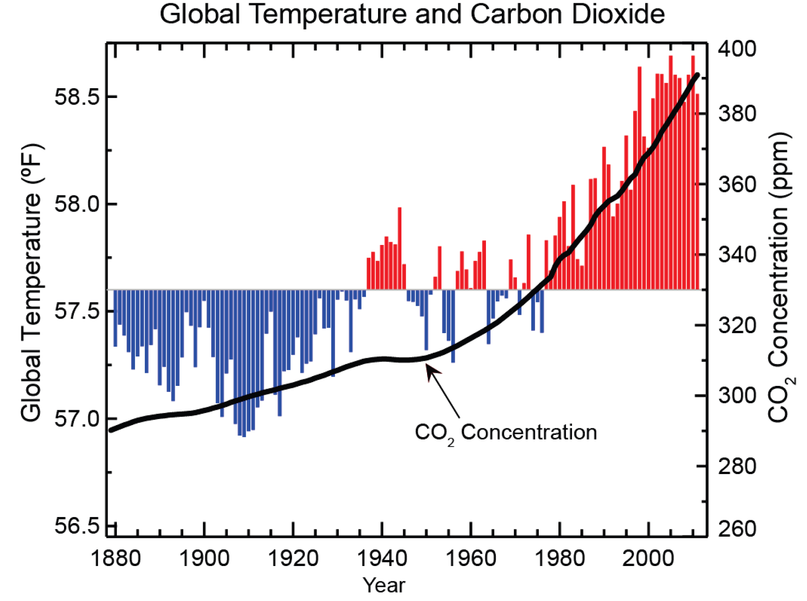
Figure source: NOAA NCDC

Slide 30
Balanço de Energia do sistema terrestre
The global annual mean energy budget of Earth for the approximate period 2000–2010. All fluxes are in Wm^{–2}. Solar fluxes are in yellow and infrared fluxes in pink. The four flux quantities in purple-shaded boxes represent the principal components of the atmospheric energy balance. (Stephens, Nature 2012)

Slide 31
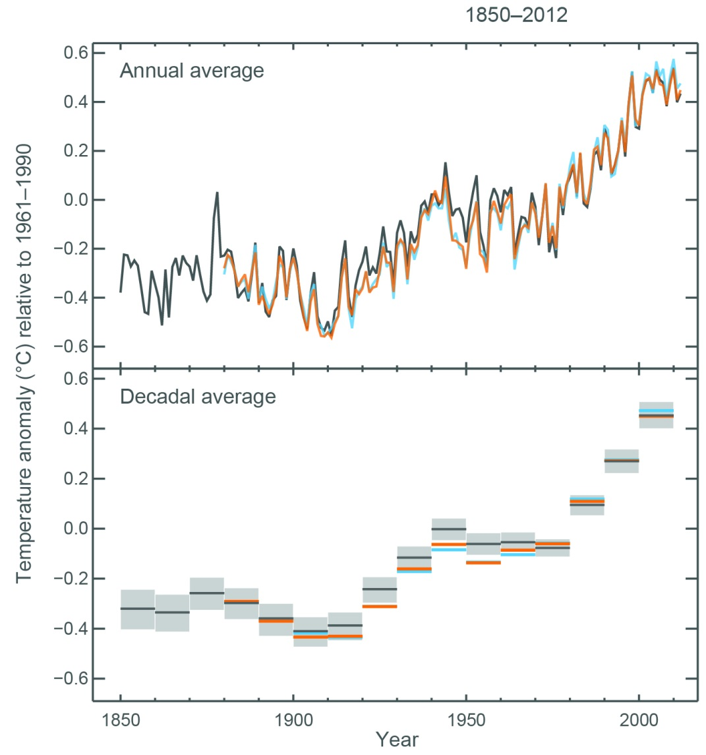
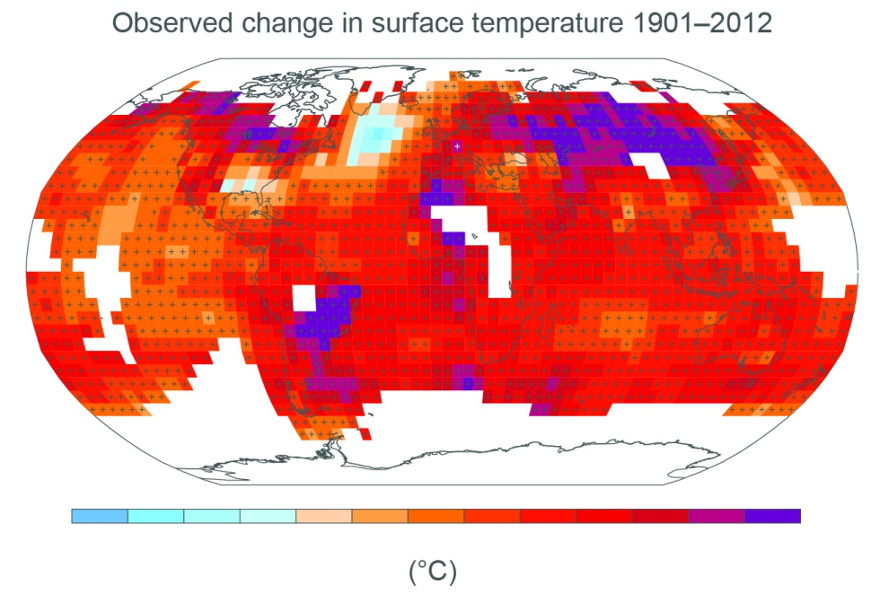
Aumento médio da temperatura observado de
1850-2012: 1.0 °C
Distribuição espacial
IPCC AR5 2013

Slide 32
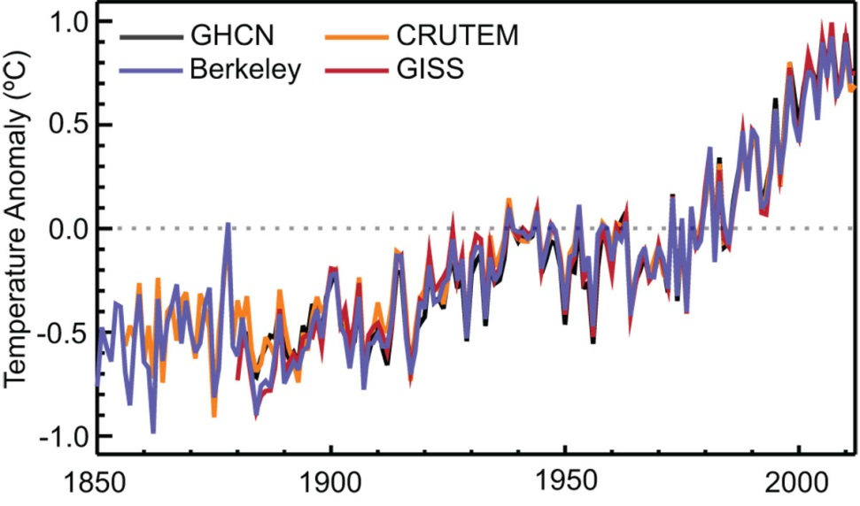
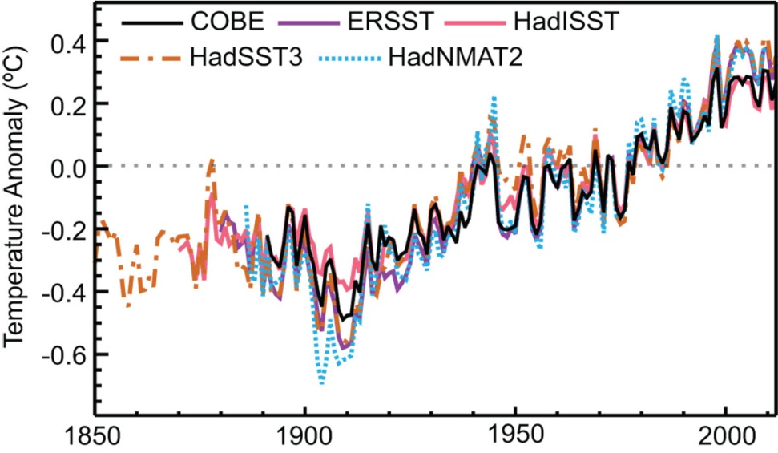
Aquecimento Atmosférico 1850-2011
Aquecimento Oceânico
1850-2011

Slide 33
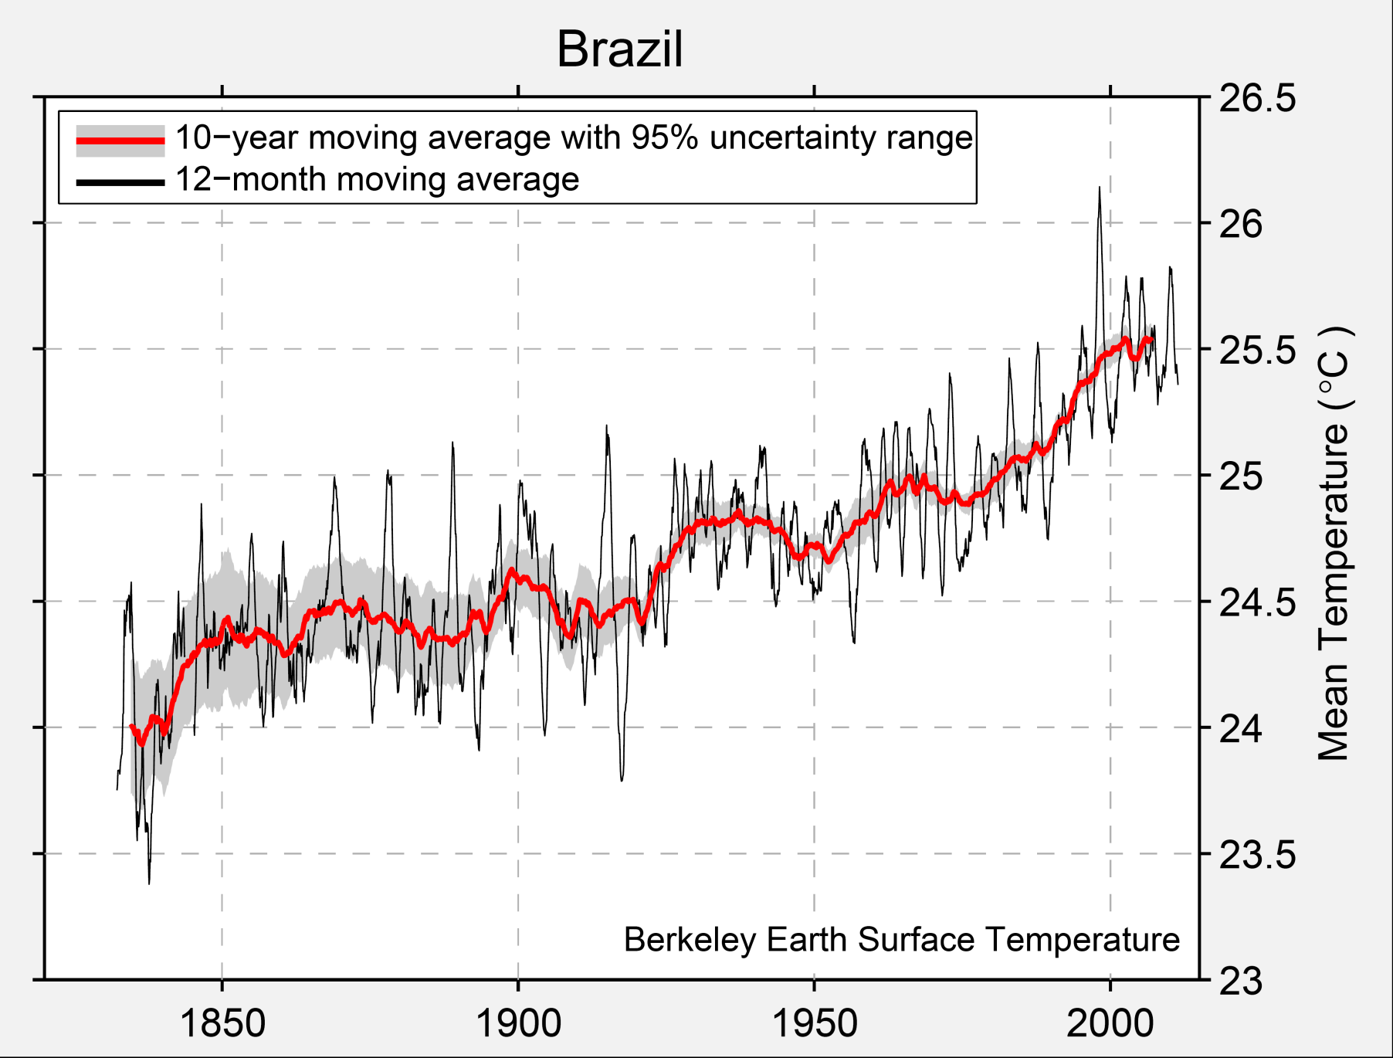
Brasil: Berkeley Earth Surface Temperature
http://berkeleyearth.org/

Slide 34
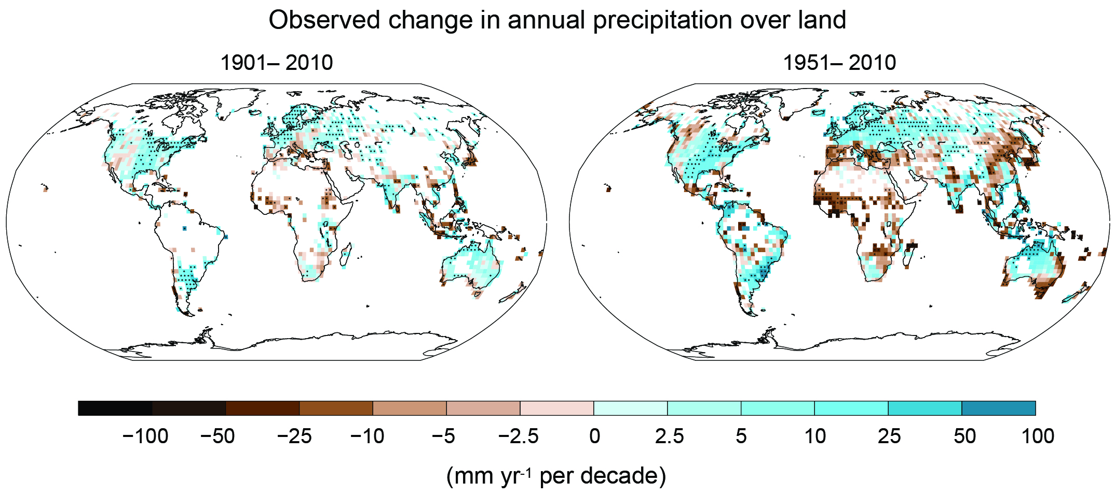
Mudanças no padrão de precipitação
Diminuição chuva
Aumento chuva

Slide 35
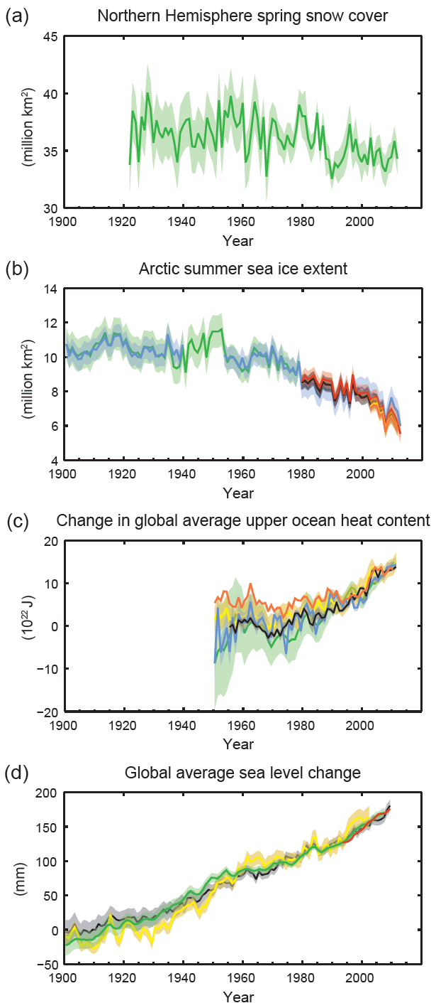
Observações do oceano e da criosfera.
O sistema climático está fora do equilíbrio: Está acumulando energia. Mais de 93% desta energia é acumulada no oceano.
Aumento observado no nível do mar:
≈19 centímetros de 1900 a 2010

Slide 36
The Natural Greenhouse Effect: clear sky
CH₄
N₂0
6%
O₃
8%
Carbon
Dioxide
26%
Water
Vapor
60%
Clouds also have a greenhouse effect
Kiehl and Trenberth 1997

Slide 37
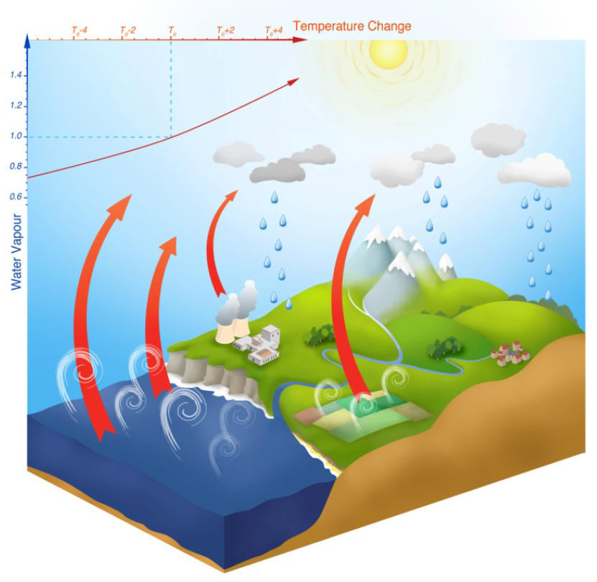
Ciclo da água e sua interação com o efeito estufa
Aumento do vapor de água na atmosfera com o aumento da temperatura

Slide 38
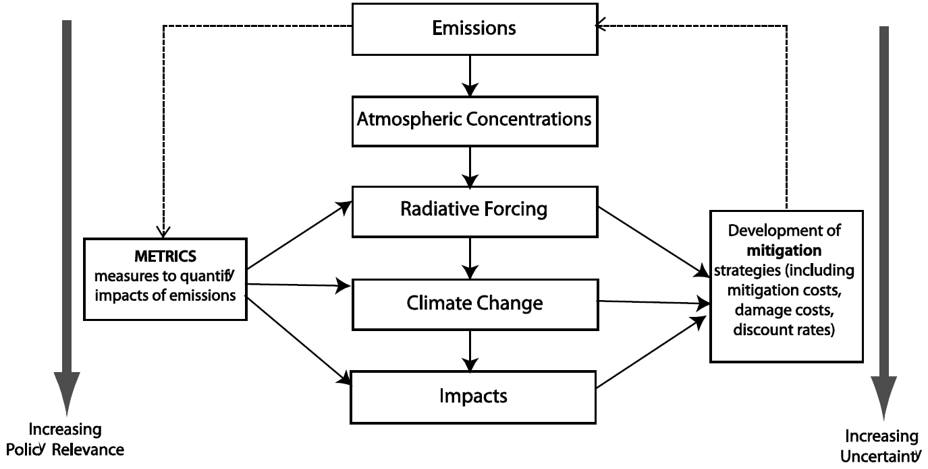
Change in energy flux caused by natural or anthropogenic drivers of climate change (in W/m²)
Positive: near-surface warming
Puts various drivers on common scale, indicates magnitude of impact
Includes rapid adjustments (e.g. cloud formation on aerosols)
Stratospheric temperature adjustment included in TAR & AR4 RF; additional adjustments included in Effective RF (ERF)
What is
Radiative Forcing?
Effective RF used for aerosols & well-mixed
greenhouse gases

Slide 39
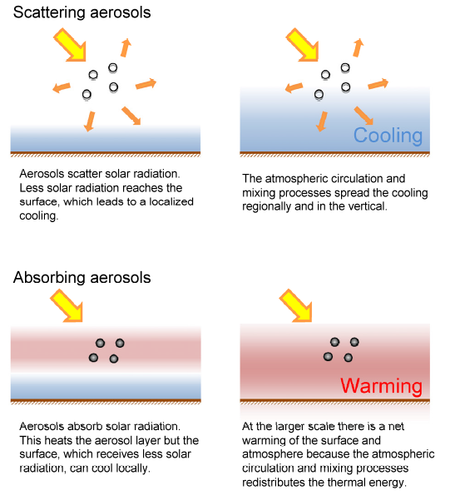
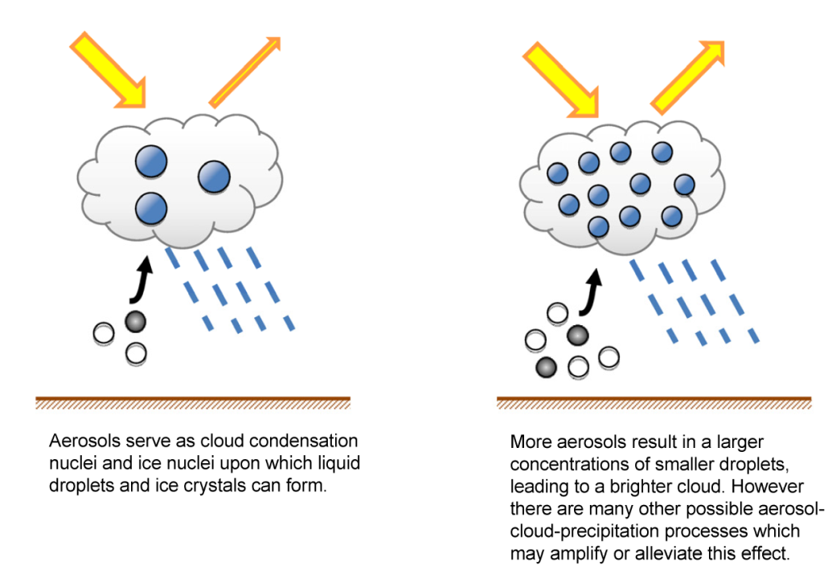
Aerosol-radiation interactions
Aerosol-cloud interactions

Slide 40
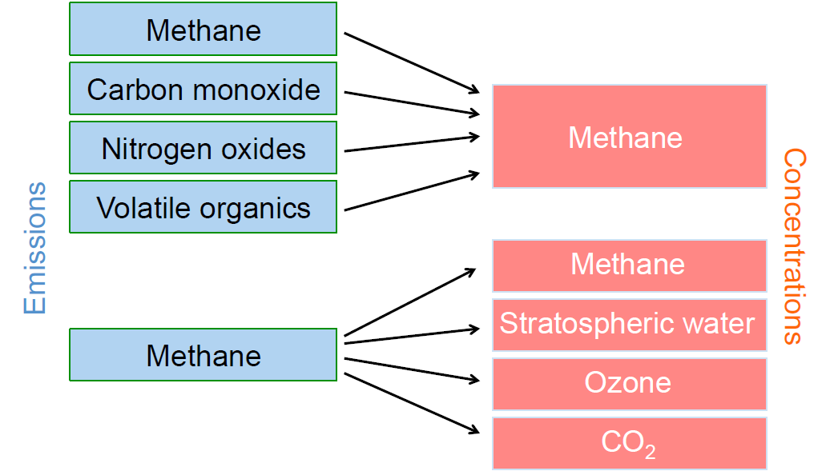
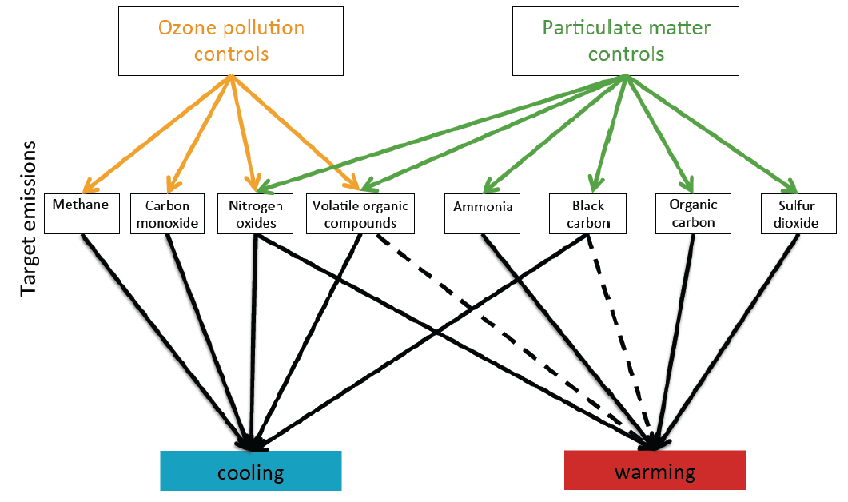
Das emissões às concentrações e à forçante radiativa
Inter-relacionamento entre emissões e concentrações
Impacto de controles de emissões específicas no aquecimento ou resfriamento.
Linhas sólidas indicam impactos conhecidos e linhas pontilhadas impacto incerto

Slide 41
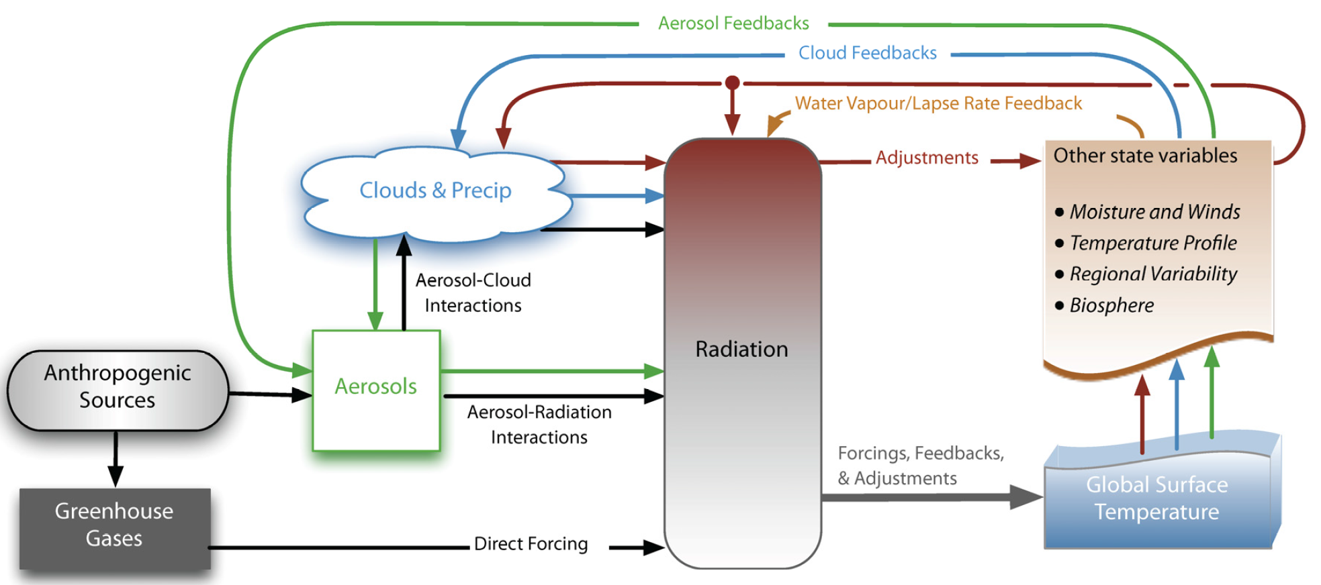
Overview of feedback and forcing pathways involving clouds and aerosols
Forcing mechanisms are represented by black arrows; forcing agents are boxes with grey shadows, rapid forcing adjustments (also called rapid responses) are shown with brown arrows and feedbacks are other-coloured arrows.

Slide 42
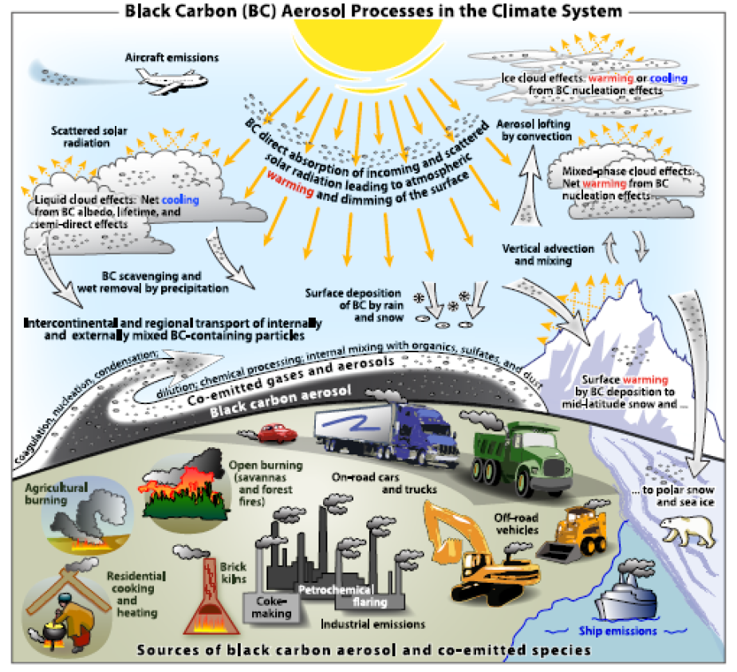

Slide 43
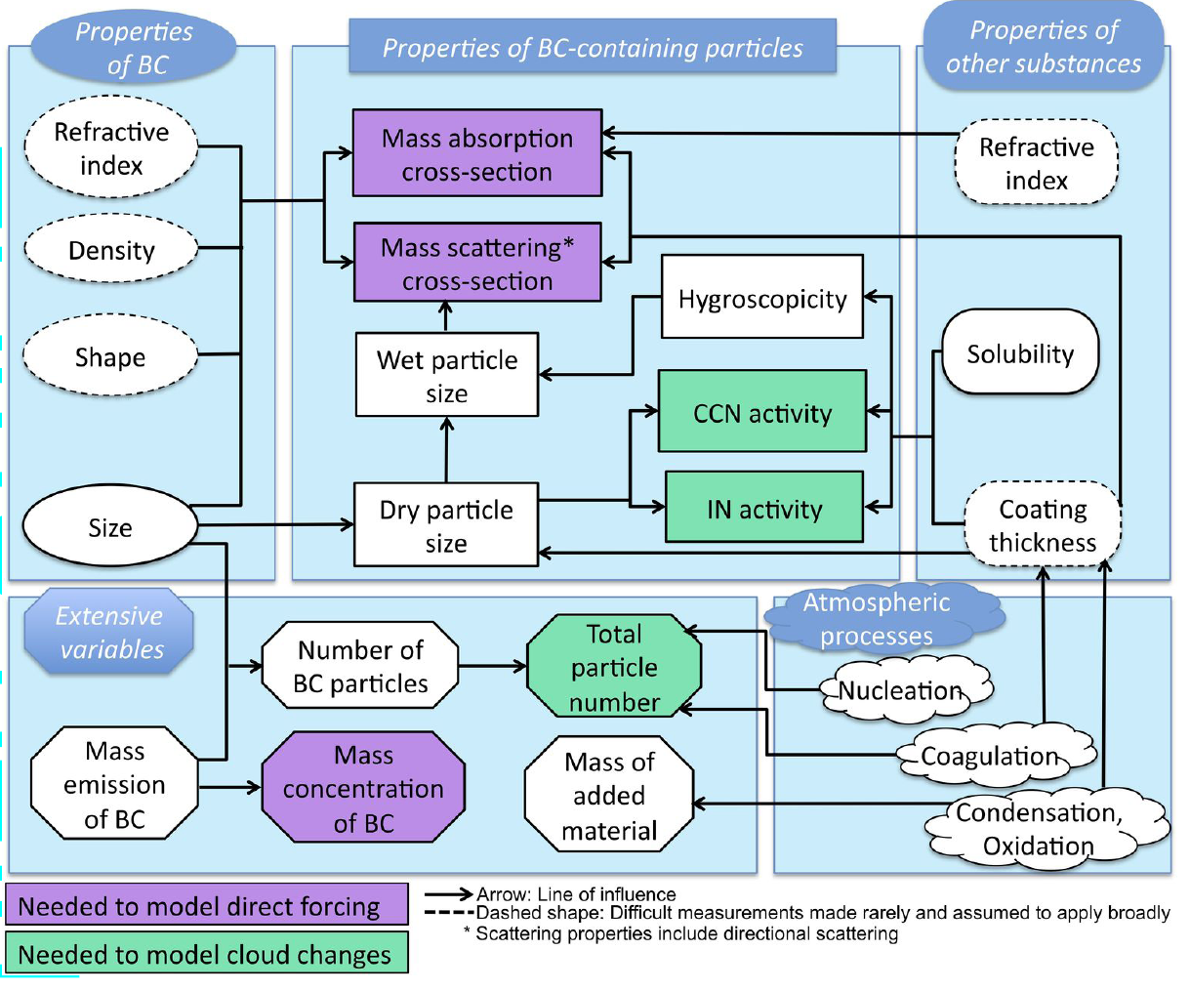
Efeitos de Black Carbon no balanço de radiação e em nuvens

Slide 44
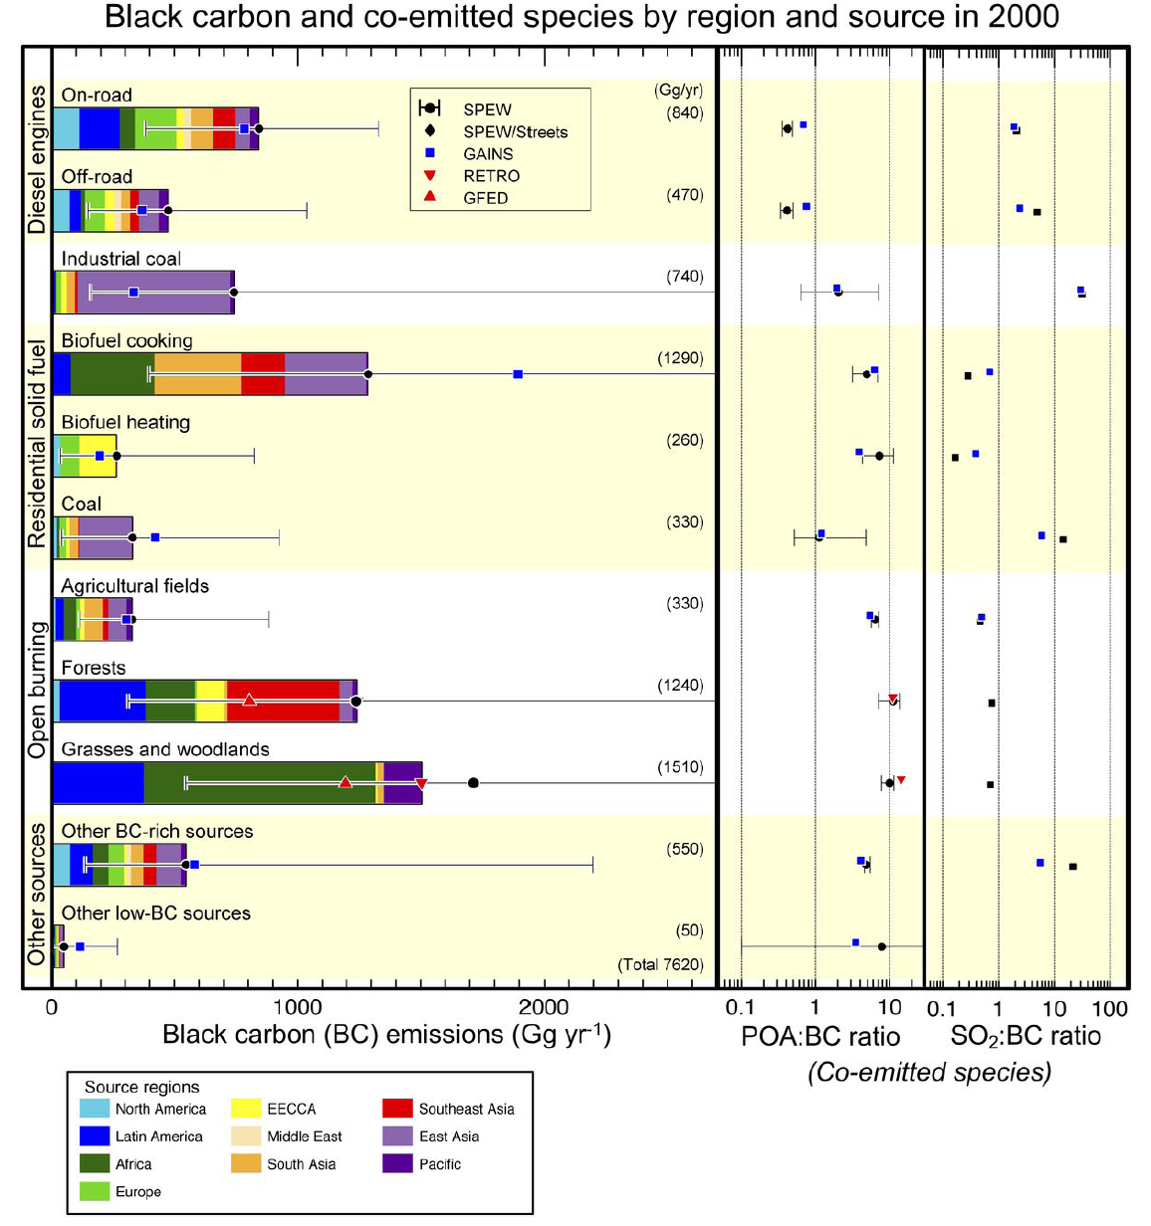

Slide 45
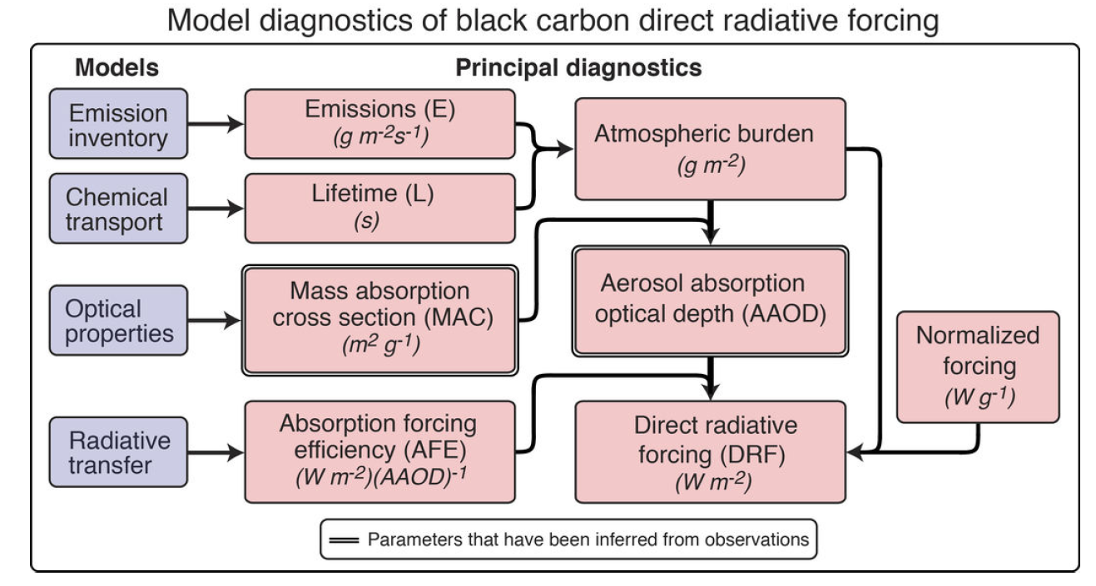

Slide 46
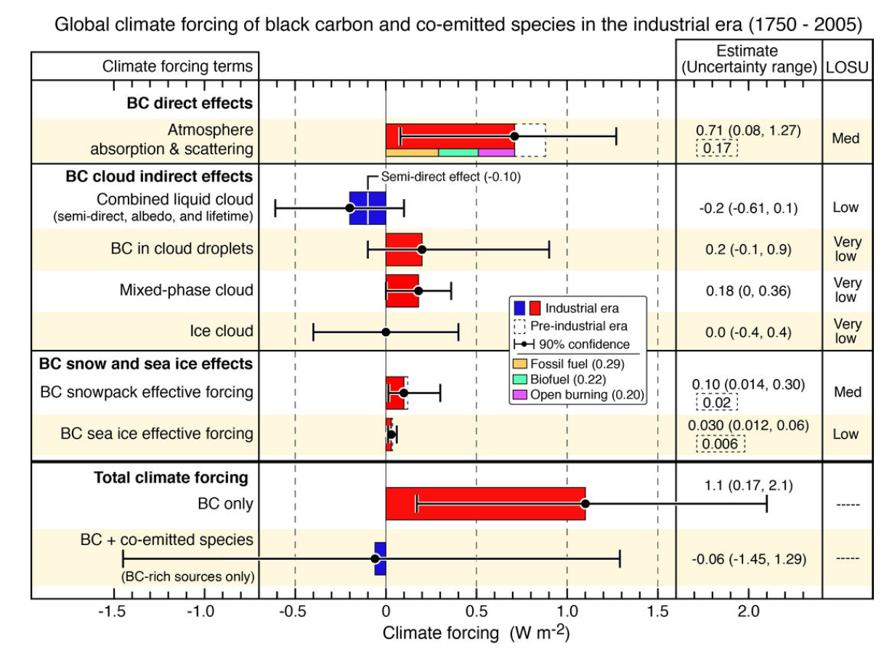

Slide 47
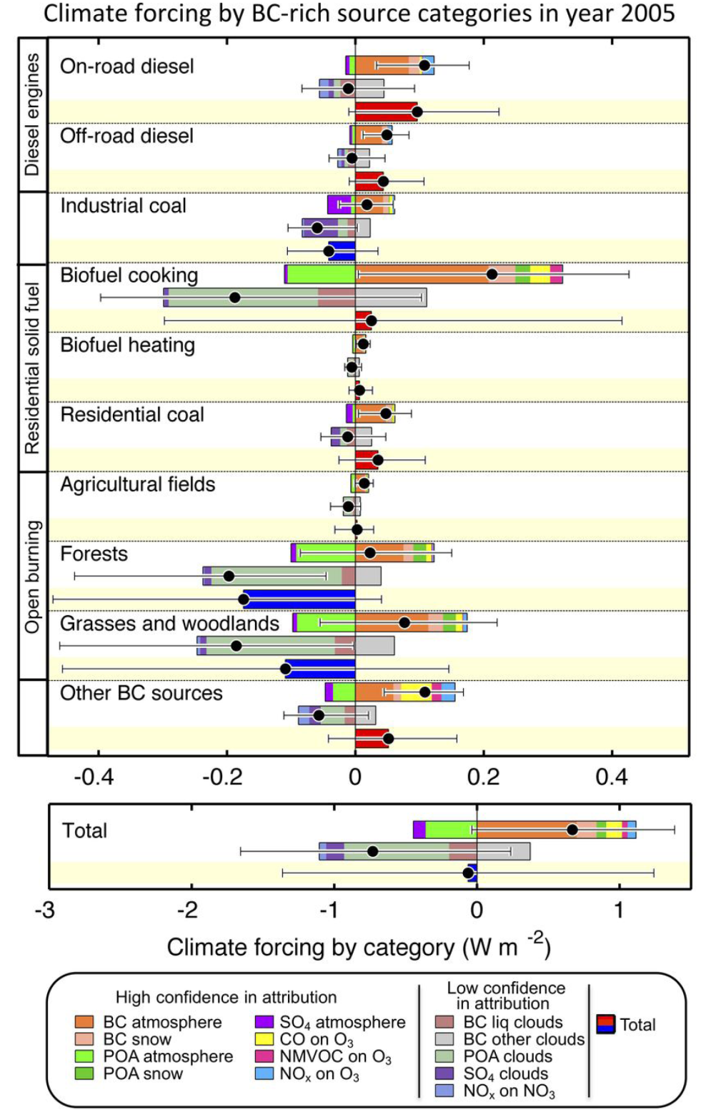
Climate forcing
By source category

Slide 48

Forçante radiativa do sistema climático global (IPCC 2007)
Maiores incertezas: aerossóis, nuvens e realimentações

Slide 49

Forçante radiativa do sistema climático global (IPCC 2013)

Slide 50

Evolução temporal da forçante radiativa por componente

Slide 51

Annual mean cloud properties
(a) Annual mean cloud fractional occurrence (CloudSat/CALIPSO 2B-GEOPROF-LIDAR dataset for 2006–2011); (b) annual zonal mean liquid water path (blue shading, ocean only, microwave radiometer dataset for 1988–2005; the 90% uncertainty range, assessed to be 70–150% of the plotted value, is schematically indicated by the white error bar) and ice water path (grey shading, from CloudSat 2C-ICE dataset for 2006–2011; the 90% uncertainty range, assessed to be 50–200% of the plotted value, is schematically indicated by the black error bar). (c-d) latitude-height sections of annual zonal mean cloud (including precipitation falling from cloud) occurrence and precipitation (attenuation-corrected radar reflectivity >0 dBZ) occurrence; the latter has been doubled to make use of a common colour scale (2B-GEOPROF-LIDAR dataset). The dashed curves show the annual-mean 0°C and −38°C isotherms.

Slide 52

Mean high, middle and low cloud cover from CloudSat/CALIPSO GEOPROF dataset (2006– 2011),
DJF
JJA
High
Middle
Low

Slide 53

Gases, aerossóis e nuvens: um sistema integrado impossível de separar
Overview of atmospheric aerosol processes and environmental variables influencing aerosol-radiation and aerosol-cloud interactions. Although this figure shows a linear chain of processes from aerosols to forcings, it is increasingly recognized that aerosols and clouds form a coupled system with two-way interactions

Slide 54

Schematic depicting the myriad aerosol-cloud-precipitation related processes
The schematic conveys the importance of considering aerosol-cloud-precipitation processes as part of an interactive system encompassing a large range of spatiotemporal scales. These processes influence the short- and longwave forcing of the system and hence climate

Slide 55

Annual zonal mean RFari (in W/m²) due to all anthropogenic aerosols
The forcings are for the 1850 to 2000 period. Myhre et al. (2012).

Slide 56

Mean (solid line), median (dashed line), one standard deviation (box) and full
(min-max) range (whiskers) for RFari (in W/m²) from different aerosol types
RFari
The forcings are for the 1850 to 2000 period. Myhre et al. (2012).

Slide 57

Atribuição: Só com emissões antropogênicas as observações são explicadas

Slide 58


Slide 59

Cenários de Emissões e “RCP - Representative Concentrations Pathways”
RCP8.5
RCP2.6

Slide 60


Time evolution of global anthropogenic and biomass burning emissions 1850–2100 used in CMIP5/ACCMIP following each RCP.
Blue (RCP2.6), light blue (RCP4.5), orange (RCP6.0) and red (RCP8.5). BC stands for black carbon (in Tg(C) yr–1), OC for organic carbon (in Tg(C) yr–1), NMVOC for non-methane volatile organic compounds (in Tg(C) yr–1) and NOX for nitrogen oxides (in Tg(NO2) yr–1). Other panels are in Tg(species) yr–1.
Gases de feito estufa de longa vida

Slide 61


Os modelos acertam na previsão climática dos últimos 150 anos?
Observational estimates of global mean temperature (black lines), compared to model simulations with natural forcings only (bottom panel) and anthropogenic and natural forcings (upper panel). (IPCC2012)
Natural forcings only

Slide 62

24 Models: Simulated historic and 21st century global mean temperature
Simulated historic and 21st century global mean temperature anomalies, relative to the preindustrial period (1880–1900), for 24 CMIP5 models based on the RCP8.5 scenario. The colored (and labeled) curves show those simulations reaching a global mean warming of 4°C–5°C warmer than preindustrial for 2080–2100, which are used for further analysis.
Sources: Hare et al. 2011; Rogelj et al. 2010; Schaeffer et al. 2012.

Slide 63

Previsões de aumento de temperatura
extensão de gelo marinho
pH acidez oceânica

Slide 64

Projeção de aumento de temperatura e chuva em dois cenários

Slide 65

Aumento médio do nível do mar

Slide 66

Estimativas de aumento de temperatura em função dos cenários de emissões
Probabilistic temperature estimates for old (SRES) and new (RCP) IPCC scenarios. Depending on which global emissions path
is followed, the 4°C temperature threshold could be exceeded before the end of the century.
Source: Rogelj, Meinshausen, et al. 2012.

Slide 67

Projeções de mudanças na precipitação
1986-2005 to 2081-2100
RCP8.5

Slide 68

Efeitos cumulativos das emissões de carbono

Slide 69


Quanto tempo o efeito do CO₂ irá afetar o clima do planeta?
Susan Salomon PNAS Fev 2009
Note a escala: Até o ano 3000 →

Slide 70

Vivemos em um mundo biológico: Feedbacks biogeoquímicos
Como bactérias no solo (responsáveis por emissões de metano) vão reagir?

Slide 71

Number of natural disasters 1980–2010
The Global Climate Report WMO 2013
source: MunichRe NatCatSERVICE

Slide 72

Global land temperature variation (1850-2012)

Slide 73

El Nino Southern Oscillations Variations
(1950 – Present)
Temperature stagnation
(mostly La Nina)
Ocean uptake
of heat???
Global warming
(mostly El Nino)
Temperature stagnation
(mostly La Nina)
Ocean uptake
of heat

Slide 74

Ocean Heat Capacity Considerations
Weight of atmosphere ≈10 m of seawater
On per unit mass basis
Water Air
4.18 joule/gm/°C 1.0 joule/gm/°C
Atmosphere column ≈ 2.5m of ocean depth
Sunlight penetration of seawater ≈ 100m
Águas profundas
Águas superficiais

Slide 75

Earth System Modeling
Necessitamos de uma nova maneira de fazer ciência

Slide 76

Obrigado pela atenção !!!

Slide 77


A Governança das mudanças globais e as interconexões
Dificuldades de acordos internacionais:
E os países com baixa emissão per capita?
Países desenvolvidos aceitam redução em seu nível de consumo?
Quem paga a conta?
Quem perde e quem ganha economicamente?
Prazos para redução de emissões? Muitos etc…
Interconnected global challenges.Global Risks Report (2011)

Slide 78
Atribuição do aumento observado de temperatura
Comparação de temperaturas modeladas e observadas usando forçantes climáticas naturais e antropogênicas para cada região do planeta.

Slide 79


Total ice sheet mass balance, dM/dt, between 1992 and 2010
Source: E. Rignot, Velicogna, Broeke, Monaghan, and Lenaerts 2011.
Total ice sheet mass balance, dM/dt, between 1992 and 2010 for (a) Greenland, (b) Antarctica, and c) the sum of Greenland and Antarctica, in Gt/year from the Mass Budget Method (MBM) (solid black circle) and GRACE time-variable gravity (solid red triangle), with associated error bars.

Slide 80

Heat storage in upper 2000 meters of ocean during 2003-2008 based on ARGO data.
Knowledge of Earth’s energy imbalance is improving rapidly as ARGO data lengthens.
Data source: von Schuckmann et al. J. Geophys. Res. 114, C09007, 2009.
Armazenamento de calor nos oceanos até 2000 metros de profundidade

Slide 81

Tropospheric aerosols mask warming
(global dimming)
Greenhouse gases dominate
Recovery from volcanic eruptions dominates
Aerosols (and greenhouse gases) dominate the temperature change

Slide 82

Aumento do nível do mar pelas diferentes contribuições
The contributions of land ice (mountain glaciers and ice caps and Greenland and Antarctic ice sheets), thermosteric sea level rise, and terrestrial storage (the net effects of groundwater extraction and dam building), as well as observations from tide gauges (since 1961) and satellite observations (since 1993).
Source: Church et al., 2011.

Slide 83


Série temporal de extremos de temperatura
Northern Hemisphere land area covered (left panel) by cold (< –0.43σ), very cold (< –2σ), extremely cold (< –3σ) and (right panel) by hot (> 0.43σ), very hot (> 2σ) and extremely hot (> 3σ) summer temperatures.
Source: Hansen et al. 2012

Slide 84

Frequência de eventos extremos
2081-2100
Changes in selected extreme indices in 2100

Slide 85
Arctic climate is changing very fast
If in 300-500 years the Greenland water mets, the sea level would rise about 7 meters.

Slide 86

Greenland and Antarctic ice loss

Slide 87

Selection of record-breaking meteorological events since 2000, their societal impacts and qualitative confidence level that the meteorological event can be attributed to climate change
D Coumou and S Rahmstorf, Nature Climate Change 2, 491 (2012).

Slide 88

Radiative forcing of climate change during the industrial era.
Forcing by component between 1750 and 2010 with associated uncertainty range (solid bars are RF, hatched bars are AF, green diamonds and associated uncertainties are those assessed in AR4).

Slide 89

The Earth’s energy budget from 1970 through 2010
The cumulative energy into the Earth system from changes in solar forcing, well-mixed and short-lived greenhouse gases, changes in surface albedo, volcanic forcing and tropospheric aerosol.
The cumulative energy from (a), with an expanded scale, is balanced by the warming of the Earth system (energy absorbed in the melting of ice and warming the atmosphere, the land and the ocean) and an increase in outgoing radiation inferred from temperature change of a warming Earth.

Slide 90

How well the models simulate important features of the climate of the 20th century
Confidence in the assessment increases towards the top-right corner as suggested by the increasing strength of shading. Features that current state-of-the-art AOGCMS and ESMs simulate well, show mixed results, or have problems representing are shown in blue, grey, and red, respectively.

Slide 91



Hadley Center Predictions

Slide 92

Global mean sea level (GMSL) and upper ocean heat content anomaly (UOHCA)
from 1900-2010
1900-2010
Global mean sea level (GMSL) from the different measuring systems . Blue: Yearly average GMSL reconstructed from tide gauges (1880–2010) Red: from altimetry. Green: Observation-based estimates of annual global mean upper ocean heat content anomaly (UOHCA) in ZJ (1021 J) from 0–700 m.
Nerem et al., 2010, Domingues et al. (2008)

Slide 93


Global temperature trend. Atmosphere: 1958– 2003. Radiosonde product global temperature trend estimates. (IPCC AR5, 2012
Decadal mean anomalies and associated uncertainties based upon the HadCRUT4 ensemble (Morice et al., Submitted). Anomalies are relative to a 1961–1990 climatology period. NCDC MLOST and GISS dataset estimates are also shown. (IPCC AR5, 2012)

Slide 94

Crescimento da população 2010-2050

Slide 95


Slide 96
Top 20 CO₂ Fossil Fuel Emitters
& Per Capita Emissions 2010
2500
2000
1500
Per Capita Emissions (tons C person y⁻¹)
Total Carbon Emissions (tons x 1,000,000)
1000
500
0
Global Carbon Project 2011; Data: Boden, Marland, Andres-CDIAC 2011; Population World Bank 2011

Slide 97

Closure of the meridional overturning circulation through Southern Ocean upwelling
A schematic diagram of the Upper Cell and Lower Cell of the global MOC emanating from, respectively, northern and southern polar seas.
John Marshall and Kevin Speer, Nature 2012
Notes:
A schematic diagram of the Upper Cell and Lower Cell of the global MOC emanating from, respectively, northern and southern polar seas. The zonally averaged oxygen distribution is superimposed, yellows indicating low values and hence older water, and purples indicating high values and hence recently ventilated water. The density surface 27:6 kgm􀀀3 is the rough divide between the two cells (neutral density is plotted). The jagged thin black line indicates roughly the depth of the Mid-Atlantic Ridge and the Scotia Ridge (just downstream of Drake Passage) in the Southern Ocean (see Fig. 2). Low-latitude, wind-driven shallow cells are not indicated. General patterns of air–sea surface density (equivalent buoyancy) flux, B (red or blue indicating that surface waters are being made less or more dense, respectively; broad pattern of zonal surface wind stress, , : eastward; , westward). Coloured arrows schematically indicate the relative density of water masses: lighter mode and thermocline waters (red), upper deep waters (yellow), deep waters including NADW(green) and bottom waters (blue). Mixing processes associated with topography are indicated by the vertical squiggly arrows. This schematic is a highly simplified representation of a three-dimensional flow illustrated more completely in Box 1.

Slide 98
Radiative forcing of climate change 1750-2010
Forcing by component between 1750 and 2010 with associated uncertainty range (solid bars are RF, hatched bars are AF, green diamonds and associated uncertainties are those assessed in AR4).
IPCC 2012

Slide 99

Global anthropogenic present-day emissions weighted by GWP and GTP for the chosen time horizons
Effective amount of year 2000 (single-year pulse) using the Global Warming Potential (GWP), which is the global mean radiative forcing integrated over the indicated number of years relative to the forcing from CO2 emissions, and the Global Temperature Potential (GTP) which estimates the impact on global mean temperature based on the temporal evolution of both radiative forcing and climate response relative to the impact of CO2 emissions. The Absolute GTP as a function of time for year 2000 emissions of all compounds from the indicated sector is shown on the right, which is the same as GTP, except is not normalized by the impact of CO2 emissions. The effects of aerosols on clouds (and in the case of black carbon, on surface albedo) are not included.

Slide 100

Reconstructed Northern Hemisphere temperature change but without model simulations. Data are expressed as anomalies from their 1500–1850 CE mean and smoothed.

Slide 101

Emissões de CO2 e aumento provável da temperatura ao longo deste século
Emissões de CO2 ao longo deste século e o provável aumento da temperatura (>66%) para 4 cenários de emissões.
Aumento provável da temperatura (>66%) ao longo deste século para 4 cenários de emissões.
IPCC 2012

Slide 102
Future Sea Level Relative to 1990
Future sea level (rel. to 1990) based
on IPCC AR4 global temperature projections
Full range: 75 – 190 cm by 2100

Slide 103

Frequência de ocorrência de eventos extremos em temperatura e precipitação
T > 95% percentil
Precip. > 95% percentil
Global mean projections for the occurrence of warm and wet days from CMIP5 for the RCP2.6, RCP4.5 and RCP8.5 scenarios relative to 1986–2005. Panel (a) shows percentage of warm days (tx90p: Tmax exceeds the 90th percentile), panel (b) shows relative change of very wet days (pr95p: annual total precipitation when daily precipitation exceeds 95th percentile).

Slide 104

Global mean sea level rise - Projections with ranges for contributions (2081–2100 relative to 1986–2005 )
It was used four RCP scenarios and scenario SRES A1B used in the AR4.

Slide 105



Slide 106
Northern Hemisphere Sea Ice Extent Anomalies

Slide 107

C40 - Megacidades e emissões de gases de efeito estufa
América Latina: 80% população urbana em 2012

Slide 108

Efeitos até o ano 3.000
As simulated by 6 EMICs (Bern3D, CLIMBER 2,CLIMBER 3-alpha, DCESS, MESMO and UVic) for the 4 RCPs, assuming zero anthropogenic emissions after 2300
Compatible anthropogenic CO2 emissions,
Projected atmospheric CO2 concentration,
Global mean surface temperature change .
Ocean thermal expansion.

Slide 109

Balanço de radiação terrestre (Wm⁻²)
Threnberg, BAMS 2009
Notes:
Threnberg, BAMS 2009

Slide 110

Mean sea-level trend over the period 1993–2010 (mm/year), derived from satellite altimeter data.
(source: CSIRO)

Slide 111

Intensities of El Niño and La Niña events in the central equatorial Pacific (Niño4 region) and the estimated linear trends, which is 0.20(±0.18)°C/decade for El Niño and −0.01(±0.75)°C/decade for La Niña events.
(Lee and McPhaden, 2010).

Slide 112


Mudanças climáticas devido a causas naturais:
  Forçante solar :
    Mudanças orbitais da Terra: Ciclos de Milancovitch
    Variações na emissão de energia solar
    Vulcanismo, choques de cometas….

Slide 113

Arctic sea ice extent for 2007–12, with the 1979–2000 average in dark grey
Source: NASA 2012. Credits (right panel): NSIDC (2012) and M. Tschudi and J. Maslanik, University of Colorado Boulder

Slide 114


Mudança de uso do solo: Os maus exemplos da Europa e Norte América...

Slide 115

Atmospheric radiative forcing, relative to 1750, of all LLGHGs and the 2010 update of the NOAA AGGI. The reference year for the index is 1990 (AGGI = 1)

Slide 116

IPCC Special report on managing the risks of extreme events

Slide 117




Intensidade de chuva em São Paulo

Slide 118
Aumento da temperatura pode estar aumentando a frequenciade eventos climáticos extremos
Extreme summer heat anomalies now cover about 10% of land area, up from 0.2%.
This is based on observations, not models.
Frequency of occurrence (vertical axis) of local June-July-August temperature anomalies (relative to 1951-1980 mean) for Northern Hemisphere land in units of local standard deviation (horizontal axis). Temperature anomalies in the period 1951-1980 match closely the normal distribution ("bell curve", shown in green), which is used to define cold (blue), typical (white) and hot (red) seasons, each with probability 33.3%. The distribution of anomalies has shifted to the right as a consequence of the global warming of the past three decades such that cool summers now cover only half of one side of a six-sided die, white covers one side, red covers four sides, and an extremely hot (red-brown) anomaly covers half of one side.
Source: Hansen, J., Sato, M., and Ruedy, R., Proc. Natl. Acad. Sci., 2012.

Slide 119



O aumento da incidência de furacões está ligada
ao aumento da temperatura superficial do mar
(1944-2005)
SST
A percentagem de furacões categoria 4 e 5 está aumentando desde 1944

Slide 120

Aumento da incidência de eventos climáticos extremos – 1950-2008
EMDAT - The International Emergency Disasters Database (www.emdat.be)

Slide 121

The climate system – HadGEM2
Online
CLIMATE
Offline
Direct and
Indirect Effects
Greenhouse Effect
Human
Emissions
AEROSOLS
GHG’s
Fe deposition
CH₄, O₃,
Oxidants:
OH, H₂O₂
HO₂,O₃
DMS,
Mineral dust
CO₂
Human
Emissions
Human
Emissions
CHEMISTRY
Biogenic Emissions:CH₄
Dry deposition: stomatal conductance
ECOSYSTEMS
Land-use
Change
Falta MUITA coisa...

Slide 122

Decadal global precipitation anomalies (mm) relative to the 1961–1990 WMO standard normal

Slide 123

Decadal global combined surface-air temperature over land and sea-surface temperature (°C)
The horizontal grey line is the long-term average value (14.0°C) (1961–1990 base period).
WMO, 2013

Slide 124
Solar radiation balance

Slide 125



Irradiância solar 1975-2012
The drop of 1.2 W m⁻² since 2001 is equivalent to
-0.2 Wm⁻² in radiative forcing

Slide 126

As temperaturas globais variam, mas nosso planeta está se tornando mais quente
Global surface temperature anomalies relative to 1951-1980 average for (a) annual and 5-year running means through 2010, and (b) 60-month and 132- month running means through July 2012.
(Hansen, J., Ruedy, R., Sato, M., and Lo, K., 2010: Global surface temperature change, Rev. Geophys. 48, RG4004.)
Gases de efeito estufa e aerossóis dominam a variabilidade da temperatura global

Slide 127

Temperature data
from different sources
GISS: NASA Goddard Institute for Space Studies GISS; NCDC: NOAA National Climate Data Center;
CRU: Hadley Center/ Climate Research Unit UK;
RSS: data from Remote Sensing Systems;
UAH: University of Alabama at Huntsville.
Source: Foster and Rahmstorf 2012.

Slide 128

Ex-céticos: resultados do “Berkeley Earth Group”
The Berkeley Earth Surface Temperature study is using over 36,000 unique stations
http://berkeleyearth.org/

Slide 129
2001-2007 Mean Surface Temperature Anomaly (◦C)
Base Period = 1951-80, Global Mean = 0.54

Slide 130

There is no trend in global precipitation amounts
GPCP Global precipitation 1979-2008
Biggest changes in absolute terms are in the tropics, and there is a strong El Niño signal

Slide 131

Air holds more water vapor at higher temperatures
A basic physical law tells us that the water holding capacity of the atmosphere goes up at about 7% per degree Celsius increase in temperature.
Observations show that this is happening: 0.55°C since 1970 over global oceans and 4% more water vapor.
This means more moisture available for storms and an enhanced greenhouse effect.
Total water vapor

Slide 132

WMO Greenhouse Gas Bulletin, No.7, 2011

Slide 133

Decadal precipitation anomalies for global land areas for 2001–2010. departures in mm/year from averages computed using 1951–2000 base period

Slide 134

Diferenças regionais no aumento do nível do mar
Ensemble mean sea level anomaly (m) with respect to global mean RS change (0.47 m) for scenario A1B between 1980–1999 and 2090–2099 (from Slangen et al., 2011). Global mean = 0.47 m; range = –3.65 to +1.01 m.

Slide 135
Greenland total snowmelt area
Area on Greenland with snowmelt
Graph credit: Konrad Steffen, Univ. Colorado
Notes:
135

Slide 136
Estimates of temperature increase for 2029 and 2099 according to 3 emission scenarios

Slide 137

Previsão de aquecimento global ao longo dos próximos 100 anos
Cenários possíveis de aumento nas concentrações de CO₂
Aumento na temperatura média global: de 2 a 4 graus centígrados ao longo deste século

Slide 138

Changes in the water cycle in 2100
(IPCC 2012)

Slide 139

Increase of incidence of extreme climatic events 1950-2000
Millennium Ecosystem Assessment, 2007

Slide 140

Global abundances (as mole fractions) of key greenhouse gases averaged over the 12 months of 2011 as well as changes relative to 2010 and 1750 from the WMO/GAW global greenhouse gas monitoring network
(*) Assuming a pre-industrial mole fraction of 280 ppm for CO₂, 700 ppb for CH₄ and 270 ppb for N₂O
Since the industrial revolution, about 375 billion tonnes of carbon have been emitted by humans into the atmosphere as carbon dioxide (CO₂).

Slide 141

Global mean sea-level rise 1900-2100
Global mean sea-level rise using a semi-empirical approach. The indicative/fixed present-day rate of 3.3 mm.yr-1 is the satellite-based mean rate 1993–2007 (Cazenave and Llovel 2010). Median estimates from probabilistic projections. See Schaeffer et al. (2012).

Slide 142

Efeitos de BC nas nuvens:
Aquecimento e resfriaento
Liquid phase clouds
Mixed phase clouds
Ice clouds

Slide 143

Schematic of the new terminology used in this assessment report for aerosol-radiation and aerosol-cloud interactions
The radiative forcing from aerosol-radiation interactions (abbreviated RFari) encompasses radiative effects from anthropogenic aerosols before any adjustment takes place, and corresponds to what is usually referred to as the aerosol direct effect. Rapid adjustments induced by aerosol radiative effects on the surface energy budget, the atmospheric profile and cloudiness contribute to the adjusted forcing from aerosol-radiation interactions (abbreviated AFari). They include what has earlier been referred to as the semi direct effect. The radiative forcing from aerosol-cloud interactions (abbreviated RFaci) refers to the instantaneous effect on cloud albedo due to changing concentrations of cloud condensation and ice nuclei. All subsequent changes to the cloud lifetime and thermodynamics are rapid adjustments, which contribute to the adjusted forcing from aerosol-cloud interactions (abbreviated AFaci).

Slide 144


Instantaneous Radiative Forcing versus adjusted forcing
flux change when the surface temperature is fixed over the whole Earth
AF, the adjusted forcing which allows atmospheric and land temperature to adjust while ocean conditions are fixed,
RF, which allows stratospheric temperature to adjust
the equilibrium response to the climate forcing agent.
Instantaneous
RF

Slide 145


Radiative Forcing versus Adjusted Forcing
satellite data (SAT)
inverse estimate (INV).

