Slide 1
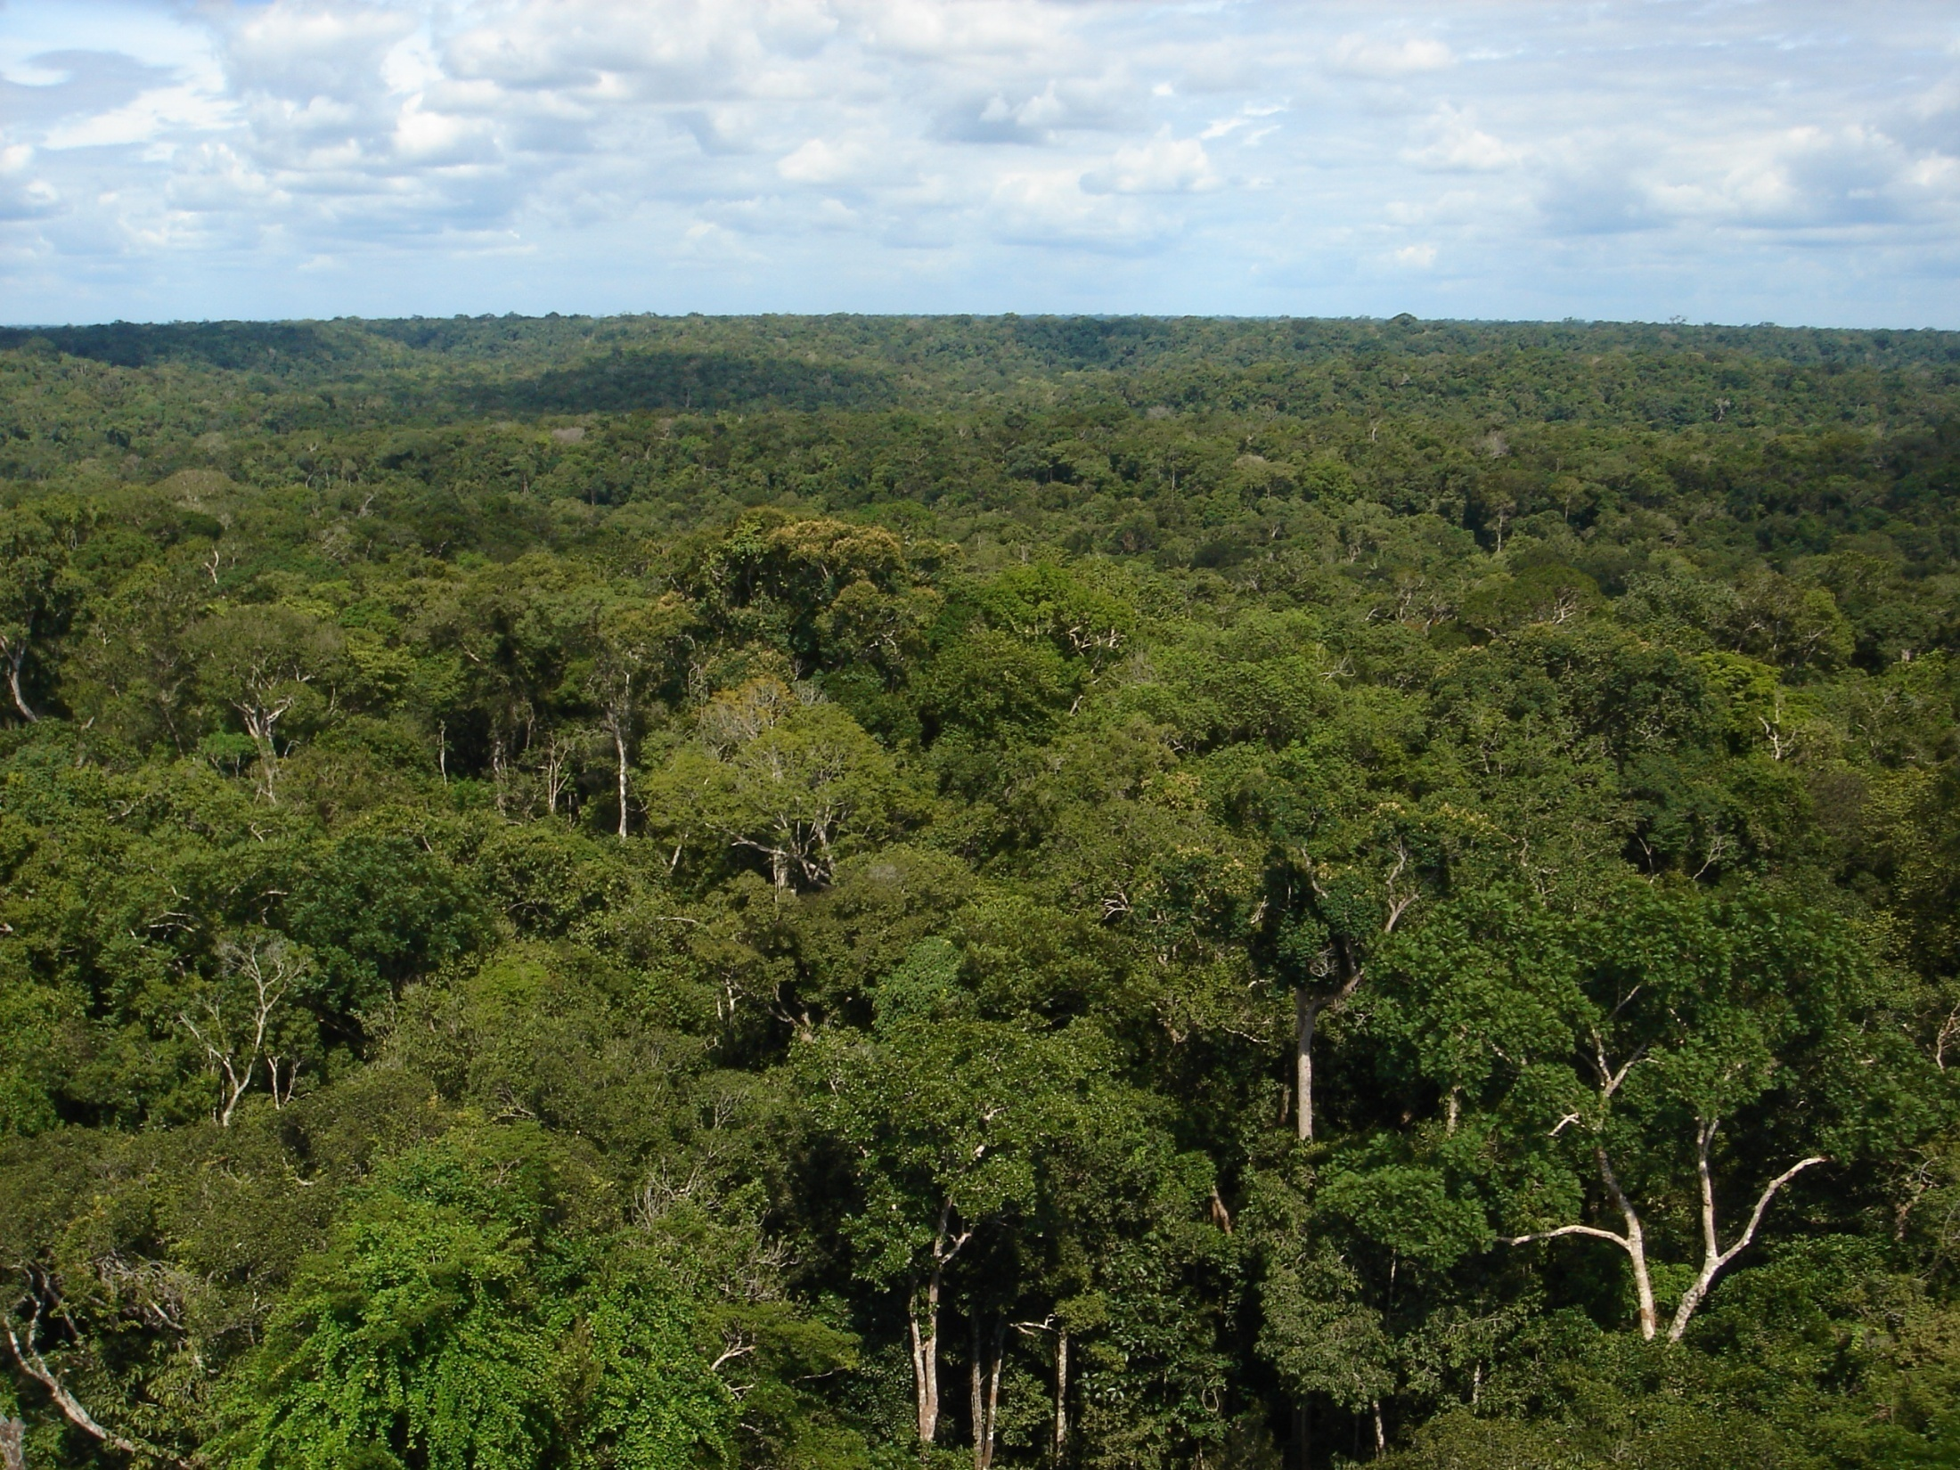
The Brazilian Component of GoAmazon
Paulo Artaxo, Henrique Barbosa, Maria Assunção Silva Dias, Luiz Augusto Machado, Gilberto Fisch, Rodrigo Souza, Joel Brito, Samara Carbone, Elisa Sena, and the Brazilian GoAmazon Science team
Carbon Cycle Cloud Life Cycle Aerosol Life Cycle
Climate
Ecosystems
Atmospheric Composition

Slide 2
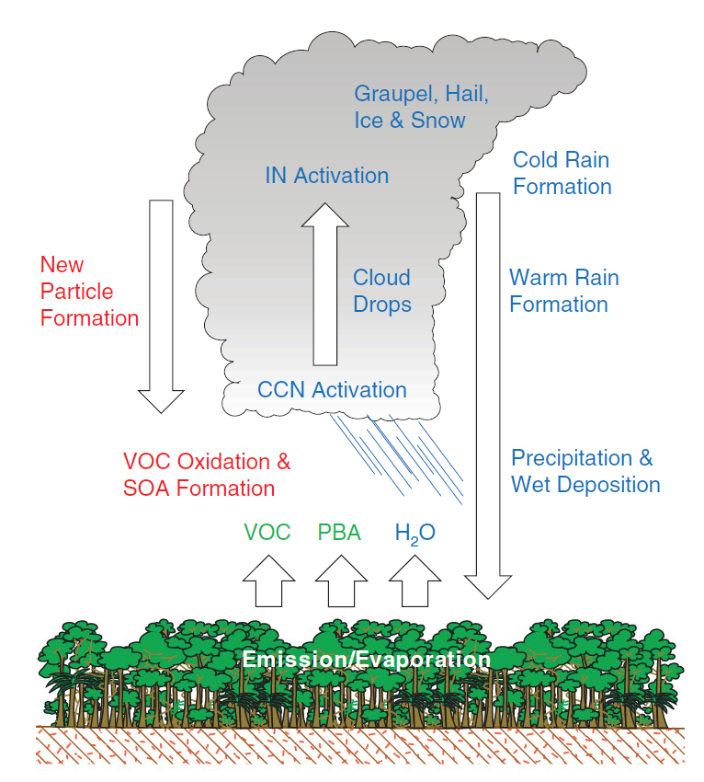
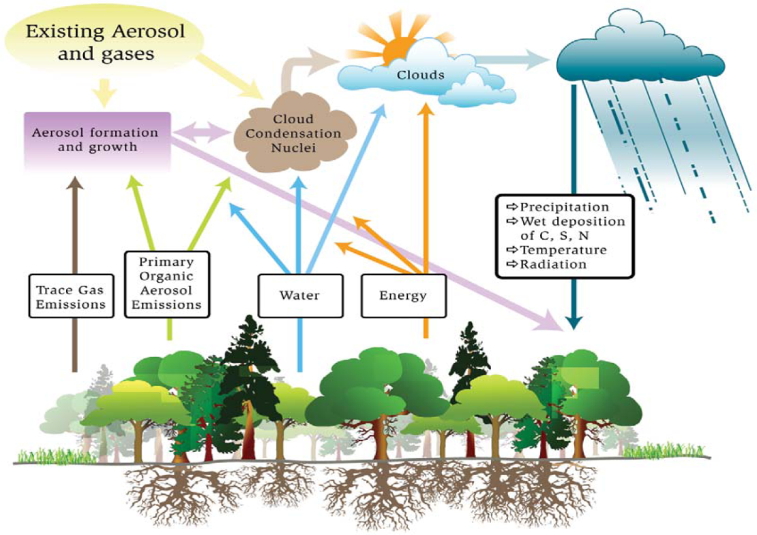
Aerosol and
cloud lifecycles
T, Precip, RH
Radiation
Deposition
BVOCs, Aerosols
Water
Energy

Slide 3
Objectives based on these critical questions and issues are as follows:
Aerosol Life Cycle
1. Study process and interactions of the Manaus pollution plume with biogenic emissions of VOCs, especially the impact on the production of secondary organic aerosol (SOA) and the formation of new particles;
2. To measure the aging of biomass burning plumes and the subsequent formation of additional SOA;
3. The influence of anthropogenic emissions i.e., (a) the Manaus pollution plume and (b) biomass burning aerosols on aerosol microphysical, optical, CCN, as obtained by comparing the aerosol properties between pristine and anthropogenically influenced air masses; and
4. Determine the optical properties of aerosols from the interaction of the Manaus plume and the natural vegetation atmosphere and obtain the aerosol radiative forcing.
Cloud Life Cycle
5. Study the role of landscape heterogeneity (e. g., the urban area of Manaus or km-long scale of rivers) on the dynamics of convection and clouds;
6. The evolution of convective intensity from severe storms in the dry season to moderate storms in the wet season, and to consider how changes caused by local deforestation lead to similar transitions;
7. The transition from shallow to deep cumulus convection during the daily cycle of the Amazon Basin, with comparison and understanding to other ARM sites; and
8. Development of a knowledge base and test cases that will improve tropical cloud parameterizations in regional and global climate models (GCMs).
Cloud-Aerosol-Precipitation Interactions
9. Aerosol effects on scattered cumulus clouds, especially the aerosol radiative effect, with a special focus on the impact of biomass burning aerosols;
10. Aerosol effects on deep convective clouds, precipitation, and lightning under different aerosol and synoptic regimes, including the roles of aerosols in changing regional climate and atmospheric circulation; and
11. Improvement of parameterizations of aerosol-cloud interactions in the regional and global climate models

Slide 4
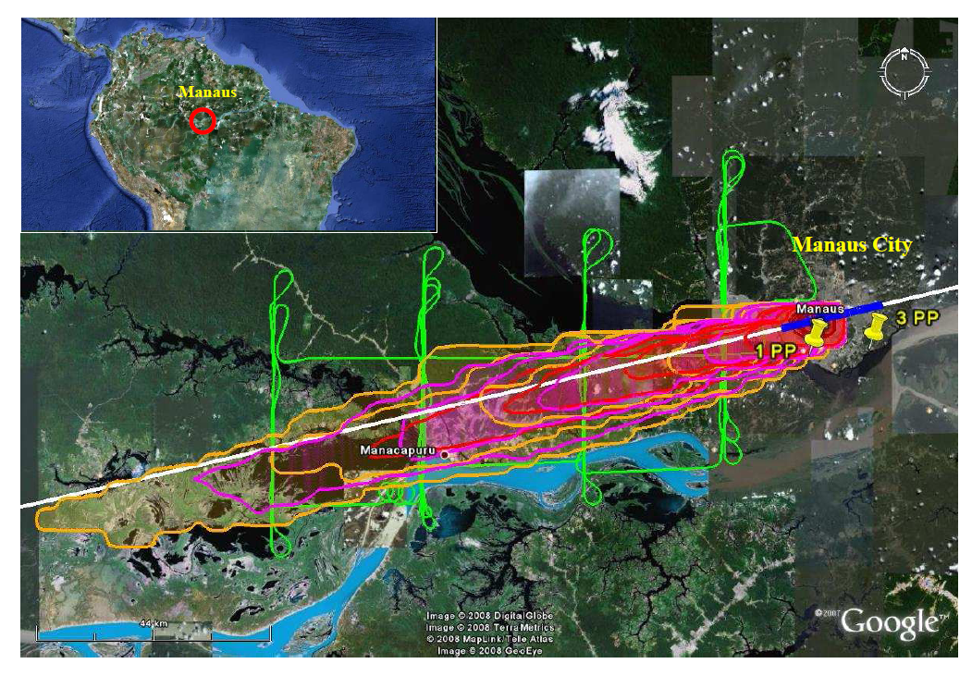
Reference: Kuhn, U.; Ganzeveld, L.; Thielmann, A.; Dindorf, T.; Welling, M.; Sciare, J.; Roberts, G.; Meixner, F. X.; Kesselmeier, J.; Lelieveld, J.; Ciccioli, P.; Kolle, O.; Lloyd, J.; Trentmann, J.; Artaxo, P.; Andreae, M. O., “Impact of Manaus City on the Amazon Green Ocean atmosphere: Ozone production, precursor sensitivity, and aerosol load,” Atmos. Chem. Phys. 2010, 10, 9251-9282.

Slide 5
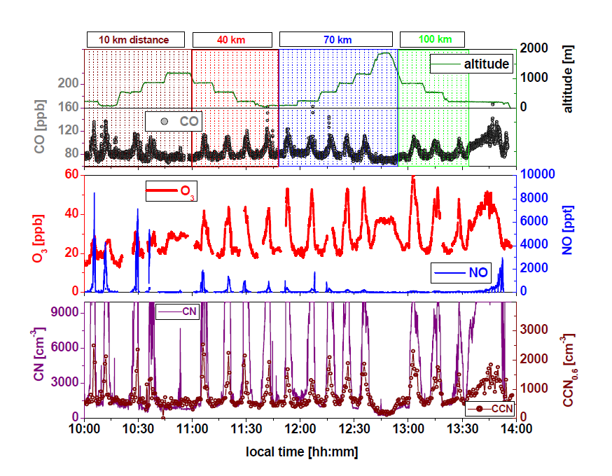
Reference: Kuhn, U.; Ganzeveld, L.; Thielmann, A.; Dindorf, T.; Welling, M.; Sciare, J.; Roberts, G.; Meixner, F. X.; Kesselmeier, J.; Lelieveld, J.; Ciccioli, P.; Kolle, O.; Lloyd, J.; Trentmann, J.; Artaxo, P.; Andreae, M. O., “Impact of Manaus City on the Amazon Green Ocean atmosphere: Ozone production, precursor sensitivity, and aerosol load,” Atmos. Chem. Phys. 2010, 10, 9251-9282.
Notes:
The atmospheric oxidant cycle in the Basin at present is in a regime of dominant HO₂ chemistry because NO_{x} concentrations are on the order of 100 ppt. Economic development can be expected to greatly increase the NO_{x} concentrations and therefore influence the atmospheric oxidant cycle. This cycle is responsible for the oxidation of BVOCs that eventually form CCN. The regulation of the hydrological by the current gaia stasis can be disrupted: isoprene is the dominant BVOC emitted in the Amazon and under higher NO_{x} conditions this BVOC forms considerably less particle-phase organic material, favoring instead higher-vapor pressure products.

Slide 6
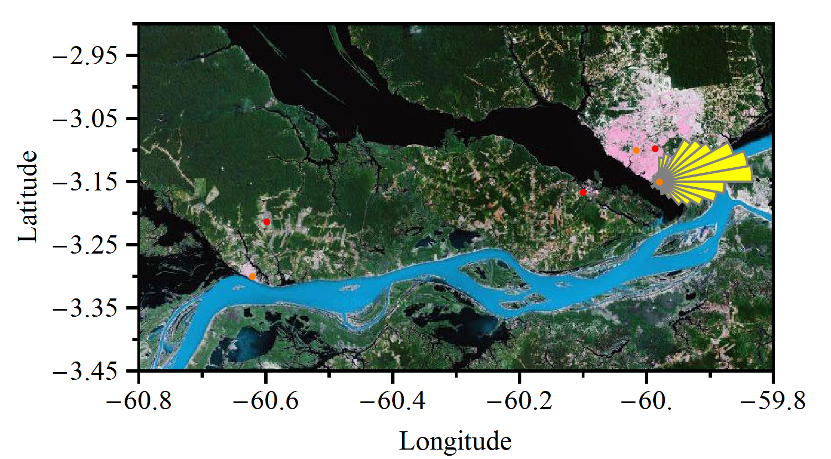
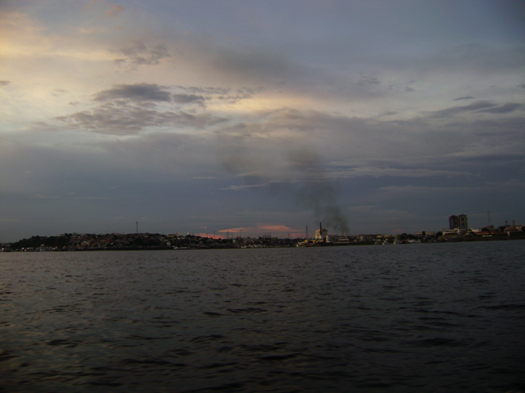
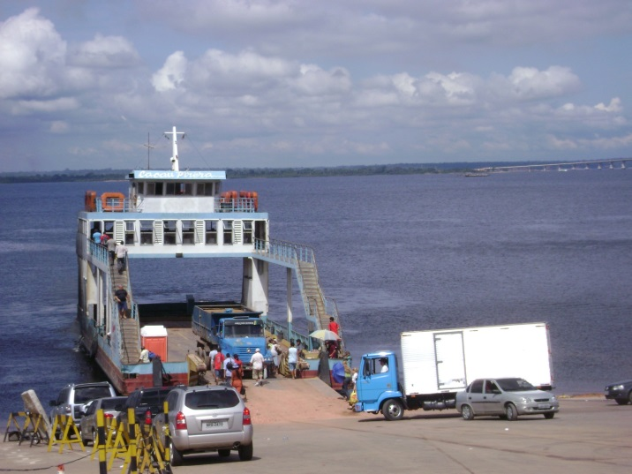

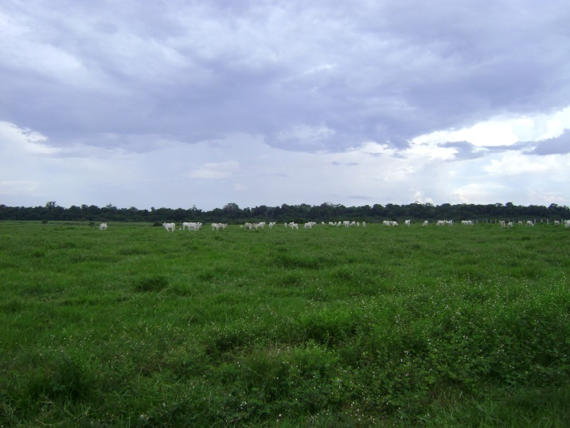
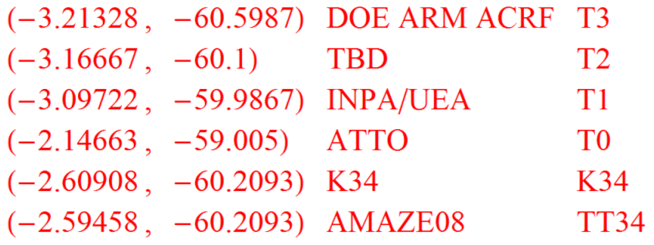
Planned sites and sampling strategy
~200 km NE
ATTO (T0 )
T1-INPA/UEA
INPA campus (Manaus)
T2-UEA/USP/ACRF(AOS)
West edge of Manaus
Manaus
T3 –ACRF
(AMF1 & MAOS)
Large pasture site
111 by 60.8 km represented by this box.
Wind speeds at 1 km altitude are typically 10 to 30 kph.
T2→T3 transit time of 2 to 6 hr.

Slide 7
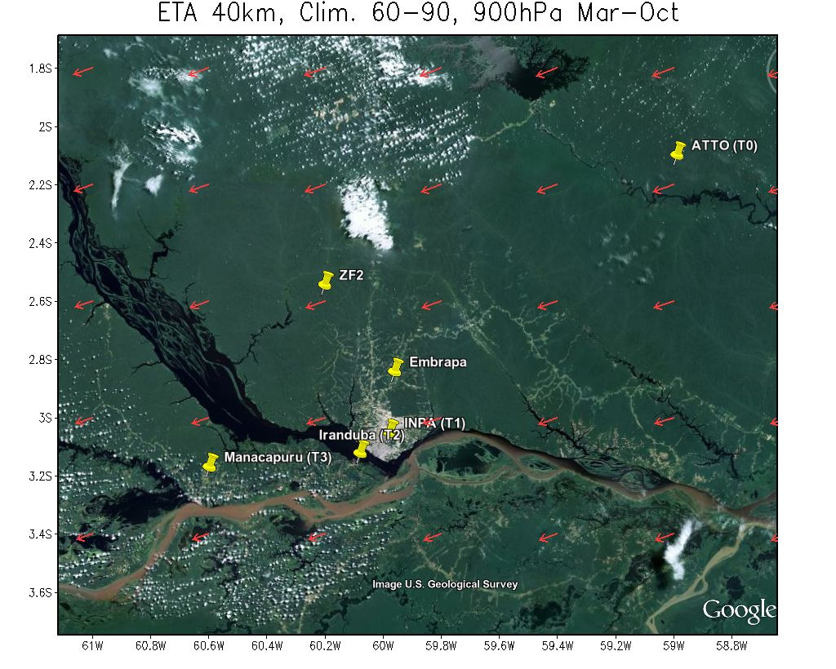

Slide 8
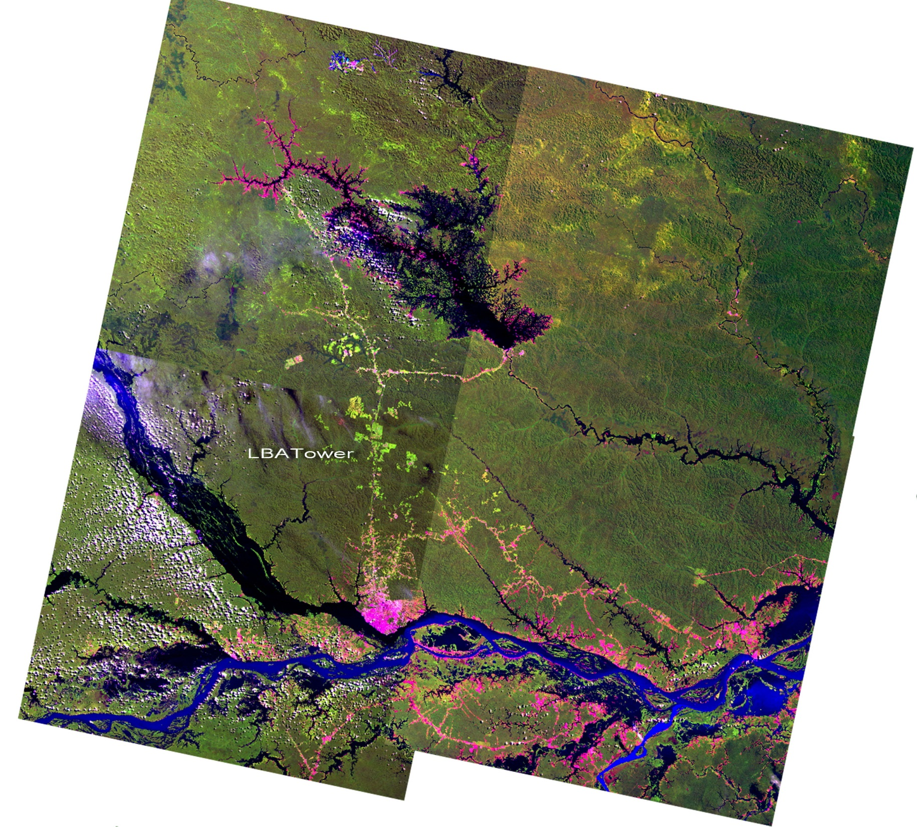
Sites
T0-ATTO
T0-ZF2
T0-EMBRAPA
T3 - Manacapuru
T2 - Tiwa

Slide 9
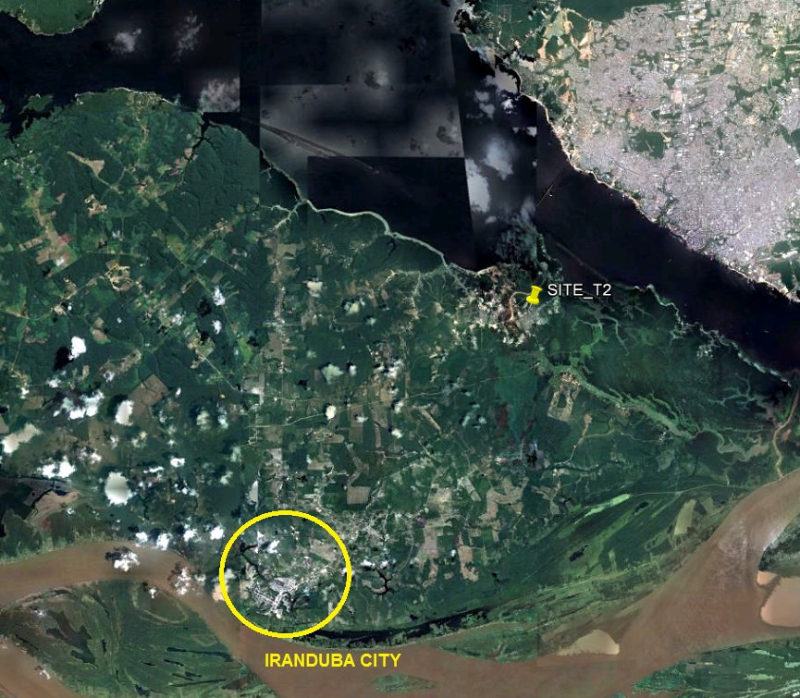
Iranduba site

Slide 10
T2 - Tiwa

Slide 11

Interactions of the Manaus plume across 60 km forest

Slide 12
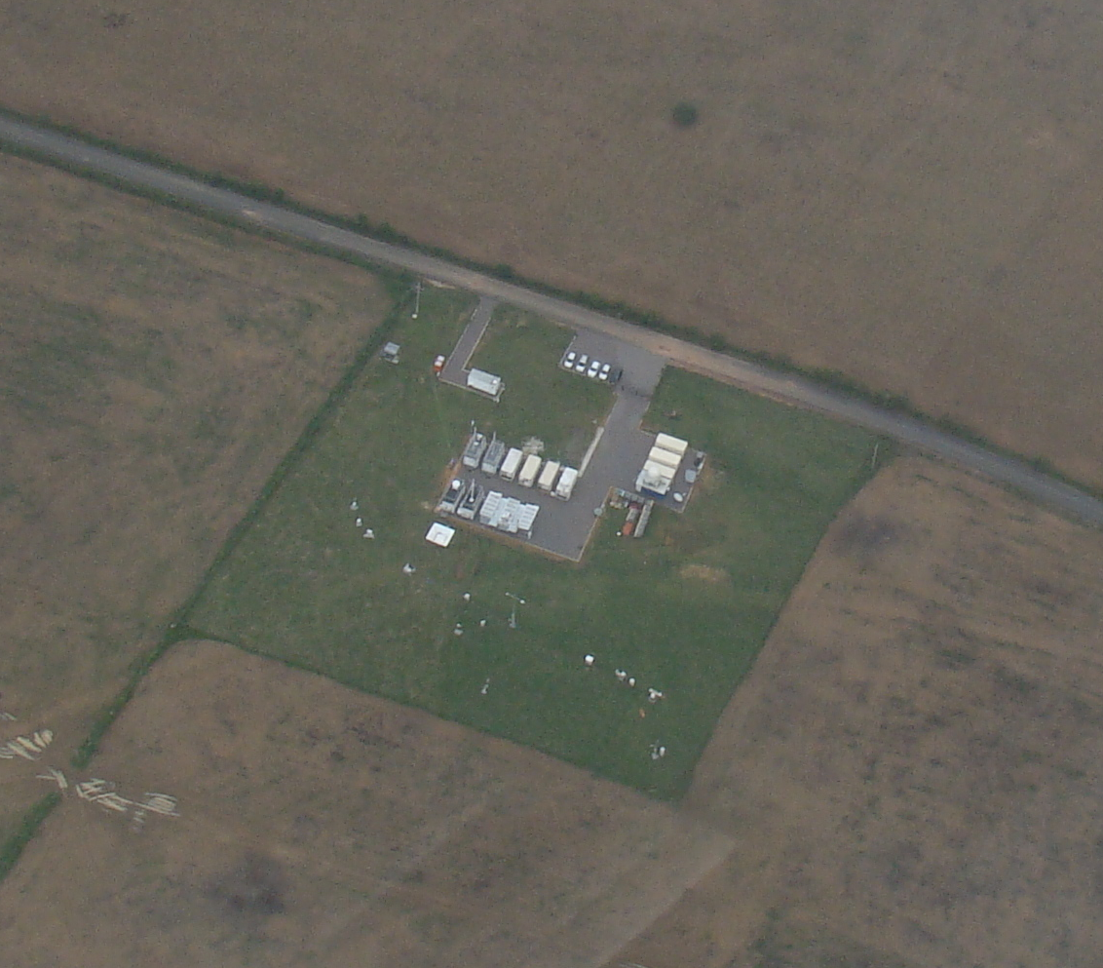
GoAmazon T3 site: 15 containers and growing

Slide 13
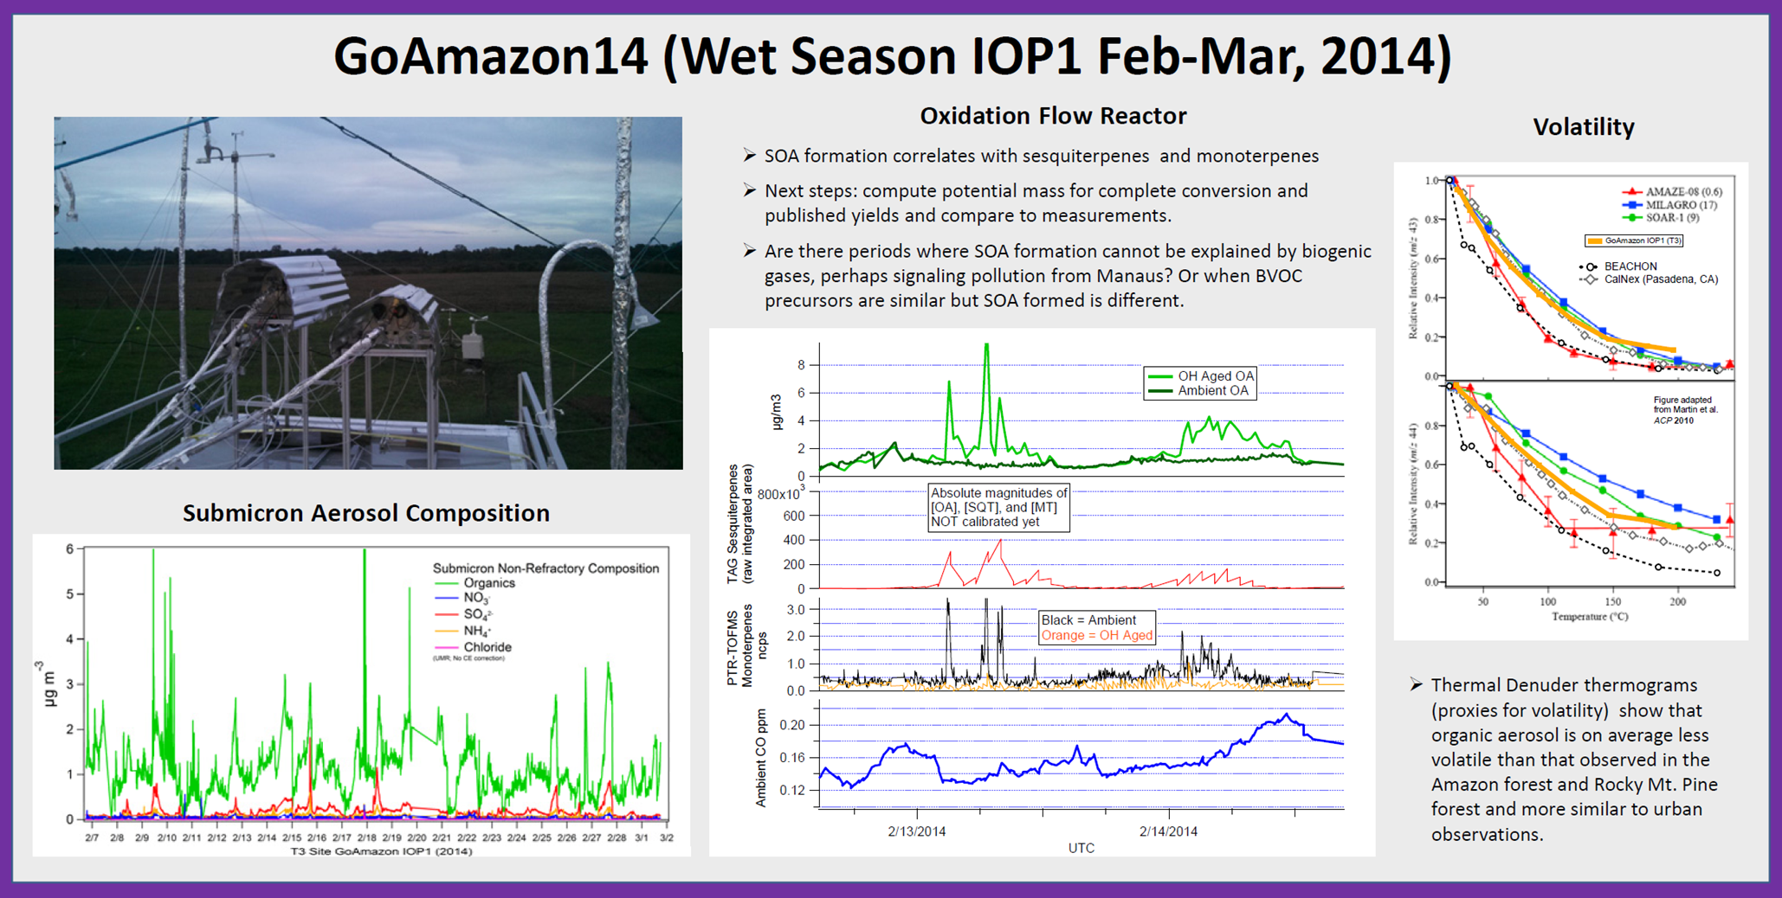
Oxidant Flow reactor measurements at T3 and T2
with PTR-MS and AMS

Slide 14
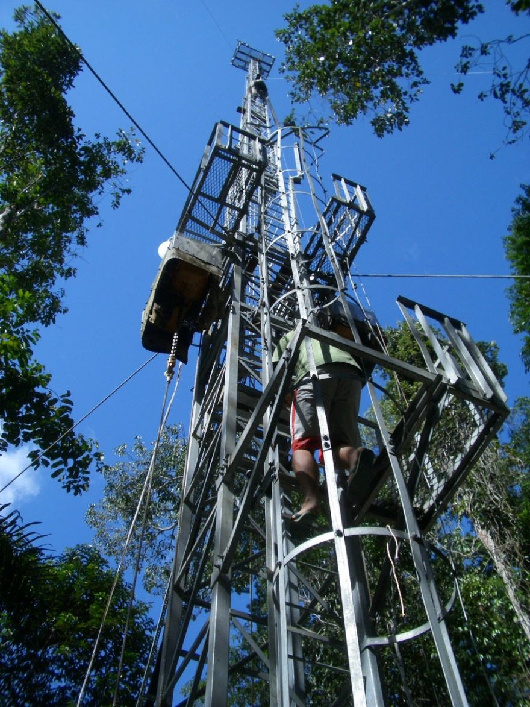
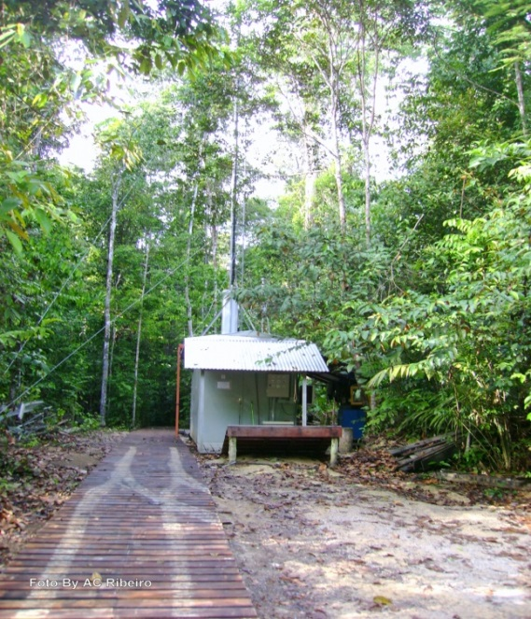
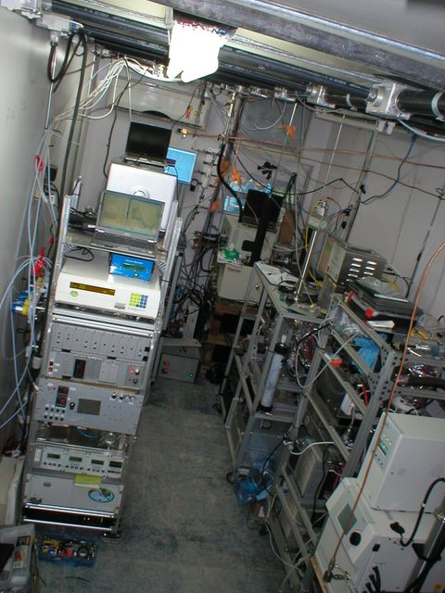
ZF2 – T0 GoAmazon site (same as AMAZE-08)
June 2013 - July 2014 – BUNIACCIC-CLAIRE VOCs (PTR-MS) and Organic aerosols (HR-AMS)

Slide 15
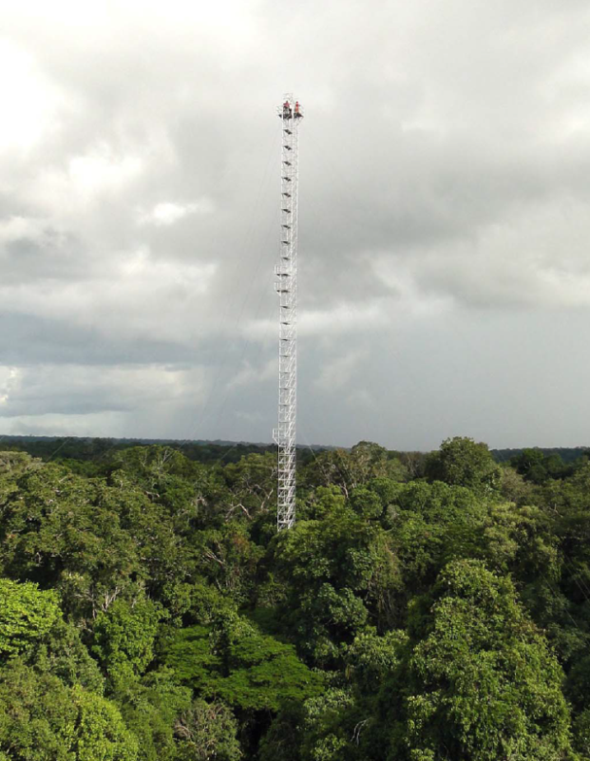
ATTO site
Already operational four 85 meters towers

Slide 16

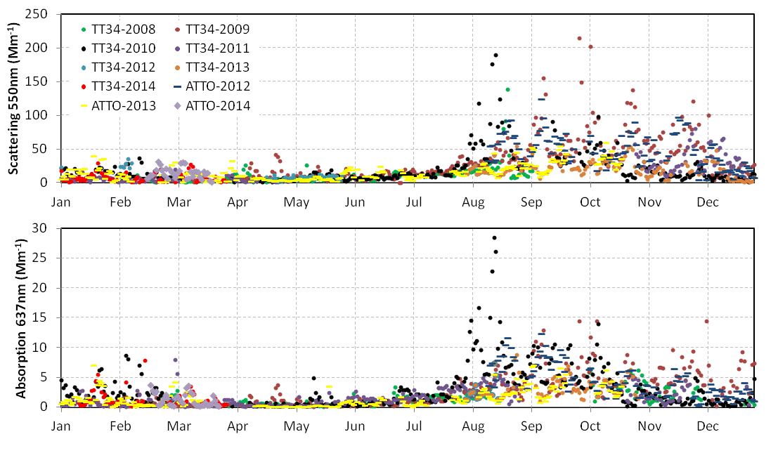
Scattering and absorption daily median comparison (2008-2014)
All data corrected for STP (1013.25 mbar, 0C).
Notes:
Dry season: ATTO and TT34 are very similar (regional biomass burning emissions dominate particle optical properties).
Wet season: occasional differences between ATTO and TT34. All data corrected for STP (1013.25 mbar, 0oC). Scattering corrected for truncation error.

Slide 17
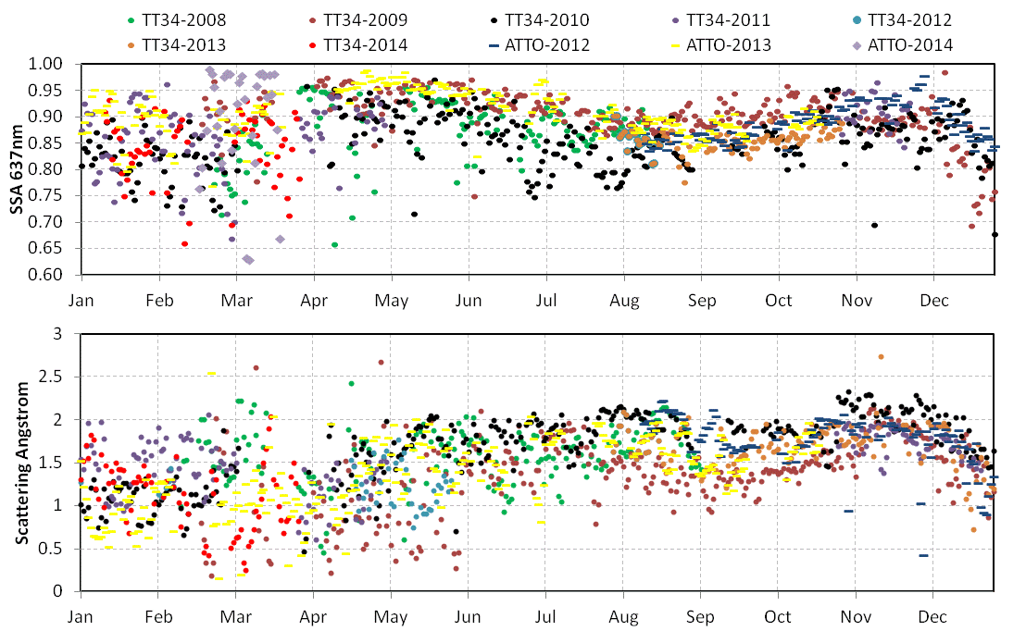
Single scattering albedo and scattering angstrom daily median comparison (2008-2014)
Notes:
Wet season: Single Scattering Albedo and Angstrom exponent are noisier at both sites, partly due to low aerosol loadings and prevailance of coarse mode particles. All data corrected for STP (1013.25 mbar, 0oC). Scattering corrected for truncation error.

Slide 18
A zoom in the dry season (Jul-Oct 2013)
Light scattering

Slide 19
A zoom in the dry season (Jul-Oct 2013)
Black Carbon

Slide 20
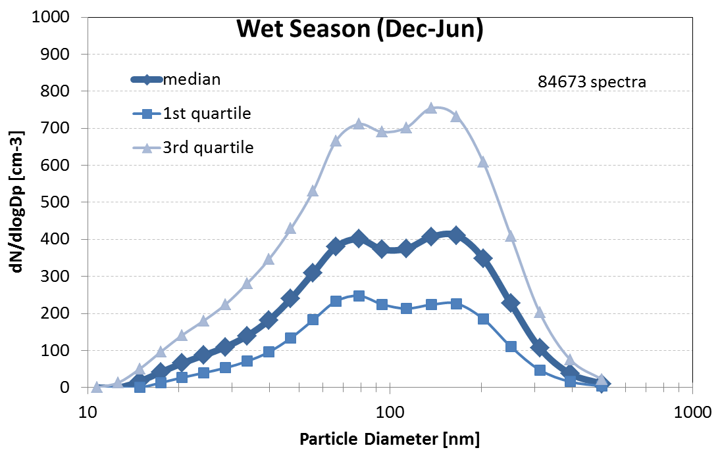
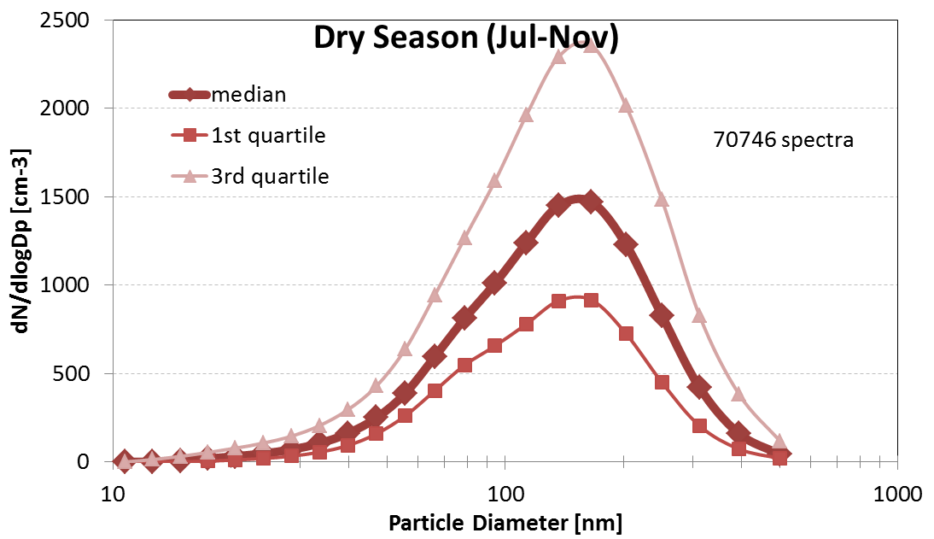
TT34 aerosol size distributions 2008-2011
Fit Parameters for median size distributions (Source: P. Artaxo, L. Rizzo):
 | Ultrafine mode |  |  | Aitken mode |  |  | Accumulation mode
 | N1 [cm-3] | Dpg1 [nm] | sg1 | N2 [cm-3] | Dpg2 [nm] | sg2 | N3 [cm-3] | Dpg3 [nm] | sg3
Wet season (Dec-Jun) | 121 | 34.9 | 0.28 | 314 | 71.0 | 0.20 | 403 | 163.5 | 0.24
Dry season (Jul-Nov) |  |  |  | 926 | 117.3 | 0.36 | 699 | 175.9 | 0.22

Slide 21
O₃ at ZF2

Slide 22
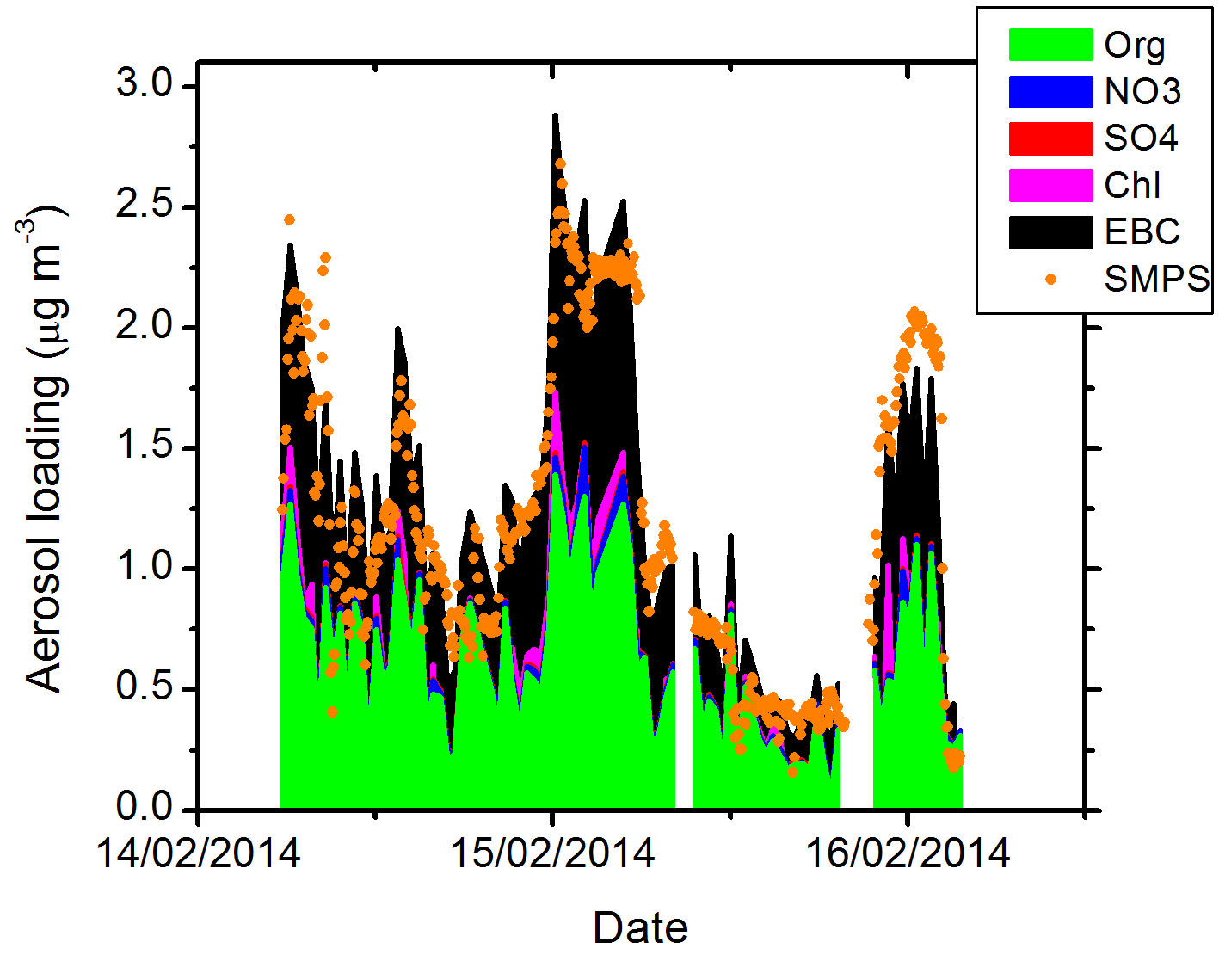
ACSM at ATTO: Comparing SMPS with sum ACSM+EBC
Notes:
Comparação início da amostragem entre aetalômetro, SMPS e ACSM

Slide 23
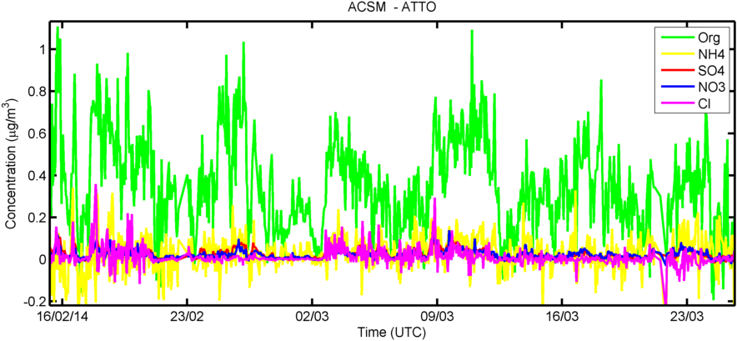
ACSM at ATTO: Time series with 30 minutes resolution
Notes:
Medidas iniciaram no meio de Fevereiro e ocorrem continuamente. Valores normalmente baixos (<1ug m-3). Detalhe para aumento significativo de cloreto, identificado como transporte de sal marinho. O ruído na medida de sal marinho é pelo fato de demorar para evaporar no vaporizador, causando problemas na subtração do branco.

Slide 24
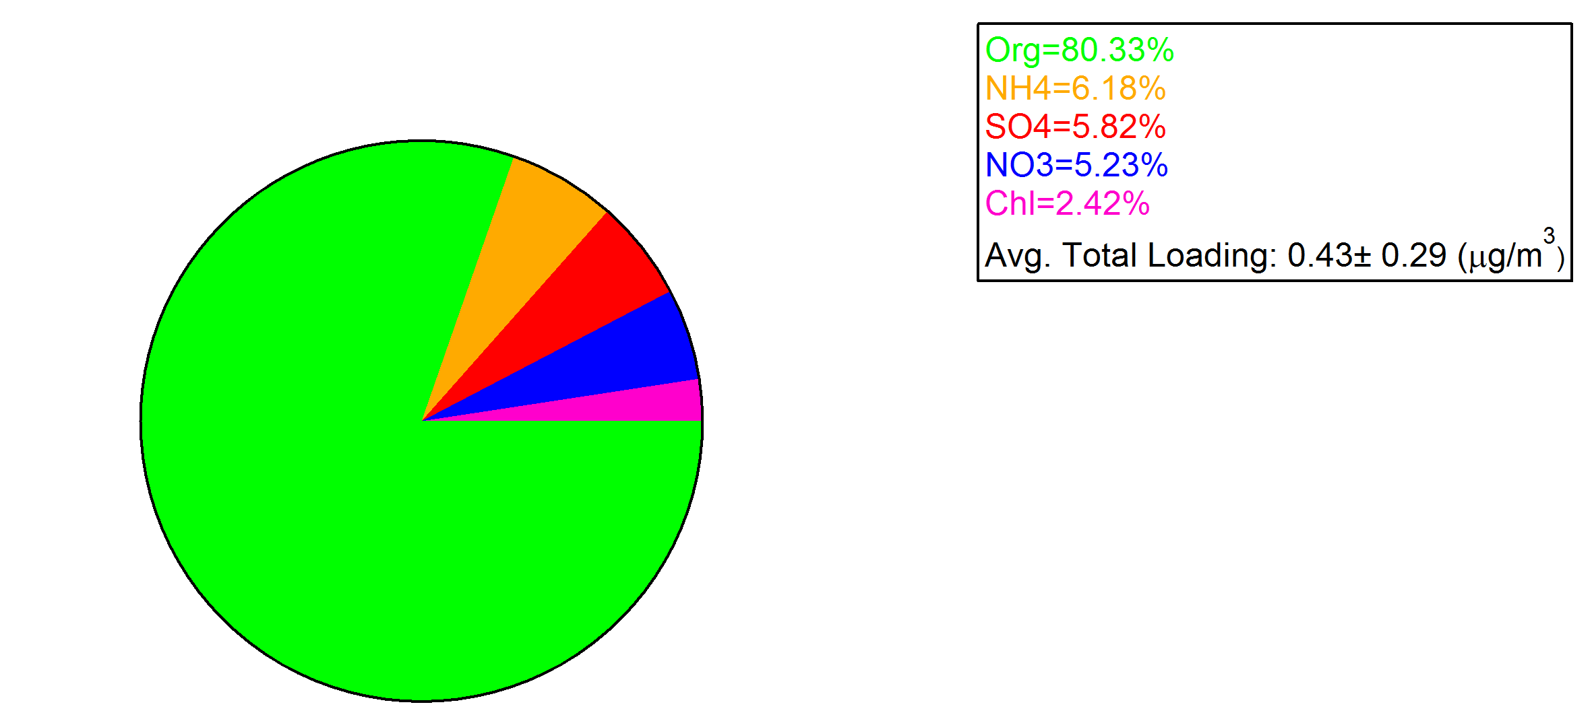
ACSM at ATTO: Mass apportionment
Feb-Mar 2014
Notes:
Valores de NO3 tem que ser revistos, provavelmente será reduzido.

Slide 25
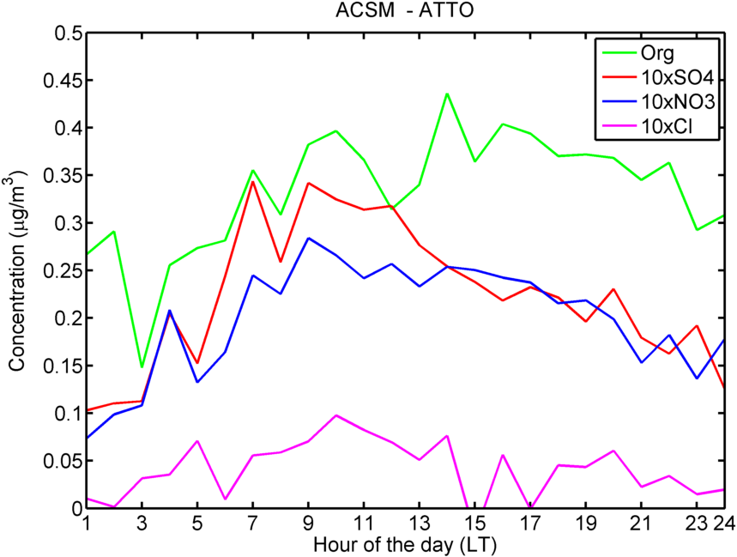
ACSM at ATTO: Diurnal variability
Notes:
Mediana das concentrações observadas durante 40 dias de amostragem. Interessante o primeiro pico da parte da manhã, acompanhando Org, SO4 e NO3, e um segundo na tarde, só de orgânicos. Cuidado com concentrações de NO3, em interferencia com orgânicos que ainda tem que ser tratado.

Slide 26
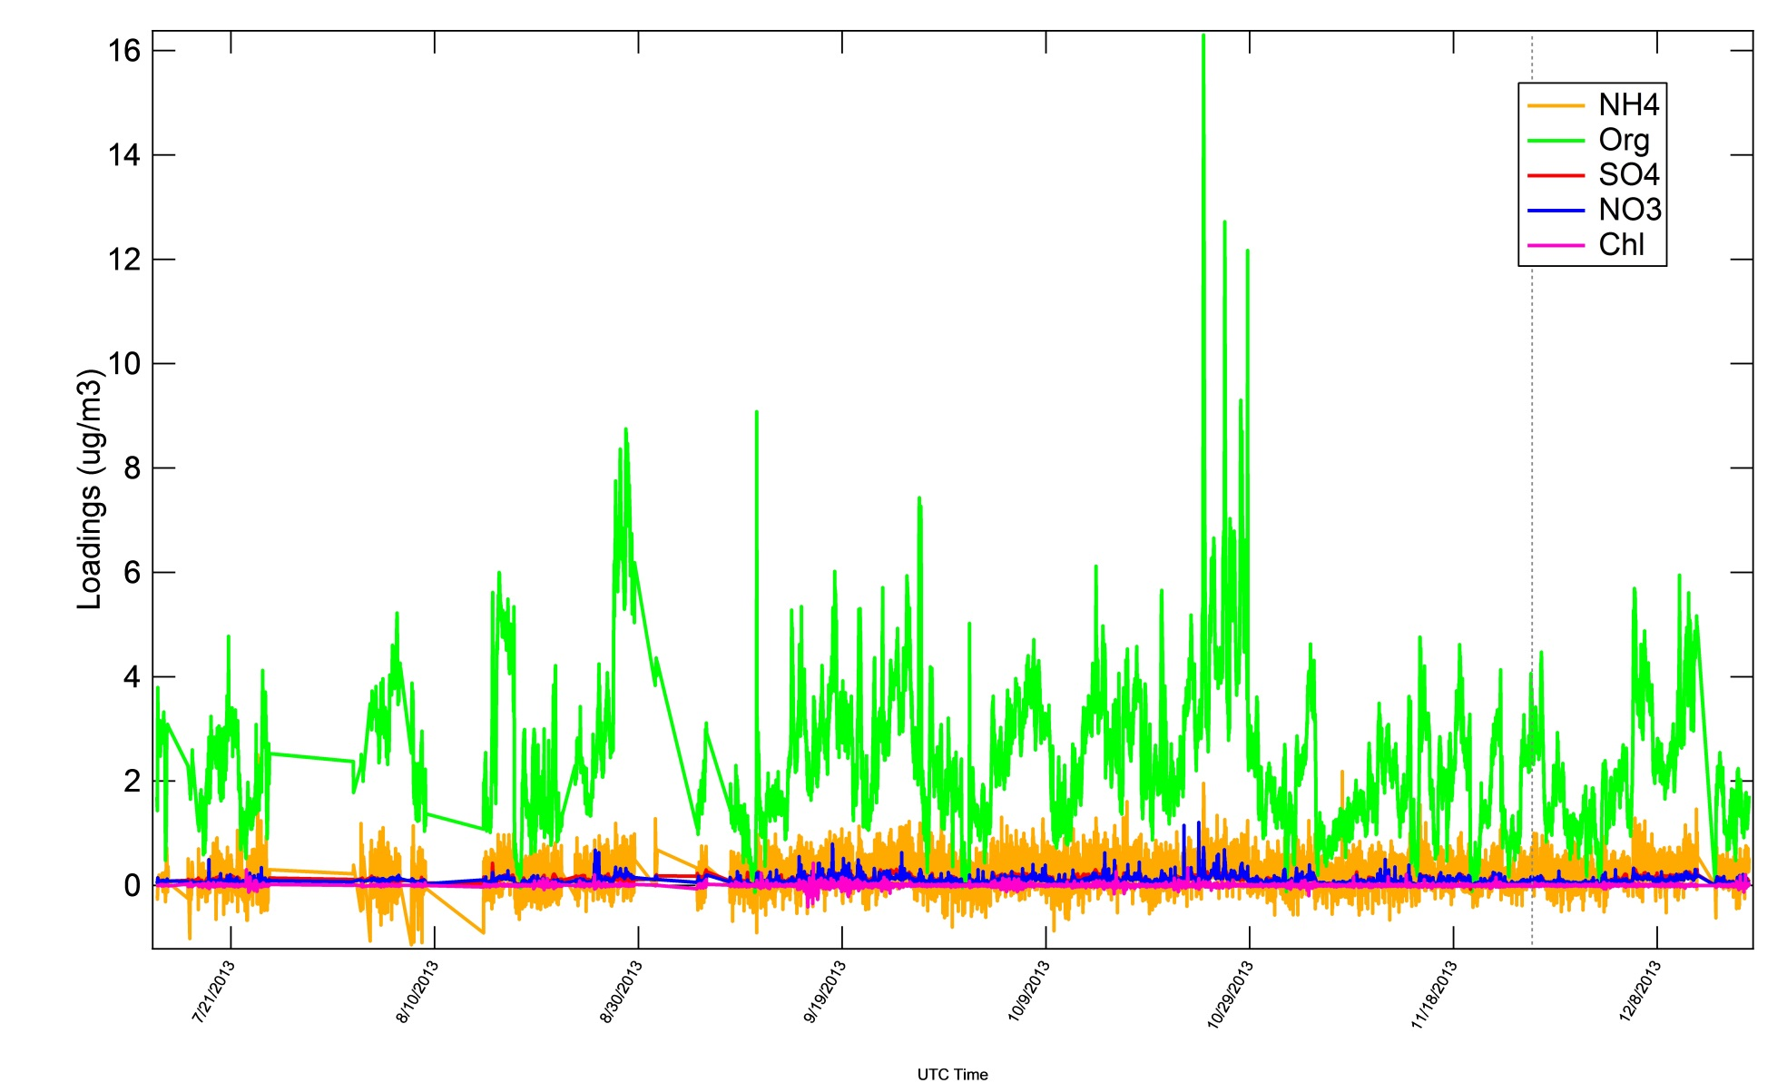
ACSM at ZF2: Time series July-Dec 2013

Slide 27
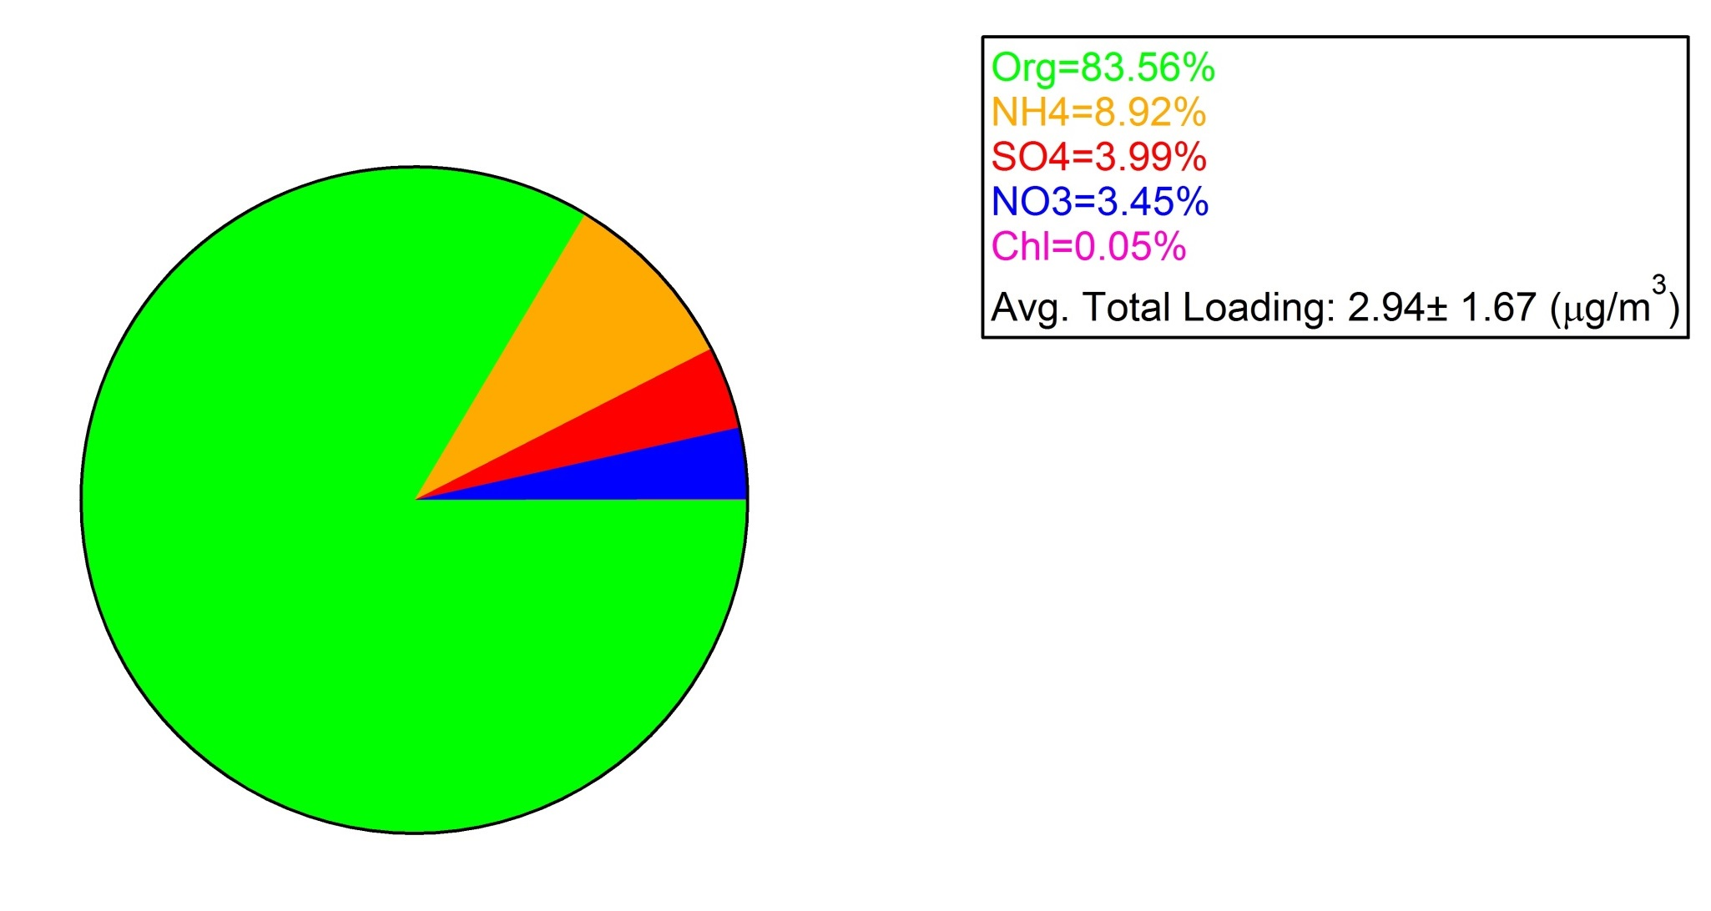
ACSM at ZF2: Mass apportionment
July to December 2013

Slide 28
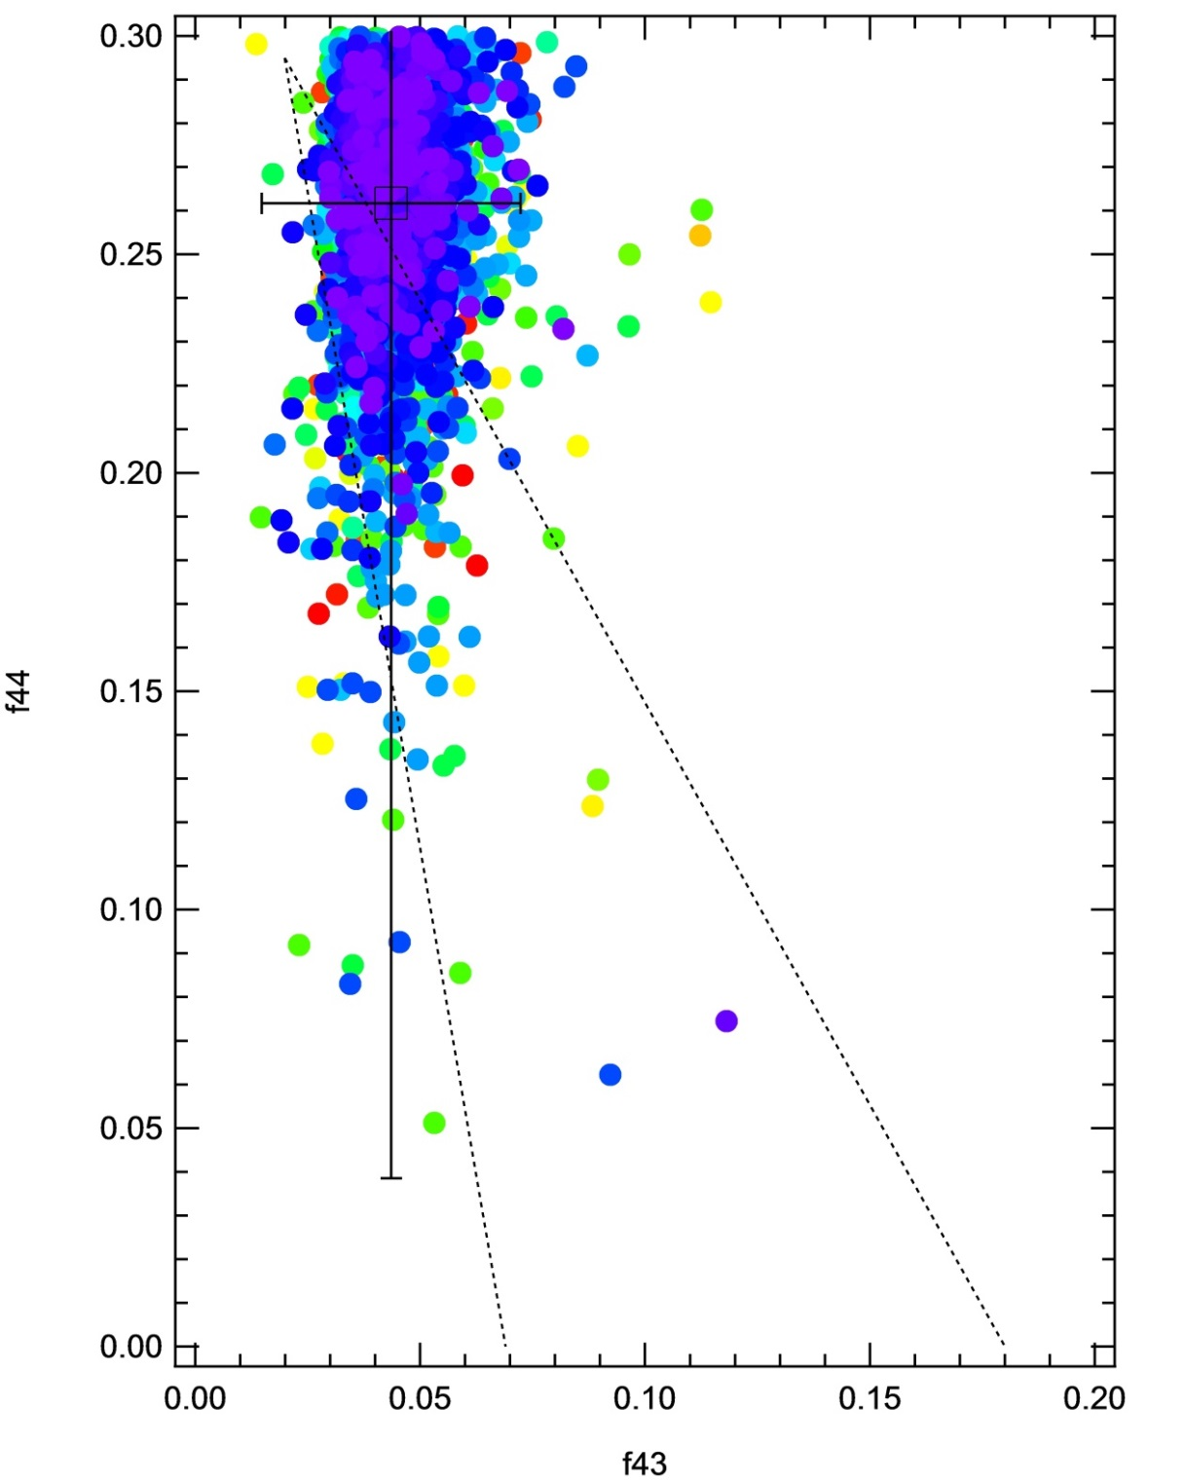
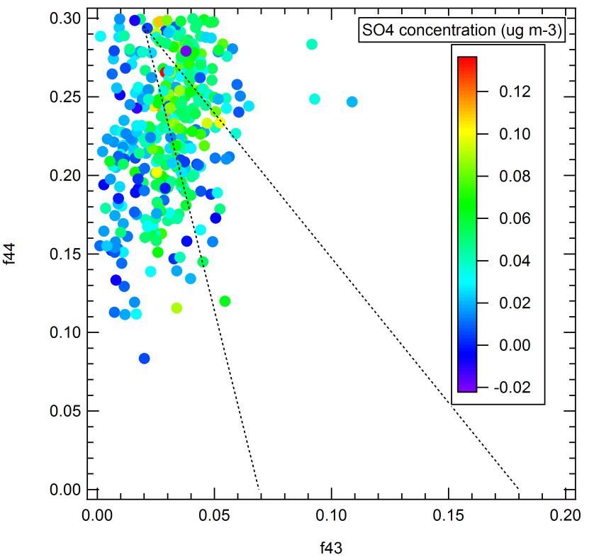
A highly oxidized aerosol at ZF2 (July-Dec 2013) and ATTO (Jan-Mar 2014)
f44 = mainly CO₂^{+,} an indicator of highly oxidized species
f43 = mostly due to C₂H₃O⁺, an indicator of less oxidized species.
ZF2
ATTO

Slide 29
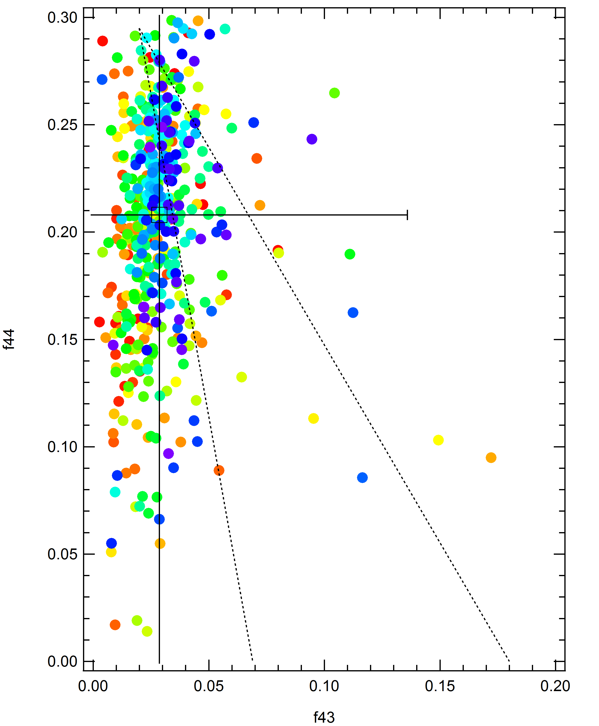
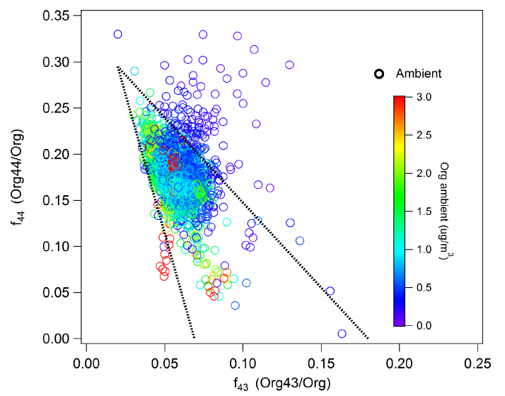
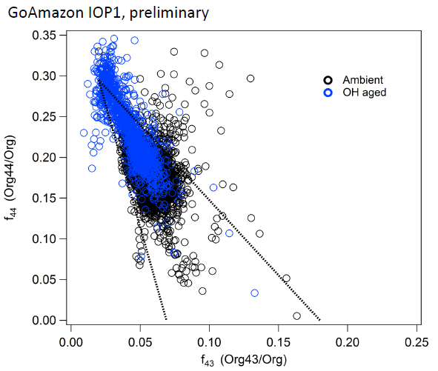
Manacapuru AMS
HR-AMS Feb-March 3014
OFR
ACSM Aug-Sept 2013

Slide 30
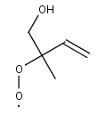



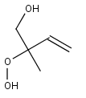
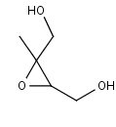
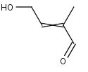

The chemistry can be completely shifted under anthropogenic influences… NO_{x} concentration, SO₂/H₂SO₄ particles
OH, O₂
Isoprene
Hydroxy-peroxy radical (8 isomers)
Polluted Condition
Pristine Condition
NO
HO₂
hydroxylnitrate
MVK
OH
Hydroxy-hydroperoxide and other hydroperoxides
Dihydroxy-epoxide
hydroxycarbonyl
MACR

Slide 31
Instrumentation at the EMBRAPA site
List of instruments at our upwind clouds site (EMB-Embrapa). Second column indicates instrument status. Third column shows if the downwind ARM site will have exactly the same instrument (=) or similar (DIF) instrumentation.
Instrument | EMB | ARM |  | Quantity Provided
UV Raman Lidar (Raymetrics) | 1 | DIF |  | Vertical profile of aerosol extinction and backscatter; night only: water vapor, lidar ratio
THIES Disdrometer | 1 | DIF |  | Raindrops size distribution (optical) at ground.
Multi Filter Radiometer (MFR) | 1 | = |  | Spectral shortwave radiation (direct and diffuse), optical depth of water vapor, ozone and clouds
Aeronet Sunphotometer | 1 | = |  | AOD, size distribution, phase function, water vapor, Angstrom coefficient, 7 wavelengths
Thermal infrared imager | 1 | DIF |  | Brightness temperature on cloud sides and cloud base
Thies Met station | 1 | DIF |  | P, T, RH, wind and radiation
Ceilometer (Jenoptix CHM15k) | 2 | DIF |  | Cloud base, Cloud amount, Penetration depth, Vertical visibility, Height of mixing layer
Micro Rain Radar (Metek MRR-2) | 2 | DIF |  | Vertical profile of reflectivity, raindrop size distribution and rain rate.
MP3000 Radiometer (Radiometrics) | 3 | = |  | Vertical profile of T, RH and liquid water of non-precipitating clouds
JOSS Disdrometer | 3 | = |  | Raindrops size distribution (acoustic) at ground.
PARSIVEL Disdrometer | 3 | DIF |  | Raindrops size distribution (optical) at ground.
Davis Met station | 4 | = |  | P, T, RH, wind and precipitation
GPS/GNSS + Vaisala Met station | 4 | = |  | Integrated Precipitable Water (IPW), P, T, RH
List of instruments to be acquired and operated within this FAPESP component, to be operated at Embrapa. Justification is included in the discussion above.
Instrument |  |  | ARM | Quantity Provided
Sky imager (YesInc TSI-880) |  |  | = | Cloud cover, Sun shine duration
Campbell CNR4-L Net Radiometer |  |  | = | up/down pyranometers and pyrgeometers for net short and thermal radiation
IRGA SON Integrated Gas Analyzer and Sonic Anemometer |  |  | DIF | latent and sensible heat fluxes

Slide 32
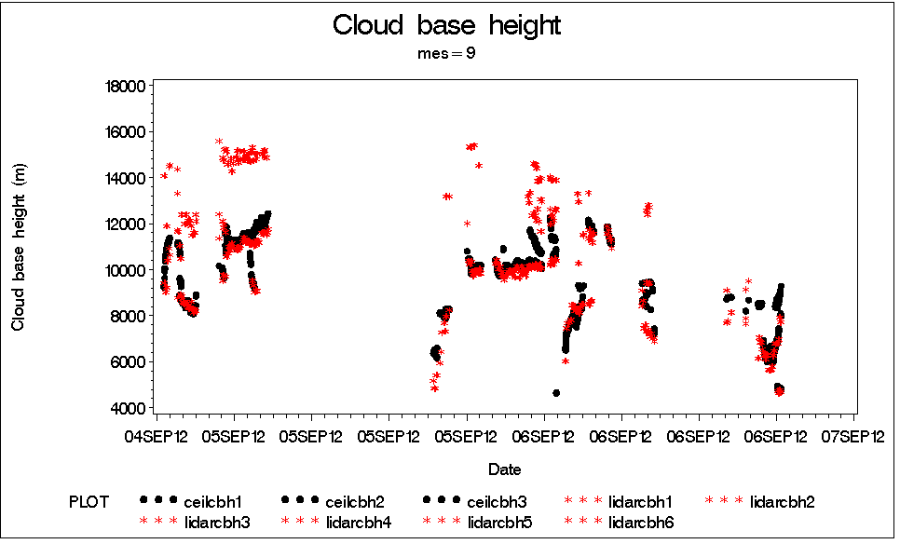
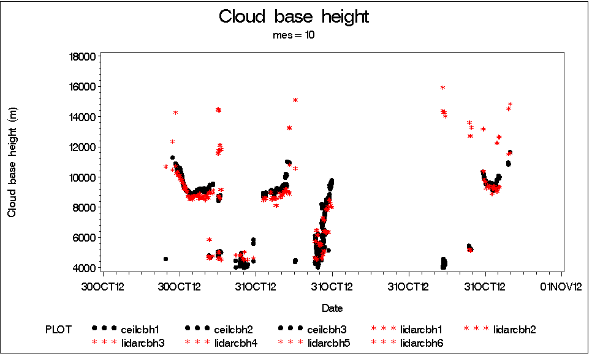
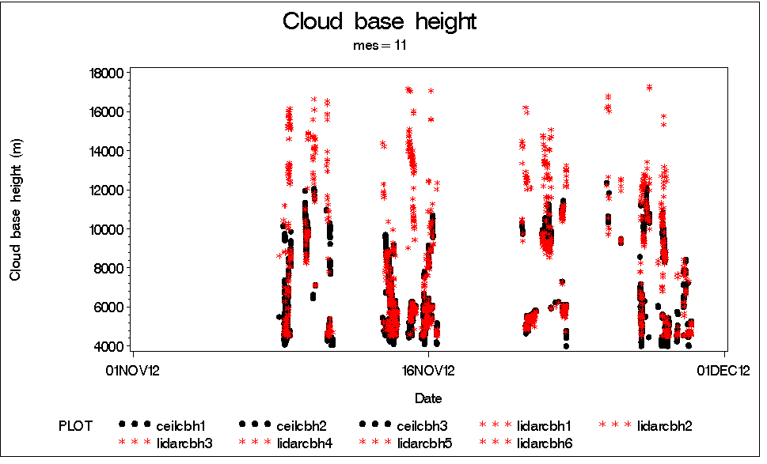
Cloud base height:
Raman Lidar versus ceilometer at EMBRAPA
Analysis by Henrique Barbosa and Elisa Sena

Slide 33
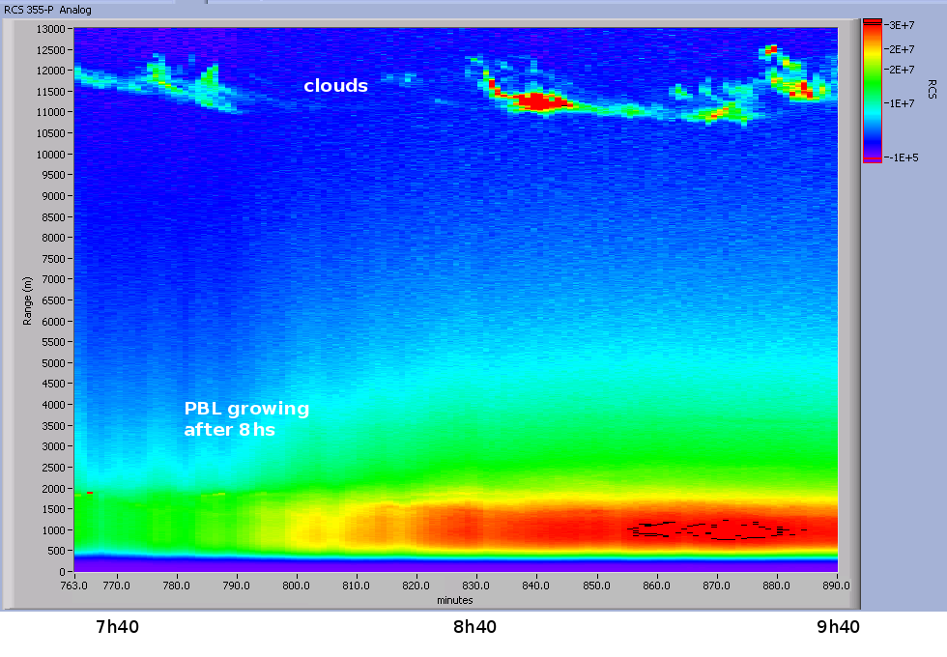
Raman Lidar: aerosols and water vapor up to 13 Km in Manaus
Henrique Barbosa, 2013

Slide 34
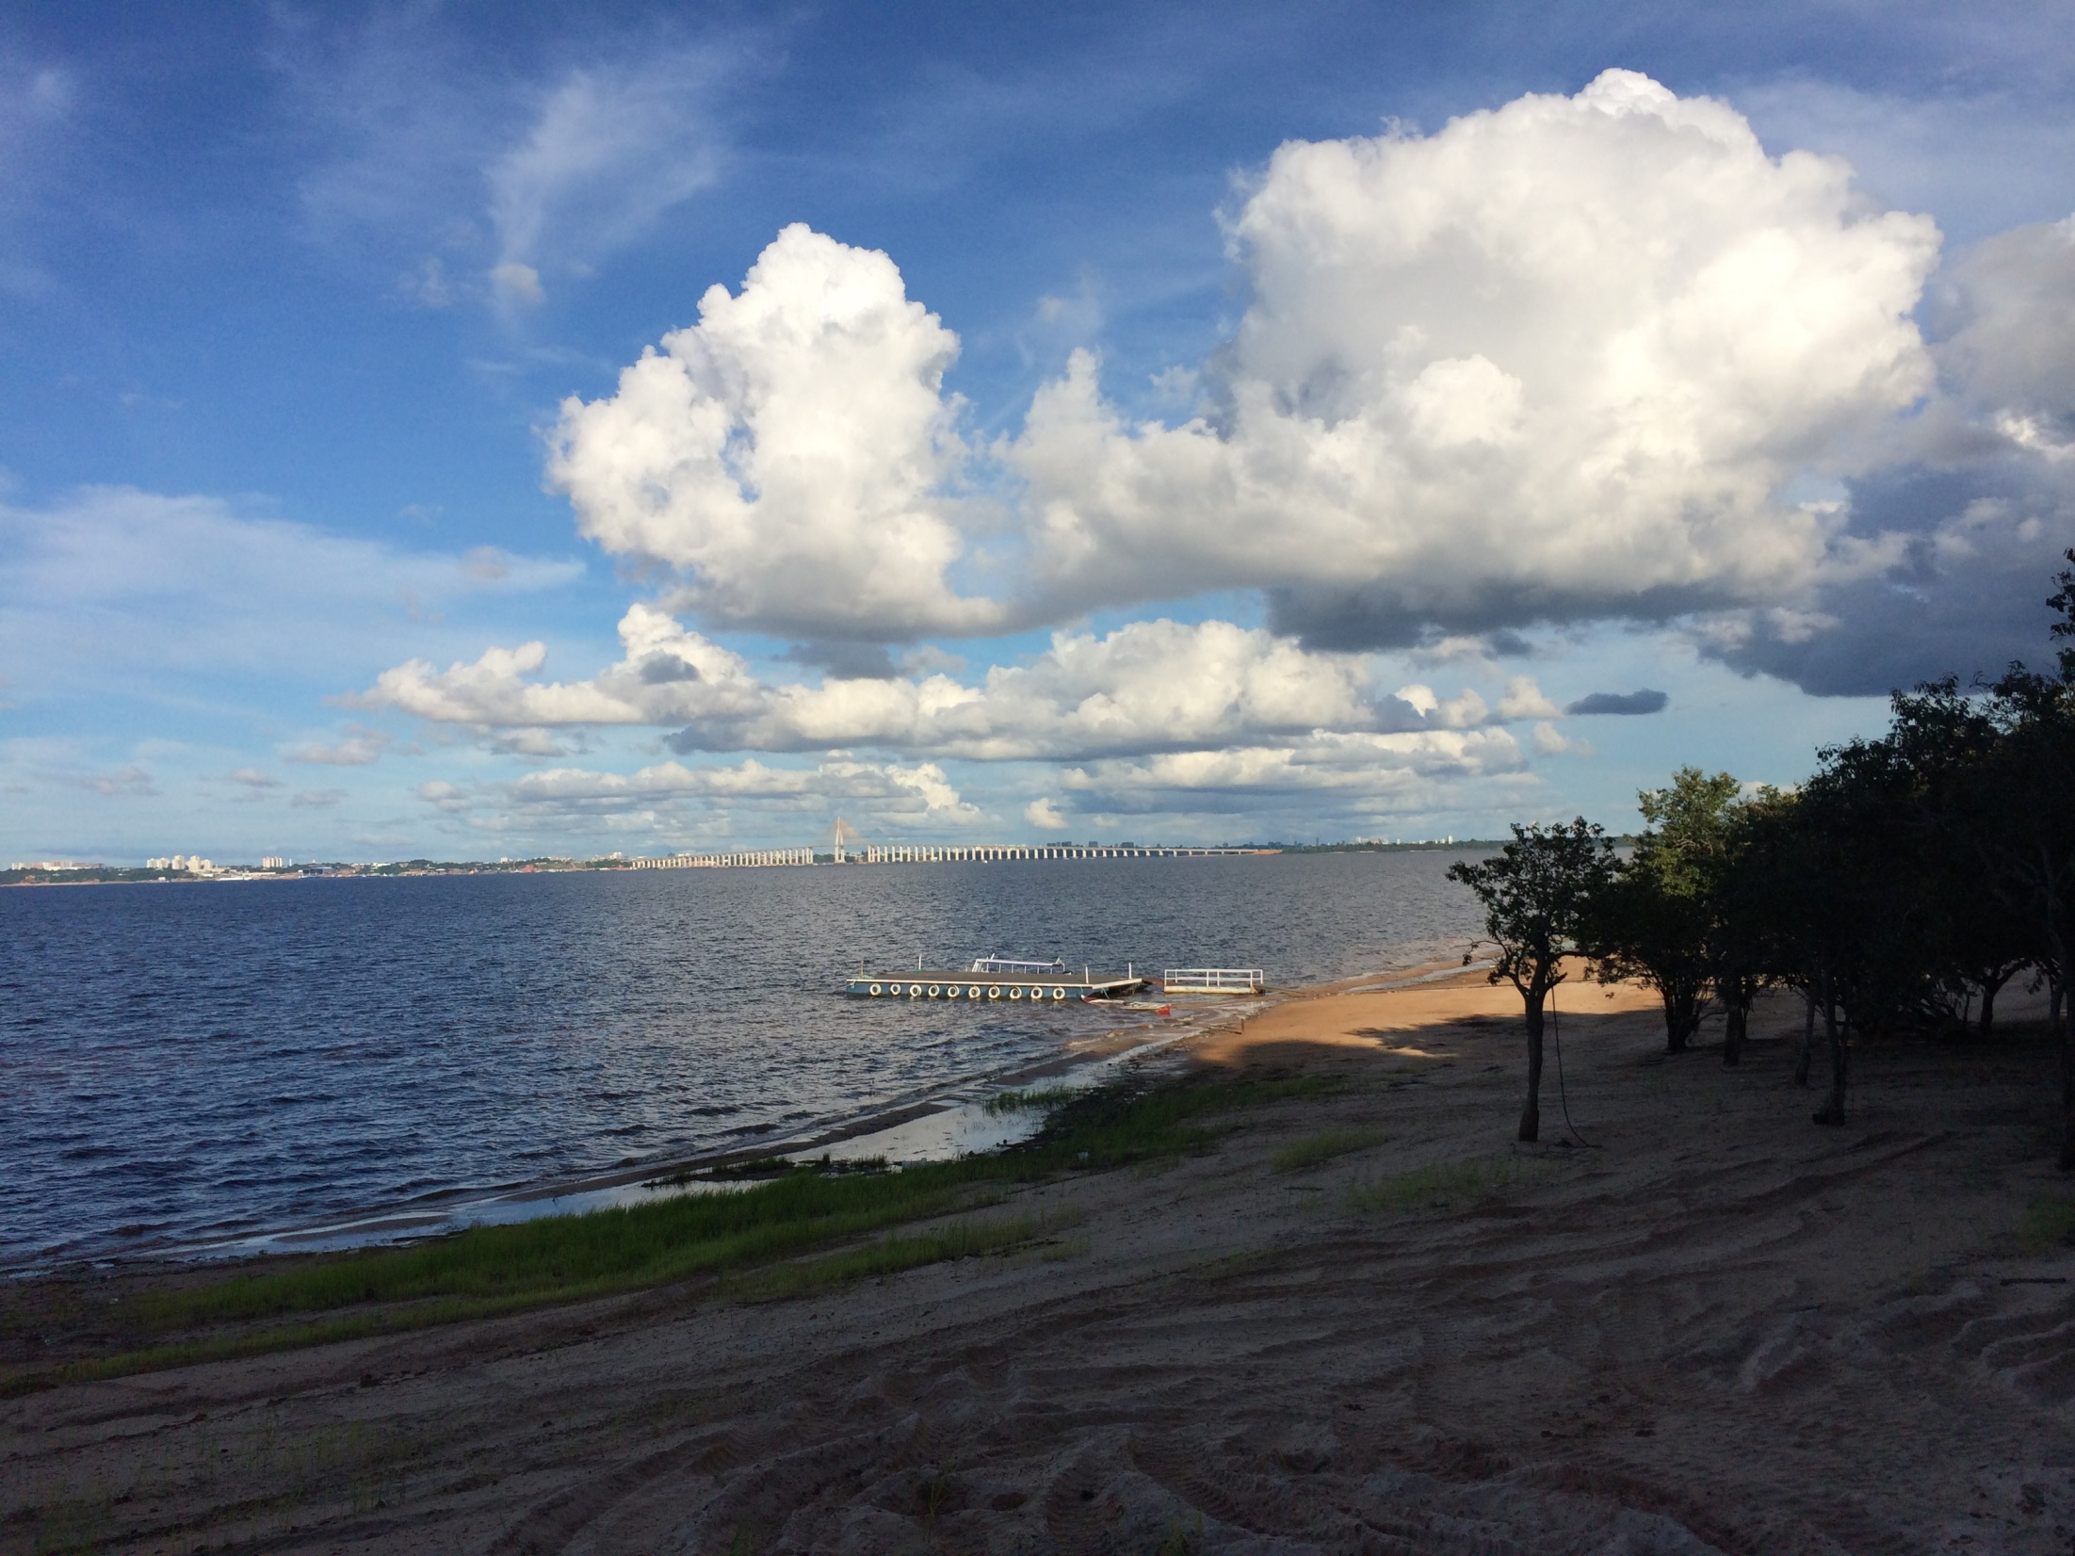
GoAmazon T2 site TIWA
Integrating pollution from Manaus

Slide 35
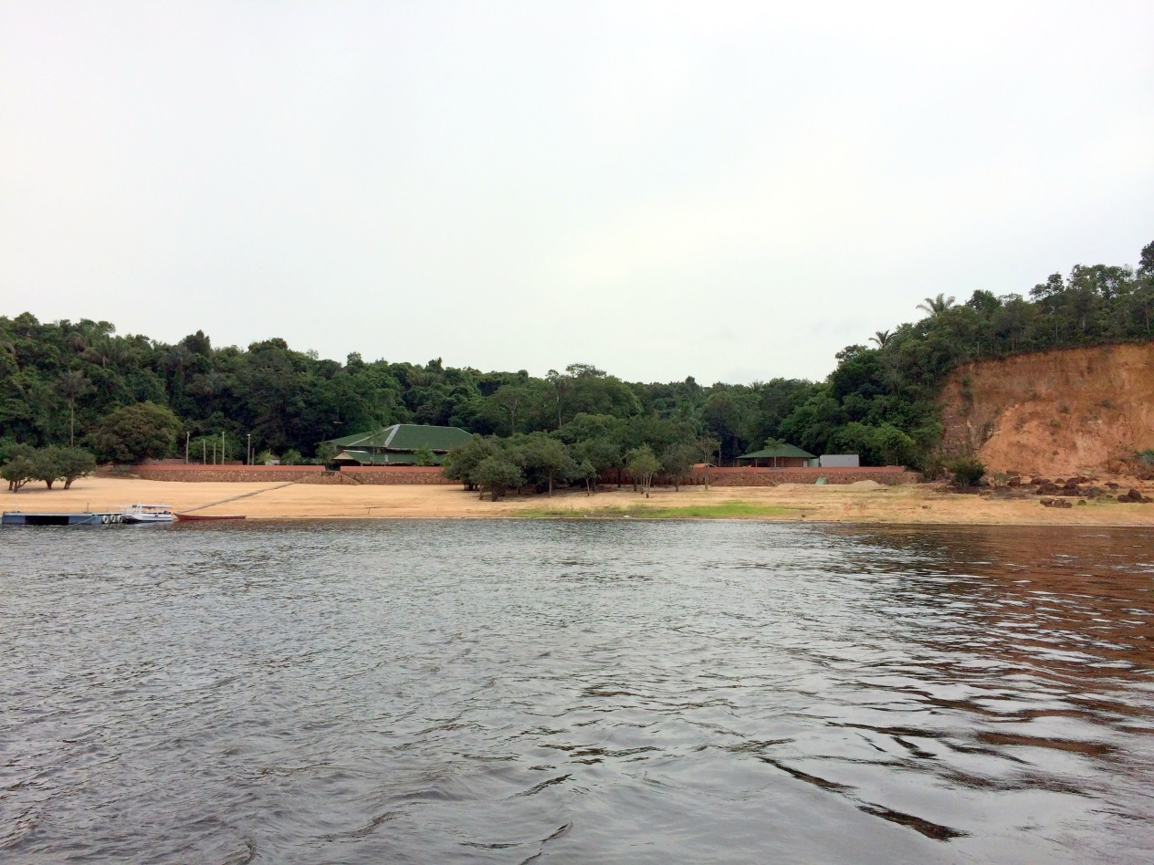
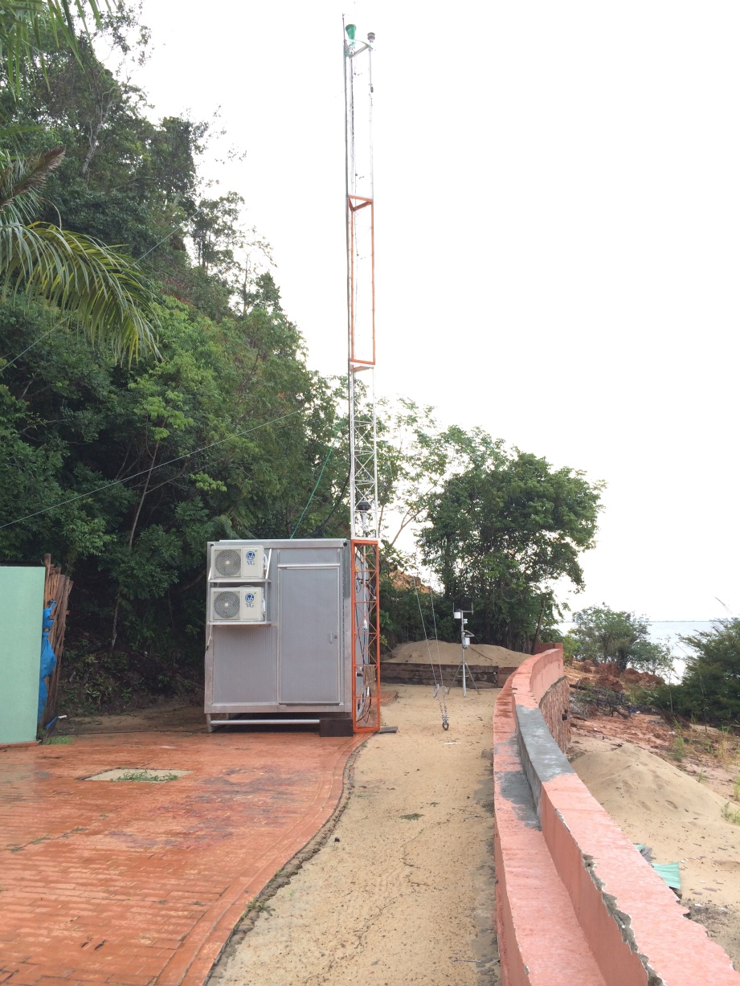
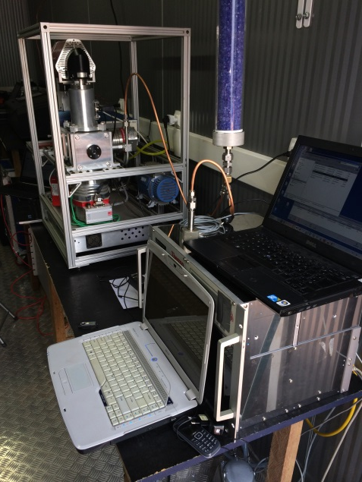
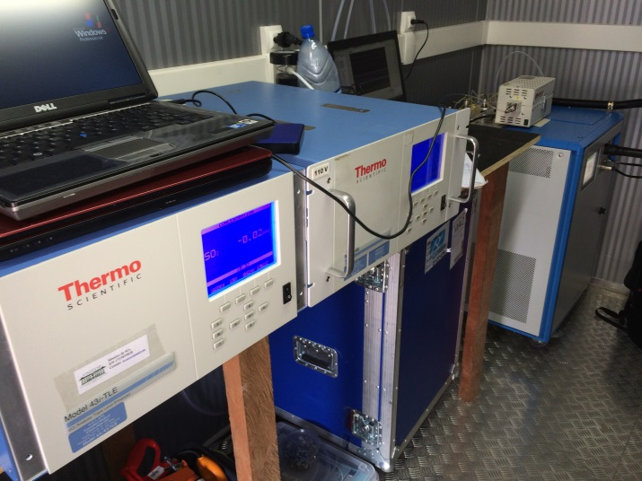
TIWA T2 container

Slide 36
Trace gases (SO₂ observable)

Slide 37
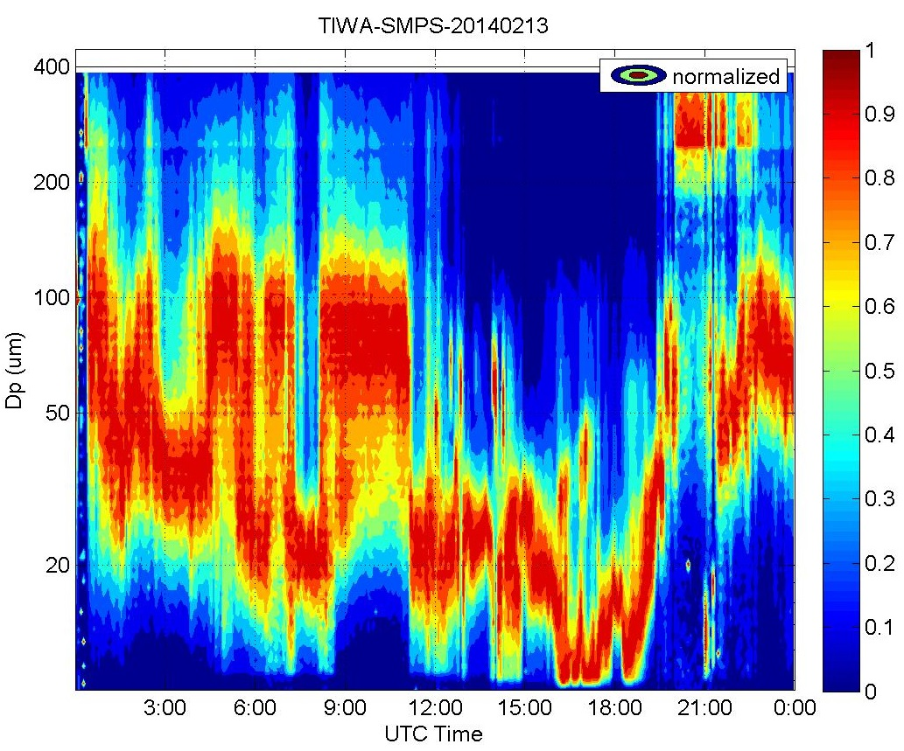
TIWA
13 Feb 2014

Slide 38
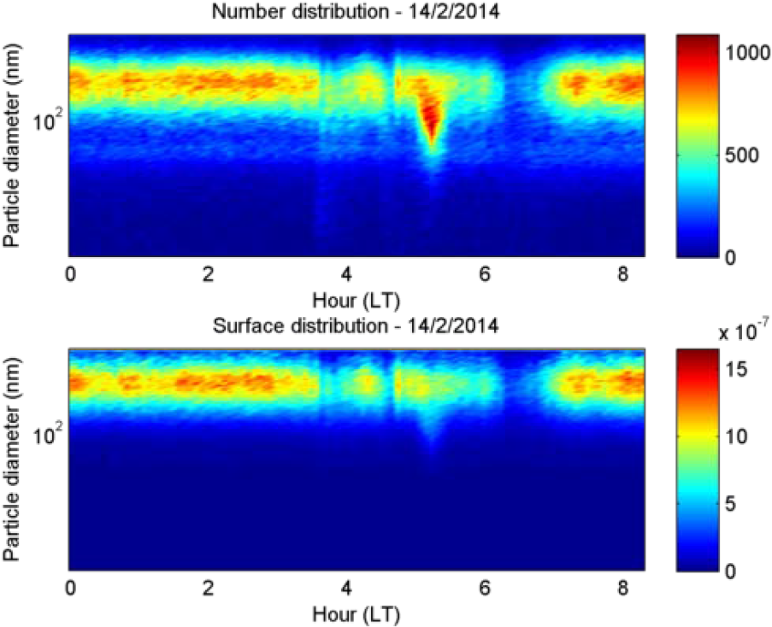
ATTO Size distribution (USP-MPI)

Slide 39
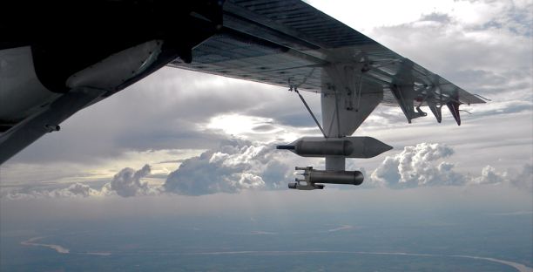





“Intensive Airborne Research in Amazonia 2014” (IARA-2014) - The ARM Aerial Facility (AAF) in Brazil
Coordinated by Karla Longo, INPE
Wet season campaign: Feb-Mar 2014, Dry Season Campaign: Sep-Oct 2014
(Karla Longo, INPE)

Slide 40



DOE Gulfstream-1
Aircraft Technical Information
Length: 19.4 m
Wingspan: 23.9 m
Height: 7.1 m
Cabin space: 15.3 m²
External probes (PMS cans): 8
Maximum gross weight: 16,330 kg
Maximum Endurance: 9.5 hours
Maximum Range: 4000 km
Endurance with full payload: 4-5 hours
Crew capacity: 7 max, 2 pilots + 3-5 scientists
Cabin payload: 1,900 kg
Research Power: 700A @ 28 VDC (incl. 85A @ 115 VAC, 60 Hz)
Ceiling: 7.6 km
(Karla Longo, INPE)

Slide 41



IARA G-1 Payload
Cloud Properties
  Liquid water, total water, ice water
  Cloud droplet size distribution (2 μm to 2 cm)
Radiation
  Up and down-welling broad-band solar
Aircraft and Atmospheric State Parameters
Trace Gases
  H₂O
  Real time Volatile Organic Compounds (PTR-MS)
  CO
  CO₂, CH₄
  O₃
  NO, NO₂ and total NO_{y}
Aerosol Properties
  Aerosol Mass Spectrometer HR-AMS)
  Total Concentration and Size Distribution (30 nm – 3 μm)
  Cloud Condensation Nuclei Concentration
  Optical Properties (absorption, scattering)
  Size resolved physico-chemical composition
(Karla Longo, INPE)

Slide 42


G-1 GOAmazon Payload
(Detail)
Aerosol Composition and droplet activation
Instrument | Measurement
Aerosol
HR-ToF-AMS | Size-resolved aerosol composition
Cloud Condensation Nuclei (CCN) Counter | CCN concentration at 2 super-saturations

Slide 43





G-1 GOAmazon Payload
(Detail)
Cloud Properties
Instrument | Measurement
Water Content
WCM-2000 | Liquid, total and ice water content
Size Distribution
CPI | Images of cloud particles 2 to1000 μm
Fast-CDP | Size Distribution 2 to 50 μm
2DS | Size Distribution 10 to 3,000 μm
HVPS-3 | Size Distribution 400 to 50,000 μm

Slide 44



Flight planning:
Manaus Plume
Before/After Manaus
Could droplets

Slide 45


Slide 46



DLR-MPI HALO HALO - The High Altitude and LOng Range Research Aircraft
Gulfstream Aerospace G550 (altitude 15 Km, range 12500 Km)

Slide 47


Slide 48


Slide 49

High resolution operational 2 km resolution regional forecast with BRAMS for the GOAMAZON. http://www.master.iag.usp.br/ind.php?inic=00&pref=2g&gr=2&prod=prev_rams

Slide 50


Thanks for the attention!!

