Slide 1
New Aerosol Particle Formation in Amazonia
M. Matisans, P. Tunved, L. Rizzo, R. Krejci, P. Artaxo, I.Riipinen, T. Hamburger, E. Swietlicki, H.E. Manninen, J. Backman, M. Kulmala
Notes:
Enigma of stability of particle concentration in Amazonia,
Hadley cell circulation, nucleation in cumulus anvils.
Primary production form biosphere, shown to be unlikely by Alhm, 2008.

Slide 2
Aerosol number size distribution
Notes:
- NO classical banana nucleation as in mid-latitudes,
Lower background aerosol load and erratic pattern of ultrafine particle blobs, also caller apple events,
Remember that measurements are seen in Eulerian frame of reference,
What if nucleation takes place at a much smaller spatial scale?
If it is the case then we should see a pattern statisticlally,
We chose run cluster analysis technique on amazonian aerosol data, and this is what we found (next slide)

Slide 3
Question
& Hypothesis
Where do new particles come from in Amazonia?
An alternative particle production pathway.
Notes:
No classical nucleation events,
Primary emissions not enough,
Subsidence not enough (it’s aitken size)
linking precipitation occurrence to new particle formation

Slide 4
Measurement site
Notes:
Station we have available is this,
Measurements of meteorology, particles and ions, down to 1 nm ABOVE CANOPY.

Slide 5
Methods & Instruments
SMPS data (10nm<Dp<500nm)
Metorological data
Precipitation, WS, WD, SR
NAIS observations (1nm<Dp<16nm)

Slide 6
Cluster Analysis

Slide 7
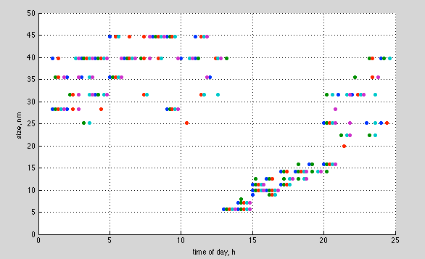
Cluster analysis for nucleation days

Slide 8
Ion production and particle growth
Notes:
SMPS scan clusters with smallest particles are measured earlareound sunrise and in afternoon, with a growing trend afterwards,
This does not mean that the growth is to be seen in any single day, since this is a statistical effect of many of these apple type of events,
However – many apples apparently go bananas,
This of course is not in any way conclusive to nucleation detection, therefore we took independent measurements of NAIS to see what happens to even smaller particles at these probable nucleation times of day.
Surprisingly we found ions also peak in cncentration at the expected time of day!
However, its been known that ion concentration is strongly correlatied with precipitation, which produces ion mode peaking at 3-4 nm diameter with preferably negative charge. Horrak 1998, Tammet 2010, Hirssiko et al. Etc.

Slide 9
Precipitation produces ions
Notes:
One example of the ion burst as a result of precipitation.
All precipitation brings ions, and no ion burst are brought without precipitation.

Slide 10
Ion self-coagulation simulation with CALM
Notes:
With P. Tunved’s CALM model we estimated that:
During 2 - 3 hours of precipitation due to self-coagulation of these generated partilces would account for 800 of 20 nm particles, at a source rate of 10 particles per cc per s.

Slide 11
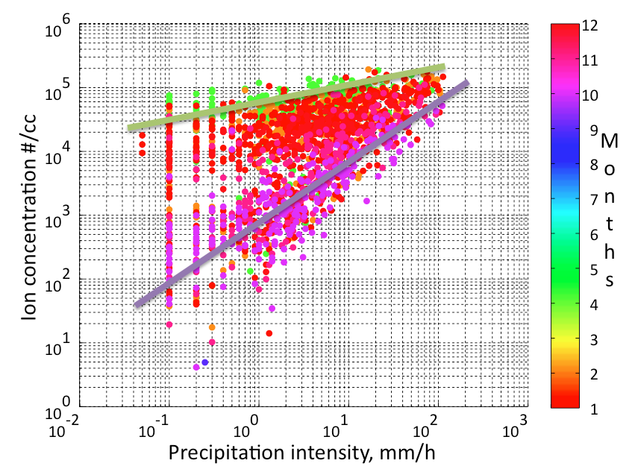
Seasonal ion production
Notes:
At lower CS the ion production (during wet season) is more effective (the correlation less steep), however at high precipitation intensity the maximum ion concentration hits a ceiling!

Slide 12
Condensational sink
< 5 nm paticles
Notes:
A summar picture:
The clouds are atmospheric agents removing preexisting CS aerosol in atmosphere, and introducing new aerosol.

Slide 13
Thank you for your attention!

Slide 14
Seasonal ion production
Notes:
At lower CS the ion production (during wet season) is more effective (the correlation less steep), however at high precipitation intensity the maximum ion concentration hits a ceiling!

Slide 15
Parameters

Slide 16
Ion charge ratio dynamics

Slide 17
CS annual cycle

Slide 18
Rainfall duration
Notes:
Rainfall duration histogram with a peak probability at 2-3 hours.

Slide 19
Ion production by rain

Slide 20
Cluster Analysis

