Slide 1
New particle formation in Amazon: Clouds, rain and ions
Radovan Krejci^{1,2}, Modris Matisans¹, Peter Tunved¹, Hanna Manninen², John Backman², Luciana Rizzo⁴, Thomas Hamburger¹, Riikka Väänänen², Paulo Artaxo⁵, Erik Swietlicki⁶, Tuukka Petäjä², Veli-Matti Kerminen², Markku Kulmala²
¹ Department of Applied Environmental science, Stockholm University, Stockholm, 10691, Sweden
²Division of Atmospheric Sciences and Geophysics, P.O.Box 64, FI-00014, Helsinki University,
Helsinki, Finland
³Institute of Physics, University of Tartu, Ülikooli 18, 50090, Tartu, Estonia
⁴Department of Earth and Exact Sciences, Institute of Environmental, Chemical and Pharmaceutics Sciences, Federal University of São Paulo, São Paulo, Brazil
⁵Department of Applied Physics, Institute of Physics, University of São Paulo, São Paulo, Brazil
⁶Division of Nuclear Physics, Dept. of Physics, Lund University, S-221 00 Lund, Sweden

Slide 2
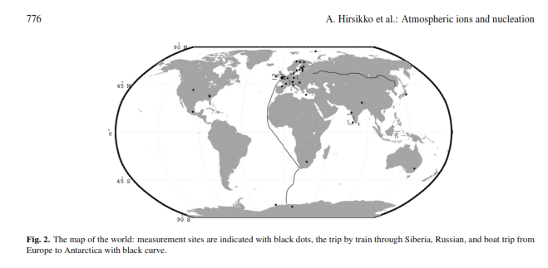
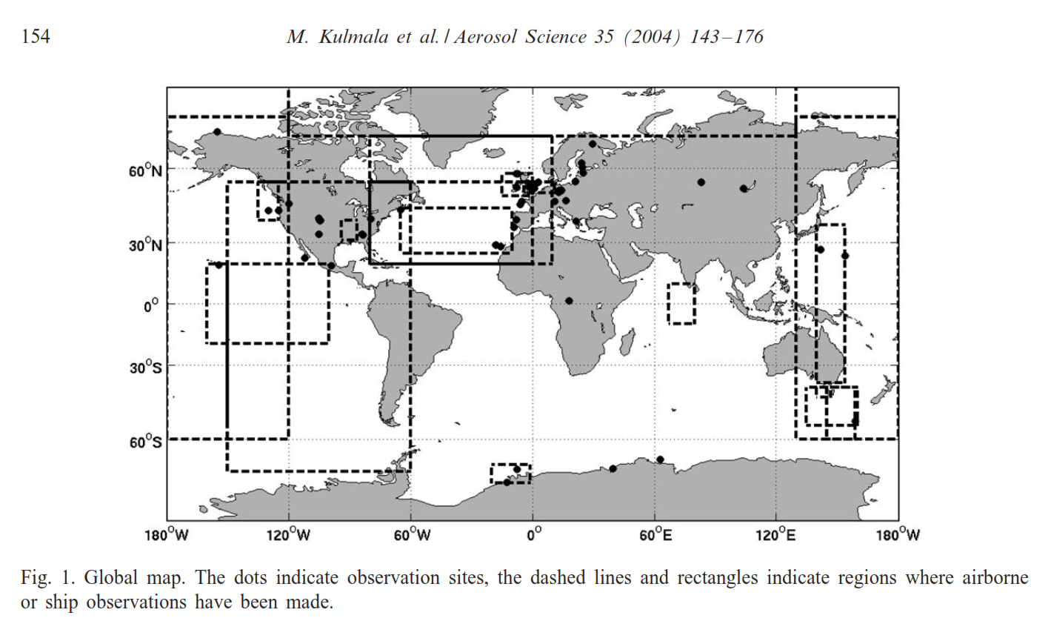
Motivation:
NPF observed nearly everywhere besides
tropical boundary layer (if we consider particles < 10-15 nm)
Is the solely aerosol source in tropics thanks to Hadley cell and subsidence (e.g. Clark et al) or
Ions and UFCN concurrent measurements limited to Europe with limited number of exceptions

Slide 3
Enhanced
new particle formation
Outflow from
ITCZ
Outflow from deep
convection
Condensation, Coagulation
Aerosol growth
Subsidence
Free
troposphere
In-cloud
processing
Entrainment
Scavenging and rain-out
Trade winds
Cloud convective
layer
Mixing
Dry and wet
deposition
Primary and
secondary
aerosols
Mixed
layer

Slide 4
Motivation:
Particle flux
Particle deposition velocity
wet season
dry season
The rain forest is a net number sink of aerosol particles even in the cleanest possible conditions when considering the total aerosol population.
This means that primary aerosol emission seems to be small in terms of number concentrations. It is hard to explain the downward particle fluxes without a large contribution of secondary particles forming in the atmosphere.
Ahlm et al, ACP

Slide 5
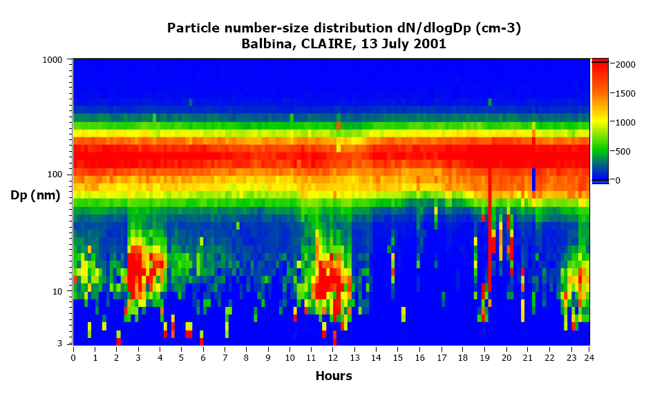
Motivation:
Erratic occurrence of fresh Aitken mode aerosol over the Amazon tropical rainforest
(Courtessy of E. Swietlicki)

Slide 6
Motivation:
Diurnal cycle of fresh Aitken mode over Amazon
(Courtessy of E. Swietlicki & J. Rissler)

Slide 7
Motivation:
Fresh Aitken mode frequently observed in outflow from shallow convective clouds
Vertical aerosol distribution observed on 15 March at 15:50 LST over southern Suriname based on 1 Hz data (⎯ N₆, ο N₆₋₁₈, • N₁₂₀). The median aerosol size distribution from 3.4 km altitude is made of 16 one minute size distributions collected between 14:51 and 15:06 LST. The aerosol size distribution at 0.6 km altitude is made of 19 size distributions collected between 15:29 and 15:47 LST. The error bars represent lower and upper quartiles. The arrows mark the altitude where the aerosol size distributions were measured. (Krejci, 2005)

Slide 8
Aerosol size distribution cluster analysis
DMPS (April 2009 – May 2010)
30 000 size distributions
50 clusters, special focus on size distributions with mode between 10 and 80 nm

Slide 9
Charged particles and rain
Higher rain intensity = more charged particles
NAIS (September 2011 April 2012)
ZF2 Research site near Manaus

Slide 10
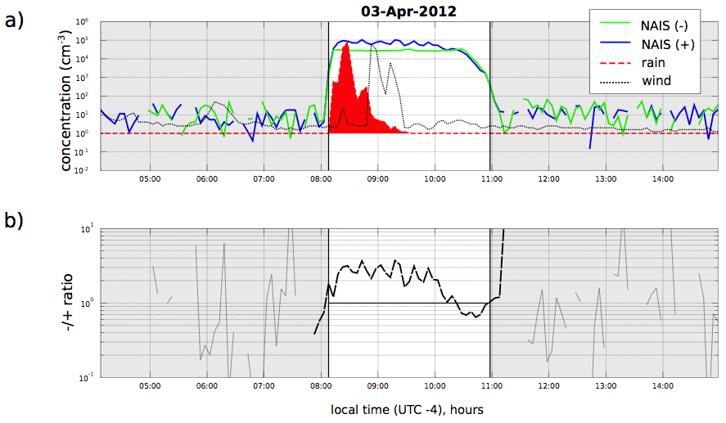
Charged particles and rain
NAIS observations from Amazonia show strong charged particle production associated with rain

Slide 11
Charged particles and rain
Duration of charged particles occurence events and relation between rain intensity and ion charge ratio (negative/positive)

Slide 12
Charged particles and rain
Evolution of charge ratio during rain events. Averaged on monthly basis

Slide 13
Combining results of aerosol size distribution cluster analysis together with NAIS on diurnal basis
DMPS (April 2009 – May 2010)
NAIS (September 2011 April 2012)

Slide 14
Summary
After combined analysis of aerosol size distribution together with charged particles data originally erratic occurrence of fresh Aitken mode aerosol can be linked to convective rain events.
Mechanism of charged particles production is unclear (similar process to ion production near waterfalls?)
Apparent aerosol growth around 5 nm*hr⁻¹, similar to boreal forest environment
Charged ion activation takes place at smaller sizes and at lower condensible vapour concentrations compared to their neutrally charged counterparts (Hirsikko et al. (2011)
We suggest that this quick neutralisation of ion charge imbalance is what indicates activation of negative ions and fostering the reconstruction of apparent growth rate of ultra-ﬁne particles by the cluster analysis method. Thus if this quick neutralisation decreases the negative ion concentration from 10⁵ to 2*10⁴, i.e. by 8*10⁴, which is the fraction of ions that is being activated after an average rainfall event in the rainy season month
Same process is likely also present elsewhere (Hyytiälä)
This process can help to explain why we do see so stable aerosol number concentration in tropics
Clouds are at the same time aerosol sink and source

