Slide 1
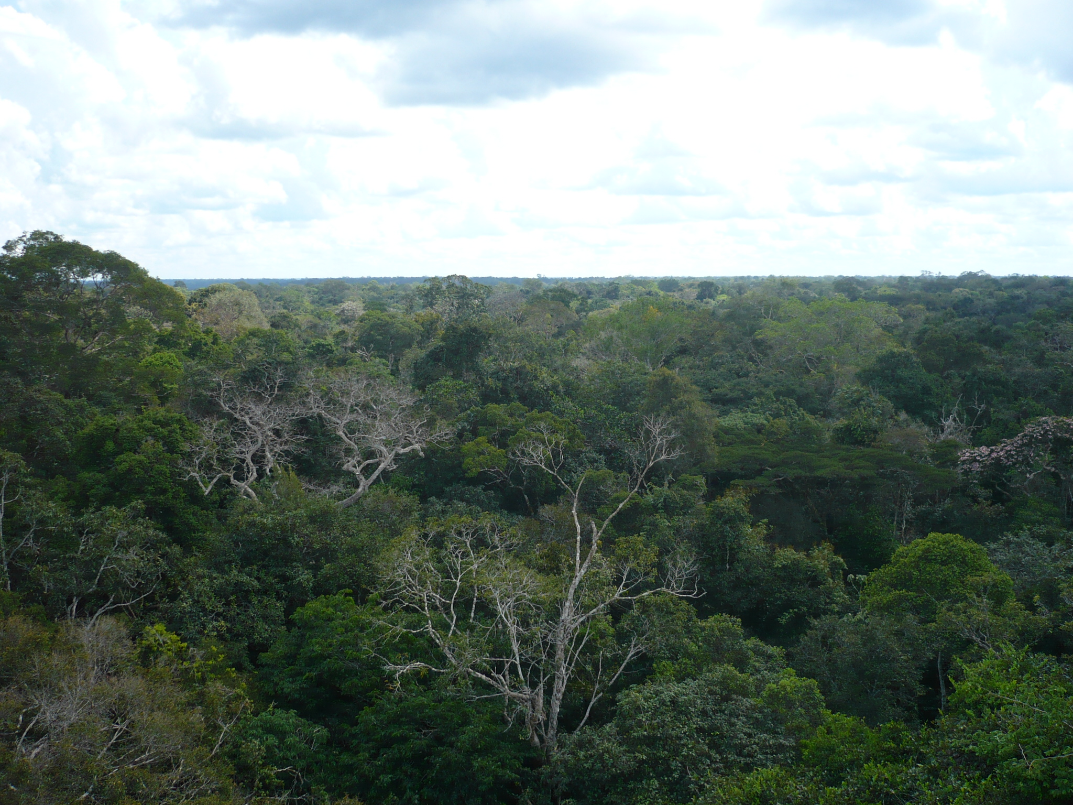
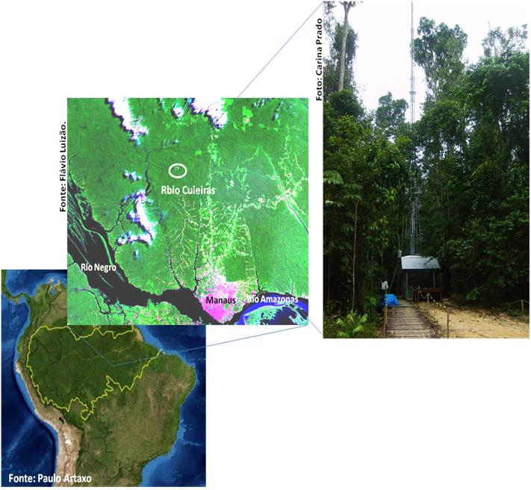
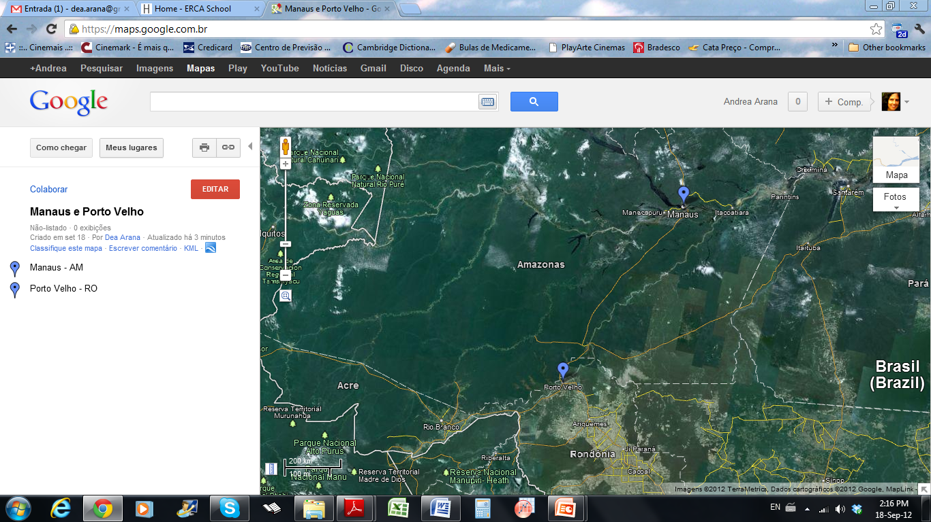
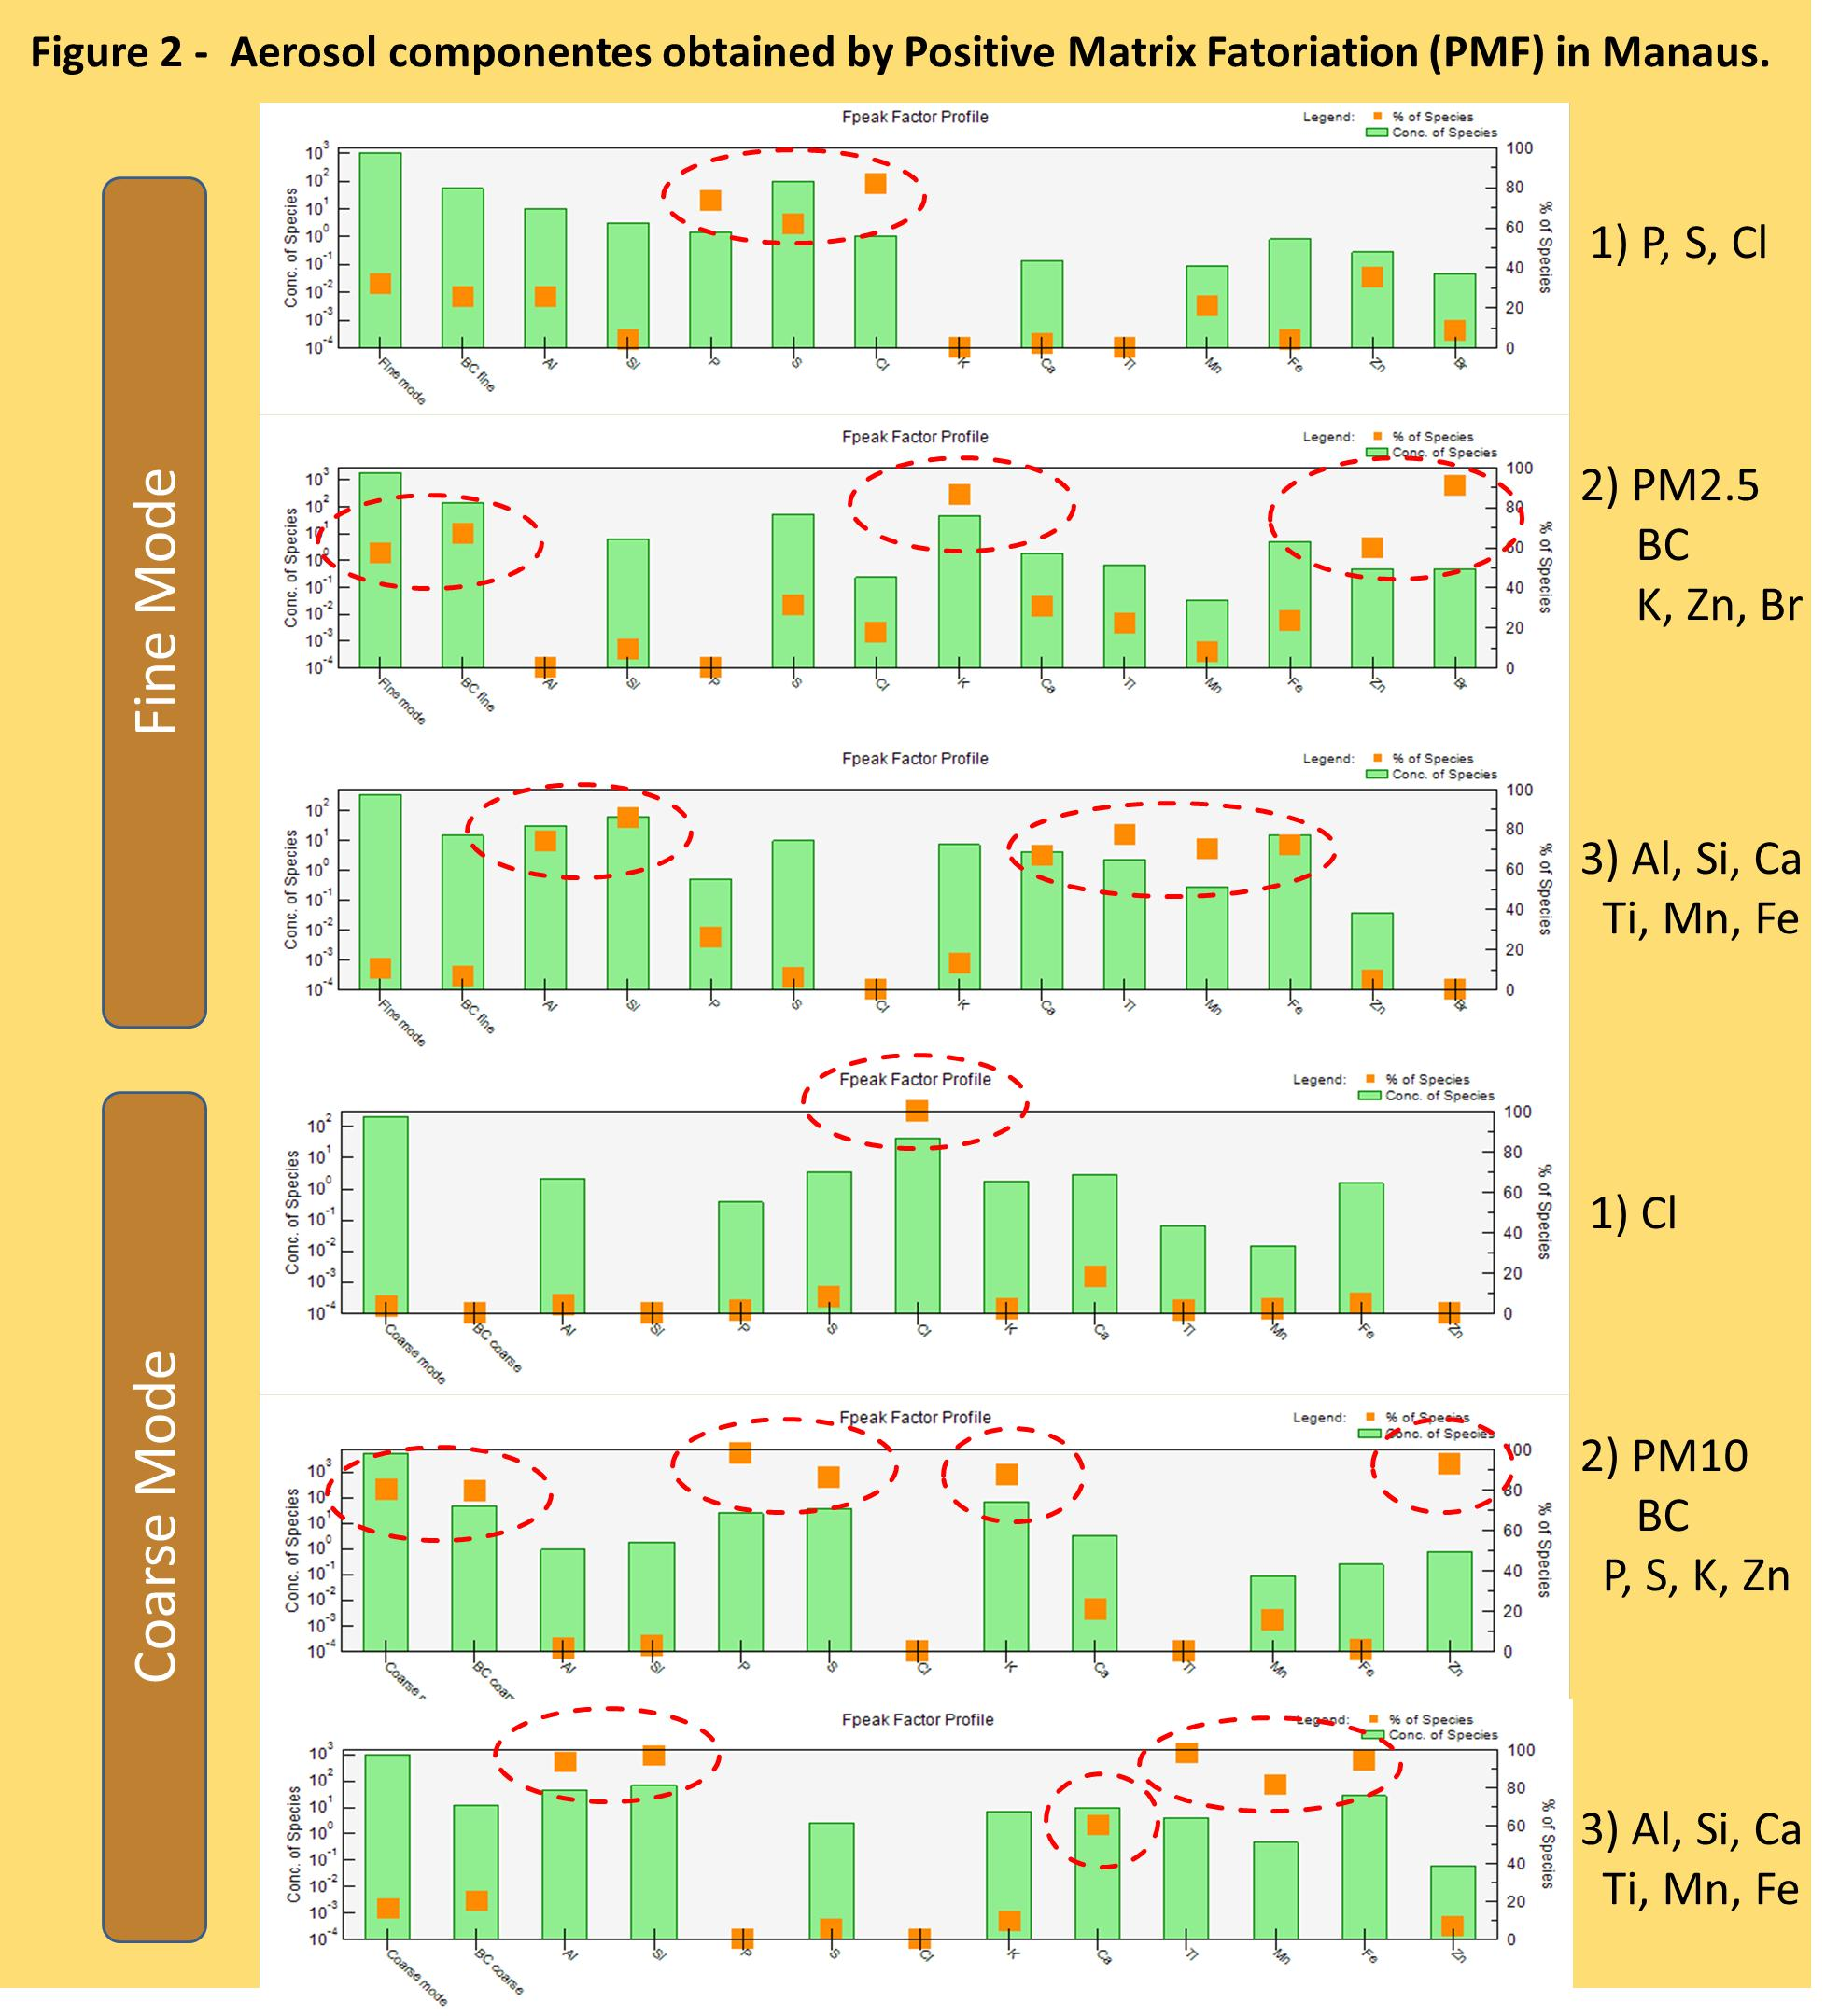
Atmospheric Aerosol in Amazônia:
Organic and Inorganic Components in areas with different land uses.
Andréa Arana¹, Paulo Artaxo²
¹ Instituto Nacional de Pesquisas da Amazônia - INPA, CEP 69060-001, Manaus, AM, Brazil.
² Instituto de Física, Universidade de São Paulo, CEP 05508-900, São Paulo, SP, Brazil.
E-mail: andreaarana@inpa.gov.br
artaxo@ifusp.com.br
1. Introduction
Central Amazonia is one of the few continental sites in the world where we can still observe very little impact of anthropogenic pollution (Davidson et al., 2012). Aerosol particles and trace metals show very low concentrations, because the air masses have travelled about 2.000 Km over pristine rainforest before being measure at sites North of Manaus (Martin et al., 2011).
Table 2 - Average concentrations in ng/m3 for trace elements in Porto Velho for wet and dry seasons. Fine mode fraction is represented by PM2.5 (particles less than 2,5 micrometers). The term “Coarse Mode” refers to particles with diameter 2.5<dp<10 micrometers. PM refers to the aerosol mass concentration and BC for the black carbon component.
Manaus
Barragem
Presidente Figueiredo
Rio Negro
Porto Velho
Rio Amazonas
Figure 1 – Study area, remote region with little influence of anthropogenic activities ,Manaus (left) and area strongly affected by land use change and biomass burning, Porto Velho (right).
2. Method
Aerosol physical and chemical properties were measured in two sites in Amazonia since January 2008. The clean site is at central Amazonia and is located in a pristine Amazonian forest site. A second sampling site is located in Porto Velho, Rondonia, an area strongly affected by land use change and biomass burning emissions. Long term measurements, are being carried out in these two sites, as part of the AEROCLIMA Project.
In both sites Stacked Filter Units (SFU) are being used to collect aerosol particles in two size fractions: PM10 and PM2.5.
Gravimetric analysis, black carbon from reflectance analyze as well as trace elements are being measured in the filters. X-ray Fluorescence using a PanAnalytical EDXRF Epsilon 5 instrument allows the detection of up to 24 trace elements. The organic aerosol component is measurement from organic carbon (OC) and elemental carbon (EC) by thermal-optic method (Sunset Lab.) The receptor model PMF (Positive Matrix Factorization) was used to quantify the absolute contribution of the sources of aerosols.
Figure 2 – Terrmograms showing the types of carbon present in atmospheric aerosol in Porto Velho and Rebio Cuieiras.
3. Results
Table 1 - Average concentrations in ng/m3 for trace elements in Rebio Cuieiras for wet and dry seasons. Fine mode fraction is represented by PM2.5 (particles less than 2,5 micrometers). The term “Coarse Mode” refers to particles with diameter 2.5<dp<10 micrometers. PM refers to the aerosol mass concentration and BC for the black carbon component.
Figure 3 – Aerosol components obtained by Positive Matrix Fatorization (PMF) in Rebio Cuieiras.
4. Acknowledgment
We acknowledge Alcides C. Ribeiro, Ana L. Loureiro, Fernando Morais and Livia Oliveira for support during sample collection. We also thank FAPESP and CNPq and the LBA Central office for support. We thank INPA, CLIAMB, CAPES and FAPEAM for a scholarship support.
.

