Slide 1
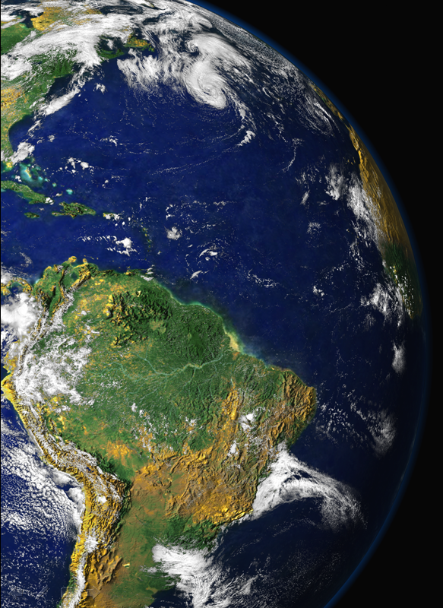
FAPESP Week
London, September 26, 2013
Amazonian ecosystem: A complex network involving climate, biology, atmospheric processing and lot´s more
Paulo Artaxo, Gordon McFiggans, Hugh Coe
University of São Paulo, Brazil,
University of Manchester, UK.

Slide 2
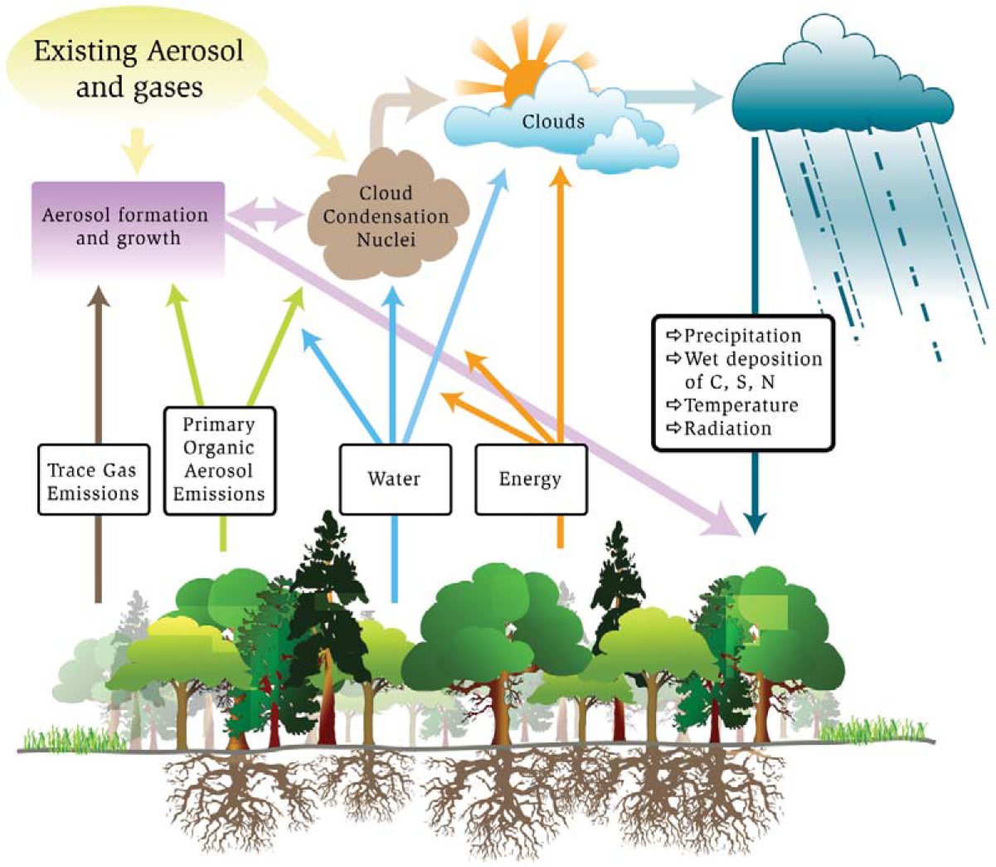
Amazon Basin has strong coupling between terrestrial ecosystem and the hydrologic cycle: The linkages among carbon cycle, aerosol life cycle, and cloud life cycle are strong and need to be understood and quantified.
High susceptibility and expected reaction to stresses of global climate change as well as pollution introduced by future regional economic development .
Barth et al., BAMS, 2005.

Slide 3
Aerosol and cloud lifecycles

Slide 4
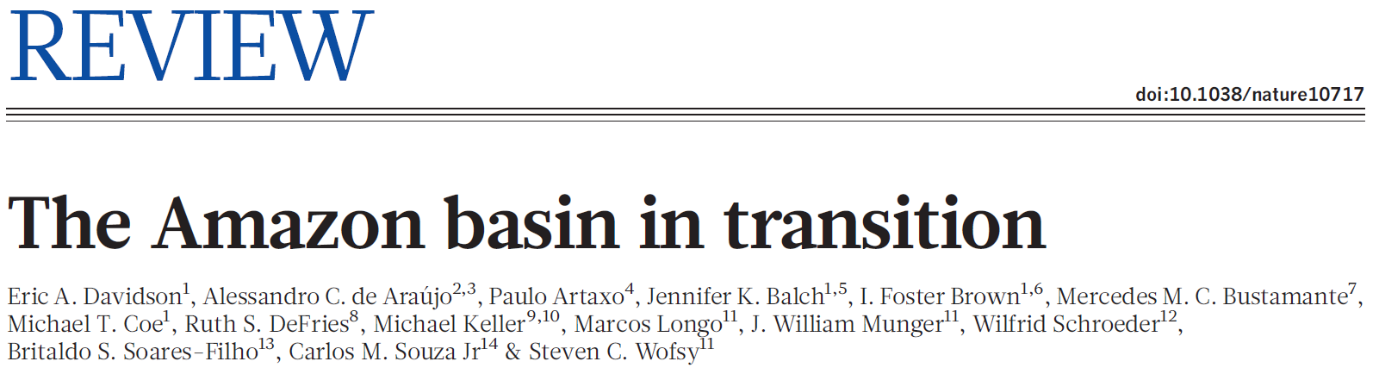
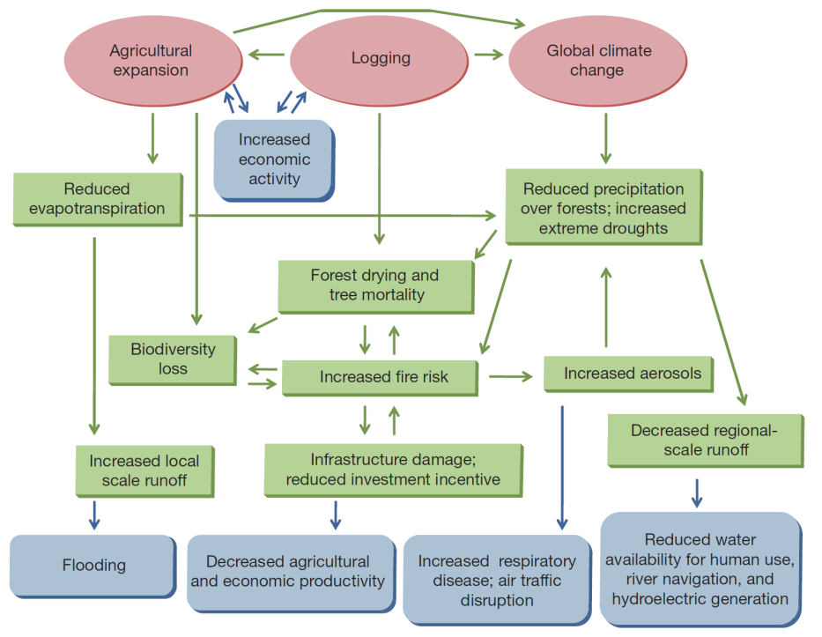
Agricultural expansion and climate variability have become important agents of disturbance in the Amazon basin. There are some signs of a transition to a disturbance-dominated regime. These signs include changing energy and water cycles in the southern and eastern portions of the Amazon basin.
Interactions between global climate, land use, fire, hydrology, ecology and human dimensions.
Forcing factors are indicated with red ovals; processes addressed in this Review are indicated by green boxes and arrows; and consequences for human society are indicated by blue boxes with rounded corners

Slide 5
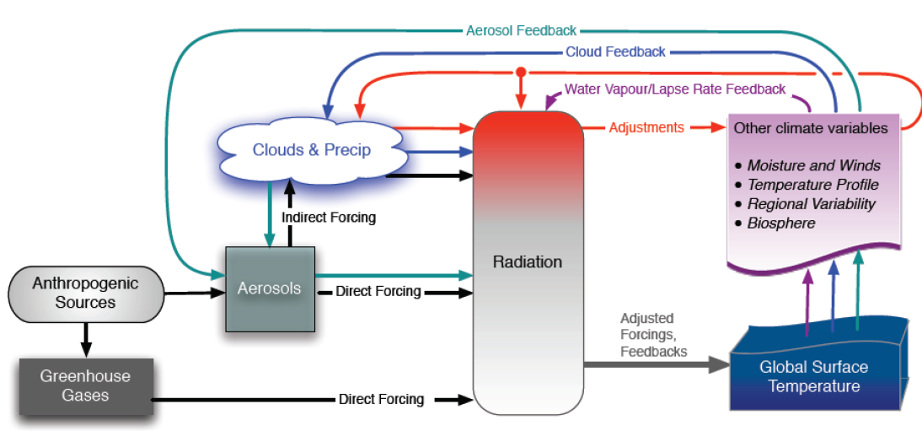
Aerosols, radiation, clouds and greenhouse gases in the global climate system
The major uncertainties in the climate system

Slide 6
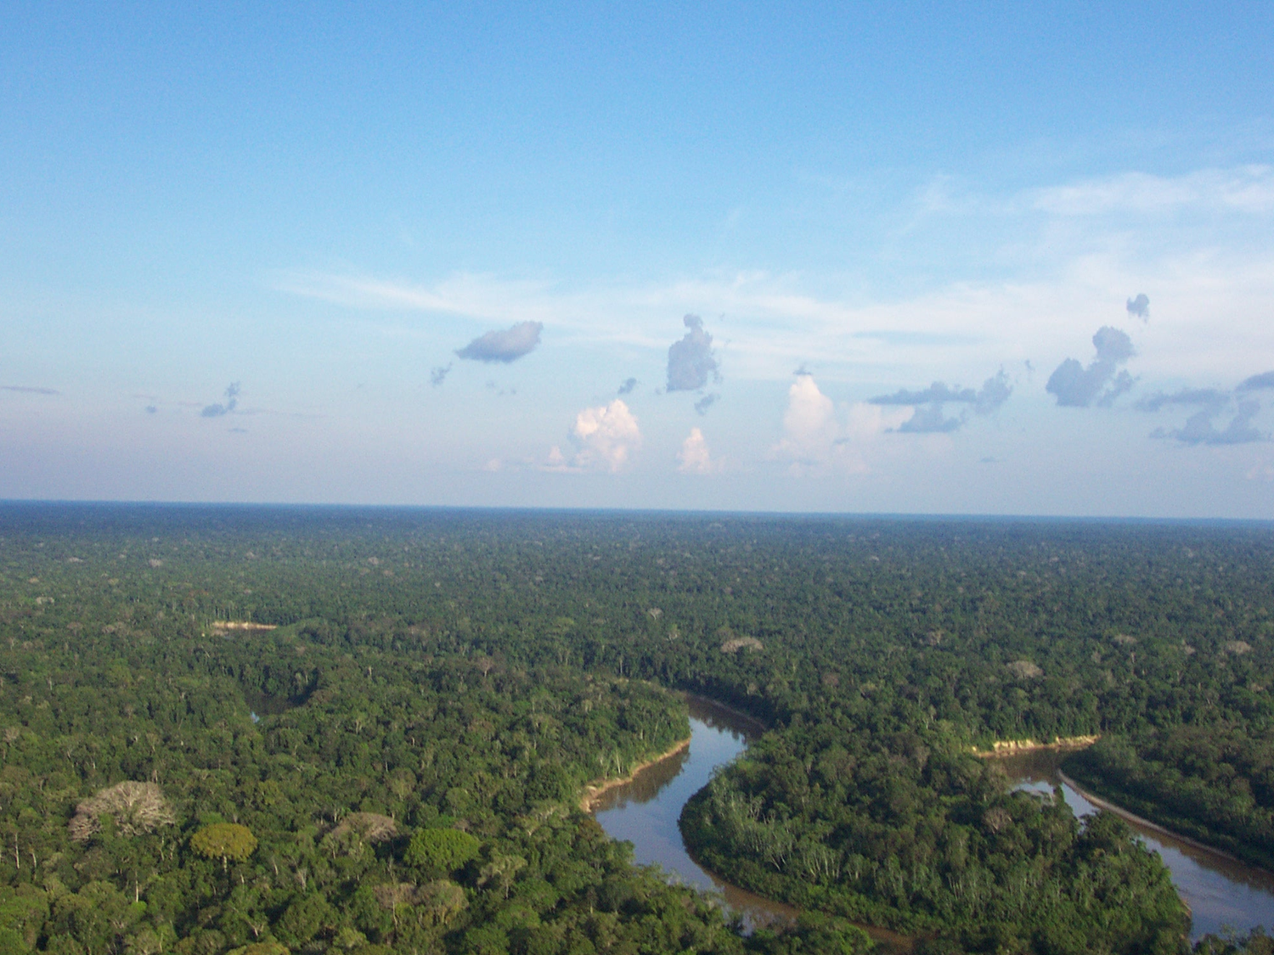
The biology of the forest partially controls the chemistry and physics of the atmosphere in Amazonia
Artaxo et al., 2013
Life in clouds: Bacteria, spores, fungus, etc
Strong interactions between forest biology, physics and chemistry of the atmosphere

Slide 7
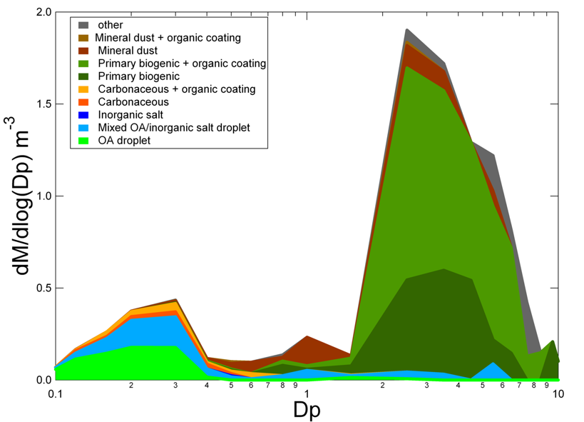
Particles in clean air over Amazon
Mass/size distribution
(µm)
Biological, chemical, and physical processes over the Amazon form a closely coupled system
Martin et al., 2010, Pueschl et al., 2010

Slide 8
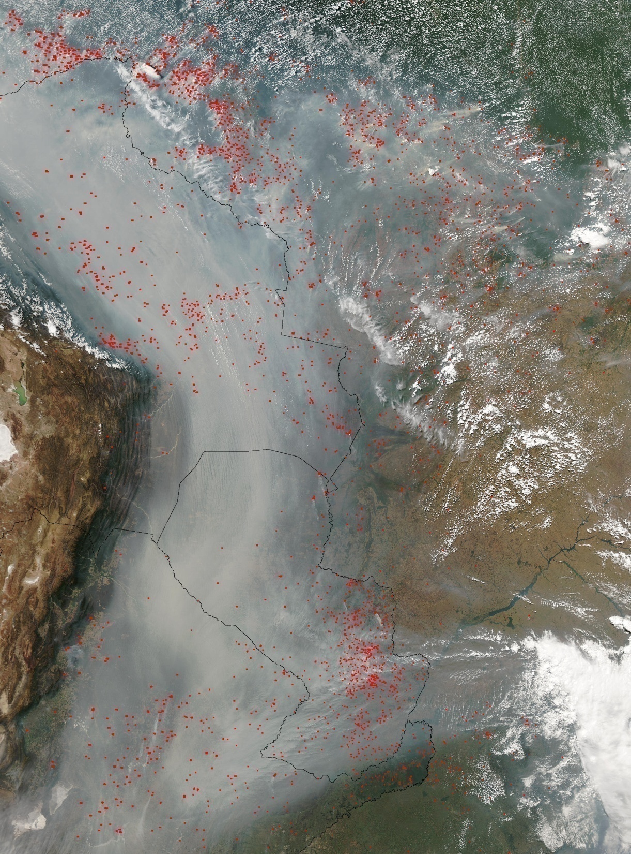

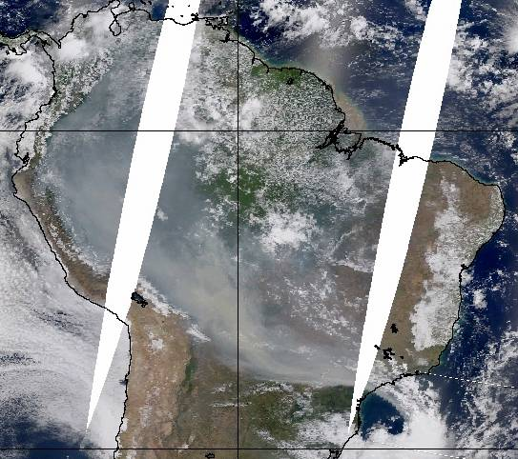
Biomass Burning in Amazonia
Severe health effects on the Amazonian population (about 20 million people)
Climatic effects, with strong effects on cloud physics and radiation balance.
Changes in carbon uptake and ecosystem functioning

Slide 9
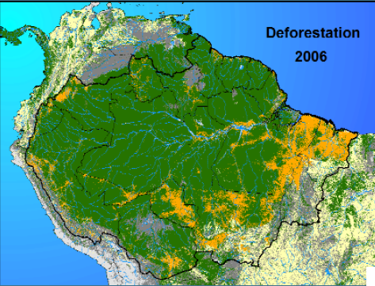
Deforestation was reduced from 27,700 Km² in 2004 to 4,571 Km² in 2012.
A very dynamical system, and we need to know what effects on the ecosystem these changes have produced
4.571 Km²
in 2012
What public policies are needed to sustain this strong reduction?

Slide 10
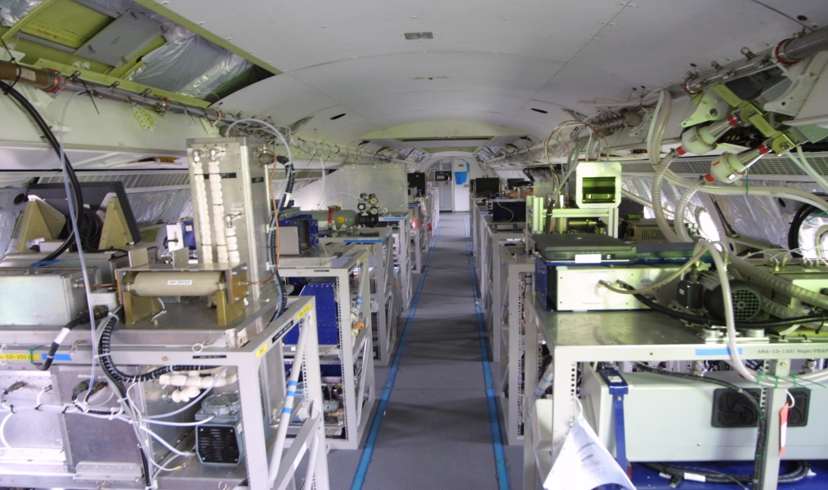

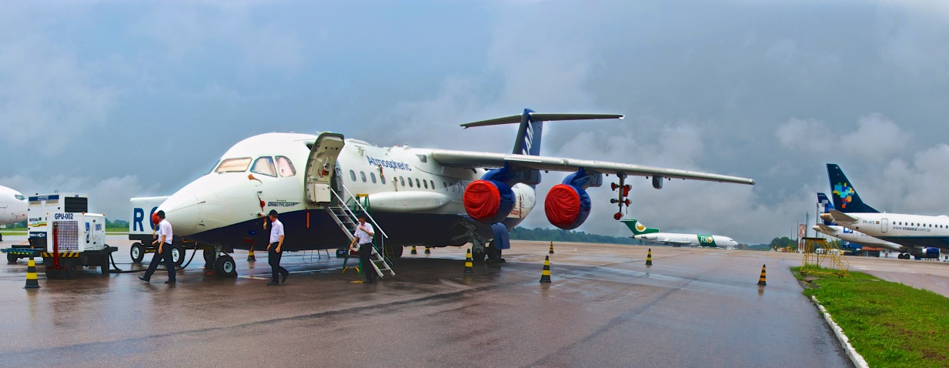
SAMBBA - South American Biomass Burning Analysis
NERC-FAPESP
Collaboration

Slide 11
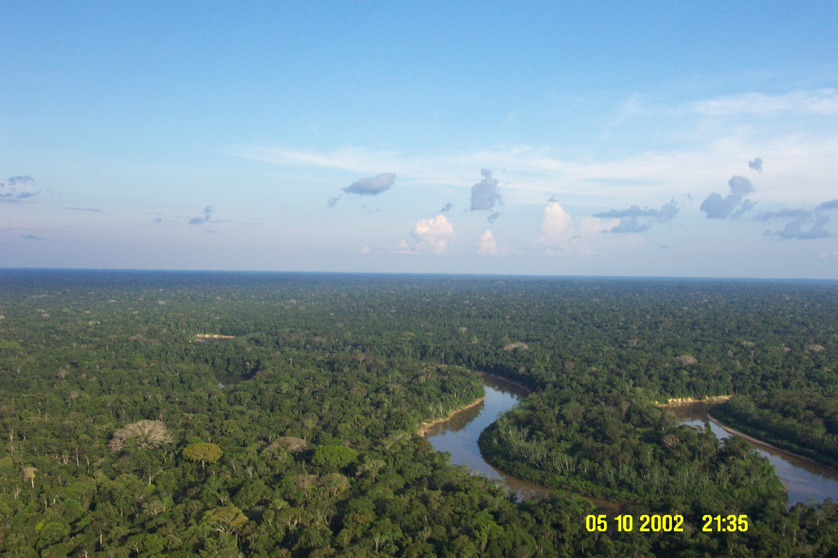
Aerosol-cloud-precipitation feedbacks
CCN = cloud condensation nuclei and IN = ice nuclei.
AEROSOLS
CCN Activation
Ice Nuclei Activation
Cloud/Aerosol
Radiative
Transfer
Cloud Microphysics
PRECIPITATION
Aerosol Wet Removal
Cloud Dynamics

Slide 12
Amazonia is critical for water vapor transport over South America
What processes controls these fluxes?

Slide 13
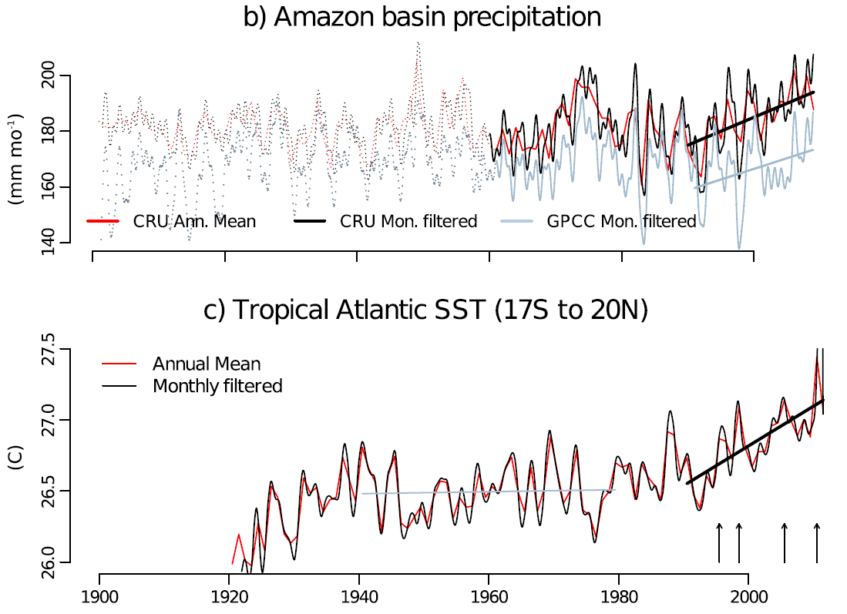
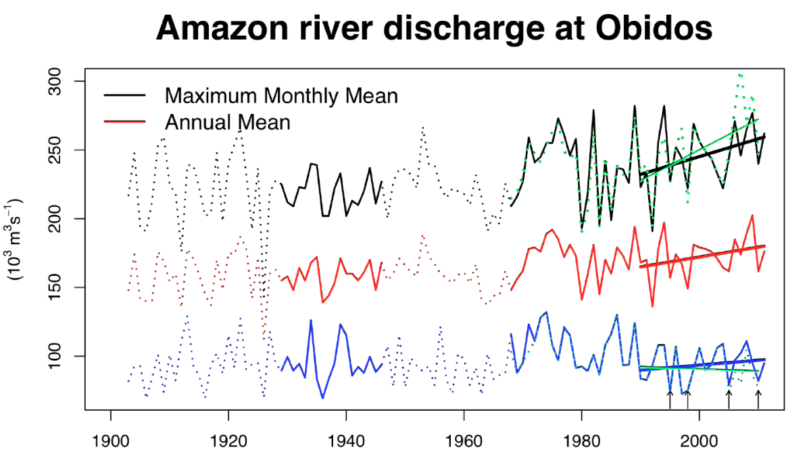
Is the Amazonian hydrological cycle intensifying?
Tropical Atlantic sea surface temperature
Maximum monthly, annual mean and minimum monthly mean Amazon river discharge at Óbidos and in green maximum and minimum daily mean river discharge, (Gloor et al. GRL 2013).

Slide 14
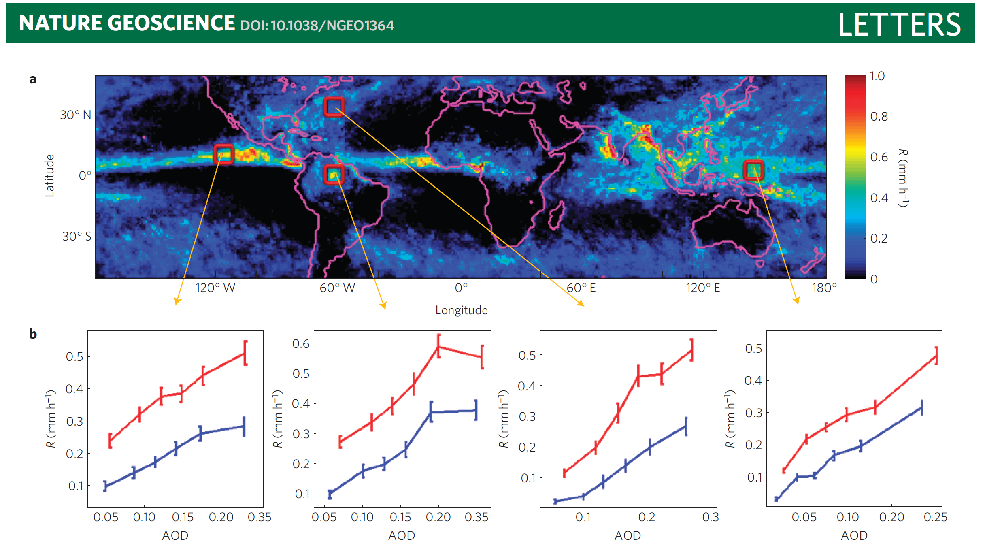
Rain rate (TRMM) versus Aerosol Optical Depth (MODIS)
Amazonia
13:30 local-time map of rain rate (R) and the observed trend with aerosol loading in four selected regions. Period: July and August 2007. b, The average R values are plotted for six aerosol-loading sets (blue, including zero R grid squares; red, without zero R grid squares). Note the R intensification as a function of AOD in all cases. (Koren et al., Nature 2012)

Slide 15
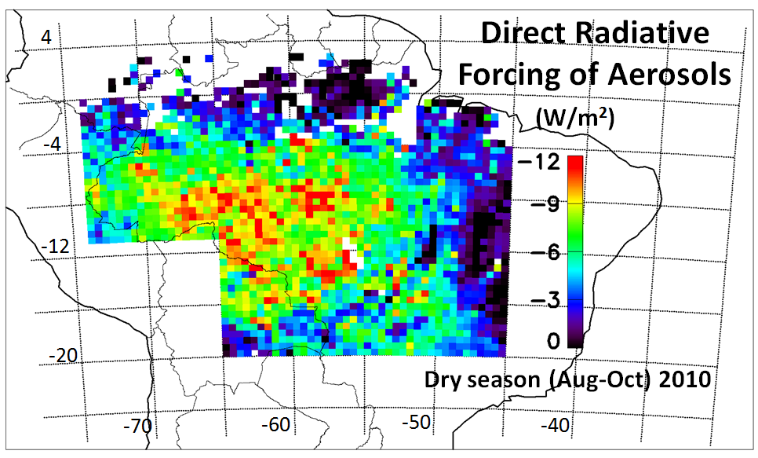
Average spatial distribution of the direct radiative forcing (DRF) of biomass burning aerosols in Amazonia during the dry season of 2010
CERES (Clouds and the Earth's Radiant Energy System) and MODIS

Slide 16
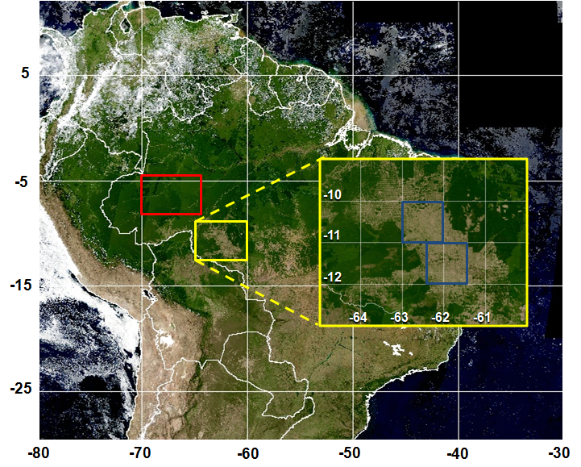
Land use change and radiative forcing
Mean Diurnal Radiative Forcing due to change in surface albedo:
-8.0 + 0.9 W/m²
Mean Diurnal Aerosol Forcing Efficiency:
Forest: -22.5 + 1.4 W/m²
Cerrado: -16.6 + 1.7 W/m²
Land-use change radiative forcing. Forested areas are selected in red and deforested areas are selected in blue.
Elisa Sena, 2013

Slide 17
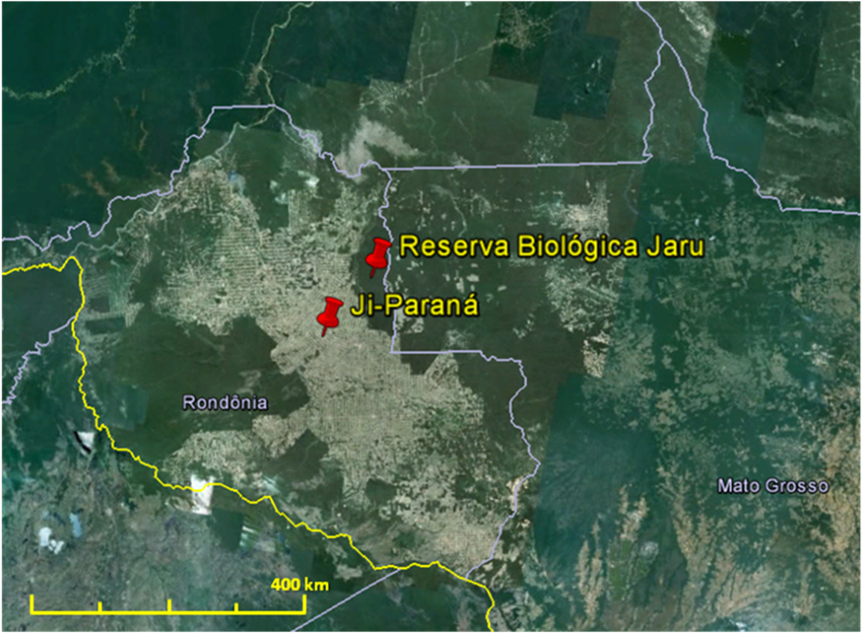
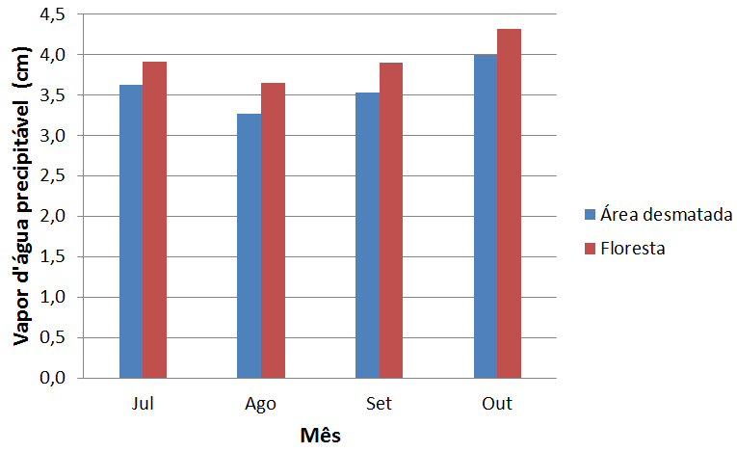
Deforestation impact on H₂O column
Reserva biológica Jaru: preserved area
Abracos Hill: deforested area
Distance: 86 km
H₂O vapor: AERONET
Deforested areas are approx. 0,35 cm of H₂O dryer than forest areas (This is about 10% total water vapor).

Slide 18
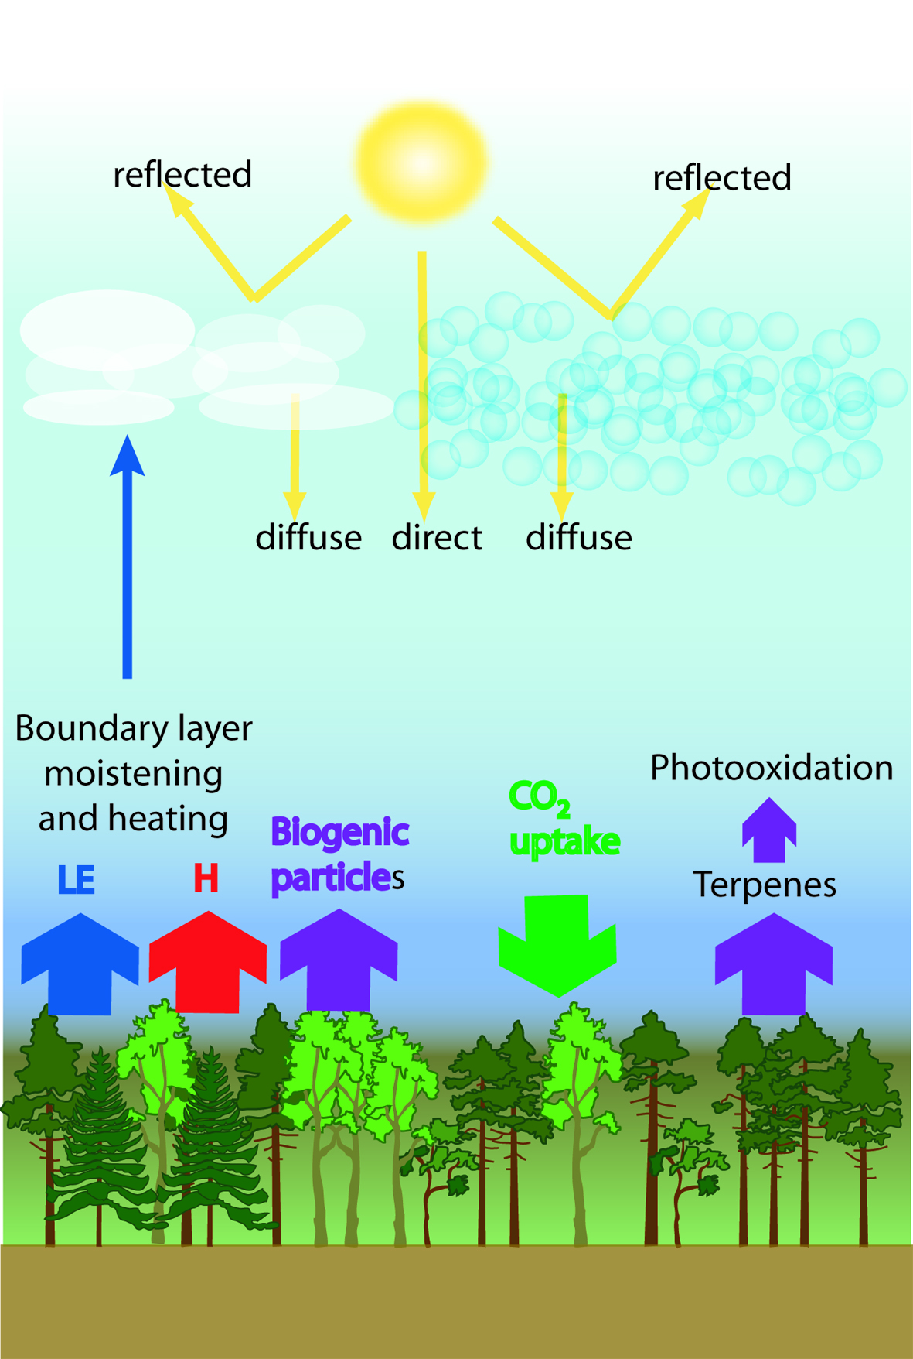
Aerosol Effects on
Net Plant Productivity
CO₂ Concentration
Aerosol Concentration
+
-
+
Temperature
+
+
+?
Photosynthesis
BVOC emissions
+
Kulmala et al., 2004

Slide 19
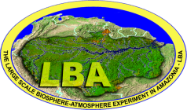
Strong aerosol effect on forest photosynthesis diffuse radiation have a large effect on CO2 fluxes
Increase in aerosol loading

Slide 20
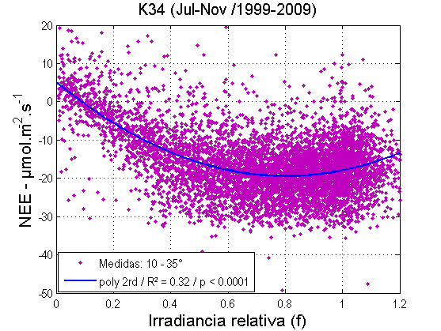
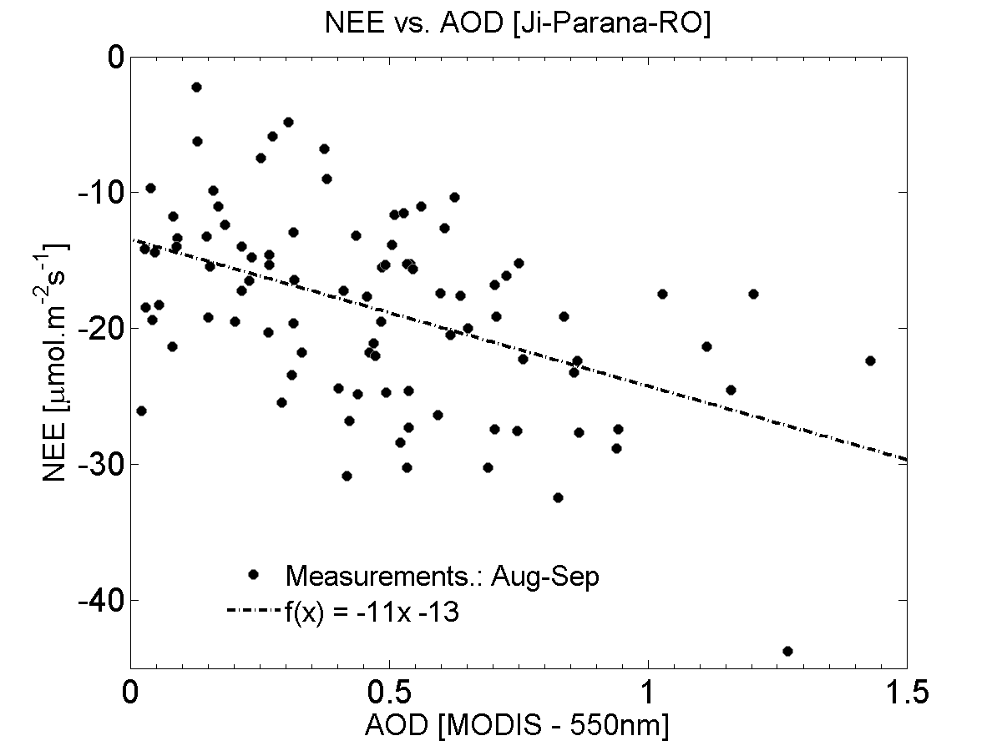
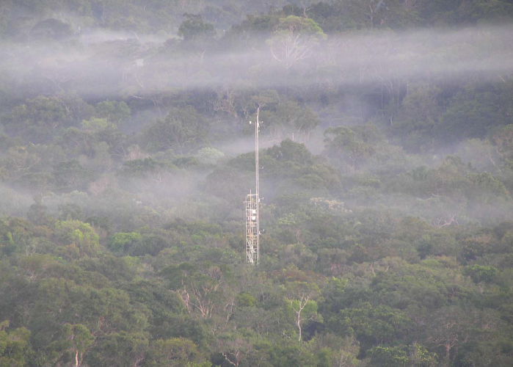
Aerosols effects on NEE – Manaus and Rondonia
(Glauber Cirino, INPA, 2013)
f max: ~ 0,80
  NEE (max): ~ -20 µmol/m²s
  AOT: ~ 0,5
Manaus K34 tower

Slide 21
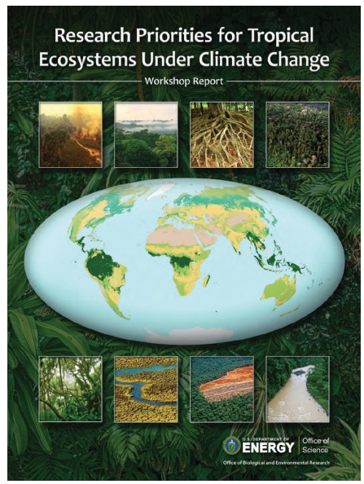
Tropical Ecosystems feedbacks and responses
How will tropical ecosystems respond to increasing temperatures, increasing CO₂ concentrations, and altered rainfall?
Will climate change increase natural disturbance events and mortality?
What are the interactions of climate change with aerosol and particulate emissions from tropical forests?
How will forest-climate interactions respond to anthropogenic disturbance and land-use change?

Slide 22
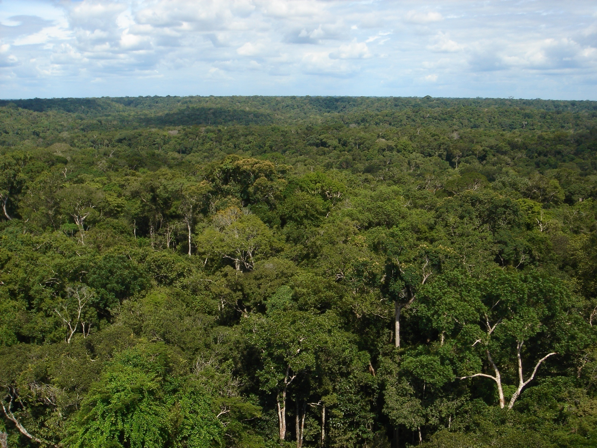
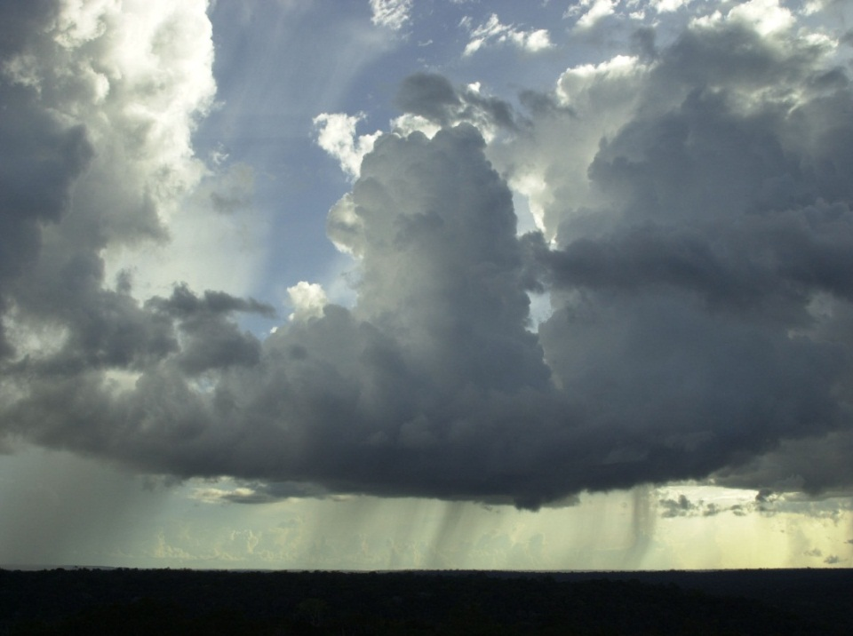

GoAmazon 2014-2015
Ecosystems, Atmosphere Composition, and Climate in Amazonia
Carbon Cycle Cloud Life Cycle Aerosol Life Cycle
Climate
Ecosystems
Atmospheric Composition

Slide 23
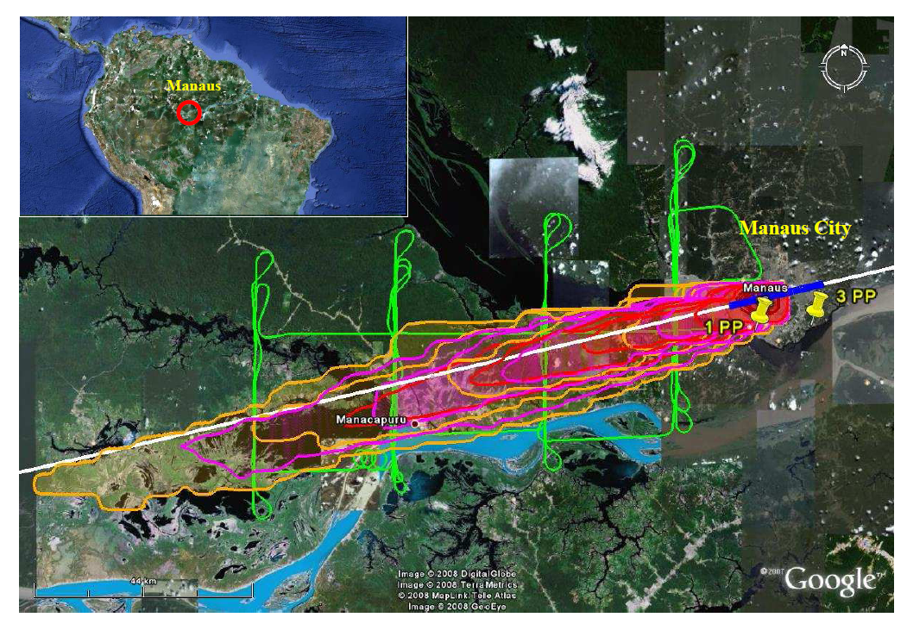
Experimento GoAmazon 2014

Slide 24
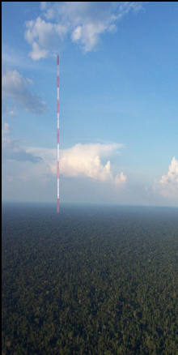
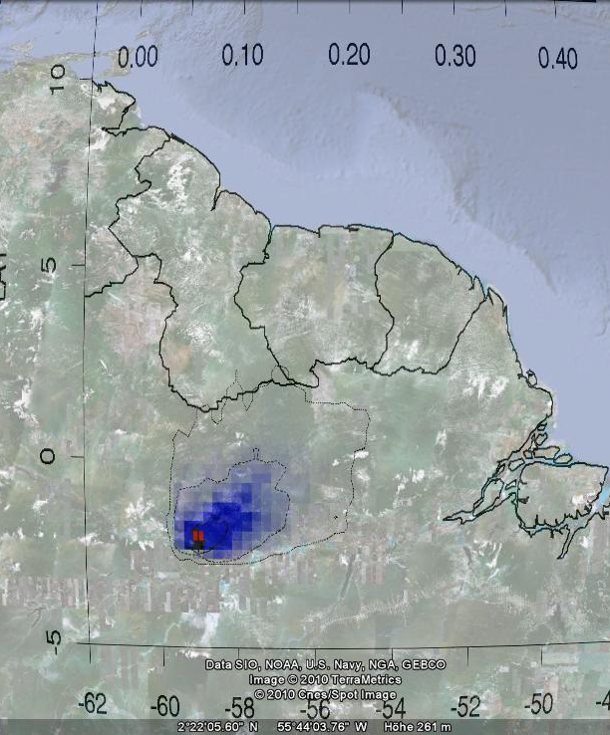

ATTO Footprint
C. Gerbig MPIBGC
Amazonian Tall Tower Observatory
ATTO – 320 meters
Long term broad objectives observatory

Slide 25
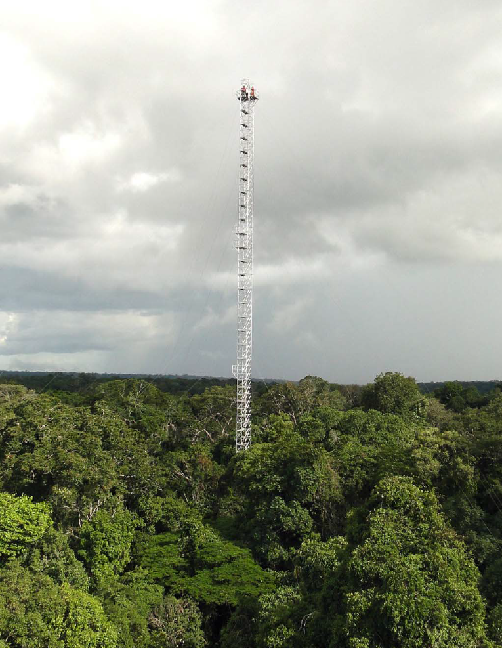
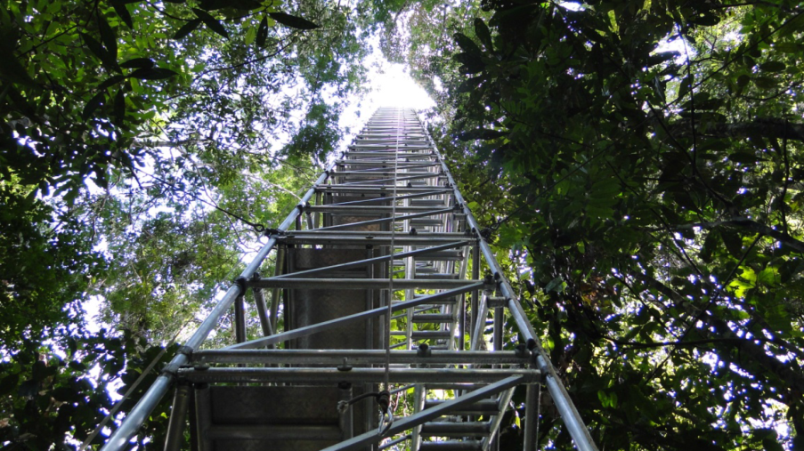
Four flux towers with 85 meters already in operation at the ATTO site
Measurements at 6 levels for
Ozone, CO, VOCs (PTR-MS), aerosol number size distribution, composition with ACSM, Light scattering (TSI Neph), light absorption using MAAP, Aethalometer, SP2), CO2, CH4, water vapor and others.

Slide 26
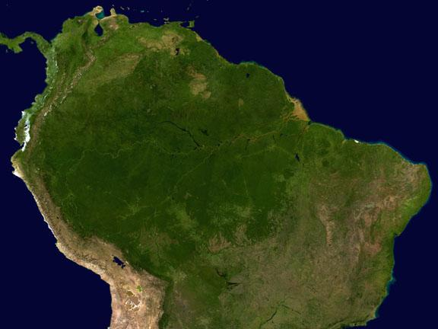

Amazonia is a great laboratory to study interactions between biology, biodiversity, climate, hydrological cycle and socio-economy interactions.
Cooperation is key!!!!
Thanks for the attention.

