Slide 1
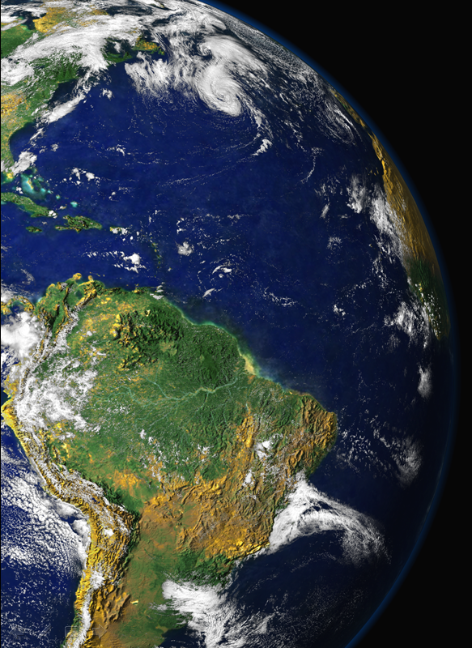
MAPFRE MUDANÇAS CLIMÁTICAS: PERSPECTIVAS E DESAFIOS SOCIAIS.
USP Biblioteca Brasiliana Mindlin – 22/Novembro/2013
Segurança ambiental
e climática
Paulo Artaxo
Instituto de Física
Universidade de São Paulo

Slide 2
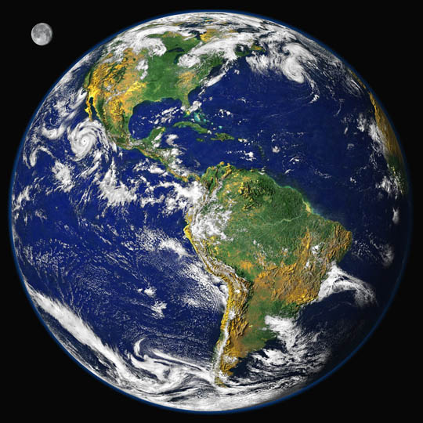
O que é “segurança ambiental e climática”?
Quais os driving forces?
Aumento lento e gradual da temperatura (já em andamento)
Alterações no padrão de precipitação: difícil de medir, difícil de modelar…
Os chamados “tipping points”: A não linearidade do sistema climático
O aumento da frequência dos eventos climáticos extremos (secas, inundações, furacões, etc.)
Impactos na produtividade agrícola e produção de biocombustíveis
Importantes links de mudanças climáticas com perda de biodiversidade
Links com segurança alimentar

Slide 3
Nosso planeta em mudança, nos compartimentos:
Atmosfera
Criosfera
Biosfera
Geosfera
Hidrosfera
Todos importantes na questão de produção energética

Slide 4
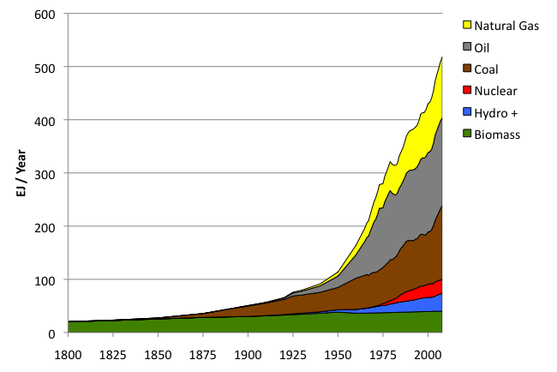
Suprimento de energia global: 1800 – 2008
Fossil
fuels
Hydro + :means hydropower plus other renewables
Sources: Grubler (2008) - Energy Transitions, BP (2009) – Statistical Review of World Energy, EIA (2009) – International Energy Annual

Slide 5
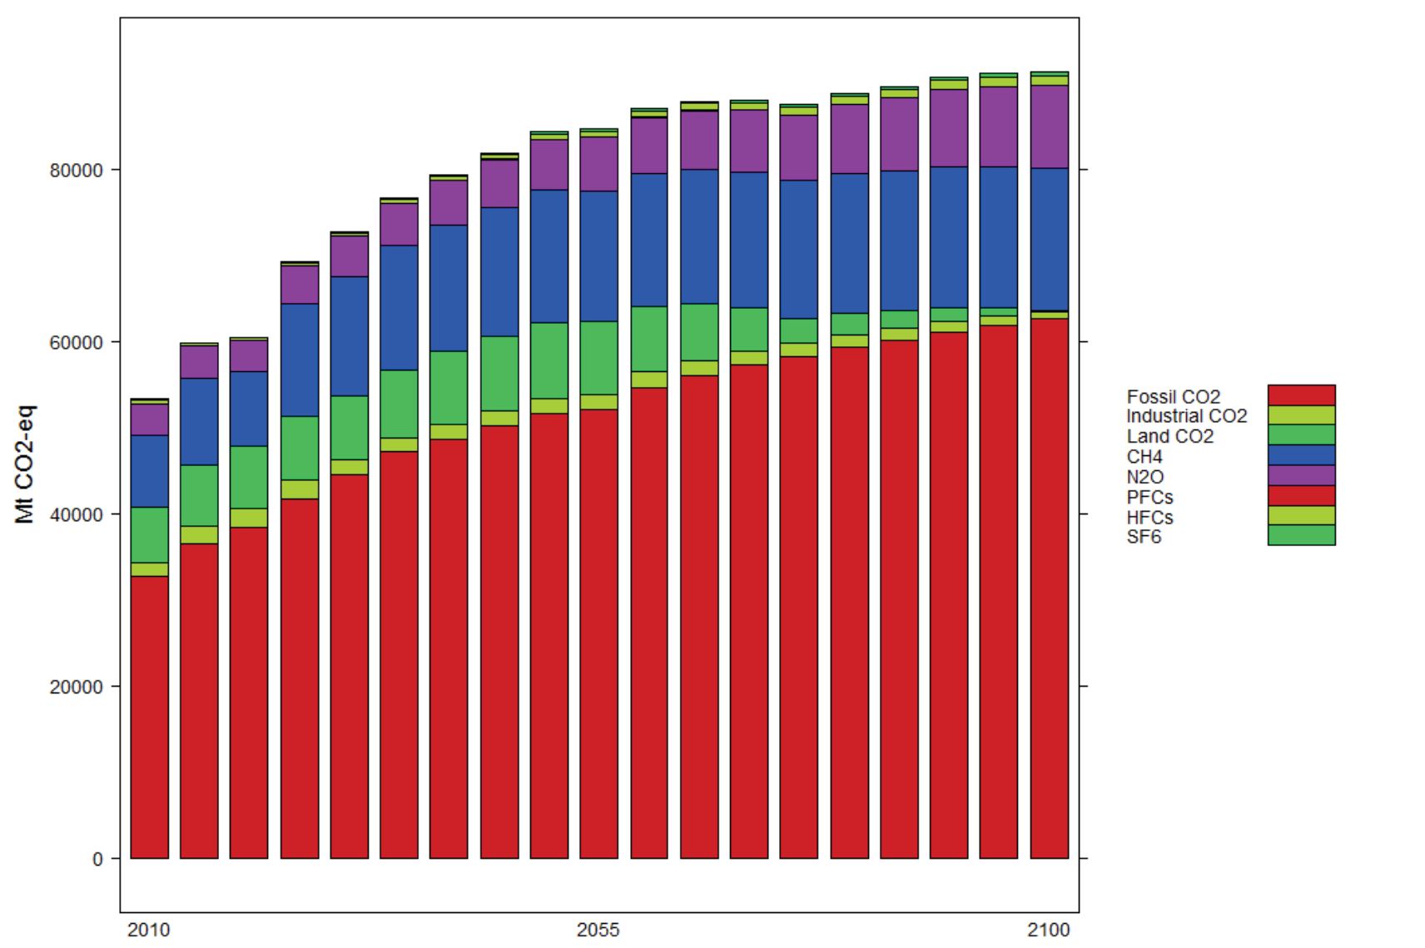
Emissões globais de gases de efeito estufa 2010-2100
MIT e IIE, 2012

Slide 6
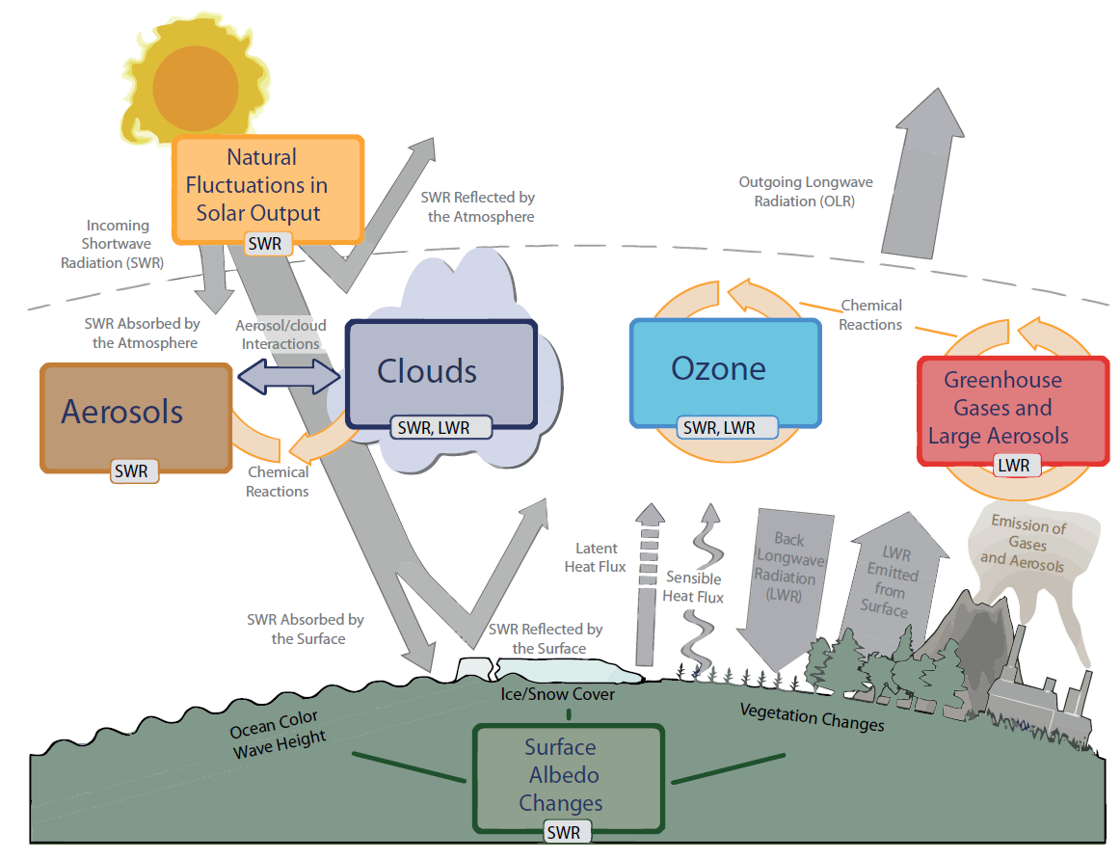
Principais agentes do sistema climático global

Slide 7

Nosso clima depende das interações entre a biosfera e a atmosfera

Slide 8
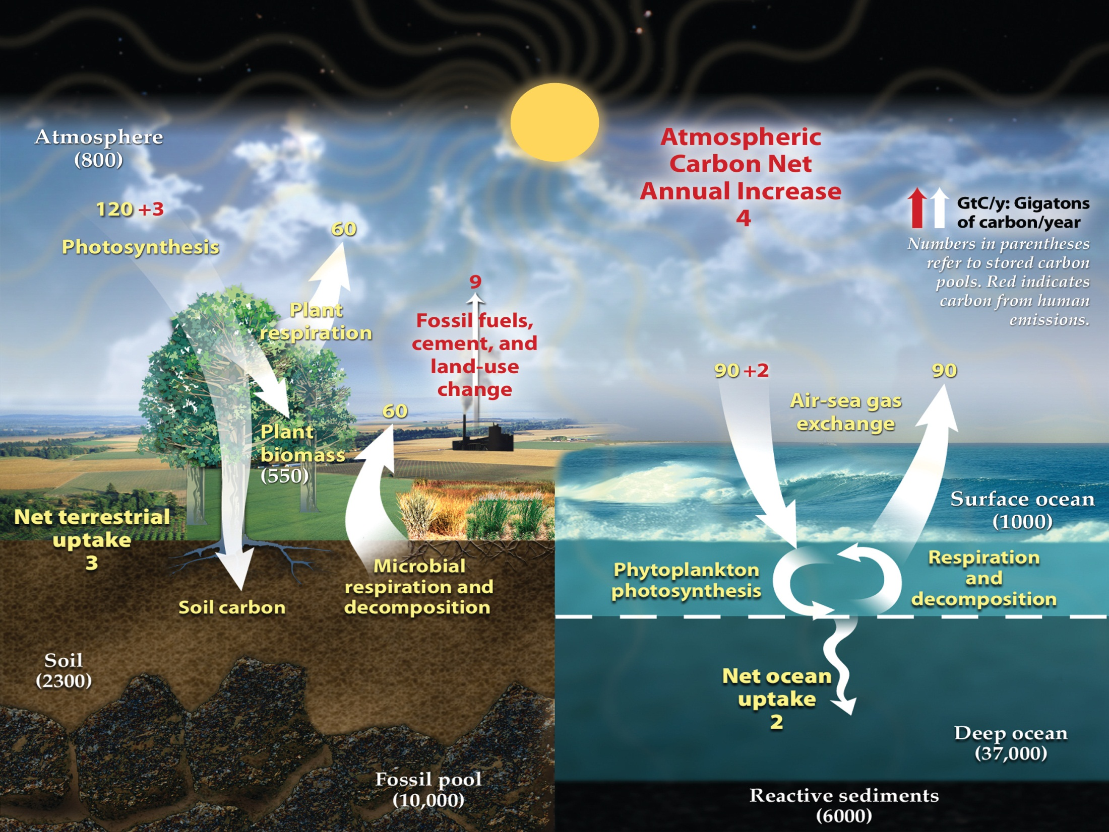
Perturbações humanas no ciclo de carbono global
(Global Carbon Project 2013)

Slide 9
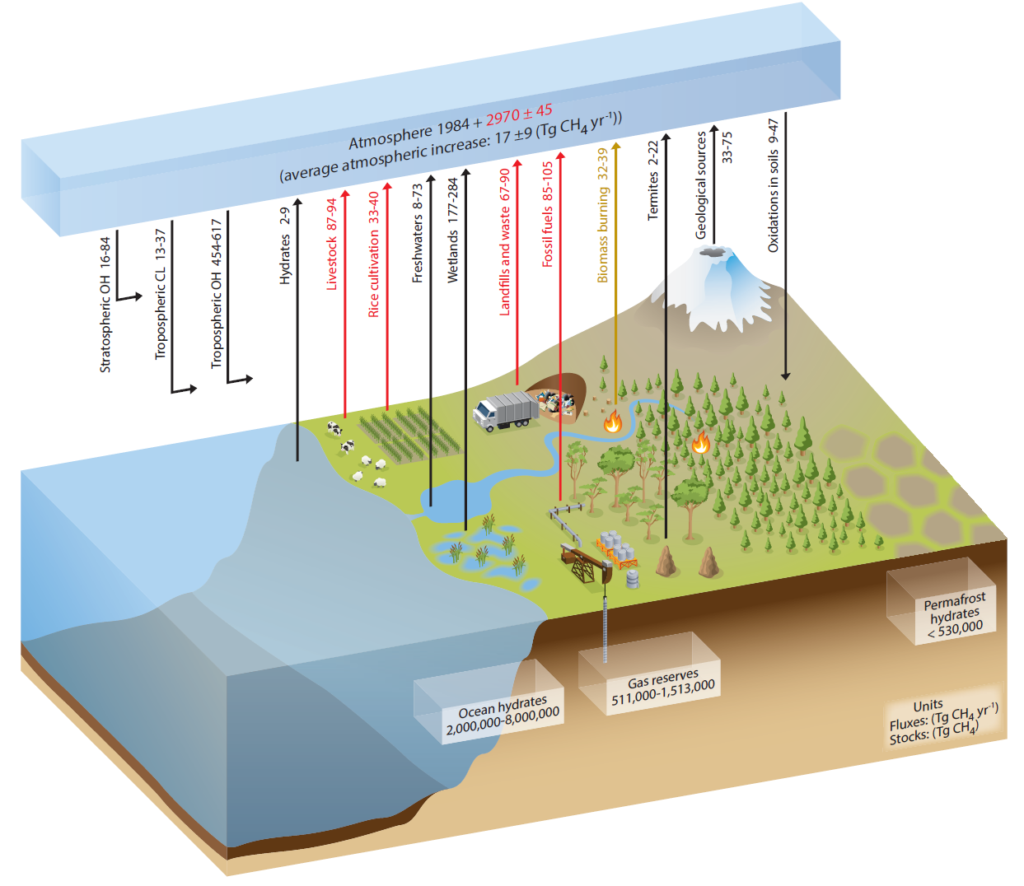
Ciclo do Metano Global
IPCC AR5, 2013

Slide 10
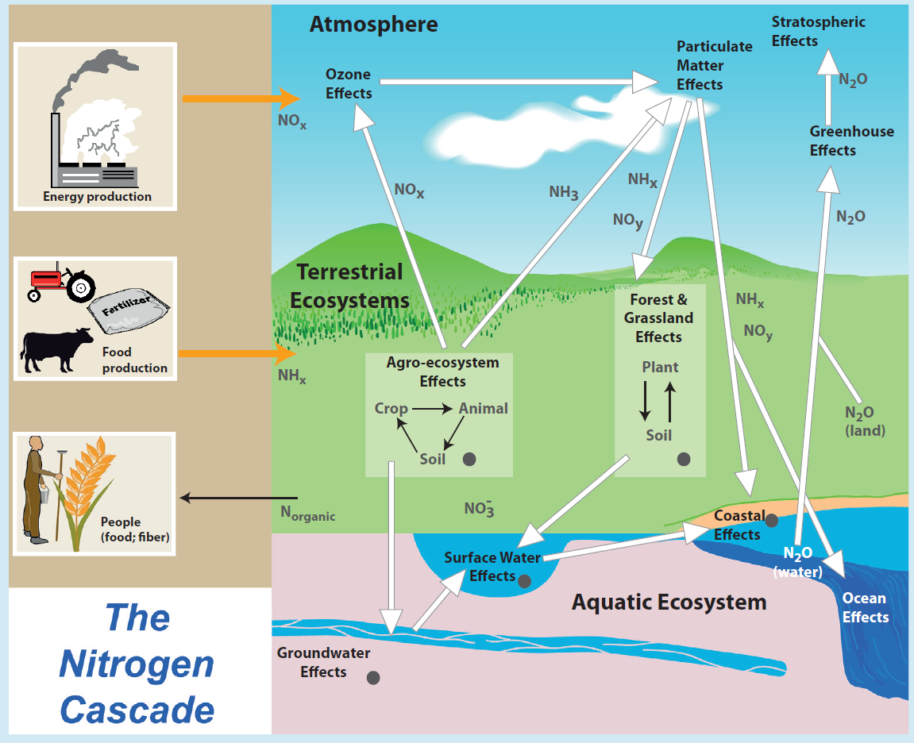

Slide 11
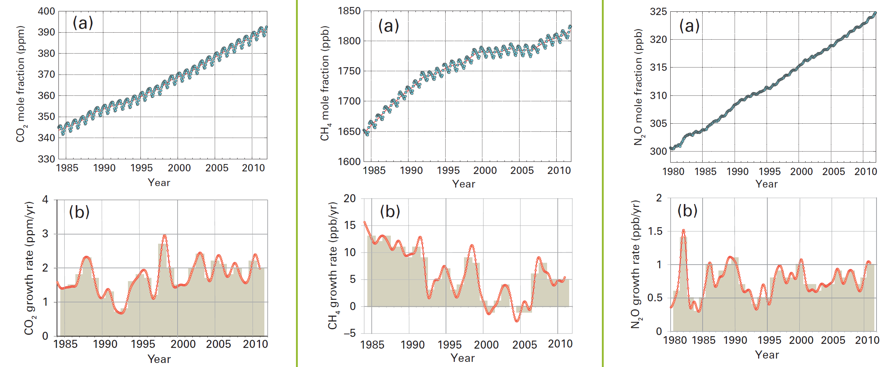
CO₂, CH₄ e N₂O de 1985 a 2011
40% aumento desde 1850
158% aumento desde 1850
20% aumento desde 1850
Globally averaged CO2 mole fraction (a) and its growth rate (b) from 1984 to 2011.
Globally averaged CH4 mole fraction (a) and its growth rate (b) from 1984 to 2011.
Globally averaged N2O mole fraction (a) and its growth rate (b) from 1980 to 2011.
WMO GREENHOUSE GAS BULLETIN Oct 2012

Slide 12

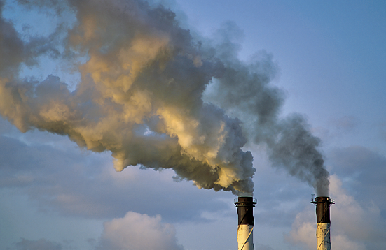
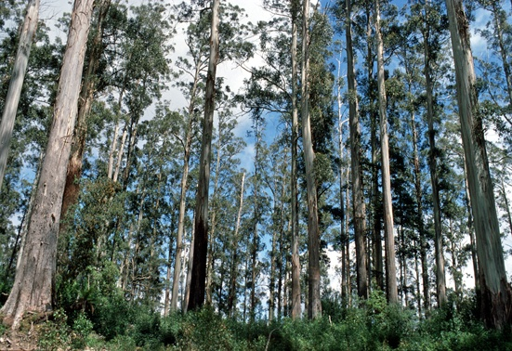
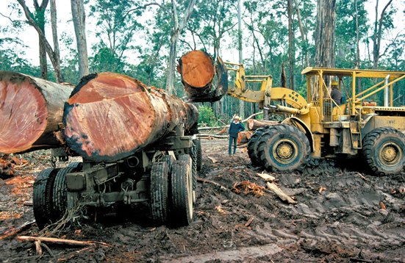
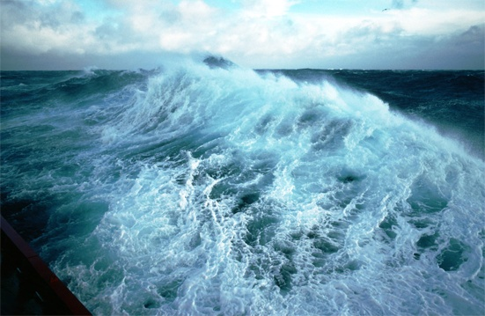
Para onde vão as emissões antropogênicas de CO₂ (média 2002-2011)
8.3±0.4 PgC/yr 90%
4.3±0.1 PgC/yr
46%
+
2.6±0.8 PgC/yr
28%
1.0±0.5 PgC/yr 10%
26%
2.5±0.5 PgC/yr
1 PgC = 10¹⁵ g C
Source: Le Quéré et al. 2012; Global Carbon Project 2012

Slide 13
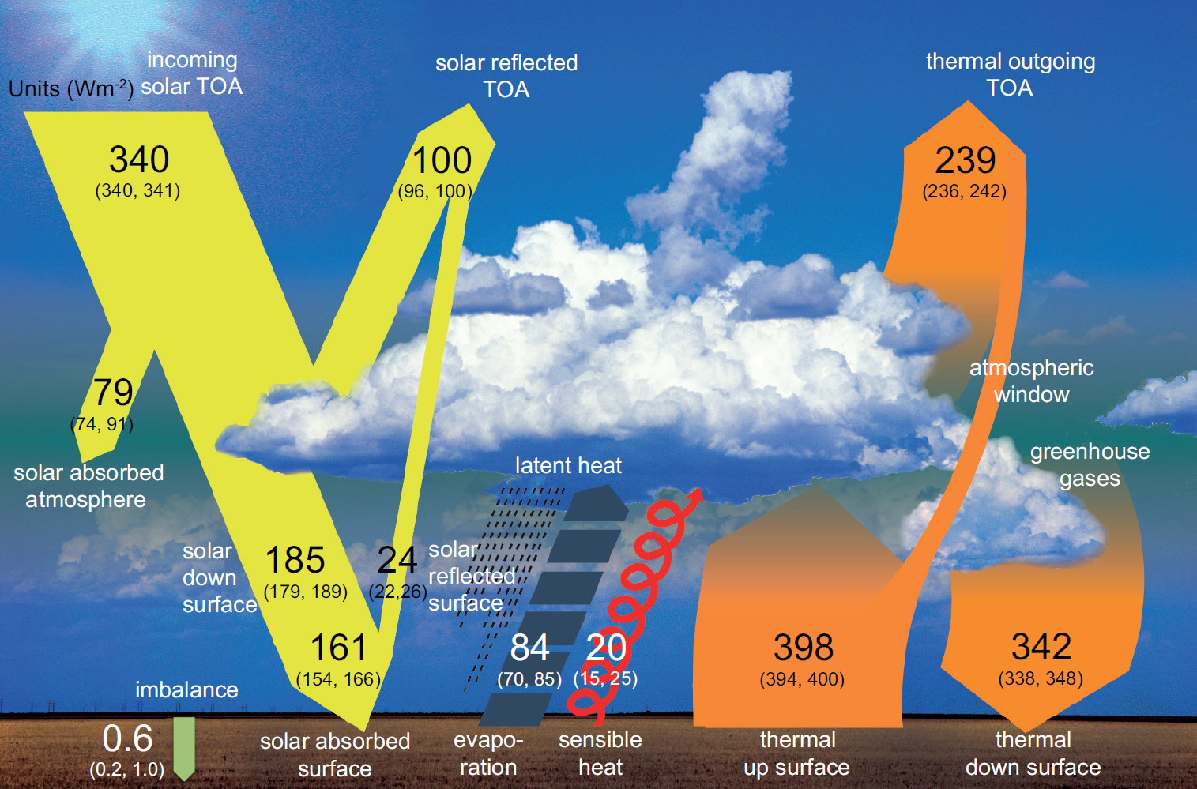
Balanço de energia sob condições climáticas atuais

Slide 14
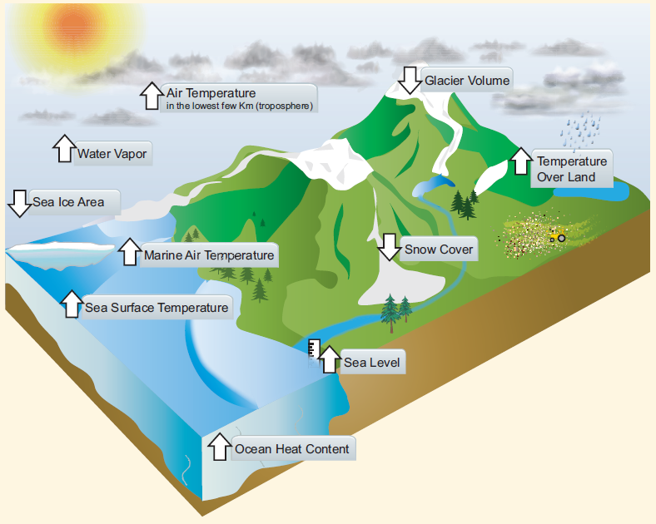
Dez indicadores de um mundo em aquecimento
TODOS os indicadores estão variando de acordo com o esperado
IPCC AR5, 2013

Slide 15
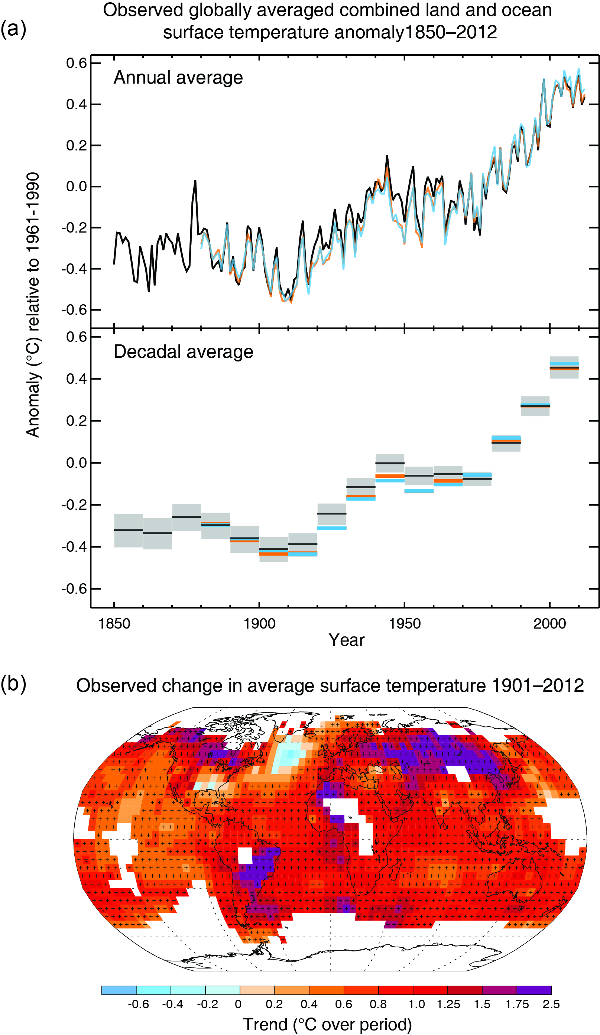
Aumento médio da temperatura observado de
1850-2012: 1.0 °C
Distribuição espacial
IPCC AR5 2013

Slide 16
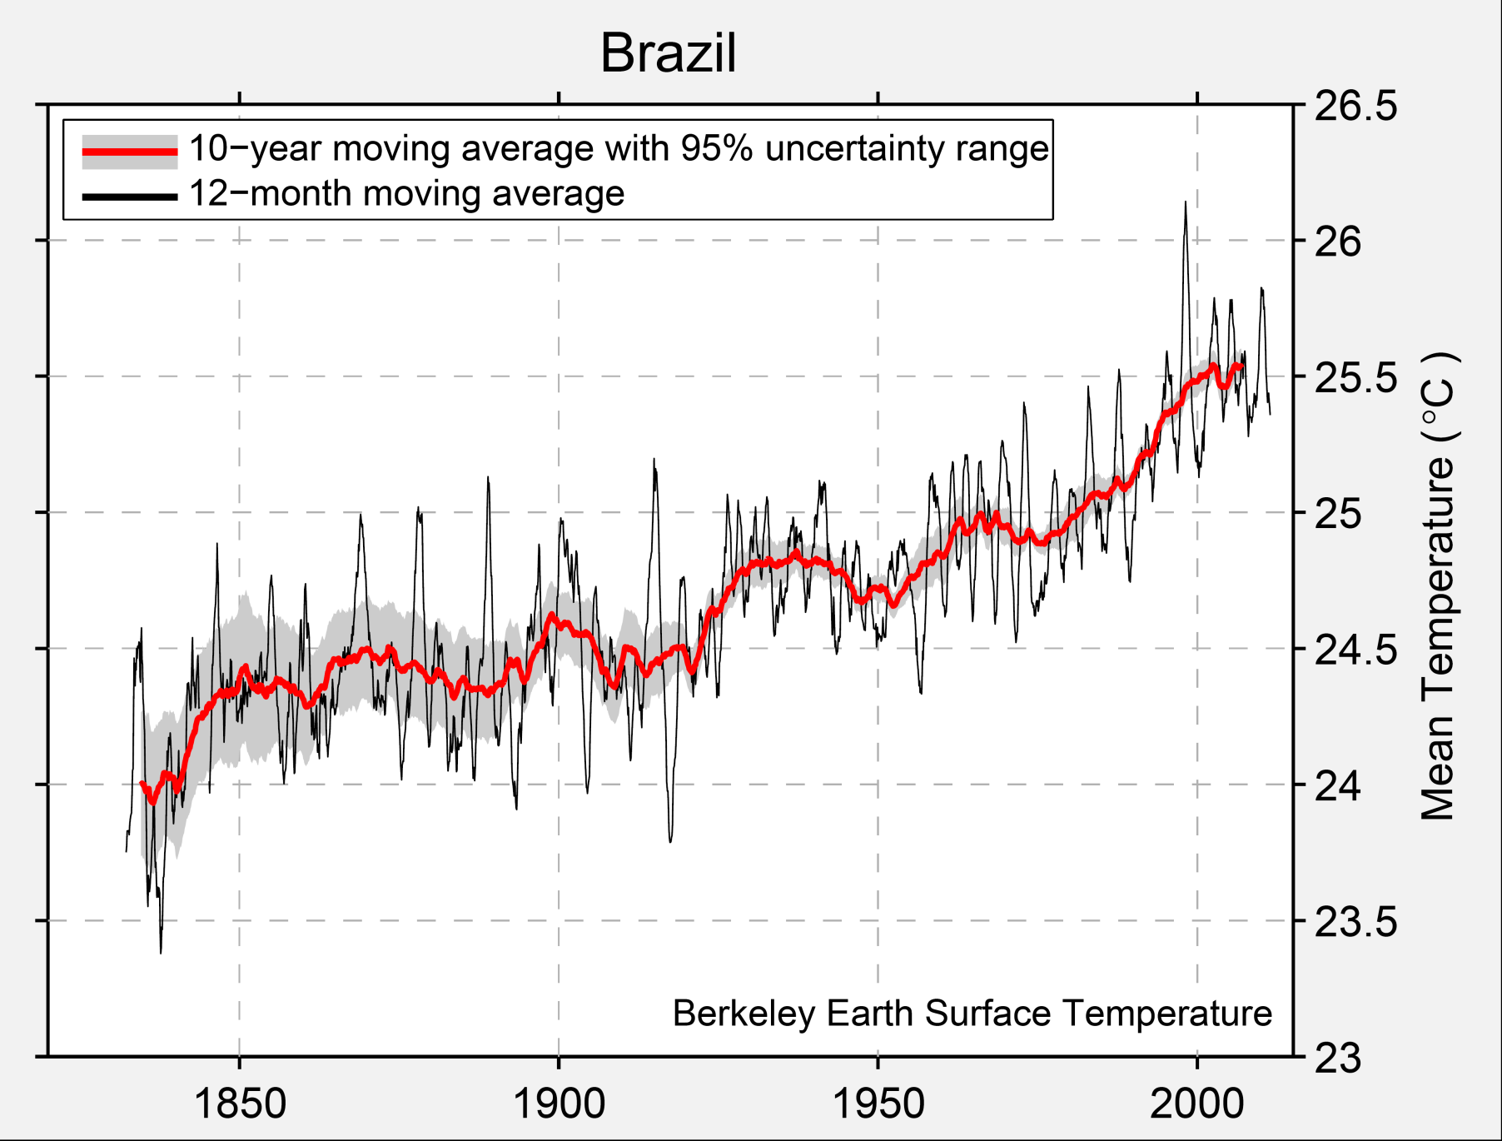
Brasil: Berkeley Earth Surface Temperature
http://berkeleyearth.org/

Slide 17
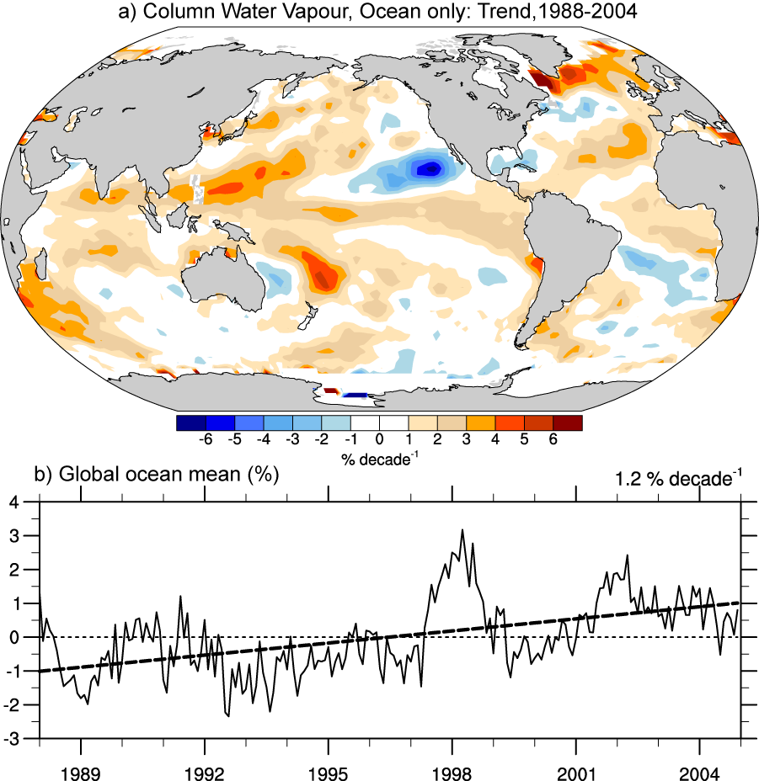
Air holds more water vapor at higher temperatures
A basic physical law tells us that the water holding capacity of the atmosphere goes up at about 7% per degree Celsius increase in temperature.
Observations show that this is happening: 0.55°C since 1970 over global oceans and 4% more water vapor.
This means more moisture available for storms and an enhanced greenhouse effect.
Total water vapor

Slide 18
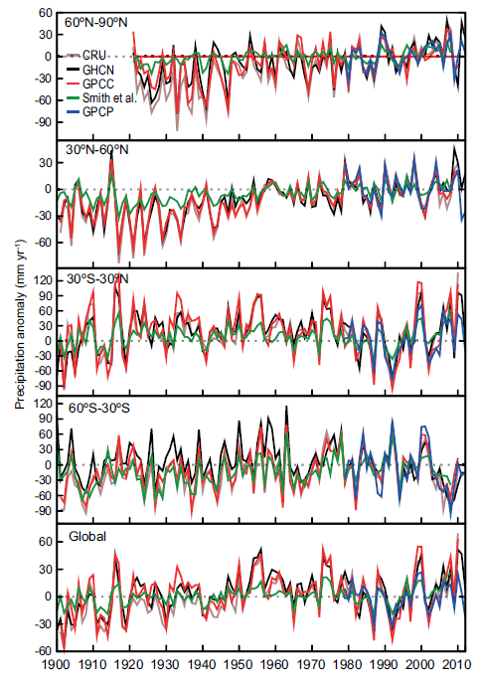
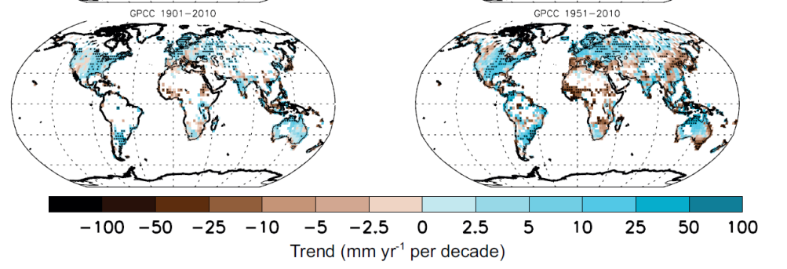
Não observa-se tendências globais na alteração da precipitação, mas regionalmente sim.
Aumento de precipitação na Bacia do Prata: aprox. 30% nos últimos 50 anos
IPCC AR5, 2013

Slide 19
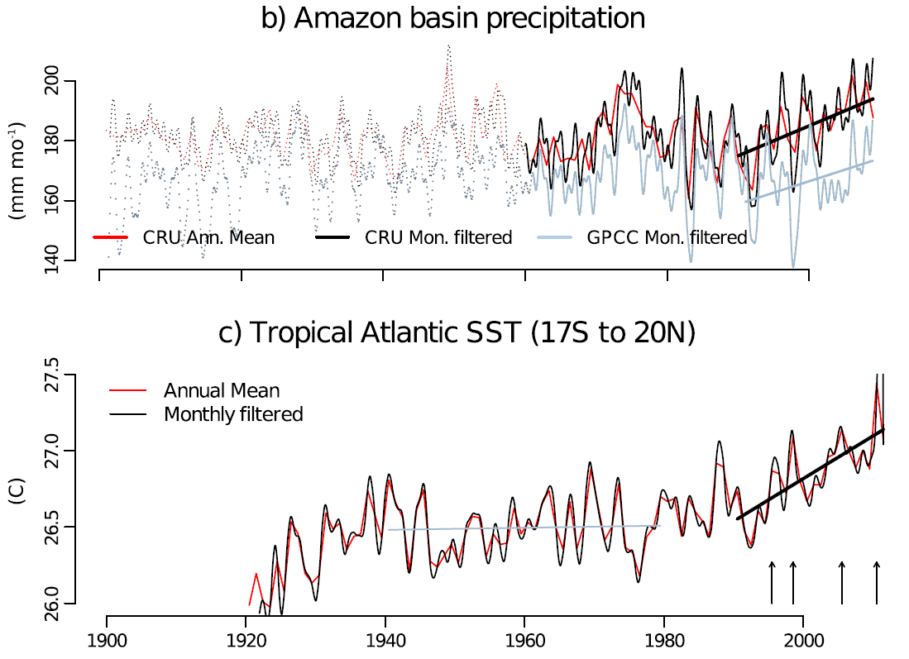
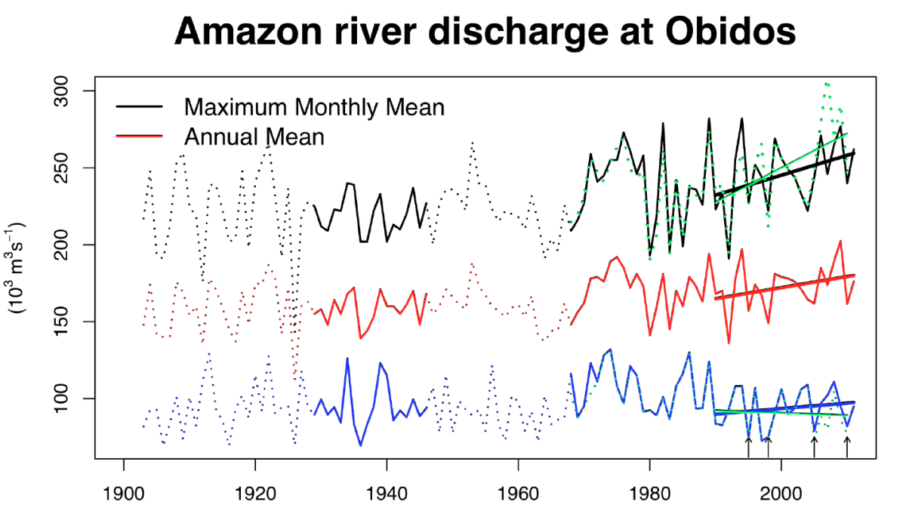
Is the Amazonian hydrological cycle intensifying?
Tropical Atlantic sea surface temperature
Maximum monthly, annual mean and minimum monthly mean Amazon river discharge at Óbidos and in green maximum and minimum daily mean river discharge, (Gloor et al. GRL 2013).

Slide 20
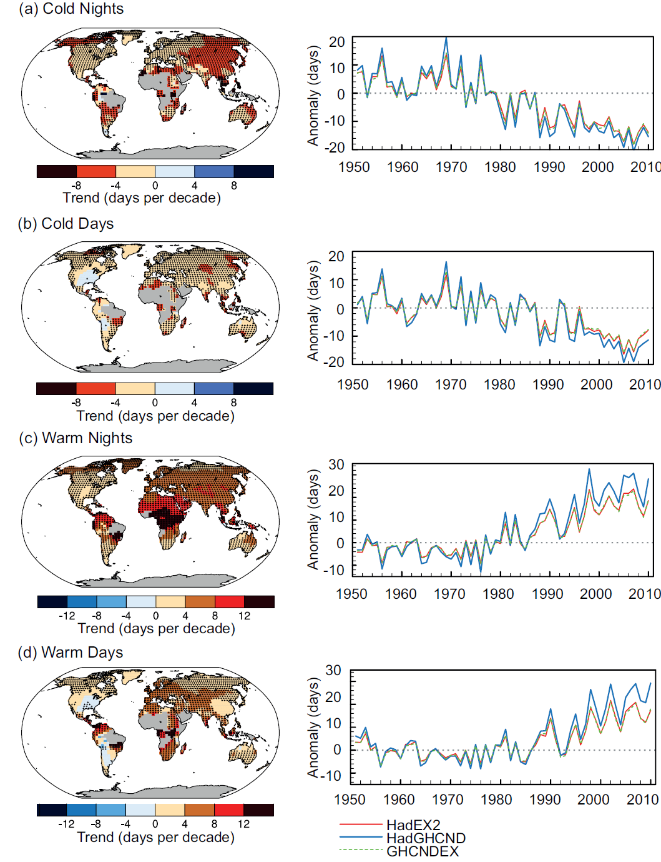
Observações de extremos climáticos de temperatura
IPCC AR5, 2013

Slide 21
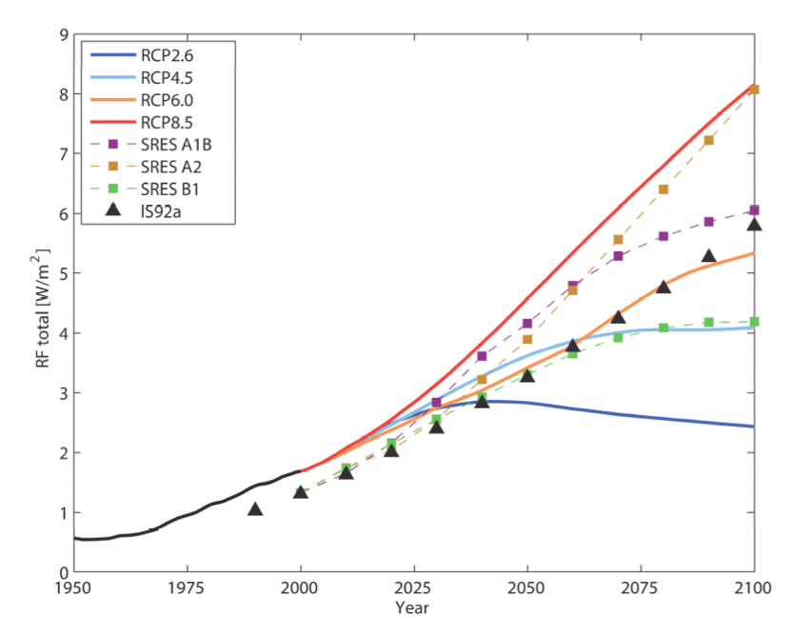
Cenários de Emissões e “RCP - Representative Concentrations Pathways”
RCP8.5
RCP2.6

Slide 22
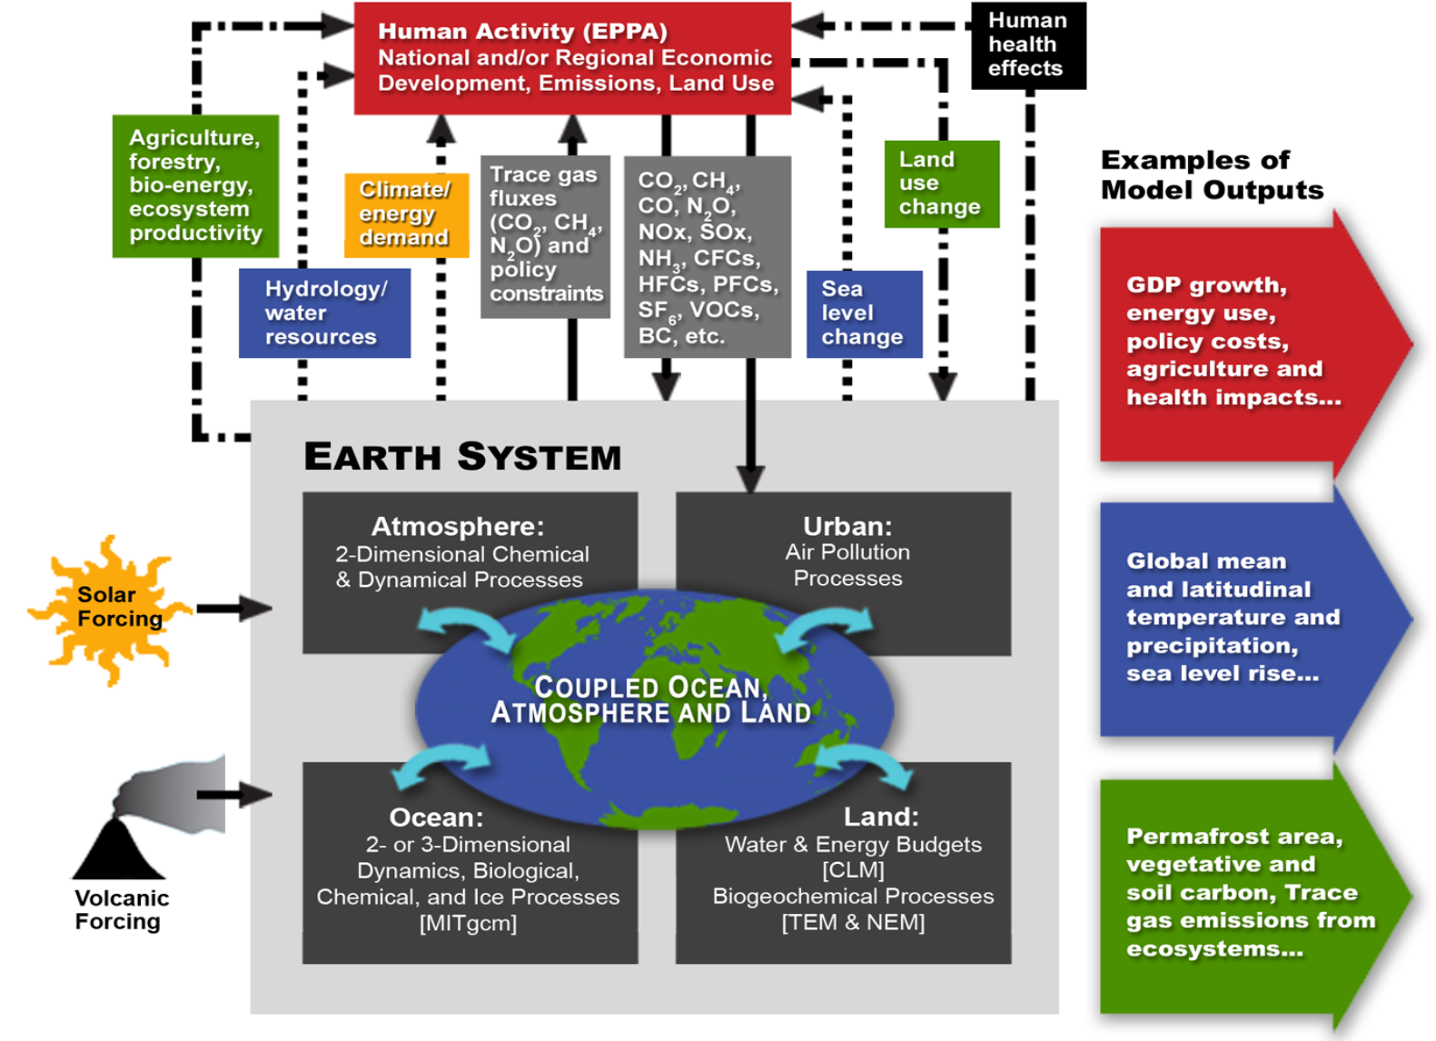

Slide 23
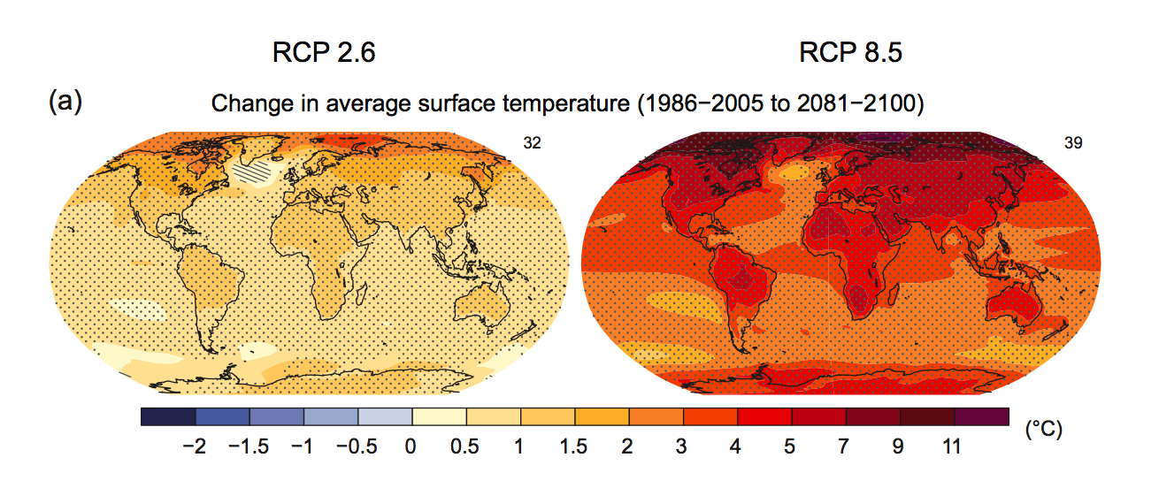
Projeção de aumento de temperatura em dois cenários

Slide 24
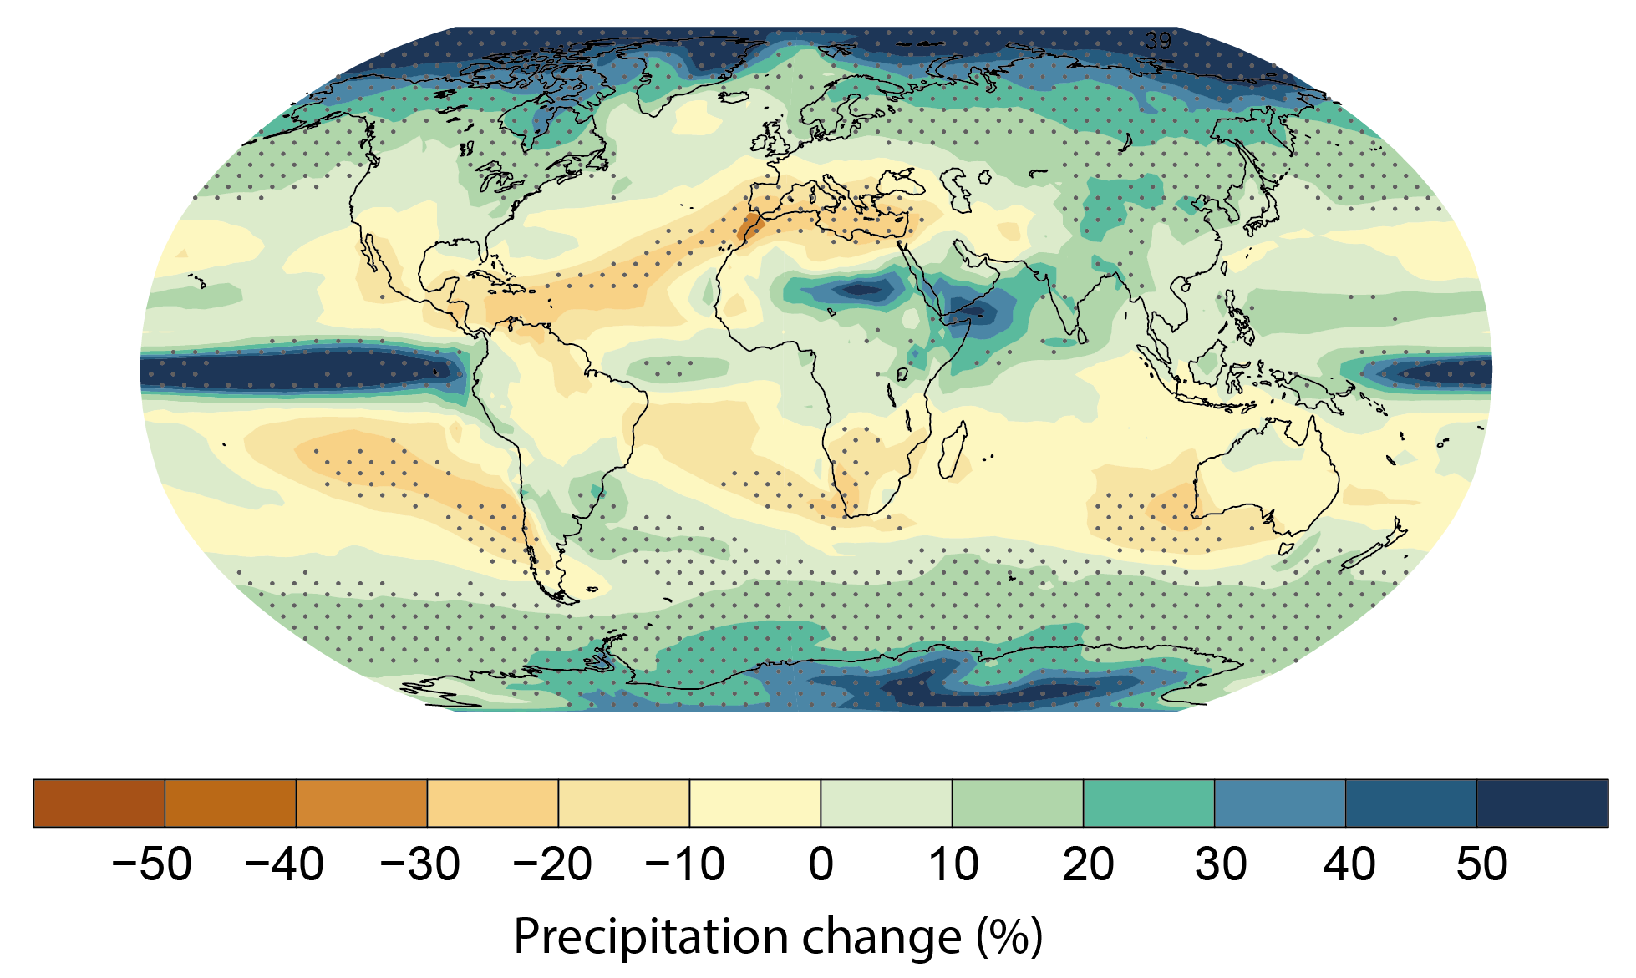
Projeções de mudanças na precipitação
1986-2005 to 2081-2100
RCP8.5

Slide 25
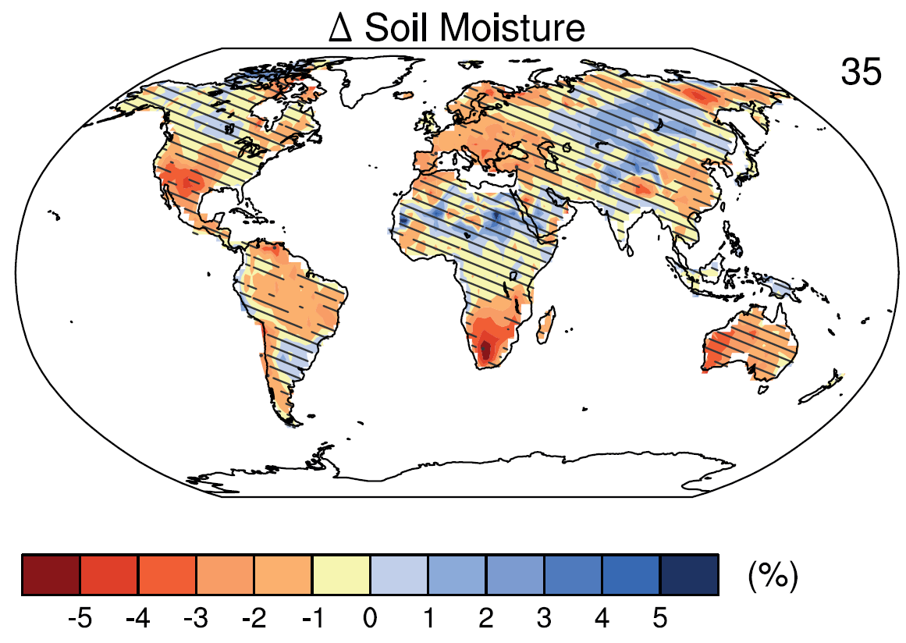
Previsão de alteração de umidade do solo para o período de 2016–2035 relativo à 1986–2005 (Cenário RCP4.5 CMIP5)

Slide 26
Mean changes in total cloud area fraction
Multi model mean changes in total cloud area fraction . Changes are given as annual means for the SRES A1B scenario for the period 2080 to 2099 relative to 1980 to 1999.

Slide 27
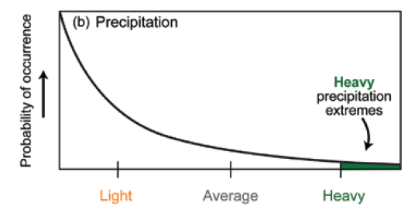
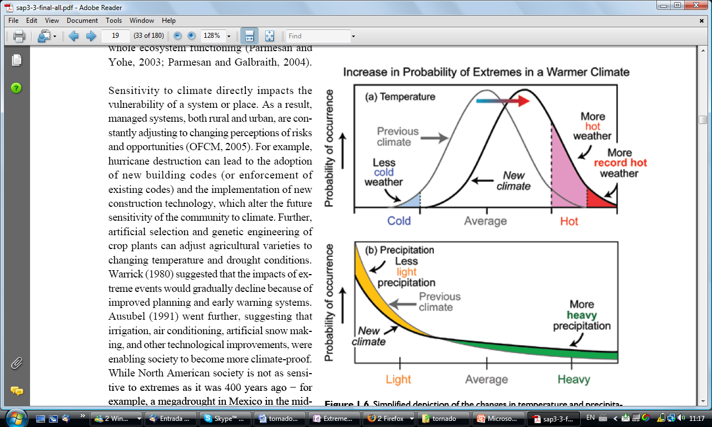
Aumento da temperatura pode estar aumentando a frequência de eventos climáticos extremos
Extreme summer heat anomalies now cover about 10% of land area, up from 0.2%.
This is based on observations, not models.
Hansen, J., R., Proc. Natl. Acad. Sci., 2012.

Slide 28
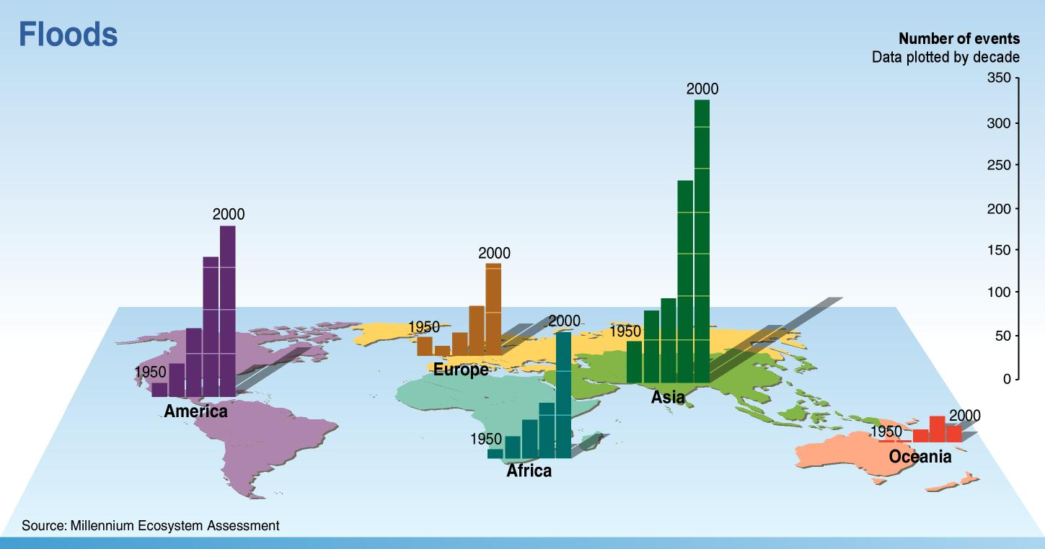
Increase of incidence of extreme climatic events 1950-2000
Millennium Ecosystem Assessment, 2007

Slide 29
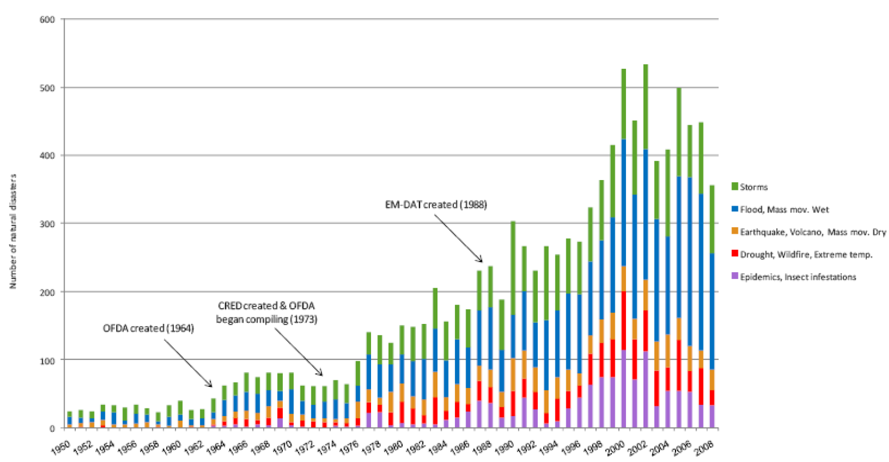
Aumento da incidência de eventos climáticos extremos – 1950-2008
EMDAT - The International Emergency Disasters Database (www.emdat.be)

Slide 30
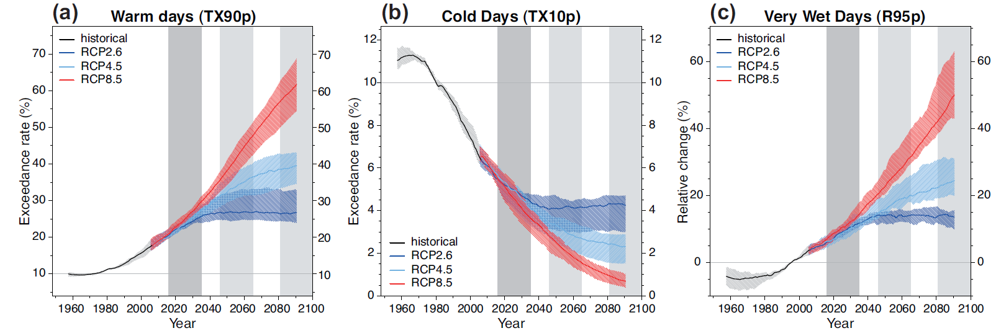
Projeções globais da ocorrência de (a) Dias quentes (TX90p), (b) Dias Frios (TX10p) e (c) Precipitação de dias muito chuvosos

Slide 31
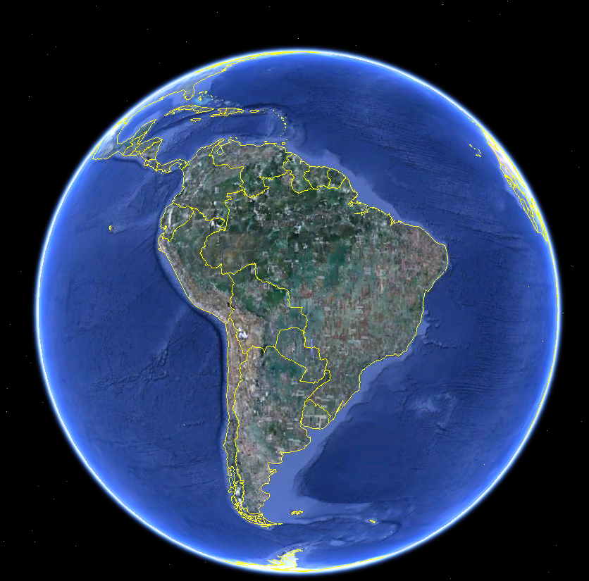
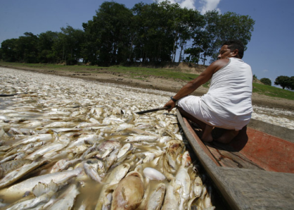
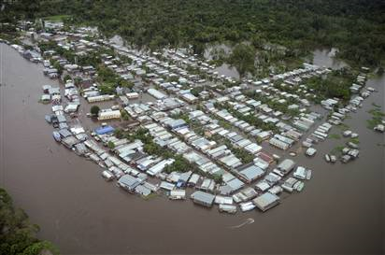
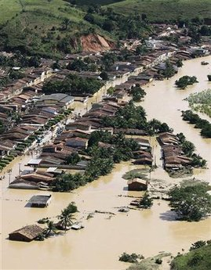
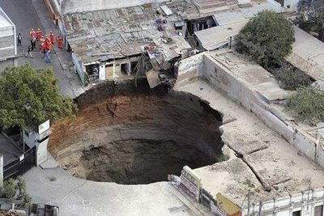
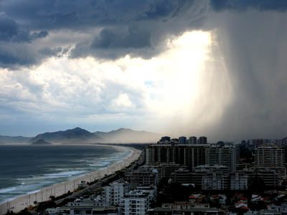
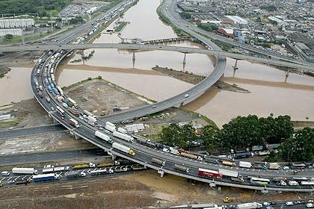
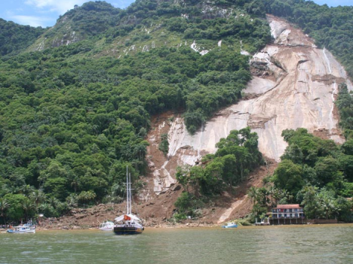
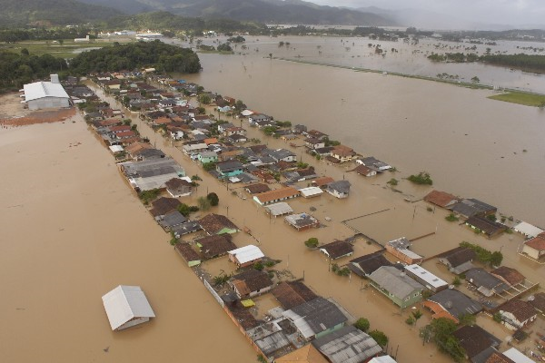

Some extreme unusual events during 2007-2010- South America
v
Floodings in theAmazon (2009)
Drought Solimões river
(2010)
Drought S. Venezuela (2009)
Rainfall Alagoas
(2010)
Rainfall Rio de Janeiro (2010)
Storm Agatha Central America (2010)
Floods Colombia
(2008)
Cold Wave Bolivia
(2010)
Rainfalls/Landslides Andes
Central Peru (2009)
Rainfall São Paulo (2010)
Rainfalls/Landslides Ilha Grande (2010)
Intense rainfalls S.Brazil/Uruguai (2009)
Rainfall Vale do Itajaí (2008)
Heat Wave Santos (2010)
Notes:
Interessante: http://wmo.asu.edu/maps/map.html

Slide 32
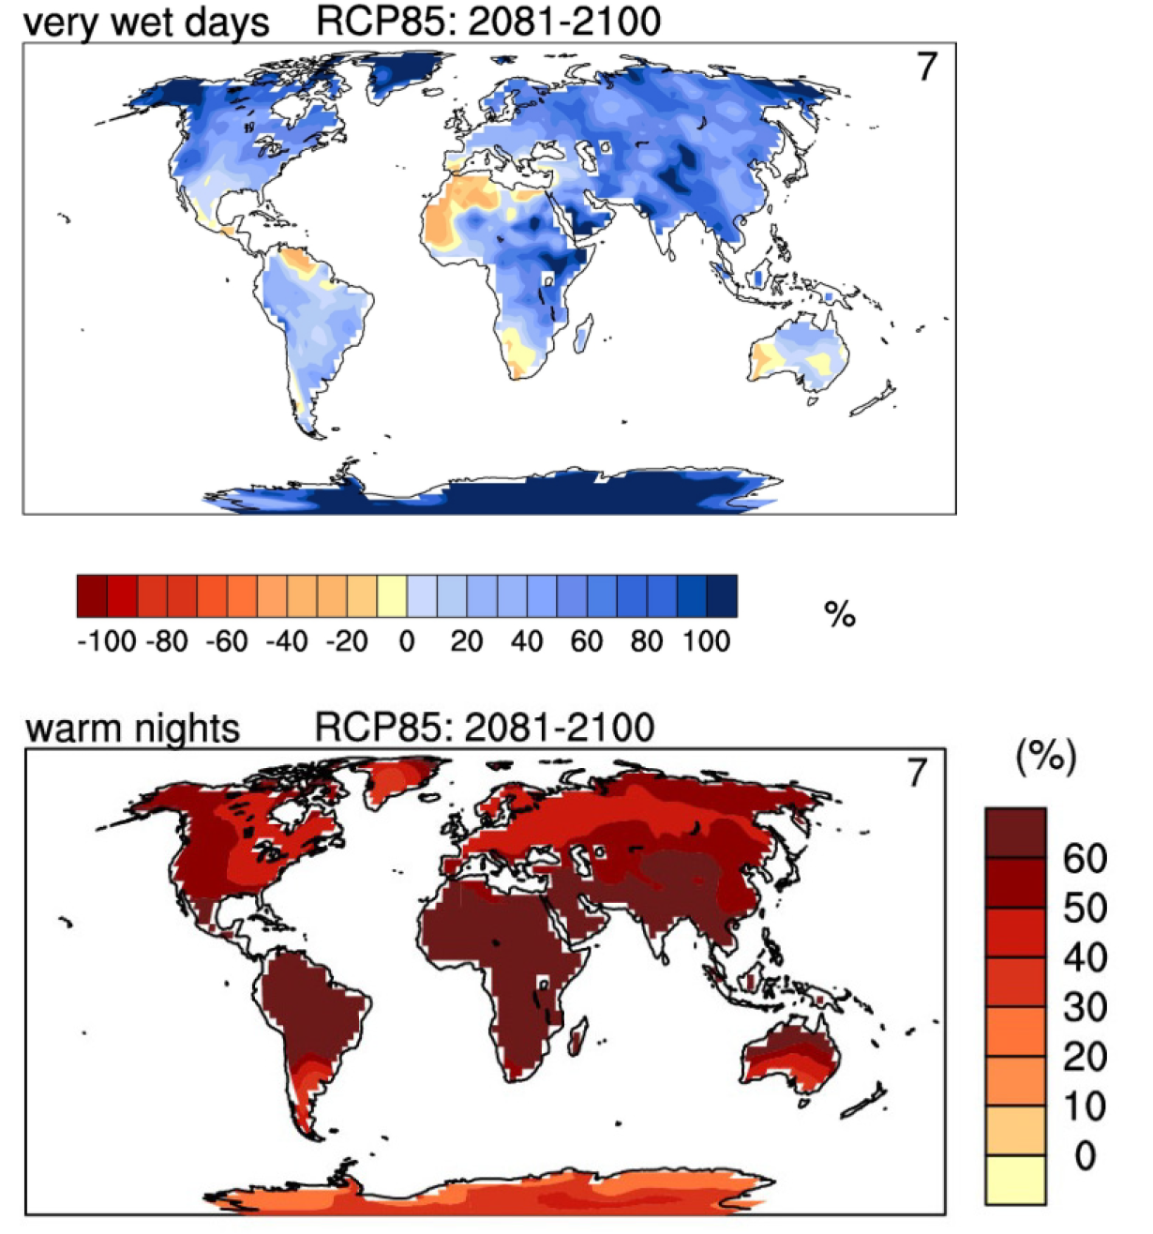
Frequência de eventos extremos
2081-2100
Changes in selected extreme indices in 2100

Slide 33
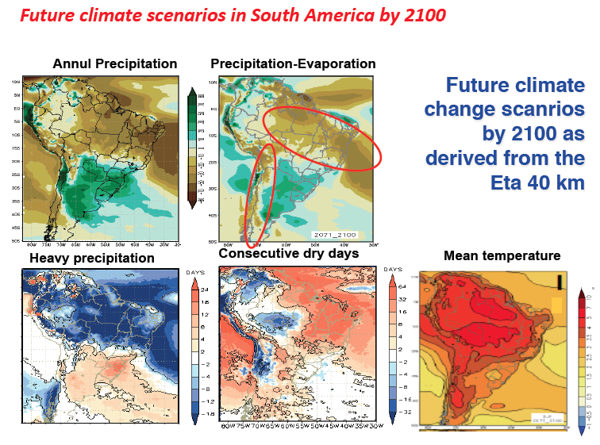
Projeções do futuro....
Marengo et al 2012,
Chou et al 2012

Slide 34
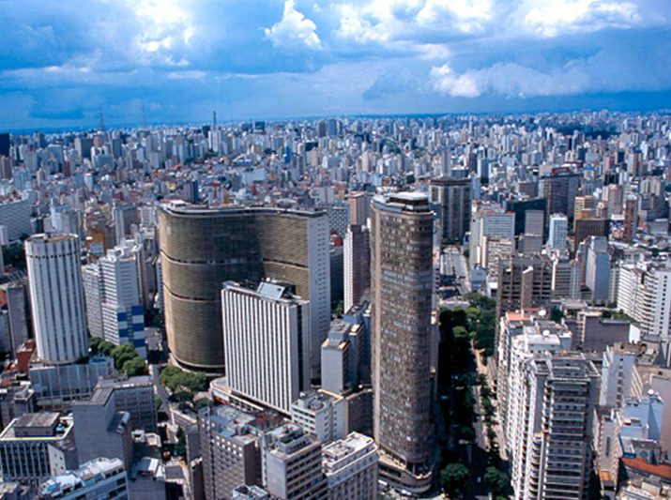
Vulnerabilidade nas grandes cidades
América Latina: 80% população urbana em 2012

Slide 35
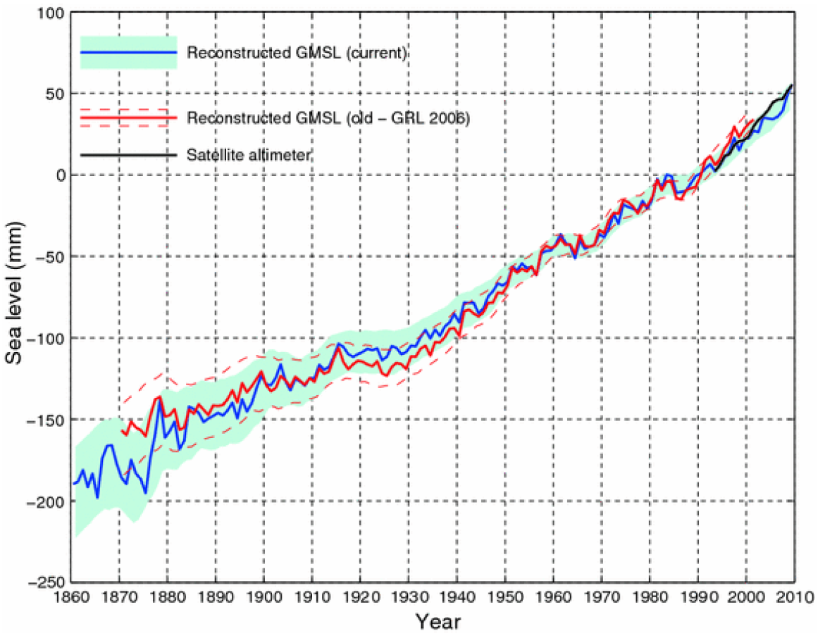
Nível médio dos oceanos (GMSL) de 1860 a 2010
23 cm
Global mean sea level (GMSL) reconstructed from tide gauge data (blue, red) and measured from satellite altimetry (black).
Source: Church and White (2011).

Slide 36
Desmatamento na Amazônia 1977-2013 em km² por ano

Slide 37
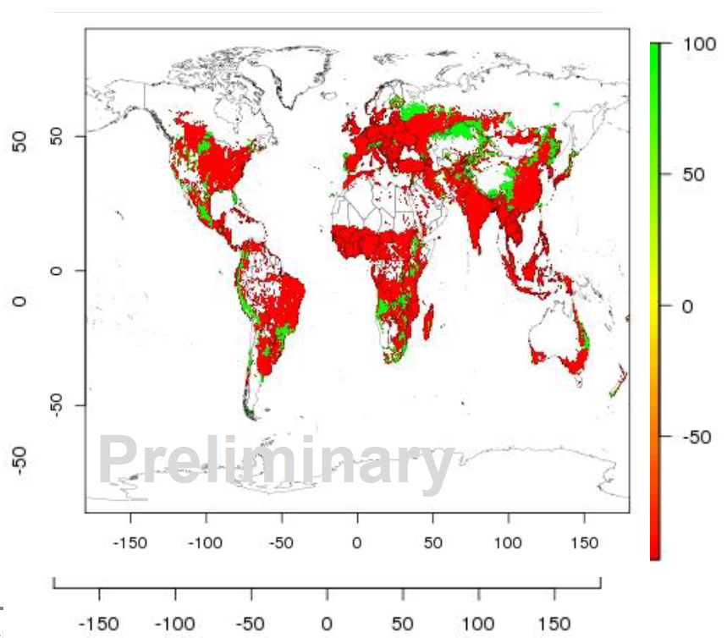
Relative change in calorie availability 2069-2099 vs. 1980-2010
HadGEM2-ES RCP 8.5 No CO₂ fertilization
12 crops: wheat, rice, maize, soy, cassava, millet, groundnuts, rapeseed, sugar beet, sugar cane, sunflower, field peas
Piontek, PNAS 2013

Slide 38
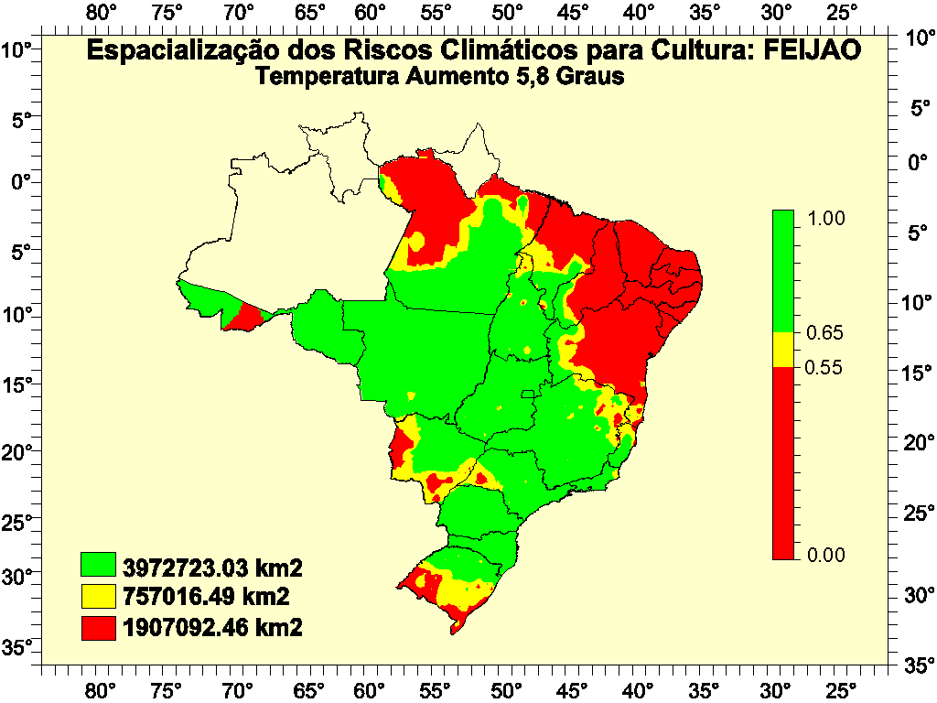
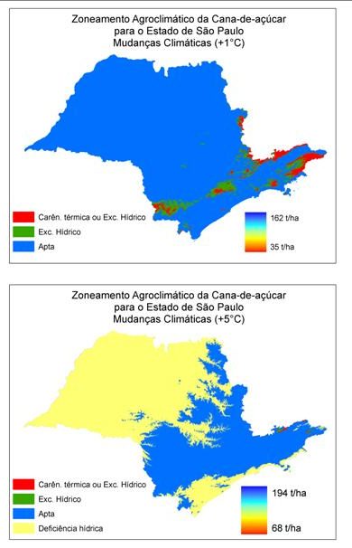
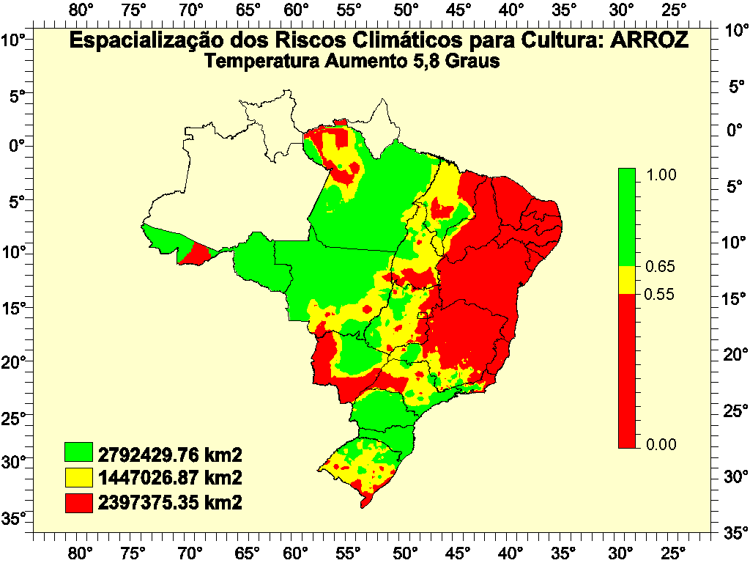
Espacialização do risco climático para Feijão, Arroz e Cana-de-açúcar
Eduardo Assad, EMBRAPA

Slide 39

Tempo de Vida do CO₂ na atmosfera

Slide 40


Quanto tempo o efeito do CO₂ irá afetar o clima do planeta?
Susan Salomon PNAS Fev 2009
Note a escala: Até o ano 3000 →

Slide 41


A Governança das mudanças globais e as interconexões
Dificuldades de acordos internacionais:
E os países com baixa emissão per capita?
Países desenvolvidos aceitam redução em seu nível de consumo?
Quem paga a conta?
Quem perde e quem ganha economicamente?
Prazos para redução de emissões? Muitos etc.
Interconnected global challenges. Global Risks Report (2011)

Slide 42

Earth System Modeling
Necessitamos de uma nova maneira de fazer ciência

Slide 43

Uma nova era ambiental já começou, com maiores riscos.
Adaptação à esta nova realidade é urgente...
Obrigado pela atenção !!!

Slide 44


Slide 45

Projeções do aumento médio do nível do mar para os vários RCP

Slide 46

Estimativas de aumento de temperatura em função dos cenários de emissões
Temperature estimates for old (SRES) and new (RCP) IPCC scenarios. Depending on which global emissions path is followed, the 4°C temperature threshold could be exceeded before the end of the century.
Source: Rogelj, Meinshausen, et al. 2012.

Slide 47


Slide 48


Os modelos acertam na previsão climática dos últimos 150 anos?
Observational estimates of global mean temperature (black lines), compared to model simulations with natural forcings only (bottom panel) and anthropogenic and natural forcings (upper panel). (IPCC2012)
Natural forcings only

Slide 49

Tempo de vida do CO₂ na atmosfera, oceano e ecossistemas terrestres

Slide 50

Forçante radiativa do sistema climático global (IPCC 2013)

Slide 51

Future changes on rainfall distribution in southern Amazonia from the Eta-HadCM3 model (Marengo et al 2012, Chou et al 2012)

Slide 52

24 Models: Simulated historic and 21st century global mean temperature
Simulated historic and 21st century global mean temperature anomalies, relative to the preindustrial period (1880–1900), for 24 CMIP5 models based on the RCP8.5 scenario. The colored (and labeled) curves show those simulations reaching a global mean warming of 4°C–5°C warmer than preindustrial for 2080–2100, which are used for further analysis.
Sources: Hare et al. 2011; Rogelj et al. 2010; Schaeffer et al. 2012.

Slide 53

Circulação oceânica global: Redistribuição de energia
Deep-water formation in the Northern Hemisphere has long received much attention as the axis of climate change. The upwelling branch in the Southern Ocean is now being recognized as a vital component of our climate system and an equally important agent of global change.
Marshall and Speer Nature Review, 2012
Notes:
Broecker95,96 put forward an ocean circulation schematic in which polar sinking is balanced by upwelling from depth through the
thermocline of the North Pacific, as sketched in his famous conveyor belt analogy, inspired from earlier descriptions97. The
neglect of a role for the Southern Ocean was subsequently addressed74,98,99. Here we have revised and updated Broecker's
famous conveyor to draw out the asymmetry among the Atlantic, Pacific and Indian basins and between the Northern and Southern
hemispheres, and to emphasize the central role of Southern Ocean upwelling. The upper cell of ocean circulation is fed
predominantly by broad upwelling across surfaces of equal density at mid-depths, distributed over the main ocean basins (rising
bluegreenyellow arrows). Upwelling to the ocean surface occurs mainly around Antarctica along surfaces of equal density (rising
yellowred arrows) with wind and eddy processes playing a central role. Much of this upwelled water is converted into intermediate depth mode waters and, after entering various thermocline layers, it eventually resupplies the upper branch of the global cell in the
Atlantic with relatively warmer waters. In the northern North Atlantic, warm water is cooled in the
subpolar gyre and eventually becomes dense enough to sink under
the thermocline in the polar seas and Labrador Sea convection
regions (blue arrows). The dense water formed by convection in
the Atlantic flows southwards in the deep branch of the upper
cell (green arrow), before joining the ACC system. Below that, in
turn, is the even denser bottom water that spreads from Antarctica
and feeds the upwelling branch of the lower cell. Antarctic regions
where water sinks to great depth are indicated in the Weddell and
Ross seas around Antarctica and the Labrador and Greenland
Iceland seas in the northern North Atlantic. (Figure 1 represents a
zonal average view of this complex pattern). To construct such a
diagram, much of the richness of the ocean's three-dimensional
circulation structure has to be ignored, and only an overall,
idealized representation of the cells can be shown. Cooler colours
indicate denser water masses, ranging from warmer mode and
thermocline waters in red to bottom waters in blue.
The new diagram builds on previous ones99, links old and new
ideas and brings the Southern Ocean to the forefront of the MOC.

Slide 54

Global land temperature variation (1850-2012)

Slide 55

El Nino Southern Oscillations Variations
(1950 – Present)
Temperature stagnation
(mostly La Nina)
Ocean uptake
of heat???
Global warming
(mostly El Nino)
Temperature stagnation
(mostly La Nina)
Ocean uptake
of heat

Slide 56

Ocean Heat Capacity Considerations
Weight of atmosphere ≈10 m of seawater
On per unit mass basis
Water Air
4.18 joule/gm/°C 1.0 joule/gm/°C
Atmosphere column ≈ 2.5m of ocean depth
Sunlight penetration of seawater ≈ 100m
Águas profundas
Águas superficiais

Slide 57

Global mean sea level obtained from satellite altimetry from 1992 to 2010. It shows large regional variability.

Slide 58
Atribuição do aumento observado de temperatura
Comparação de temperaturas modeladas e observadas usando forçantes climáticas naturais e antropogênicas para cada região do planeta.

Slide 59


Total ice sheet mass balance, dM/dt, between 1992 and 2010
Source: E. Rignot, Velicogna, Broeke, Monaghan, and Lenaerts 2011.
Total ice sheet mass balance, dM/dt, between 1992 and 2010 for (a) Greenland, (b) Antarctica, and c) the sum of Greenland and Antarctica, in Gt/year from the Mass Budget Method (MBM) (solid black circle) and GRACE time-variable gravity (solid red triangle), with associated error bars.

Slide 60

Heat storage in upper 2000 meters of ocean during 2003-2008 based on ARGO data.
Knowledge of Earth’s energy imbalance is improving rapidly as ARGO data lengthens.
Data source: von Schuckmann et al. J. Geophys. Res. 114, C09007, 2009.
Armazenamento de calor nos oceanos até 2000 metros de profundidade

Slide 61

Tropospheric aerosols mask warming
(global dimming)
Greenhouse gases dominate
Recovery from volcanic eruptions dominates
Aerosols (and greenhouse gases) dominate the temperature change

Slide 62

Aumento do nível do mar pelas diferentes contribuições
The contributions of land ice (mountain glaciers and ice caps and Greenland and Antarctic ice sheets), thermosteric sea level rise, and terrestrial storage (the net effects of groundwater extraction and dam building), as well as observations from tide gauges (since 1961) and satellite observations (since 1993).
Source: Church et al., 2011.

Slide 63

Frequência de ocorrência de eventos extremos em temperatura e precipitação
T > 95% percentil
Precip. > 95% percentil
Global mean projections for the occurrence of warm and wet days from CMIP5 for the RCP2.6, RCP4.5 and RCP8.5 scenarios relative to 1986–2005. Panel (a) shows percentage of warm days (tx90p: Tmax exceeds the 90th percentile), panel (b) shows relative change of very wet days (pr95p: annual total precipitation when daily precipitation exceeds 95th percentile).

Slide 64

IPCC Special report on managing the risks of extreme events

Slide 65



Aumento na concentração global de ozônio: Gás fortemente fitotóxico
IPCC AR5, 2013

Slide 66




Intensidade de chuva em São Paulo

Slide 67



O aumento da incidência de furacões está ligada
ao aumento da temperatura superficial do mar
(1944-2005)
SST
A percentagem de furacões categoria 4 e 5 está aumentando desde 1944

Slide 68

The climate system – HadGEM2
Online
CLIMATE
Offline
Direct and
Indirect Effects
Greenhouse Effect
Human
Emissions
AEROSOLS
GHG’s
Fe deposition
CH₄, O₃,
Oxidants:
OH, H₂O₂
HO₂,O₃
DMS,
Mineral dust
CO₂
Human
Emissions
Human
Emissions
CHEMISTRY
Biogenic Emissions:CH₄
Dry deposition: stomatal conductance
ECOSYSTEMS
Land-use
Change
Falta MUITA coisa...

Slide 69

Decadal global precipitation anomalies (mm) relative to the 1961–1990 WMO standard normal

Slide 70

Interações e feedbacks entre solo, superfície e atmosfera
(GEWEX 2013)

Slide 71

Decadal global combined surface-air temperature over land and sea-surface temperature (°C)
The horizontal grey line is the long-term average value (14.0°C) (1961–1990 base period).
WMO, 2013

Slide 72

As temperaturas globais variam, mas nosso planeta está se tornando mais quente
Global surface temperature anomalies relative to 1951-1980 average for (a) annual and 5-year running means through 2010, and (b) 60-month and 132- month running means through July 2012.
(Hansen, J., Ruedy, R., Sato, M., and Lo, K., 2010: Global surface temperature change, Rev. Geophys. 48, RG4004.)
Gases de efeito estufa e aerossóis dominam a variabilidade da temperatura global

Slide 73

Ex-céticos: resultados do “Berkeley Earth Group”
The Berkeley Earth Surface Temperature study is using over 36,000 unique stations
http://berkeleyearth.org/

Slide 74
2001-2007 Mean Surface Temperature Anomaly (◦C)
Base Period = 1951-80, Global Mean = 0.54

Slide 75

There is no trend in global precipitation amounts
GPCP Global precipitation 1979-2008
Biggest changes in absolute terms are in the tropics, and there is a strong El Niño signal

Slide 76
Air holds more water vapor at higher temperatures
A basic physical law tells us that the water holding capacity of the atmosphere goes up at about 7% per degree Celsius increase in temperature.
Observations show that this is happening: 0.55°C since 1970 over global oceans and 4% more water vapor.
This means more moisture available for storms and an enhanced greenhouse effect.
Total water vapor

Slide 77

WMO Greenhouse Gas Bulletin, No.7, 2011

Slide 78

Decadal precipitation anomalies for global land areas for 2001–2010. departures in mm/year from averages computed using 1951–2000 base period

Slide 79
Estimates of temperature increase for 2029 and 2099 according to 3 emission scenarios

Slide 80

Previsão de aquecimento global ao longo dos próximos 100 anos
Cenários possíveis de aumento nas concentrações de CO₂
Aumento na temperatura média global: de 2 a 4 graus centígrados ao longo deste século

Slide 81

Changes in the water cycle in 2100
(IPCC 2012)

Slide 82

Ciclo de Carbono Global
IPCC AR5, 2013

