Slide 1
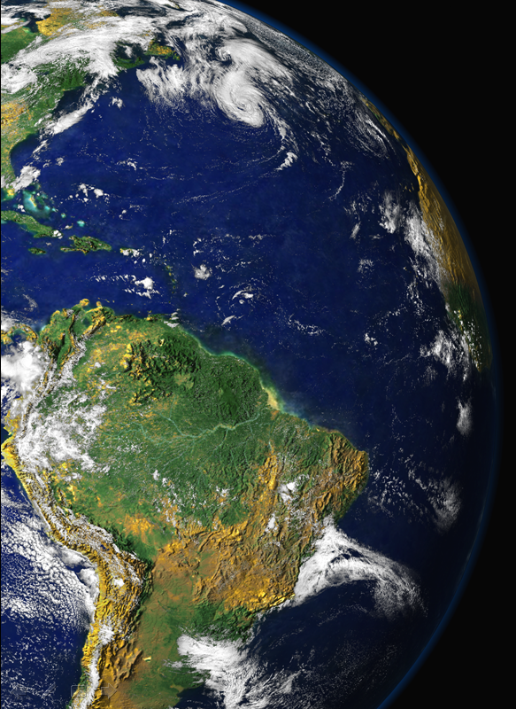
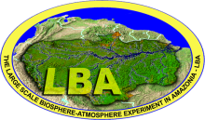
USP-CNR Workshop
August 28, 2013
Vertical profiles of trace gases and aerosols in Amazonia
Prof. Paulo Artaxo
Instituto de Física
Universidade de São Paulo - USP
artaxo@if.usp,br

Slide 2
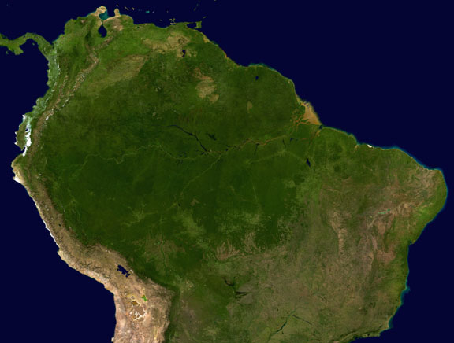

Motivations and outline
In Amazonia, there key issues related to the links between forest biology and atmospheric properties.
Trace gases: VOCs emissions and processing; CO2 fluxes, Ozone formation and deposition, interactions betwen Nox, VOCs and Ozone, etc.
Aerosols: New particle formation, secondary organic aerosol formation, optical properties, aerosol fluxes, etc.
Natural biogenic aerosol properties
Biomass Burnign aerosols and trace gases
Two recent experiments: BARCA ( ) and SAMBBA (South American Biomass Burning Analysis)
Future experiments: GoAmazon.

Slide 3
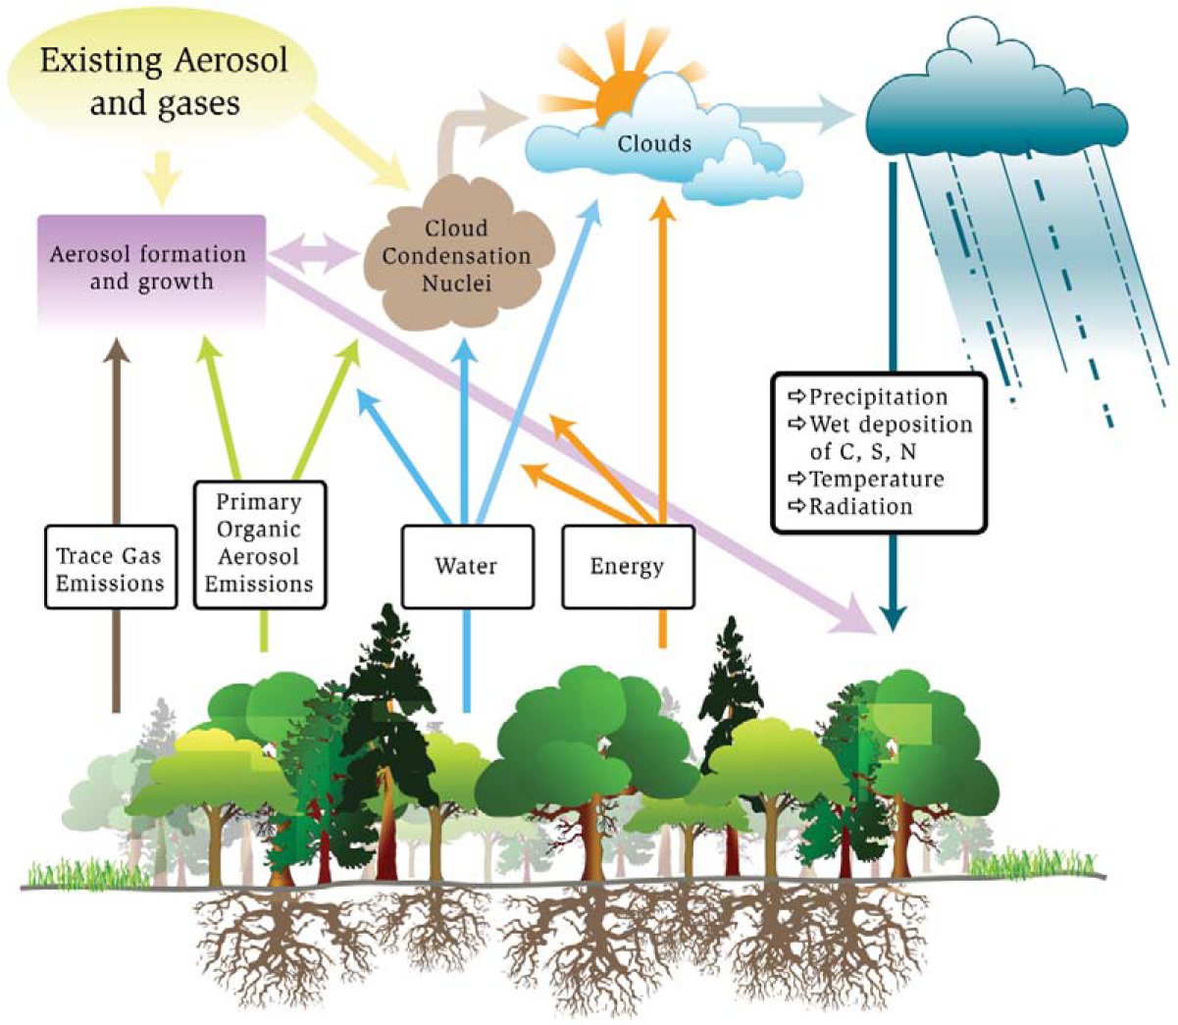
Amazon Basin has strong coupling between terrestrial ecosystem and the hydrologic cycle: The linkages among carbon cycle, aerosol life cycle, and cloud life cycle are strong and need to be understood and quantified.
Susceptibility and expected reaction to stresses of global climate change as well as pollution introduced by future regional economic development are not known or quantified at present time.
Source: Barth et al., “Coupling between Land Ecosystems and the Atmospheric Hydrologic Cycle through Biogenic Aerosol Particles,” BAMS, 86, 1738-1742, 2005.

Slide 4
Aerosol and cloud lifecycles

Slide 5
Amazonia is critical for water vapor transport over South America
What processes controls these fluxes?

Slide 6
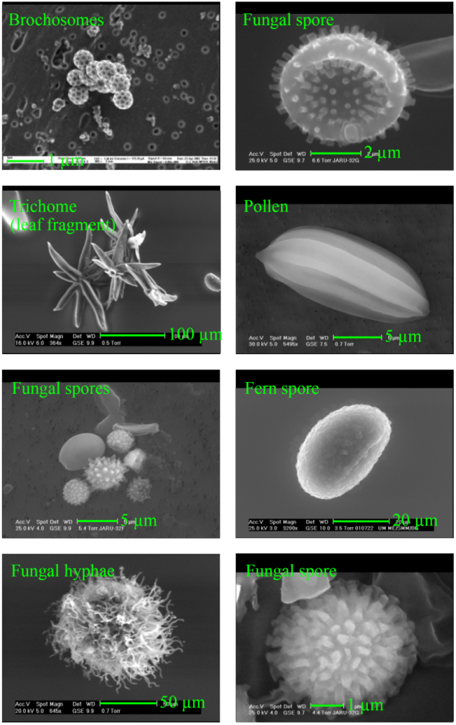
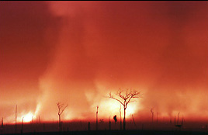
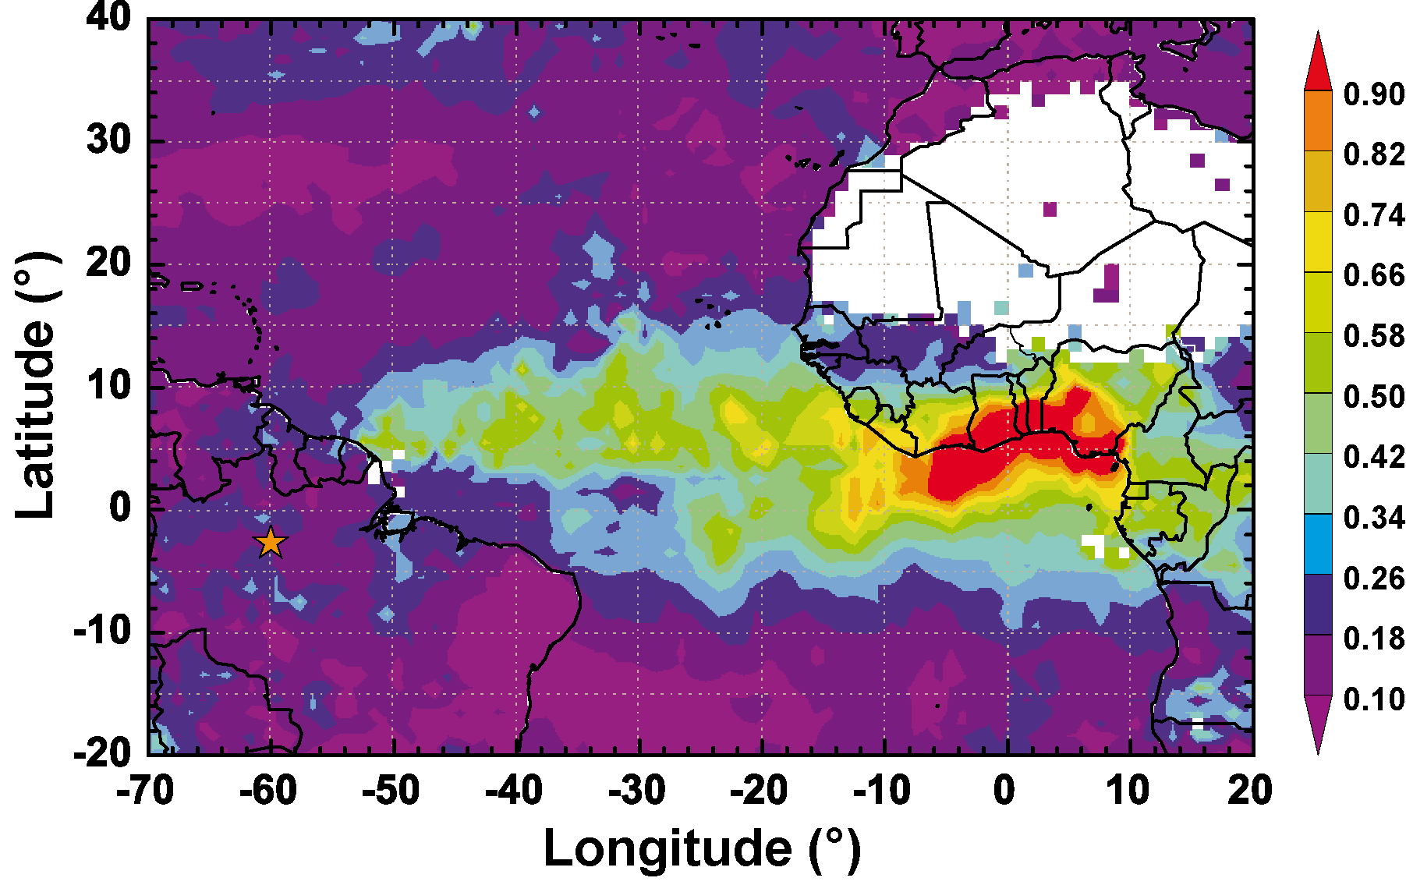
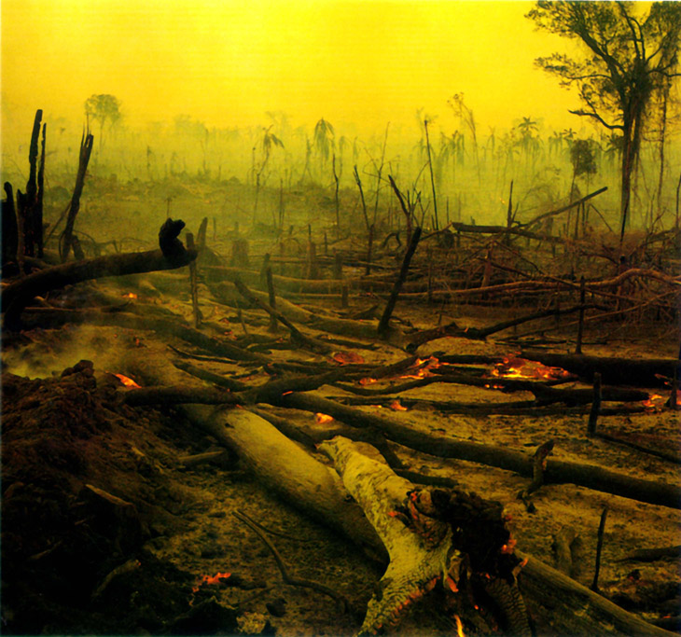
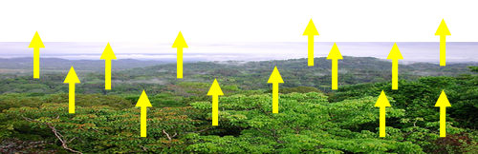
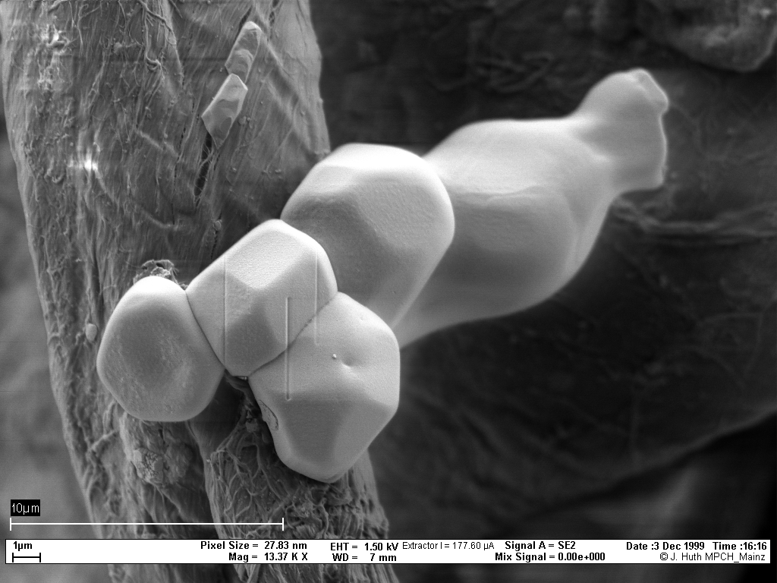
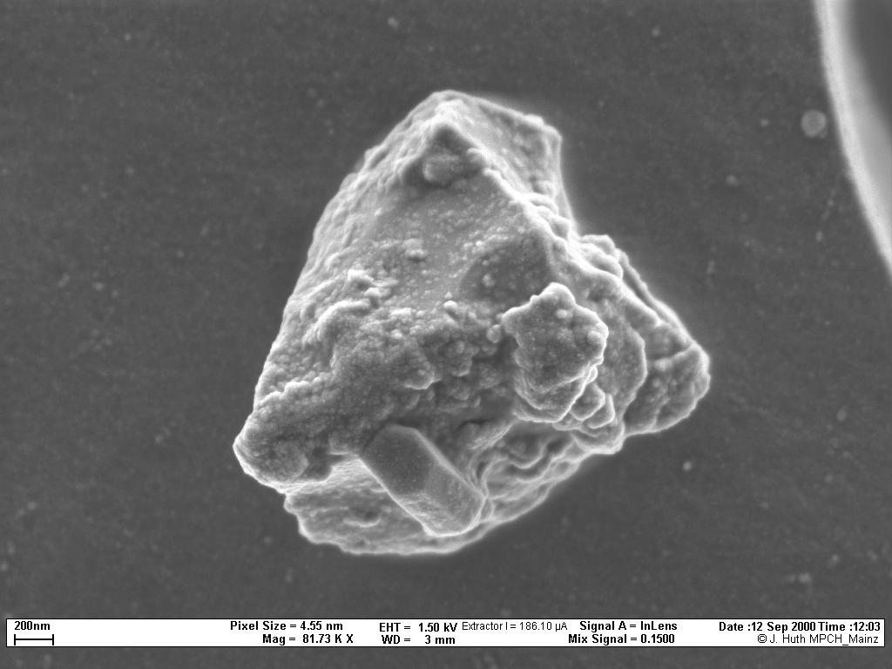
Amazonia: 3 different types of aerosols
Biogenic (primary and SOA)
Biomass Burning
Dust from Sahara
Each with VERY different properties and impacts

Slide 7
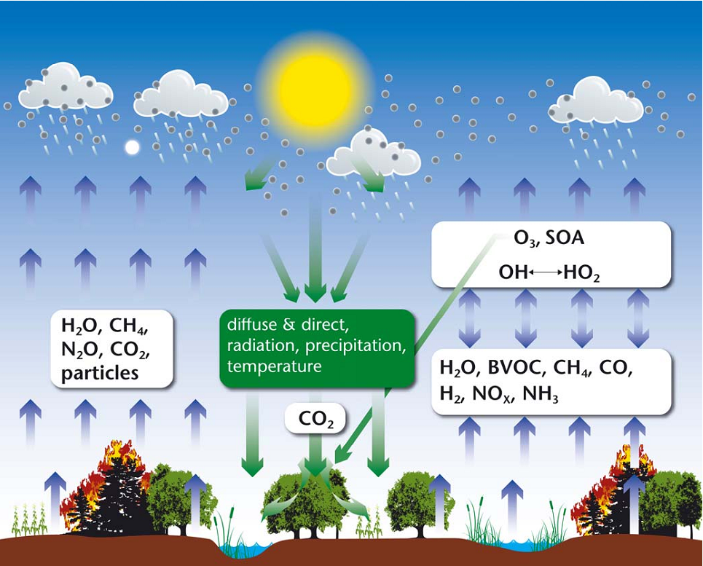
Conceptual overview of terrestrial carbon cycle –
chemistry – climate interactions
Arneth et al., 2011
Notes:
The land surface aﬀects atmospheric chemistry and climate directly via surface energy partitioning into latent and sensible heat ﬂux (not shown), and emissions of greenhouse gases (H2O, CH4, N2O, CO) and aerosol particles from forests, grasslands, wetlands, agricultural systems, and vegetation biomass burning. Atmospheric chemistry and climate is also aﬀected by atmospheric reactions of reactive trace gases emitted from vegetation, soils and ﬁres (H2O, VOC, CH4, CO, NOx, NH3, H22). These contribute to complex oxidation patter ns along variable pathways that depend on the overall chemical and physical environment. Reaction kinetics vary greatly, and the lifetime of substances or their reaction products may vary from seconds (e.g., some BVOC) to years (e.g., CH) which in turn deter mines whether associated chemistry-climate eﬀects are regional or continental to global. The chief oxidizing agent is the hydroxyl radical OH, while some BVOC react directly with O3. Tropospheric humidity and hence latent heat ﬂux is an important constraint for OH formation. The main climate relevance of the atmospheric reactions is to consume or generate O, formation of secondary organic aerosol (SOA), and eﬀects on the lifetime of CH43. Climate feedbacks in the system occur directly (e.g., via the temperature and/or light response of emissions) or indirectly, for example, O
eﬀects on vegetation composition, productivity and carbon cycle.

Slide 8
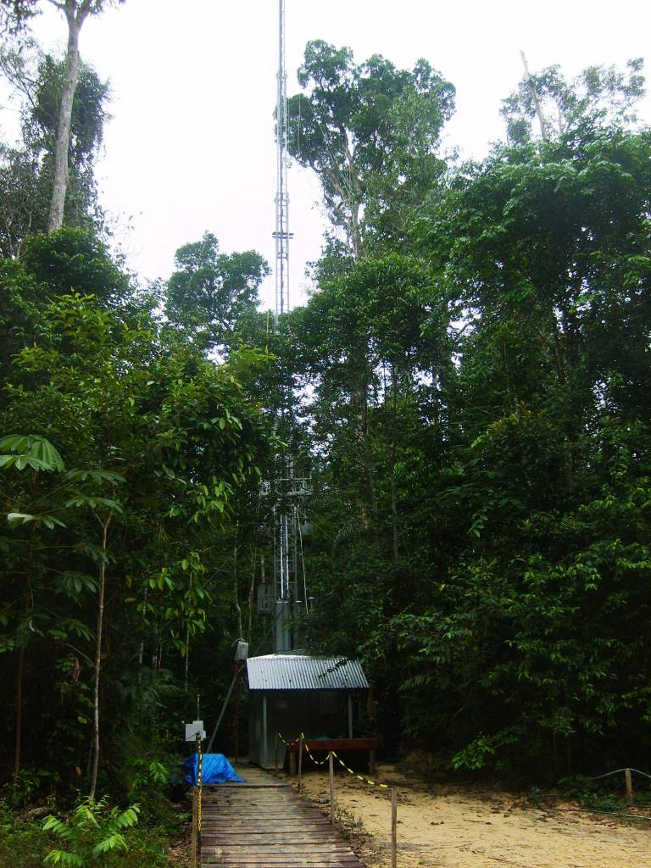
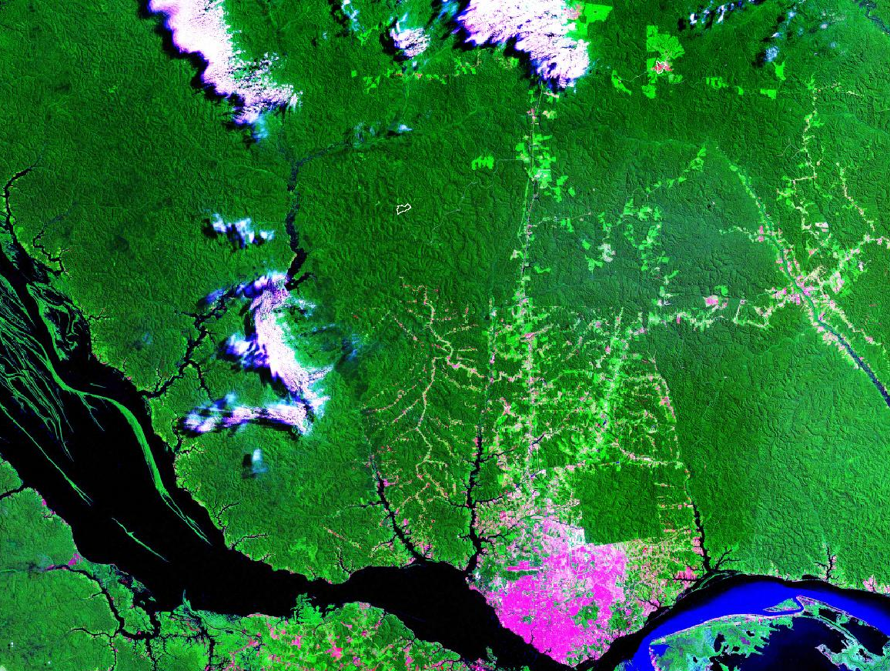
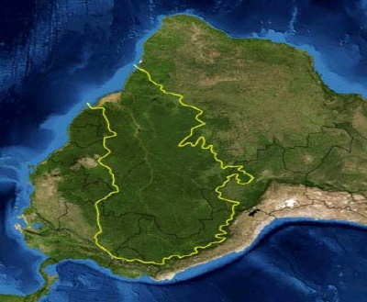
Long term 13 monitoring stations with flux towers in Amazonia
Foto: Carina Prado
Fonte: Flávio Luizão.
Rbio Cuieiras
Rio Negro
Manaus
Rio Amazonas
13 towers with 50-67 meters.
Santarem, Manaus, Ji Parana, Bananal, Caxiuanã, Pantanal, etc
Construction of a 320 meters tall tower.

Slide 9
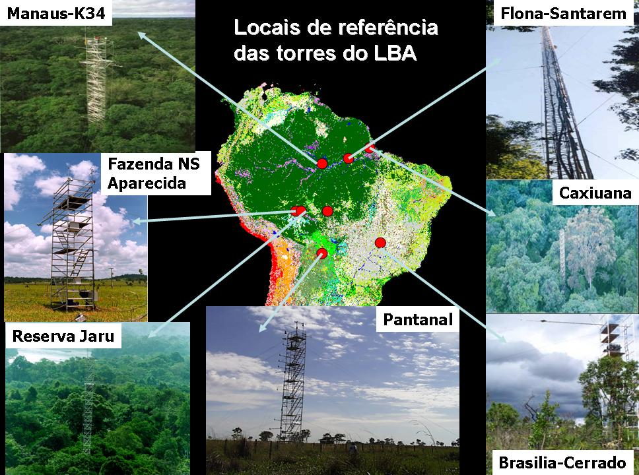

Slide 10
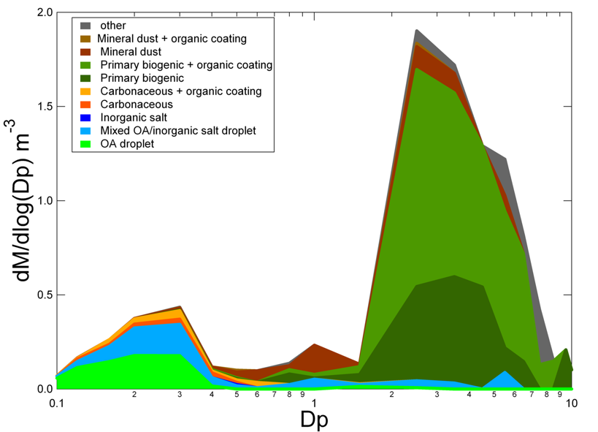
Particles in clean air over Amazon
Mass/size distribution
Biological, chemical, and physical processes over the Amazon form a closely coupled system
Artaxo et al., 2013, Martin et al., 2010, Pueschl et al., 2010

Slide 11
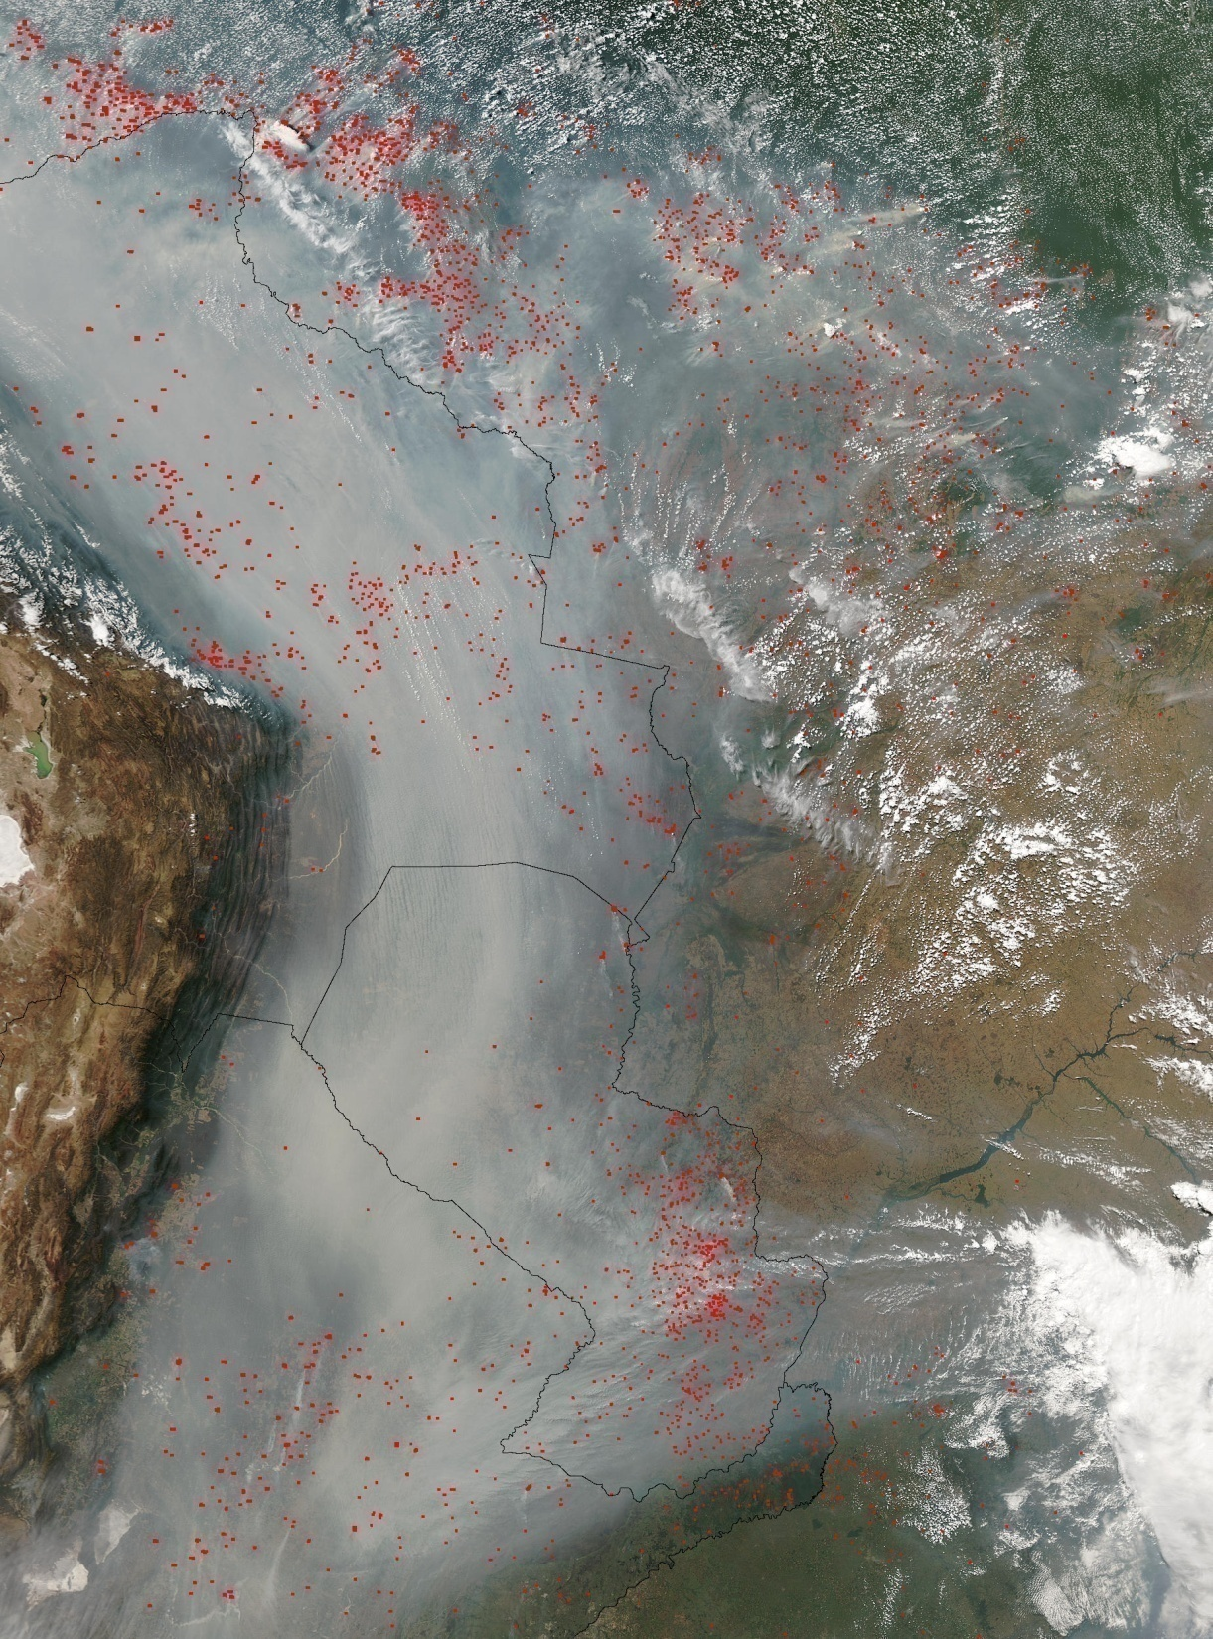

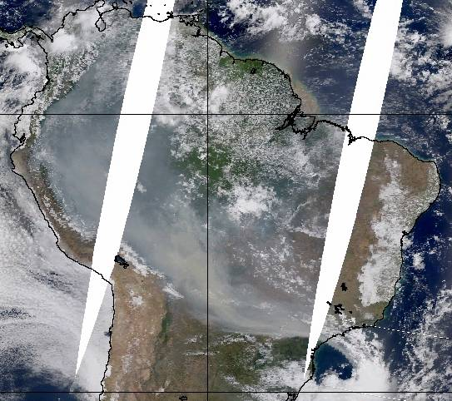
Large scale aerosol distribution in Amazonia
Severe health effects on the Amazonian population (about 20 million people)
Climatic effects, with strong effects on cloud physics and radiation balance.
Changes in carbon uptake and ecosystem functioning

Slide 12
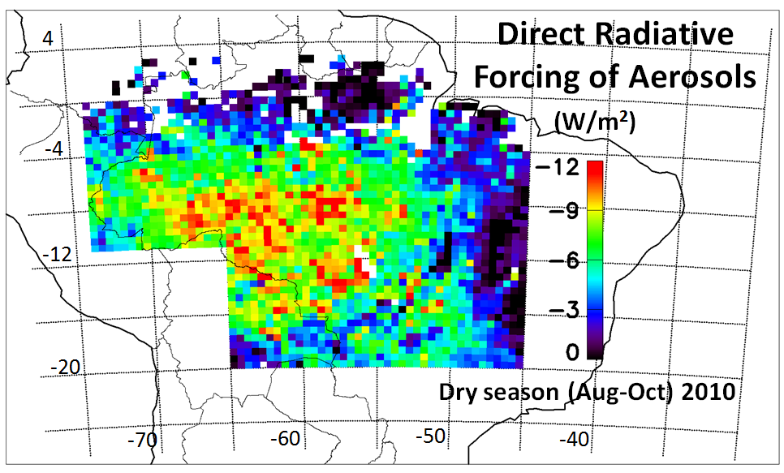
Average spatial distribution of the direct radiative forcing (DRF) of biomass burning aerosols in Amazonia during the dry season of 2010
CERES (Clouds and the Earth's Radiant Energy System) and MODIS

Slide 13
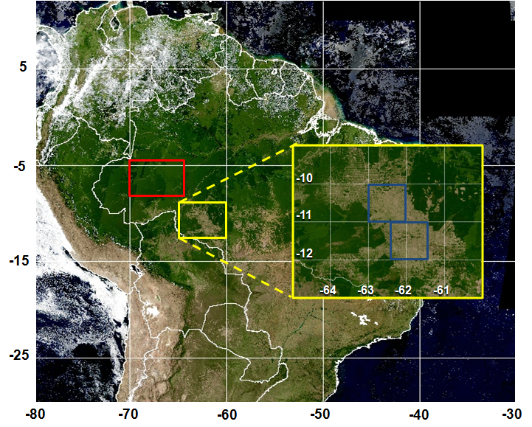
Mean Diurnal Radiative Forcing due to change in surface albedo in Rondonia:
-7.3 + 0.9 W/m²
Mean Diurnal Aerosol Forcing Efficiency:
Forest: -22.5 + 1.4 W/m²
Cerrado: -16.6 + 1.7 W/m²
Water column difference by 6-10%
Forcing of water vapor column: -0.4 to -1.2 W m⁻²
Land-use change radiative forcing. Forested areas are selected in red and deforested areas are selected in yellow.
Sena et al., 2013

Slide 14
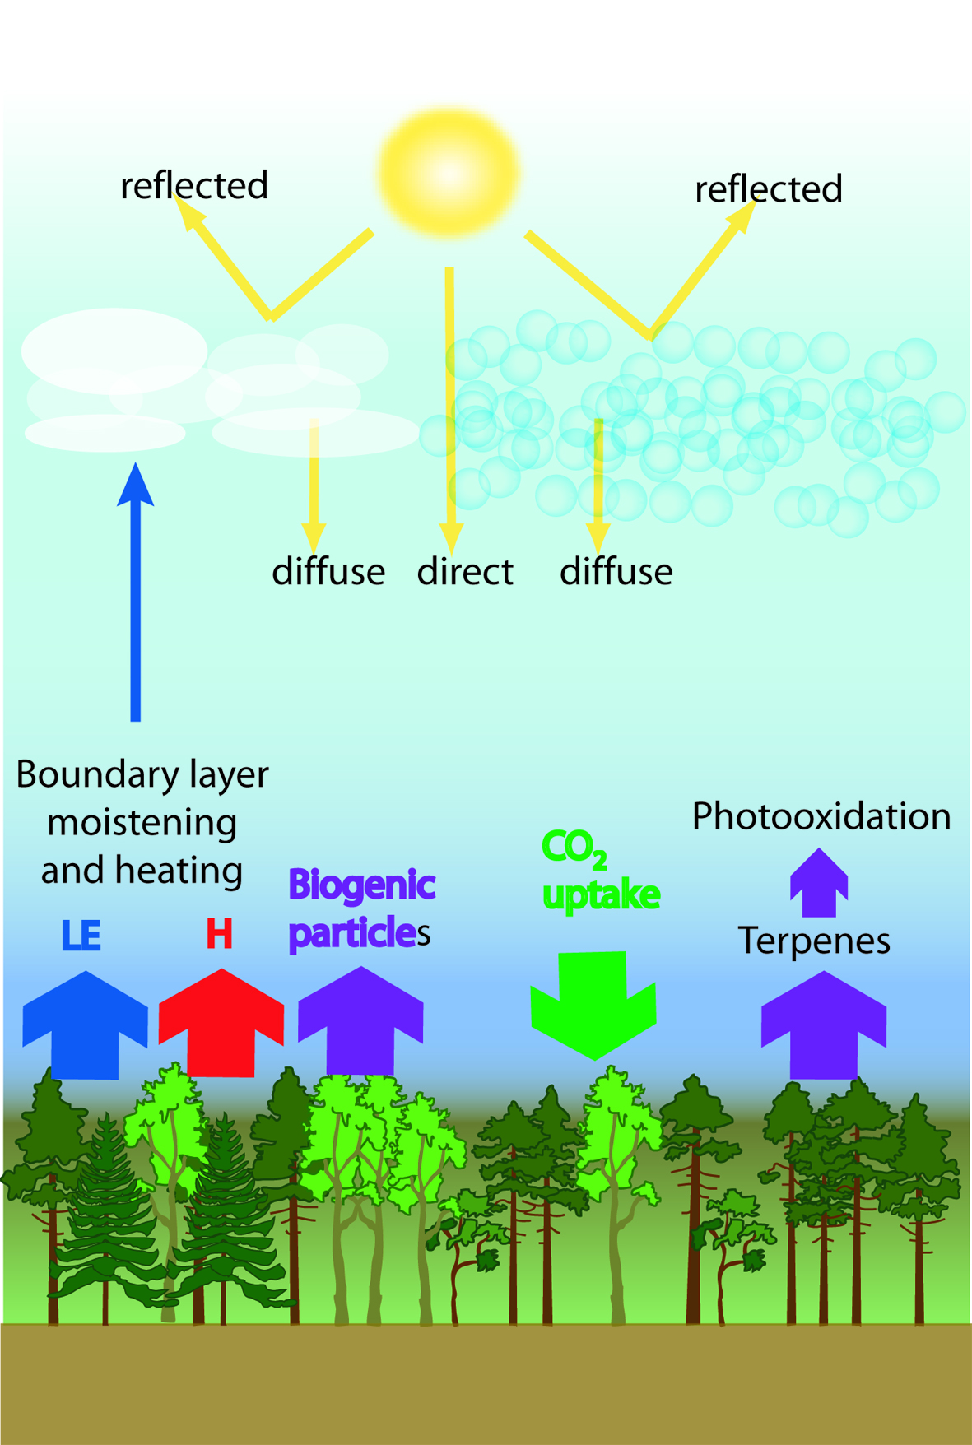
Aerosol Effects on
Net Plant Productivity
CO₂ Concentration
Aerosol Concentration
+
-
+
Temperature
+
+
+?
Photosynthesis
BVOC emissions
+
Kulmala et al., 2004

Slide 15

Strong aerosol effect on forest photosynthesis diffuse radiation have a large effect on CO2 fluxes
Increase in aerosol loading

Slide 16
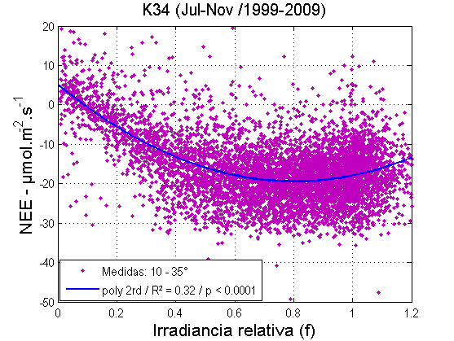
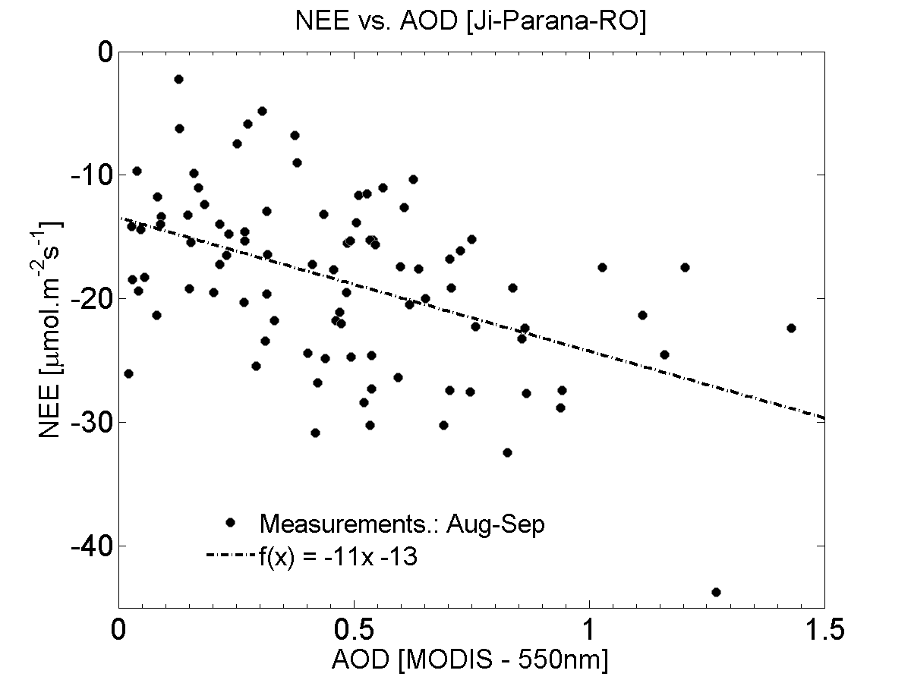
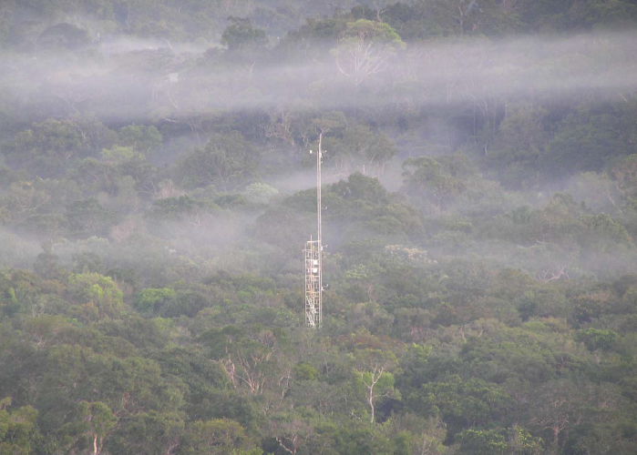
Aerosols effects on NEE – Manaus and Rondonia
(Glauber Cirino, 2013)
f max: ~ 0,80
  NEE (max): ~ -20 µmol/m²s
  AOT: ~ 0,5
Manaus K34 tower

Slide 17
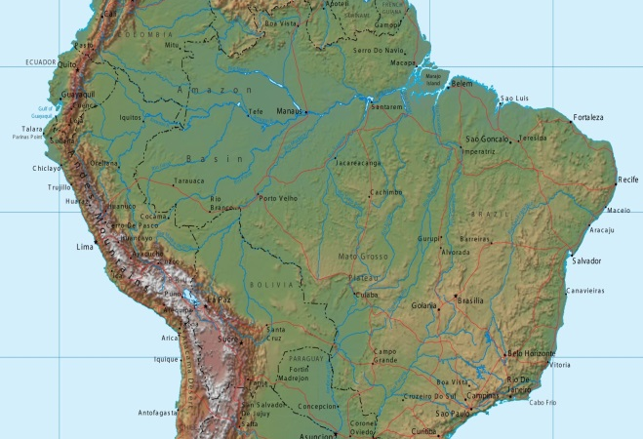
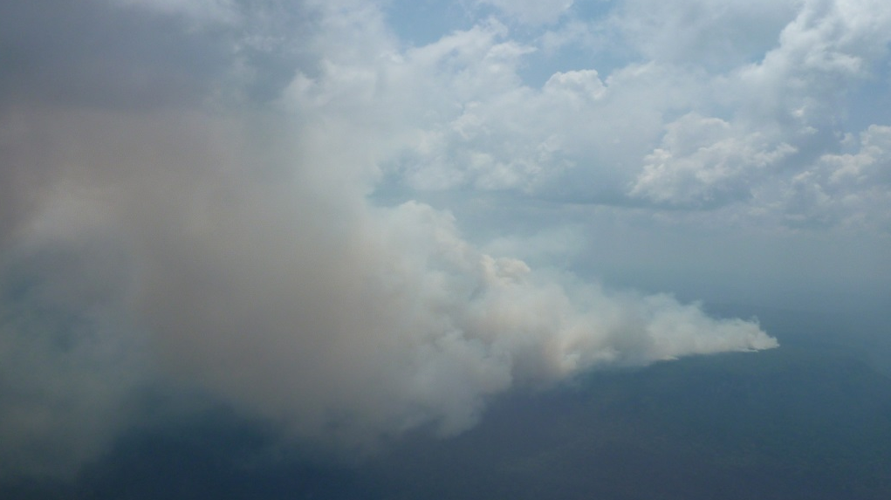
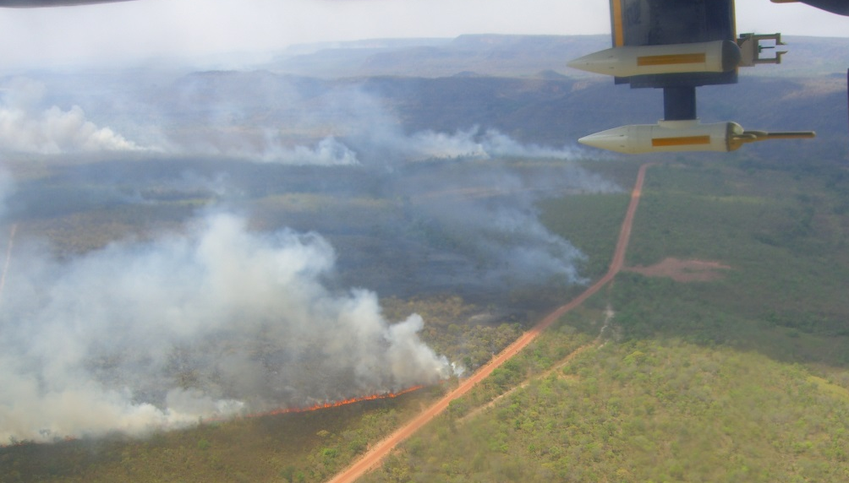
Overview of South American Biomass Burning Analysis (SAMBBA) field experiment [Brazil, Sept – Oct 2012]
Ben Johnson¹, Jim Haywood^{1,5}, Karla Longo², Hugh Coe³, Paulo Artaxo⁴, Saulo Freitas², William Morgan³, and Kate Szpek¹
¹ Met Office, UK
² National Institute for Space Research (INPE), Brazil
³ University of Manchester, UK
⁴ University of Sao Paulo, Brazil
⁵University of Exeter
Acknowledgements: FAAM, DirectFlight, UK-FCO, BAe

Slide 18
SAMBBA Broad science drivers
Quantify biomass burning emissions from S. America
Increase understand of atmospheric processes associated with BB (aerosols, chemistry, plumes, transport).
Assess the impacts of BB on climate, weather, air quality, biosphere.
Evaluation & development of models
Validation of remote sensing observations: Fire products (FRP), aerosol retrievals, etc.

Slide 19

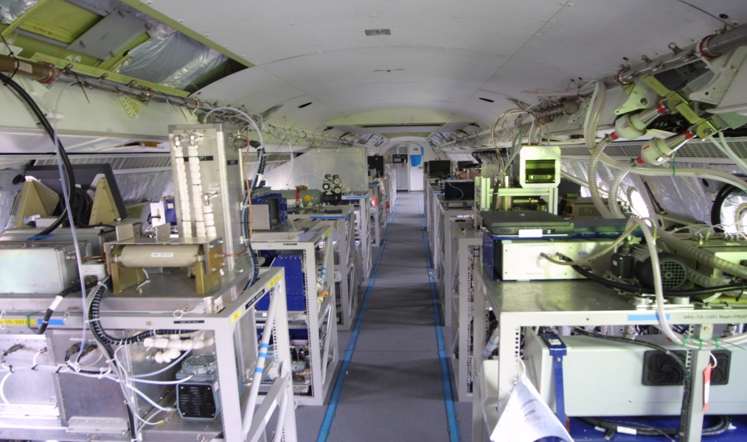
FAAM BAe146 aircraft
(Facility for Airborne Atmospheric Measurements)

Slide 20
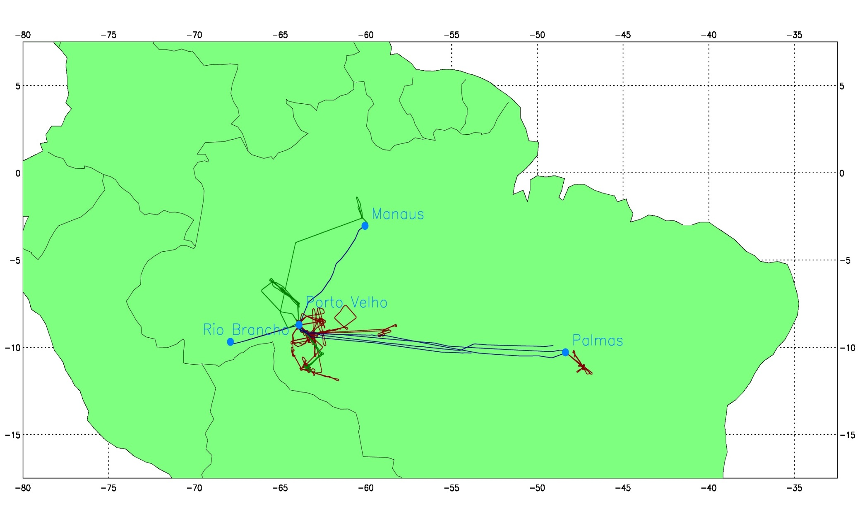
SAMBBA flights
20 Science flights 14 Sept – 3 Oct, 2012
9 Biomass burning
6 remotes sensing surveys
5 unpolluted / biogenic emissions
67 science flight hours, 16 fly days

Slide 21
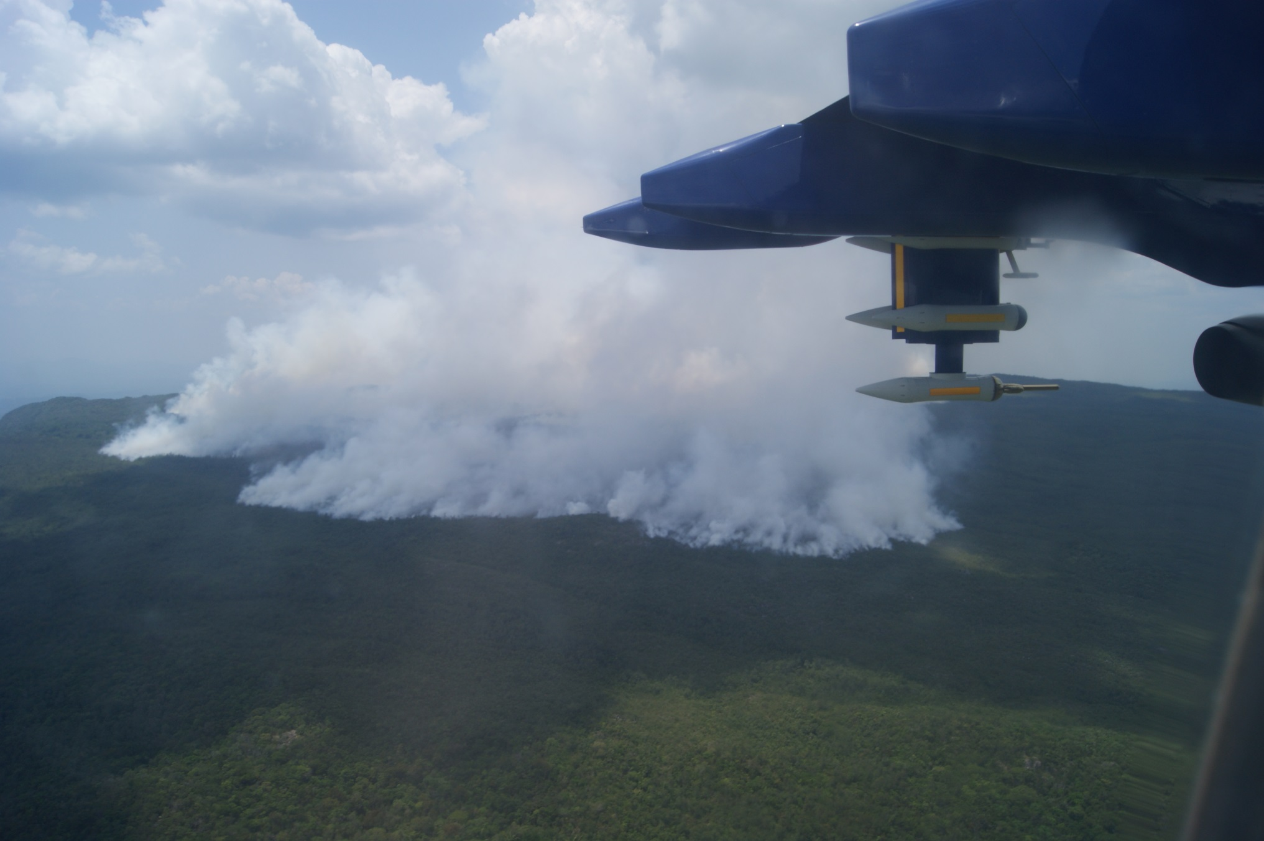
Flight B737 – View approaching the fire

Slide 22
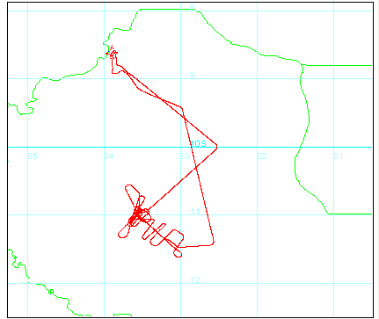

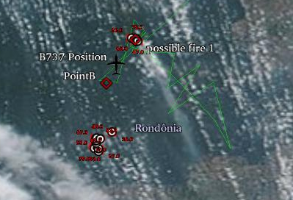
Flight B737 (20/9/12):
Big forest fire in Rondônia Pacaás Novos National Park
Large plume was followed 90km downwind with rastar pattern for plume evolution study

Slide 23
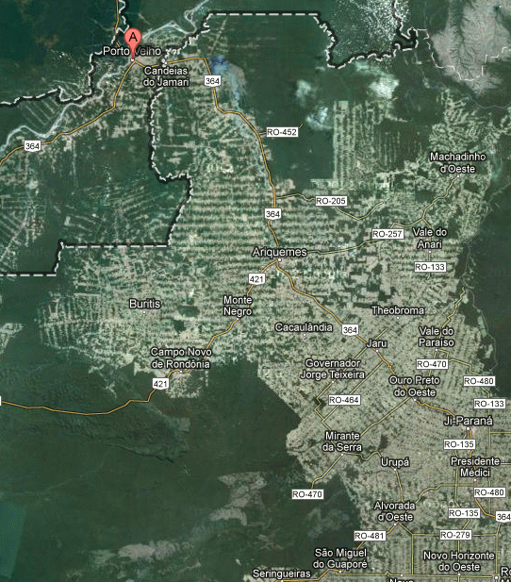
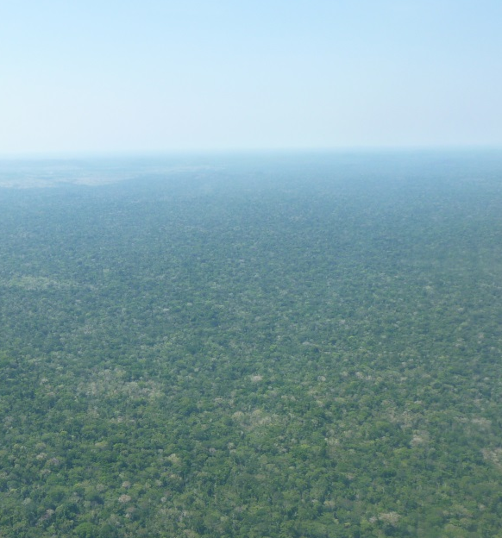
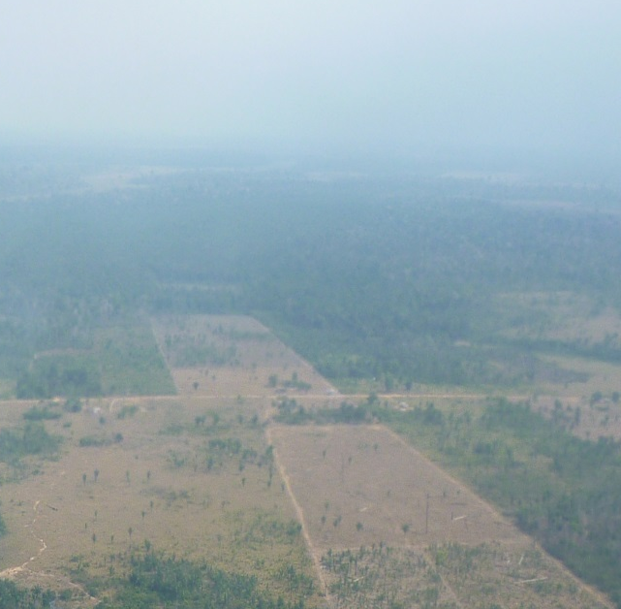
B744 & 745 – Diurnal cycle of biogenic emissions & BL processes over contrasting surfaces
Two identical sorties, 28th Sept, 8:00-11:30 & 13:00 – 16:30 local time
Stack of runs in BL, one above
Dropsondes over both surfaces
Rondônia Pacaás Novos National Park

Slide 24
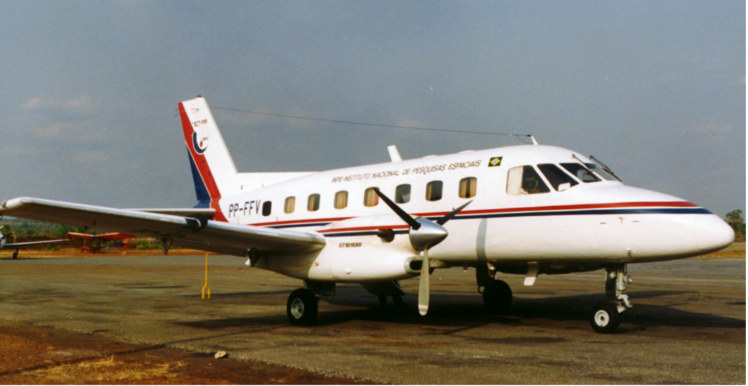
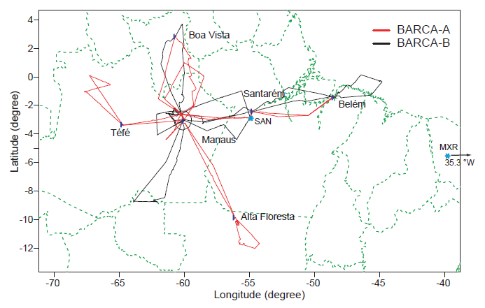
BARCA – Balanço Regional de Carbono na Amazonia
USP – INPE - Harvard – Max Plank
Flight tracks of the BARCA aircraft campaigns (red: BARCA-A, black: BARCA-B.

Slide 25
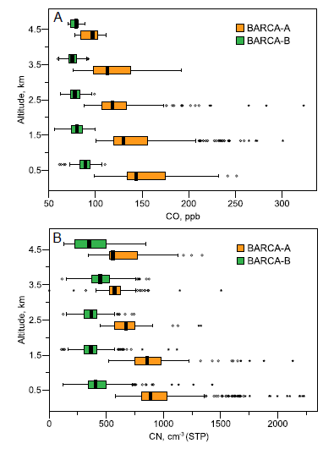
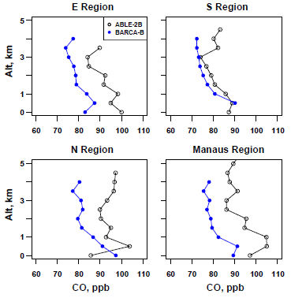
Comparisons of median vertical profiles for the Equatorial Transect east of Manaus (“E. Region”), N and S transects along
60Wlongitude, and near Manaus (excluding local pollution). Note the strong similarities between ABLE-2B and BARCA-B data taken
more than 20 years apart. (Source of ABLE data: Harriss et al., 1990b).
Vertical profiles of CO mixing ratios (A) and CN number concentrations (B) during BARCA-A (excluding the smoky region) and BARCA-B.
Andreae et al., 2012

Slide 26
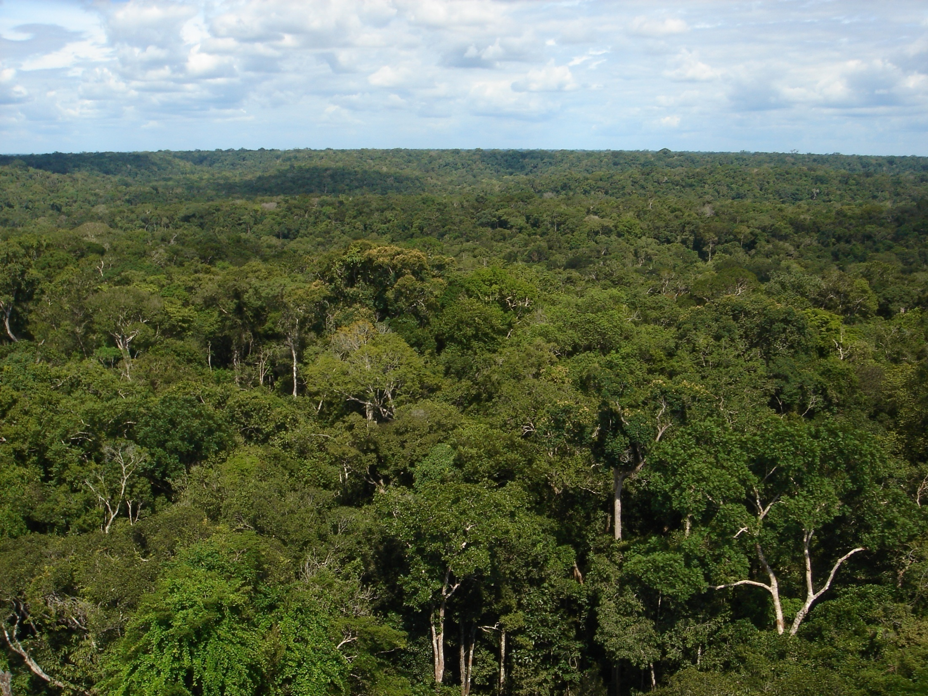
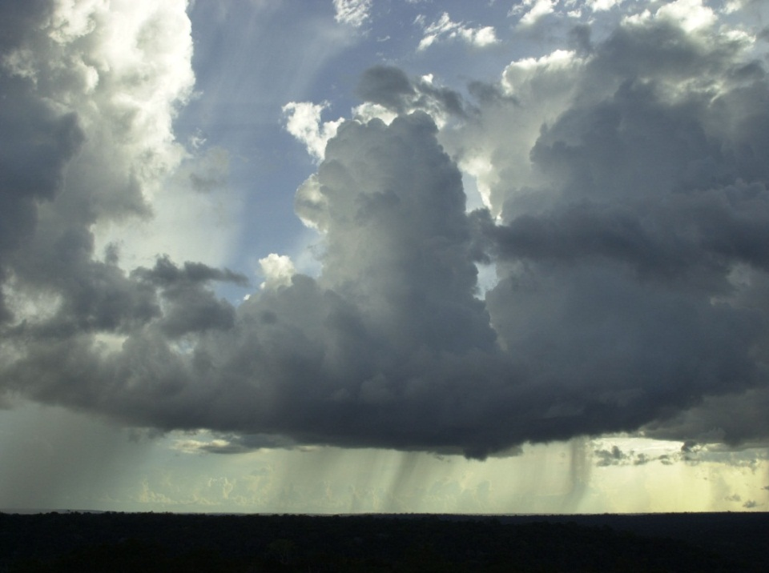

GoAmazon 2014-2015
Ecosystems, Atmosphere Composition, and Climate in Amazonia
Carbon Cycle Cloud Life Cycle Aerosol Life Cycle
Climate
Ecosystems
Atmospheric Composition

Slide 27
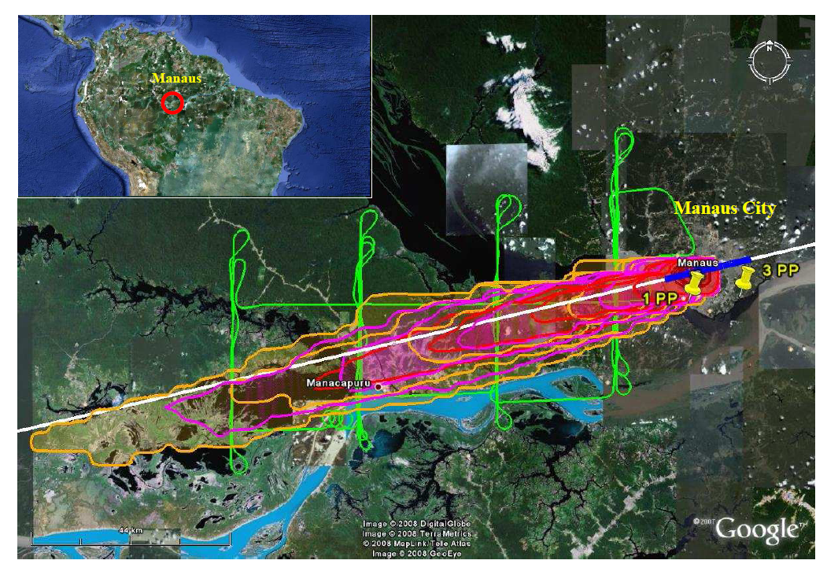
Experimento GoAmazon 2014

Slide 28
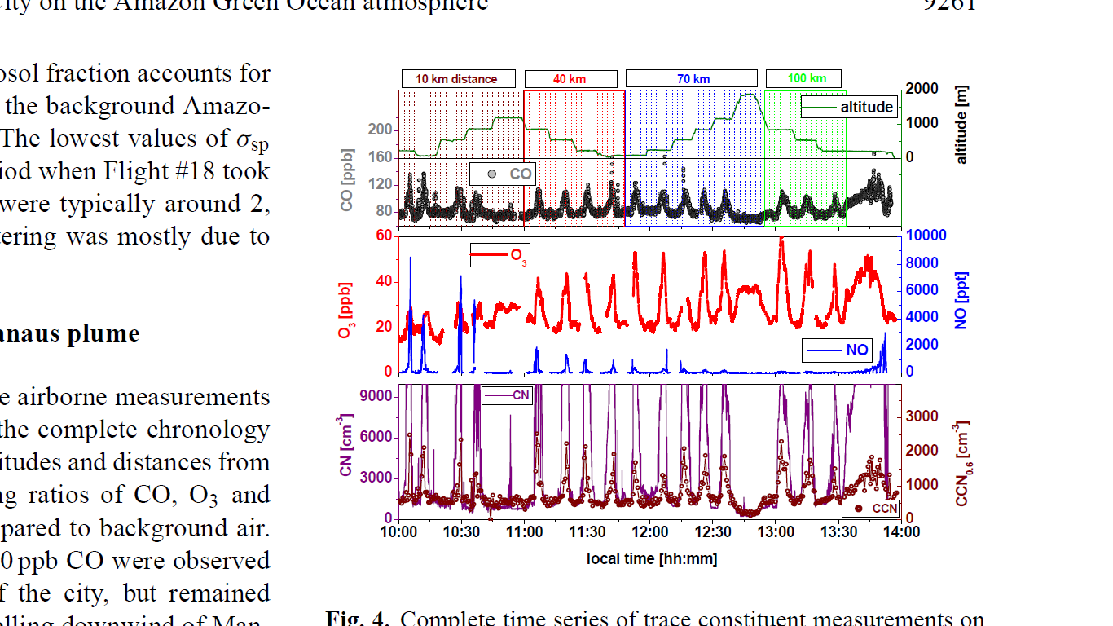
Reference: Kuhn, U.; Ganzeveld, L.; Thielmann, A.; Dindorf, T.; Welling, M.; Sciare, J.; Roberts, G.; Meixner, F. X.; Kesselmeier, J.; Lelieveld, J.; Ciccioli, P.; Kolle, O.; Lloyd, J.; Trentmann, J.; Artaxo, P.; Andreae, M. O., “Impact of Manaus City on the Amazon Green Ocean atmosphere: Ozone production, precursor sensitivity, and aerosol load,” Atmos. Chem. Phys. 2010, 10, 9251-9282.
Notes:
The atmospheric oxidant cycle in the Basin at present is in a regime of dominant HO₂ chemistry because NO_{x} concentrations are on the order of 100 ppt. Economic development can be expected to greatly increase the NO_{x} concentrations and therefore influence the atmospheric oxidant cycle. This cycle is responsible for the oxidation of BVOCs that eventually form CCN. The regulation of the hydrological by the current gaia stasis can be disrupted: isoprene is the dominant BVOC emitted in the Amazon and under higher NO_{x} conditions this BVOC forms considerably less particle-phase organic material, favoring instead higher-vapor pressure products.

Slide 29
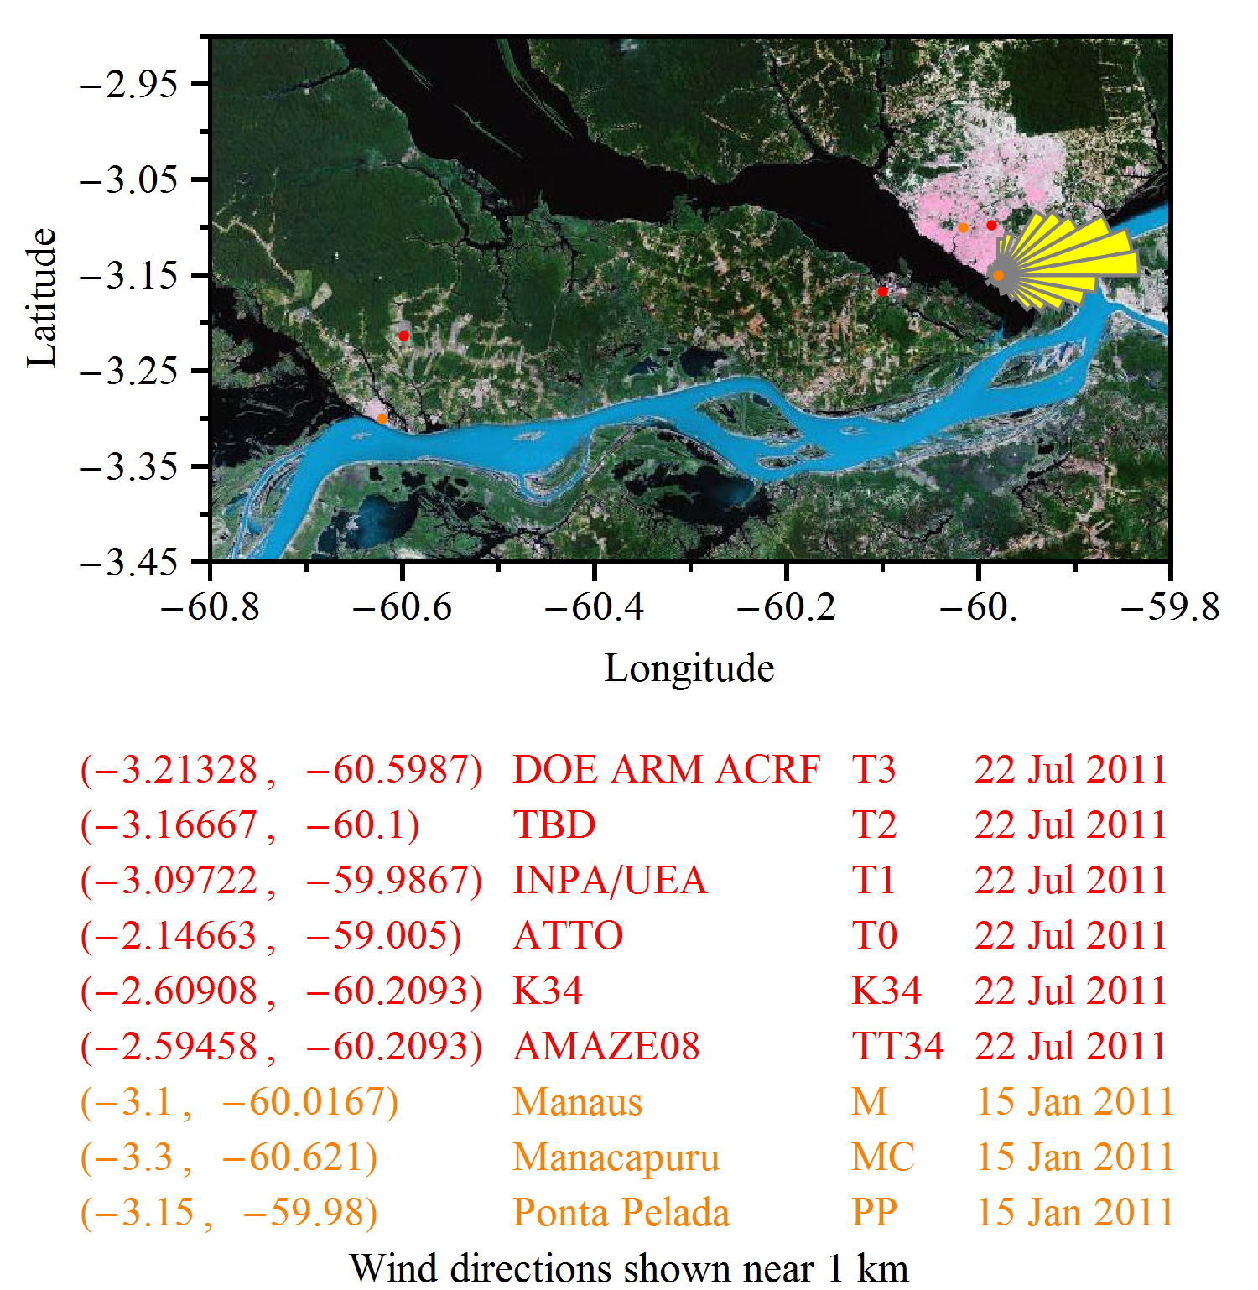
Downwind of Manaus
111 by 60.8 km represented by this box.
Wind speeds at 1 km altitude are typically 10 to 30 kph.
T2→T3 transit time of 2 to 6 hr.

Slide 30
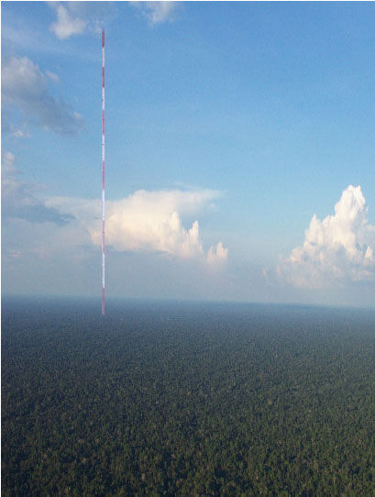
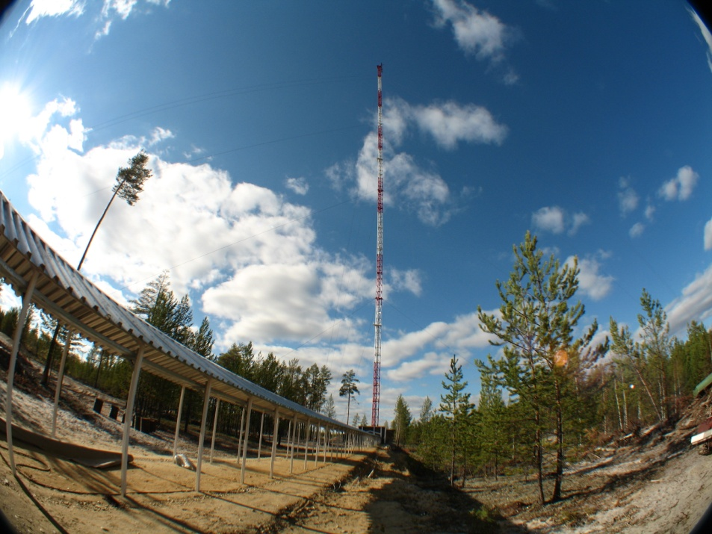
ATTO: Observatório de longo prazo na Amazônia:
Torre com 320 metros
Iniciativa USP, INPE, UEA, INPA, SECT, FAPESP e outros parceiros

Slide 31
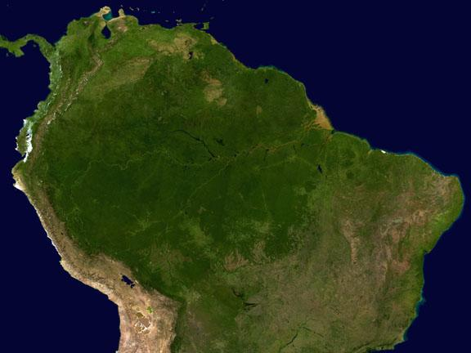
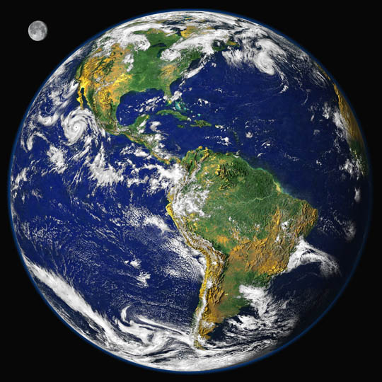
Thanks for the attention!!!

